Slide 1
Management of Pelvic Ring Disruption and Hip Fractures
Richard Miskimins, MD, FACS
Assistant Professor, UNM School of Medicine
Associate Trauma Medical Director UNM Hospital

Slide 2
Overview
Why do we care
Anatomy
Fracture Patterns
Case Presentation
Hemorrhage Control Adjuncts

Slide 3
Why do we Care
Rare only 3% of fractures in adults
Pelvic Fracture is a Marker for Severe Injury
2000 N to break a femur
9000 N to disrupt the pelvic ring
Mortality is 8% to 40%
Early Mortality is related to uncontrolled bleeding
Late mortality is related to associated injuries
Pelvic Fractures Rarely occur in isolation
Blunt aortic injury 4 times higher
30 % Intra-abdominal
40% thoracic
60% spine
40% Associated Long bones

Slide 4
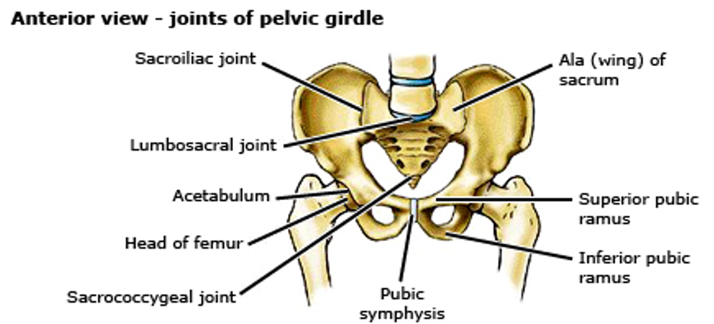
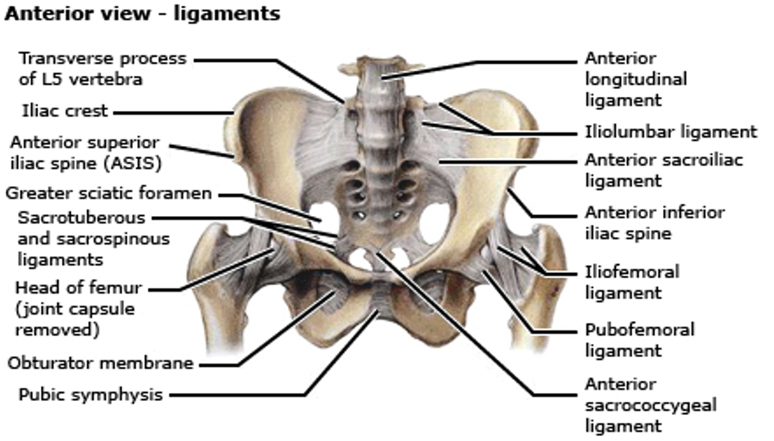
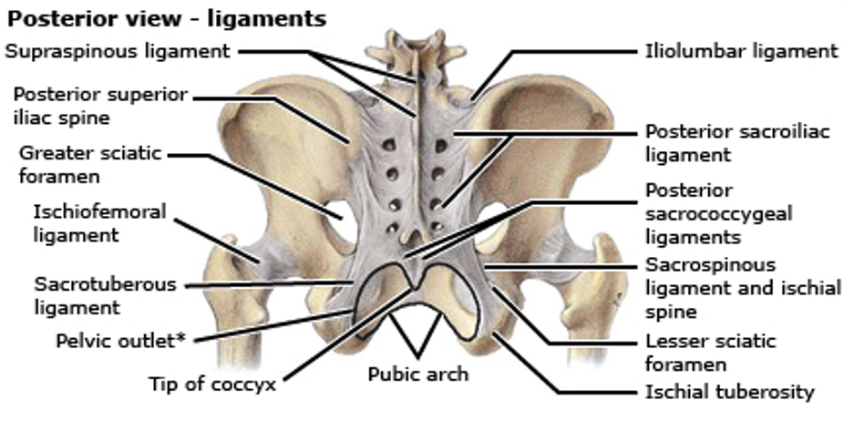
Pelvic Anatomy Ligament and Bone

Slide 5
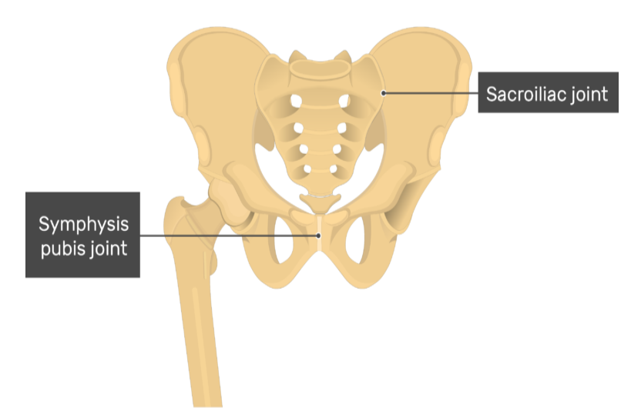
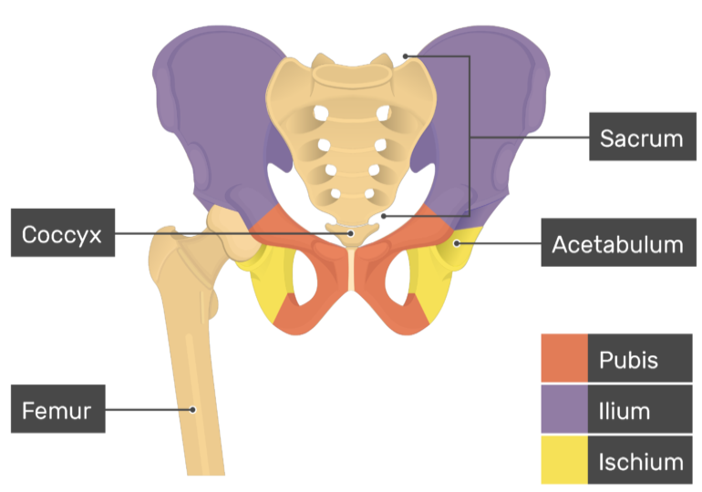
My View of Pelvic Anatomy

Slide 6
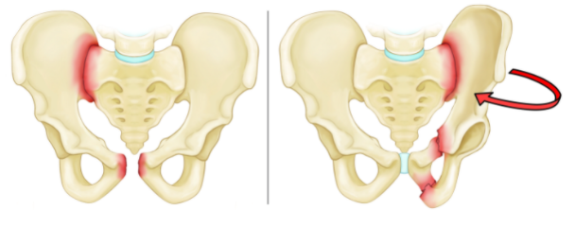
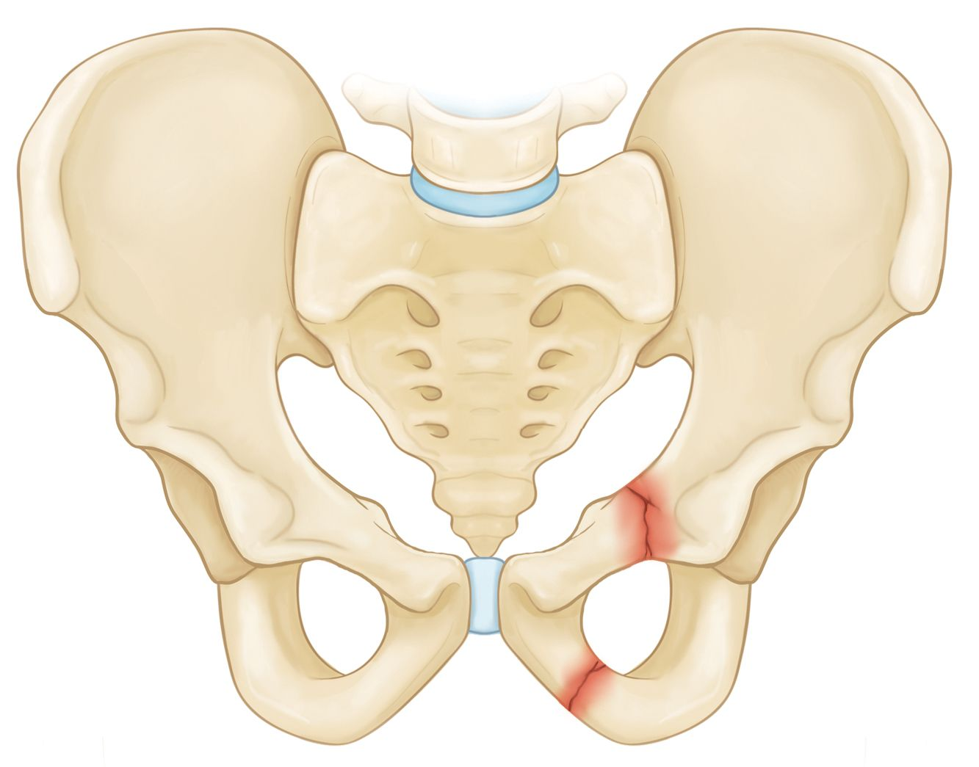
Pelvic Fractures
Stable
Unstable
Notes:
STABLE
In this type of fracture, there is often only one break in the pelvic ring and the broken ends of the bones line up adequately. Low-energy fractures are often stable fractures. Stable pelvic fracture patterns include:
UNSTABLE
In this type of fracture, there are usually two or more breaks in the pelvic ring and the ends of the broken bones do not line up correctly (displacement). This type of fracture is more likely to occur due to a high-energy event. Unstable pelvic fracture patterns include:

Slide 7
Classification of Pelvic Fractures
TILE
Stability
Young-Burgess
Mechanism & Stability
Tile A
Rotationally stable
Vertically stable
Tile B
Rotationally unstable
Vertically stable
Tile C
Rotationally unstable
Vertically unstable
Anteroposterior Compression
APC 1 - Stable
APC 2 - Rotationally Unstable
APC 3 - Completely Unstable
Lateral Compression
LC 1 - Stable
LC 2 - Rotationally Unstable
LC 3 - Completely Unstable
Vertical Shear
Completely Unstable

Slide 8
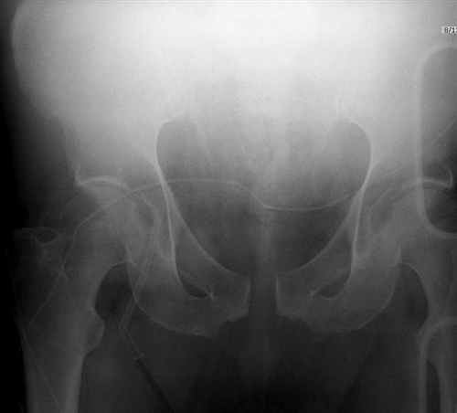
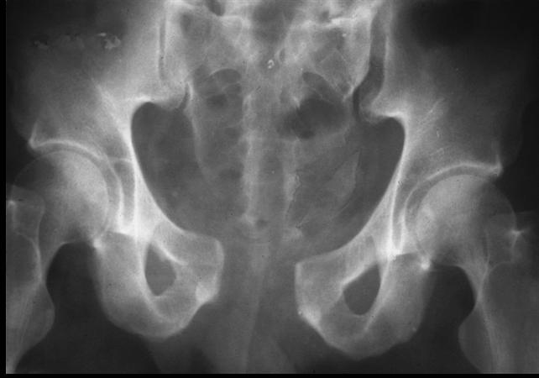
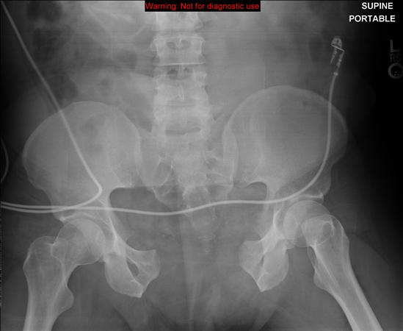
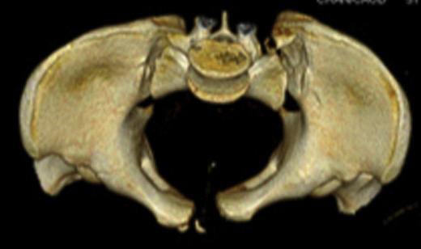
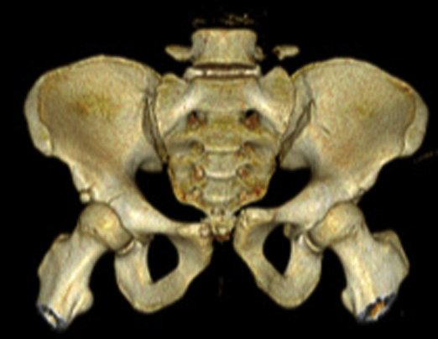
APC Fracture
Notes:
APC I- Symphysis widening < 2.5 cm
APC-II Symphysis widening > 2.5 cm, Anterior SI joint diastasis, Posterior SI ligaments are intact
APC III Symphysis widening > 2.5 cm Disruption of anterior and posterior SI ligaments (SI dislocation)

Slide 9
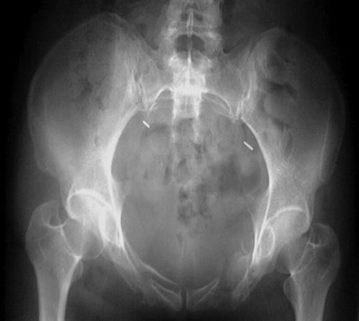
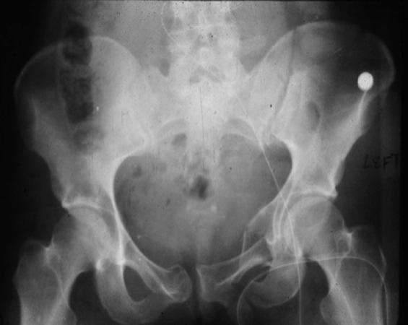
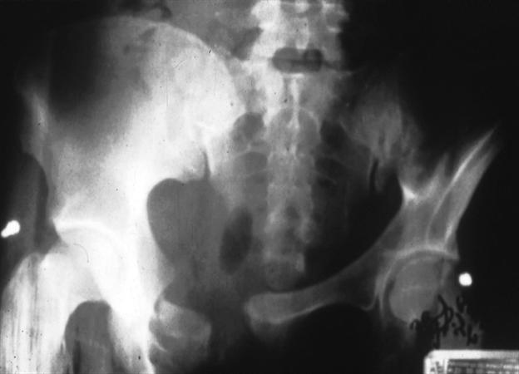
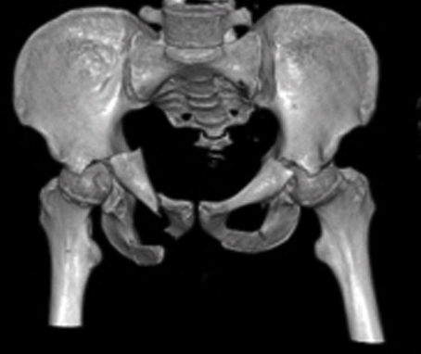
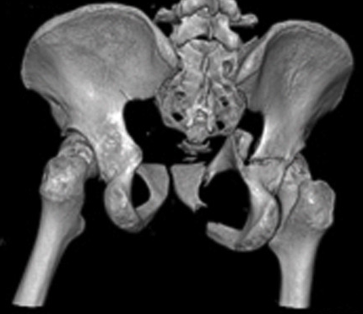
LC Fracture
Notes:
LC-I Oblique or transverse ramus fracture and ipsilateral anterior sacral ala compression fracture.
LC-II Rami fracture and ipsilateral posterior ilium fracture dislocation (crescent fracture).
LC III Ipsilateral lateral compression and contralateral APC (windswept pelvis), Common mechanism is rollover vehicle accident or pedestrian vs auto.

Slide 10
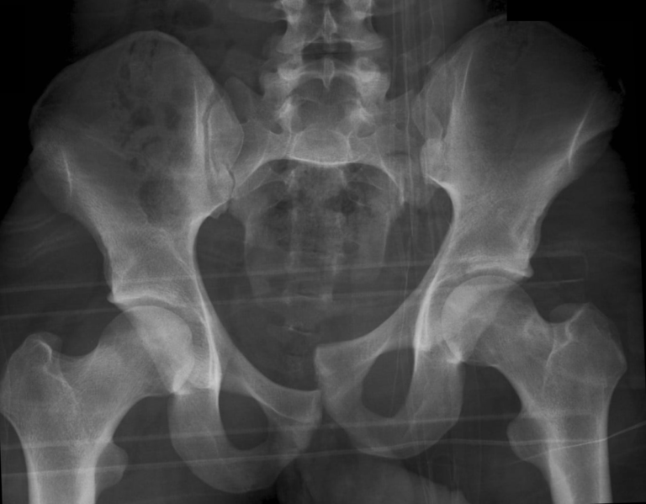
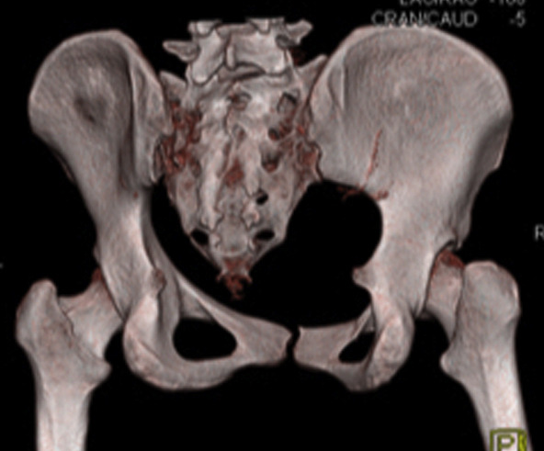
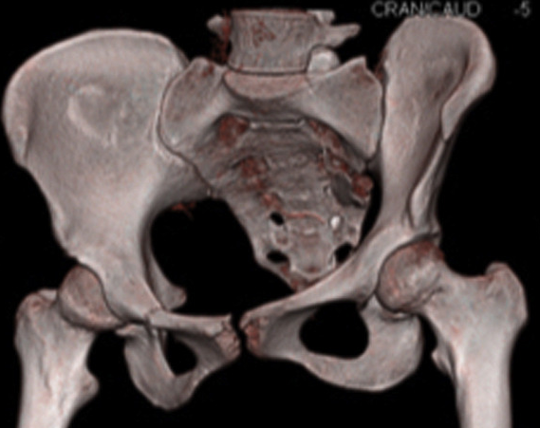
VS Fracture
Notes:
Posterior and superior directed force. Associated with the highest risk of hypovolemic shock (63%); mortality rate up to 25%

Slide 11
Hemorrhage from Pelvic Fractures
There are 4 potential sources:
Surfaces of fractured bones
Pelvic venous plexus
Pelvic arterial injury
Extra-pelvic sources
Venous and Fracture Bleeding account for 90% of bleeding in hemodynamically unstable patients with pelvic fractures

Slide 12
Hemorrhage from Pelvic Fractures
Normal Pelvic volume 1.5 Liters
Tamponade effect of pelvis is lost with disruption of ligaments and fascia
Retroperitoneal bleeding is far more common
Peritoneum is mm thick easy to disrupt and bleed into
Can bleed into thighs

Slide 13
Pelvis has a lot of blood vessels

Slide 14
Case Presentation
17 y/o male high speed MVC into telephone pole
Initial Vitals
70/45
Pulse 135
RR: 39
O2: 77
GCS: 11
Normal ATLS Stuff-stableish

Slide 15
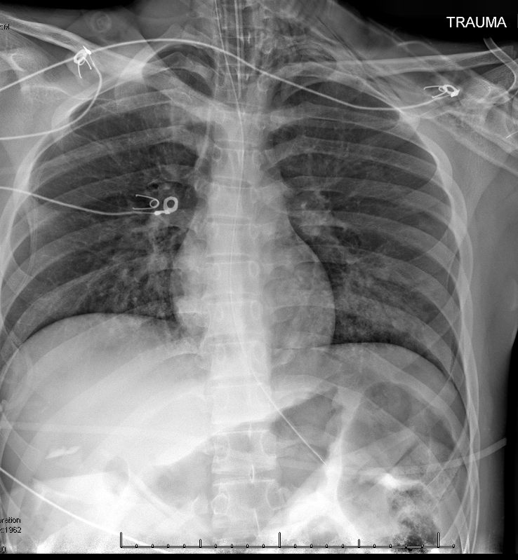
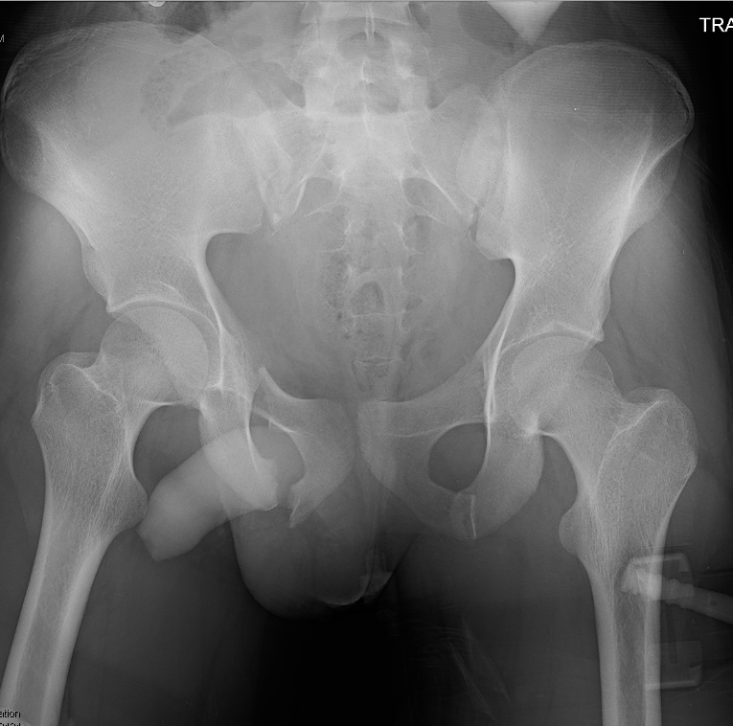
X-rays

Slide 16
Case Continued
Combative, combative, combative
Intubated
E-FAST:
Morrison's Pouch: Negative
Perisplenic: Negative
Pericardial: Negative
Retrovesicular: Negative
Right Chest: Sliding Present
Left Chest: Sliding Present
Binder Placed
Remains Hypotensive with tachycardia despite 4 units whole blood

Slide 17
OR-1
Preperitoneal Pelvic packing
Exploratory Laparotomy
Liver Packing, coagulation, debridement, hemostatic agents
Splenectomy
Distal Pancreatectomy
Bilateral Chest-tubes

Slide 18
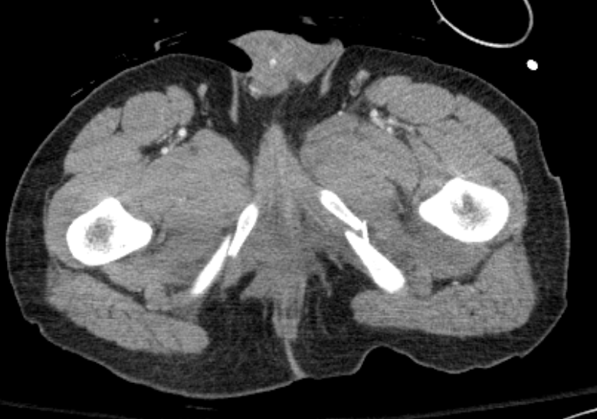
Comparison

Slide 19
OR-2
Re-packing of preperitoneal space
Pelvic Angiography with angioembolization of left superior gluteal artery
Exploratory Laparotomy
Mild oozing no major bleeding and repacked

Slide 20
OR-3
Re-packing (AGAIN) of preperitoneal space with quick clot and hemostatic agents
Exploratory Laparotomy
Mild oozing no major bleeding and repacked
Finally the pelvic bleeding stopped
80 units of Blood and Blood products in first 24 hours

Slide 21
Case Continues
Discharged HOD 32
Grade 5 Splenic Laceration
Grade 4 Hepatic Laceration
Grade 3 Pancreatic Laceration
Bilateral Grade 3 Kidney Injuries
Bilateral Hemopneumothorax
Bilateral mid-shaft femur fractures
APC 3 Pelvic Fracture
Bilateral Obturator ring fractures
Right SI joint diastasis

Slide 22
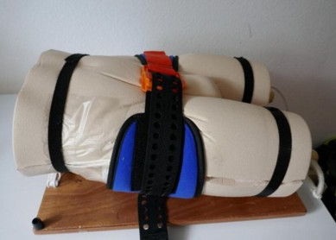
BINDER, BINDER, BINDER

Slide 23
BINDER

Slide 24
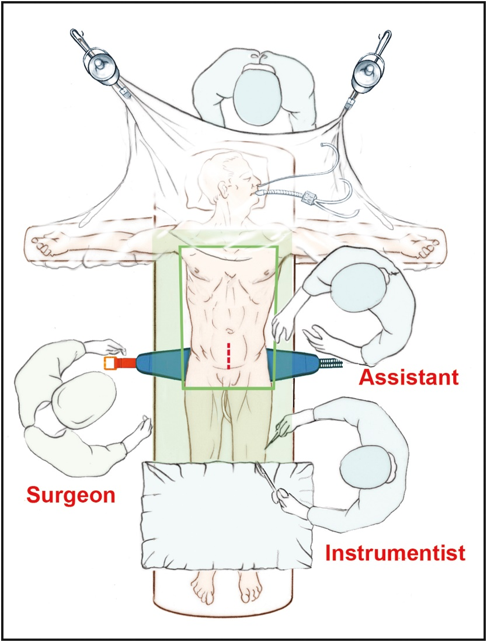
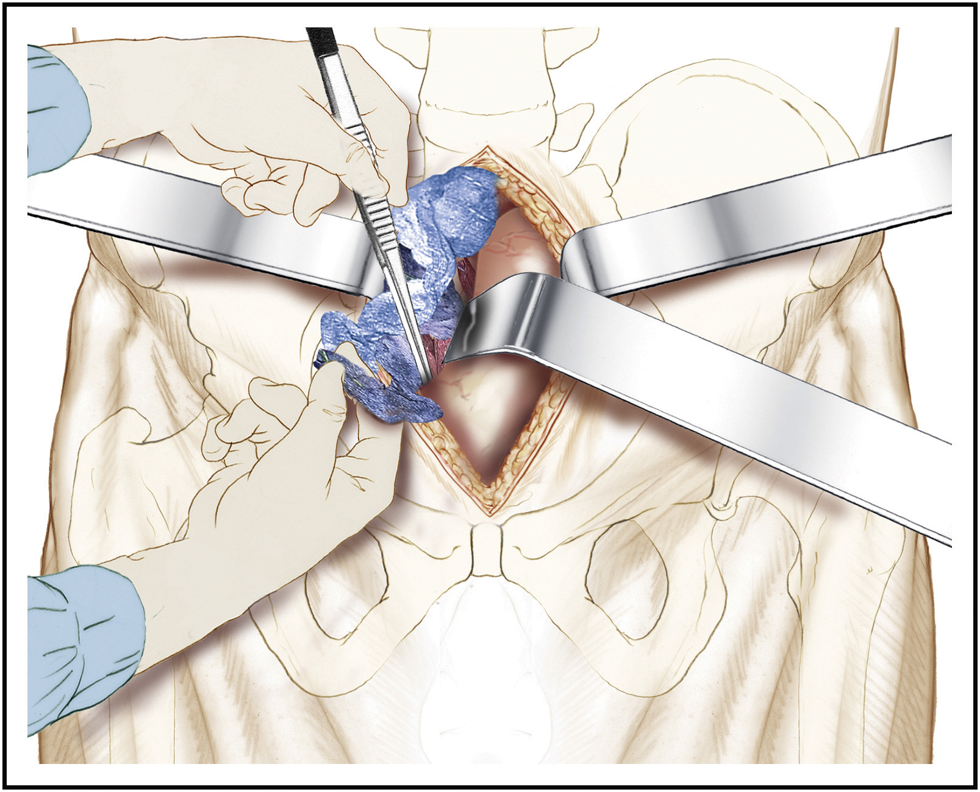
Pre-peritoneal Pelvic Packing

Slide 25
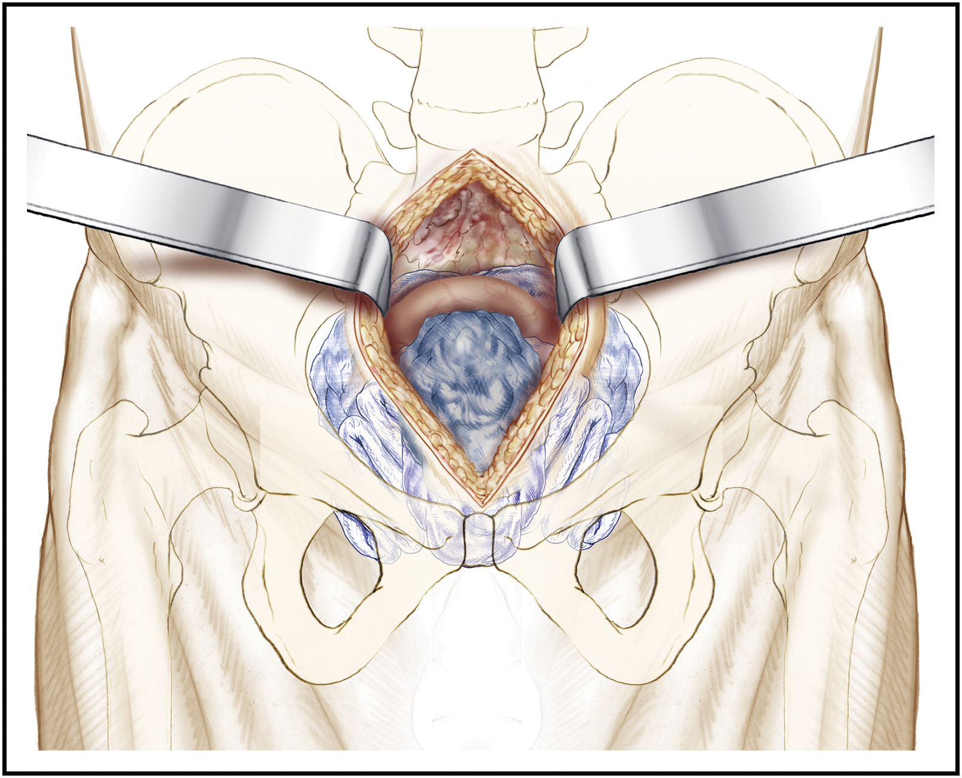
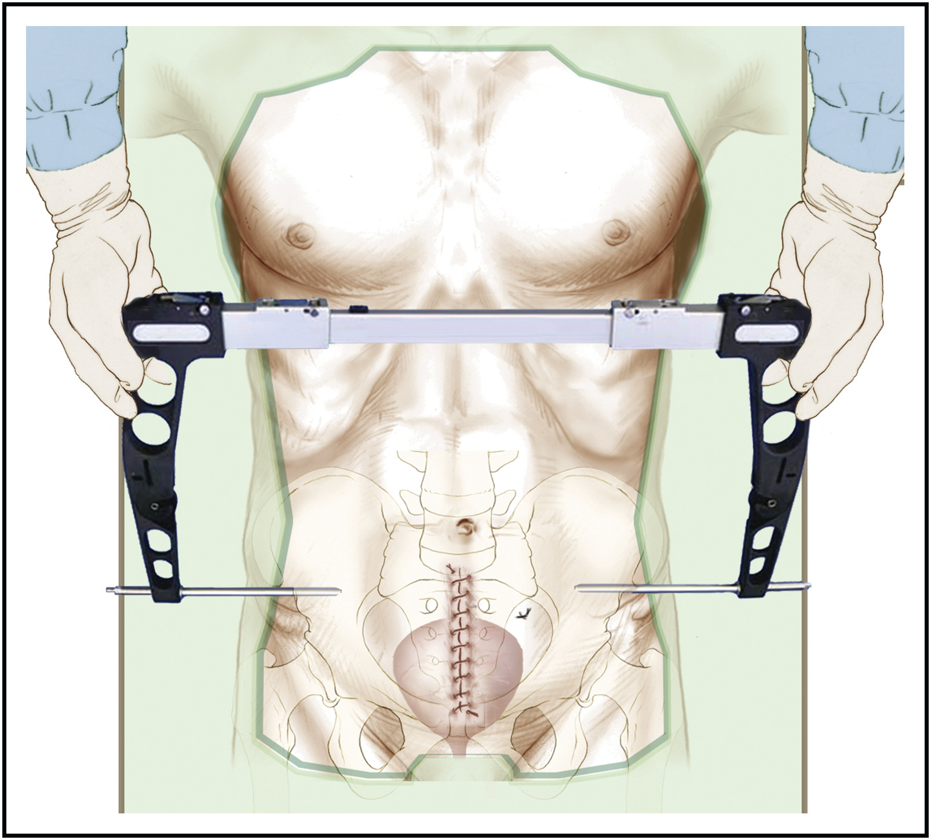
Pre-peritoneal Pelvic Packing

Slide 26
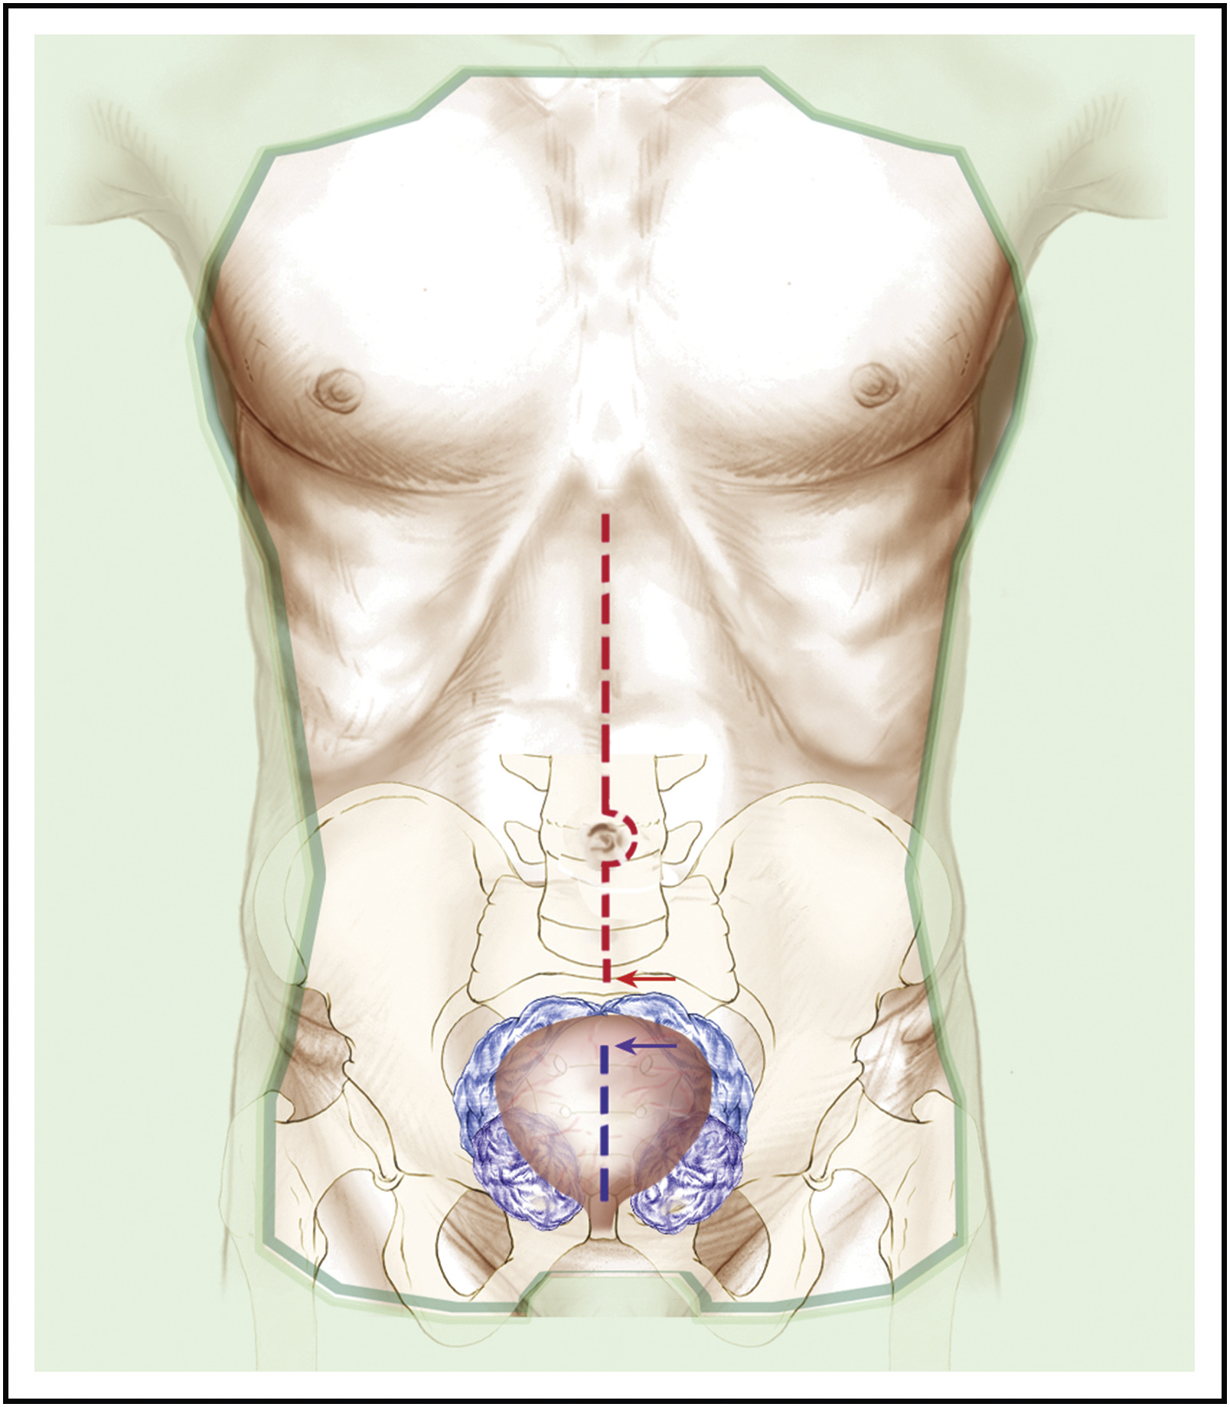
Pre-peritoneal Pelvic Packing

Slide 27
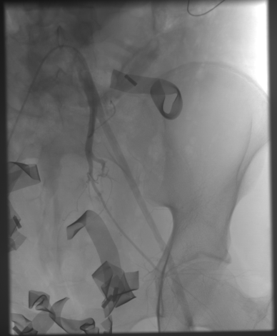
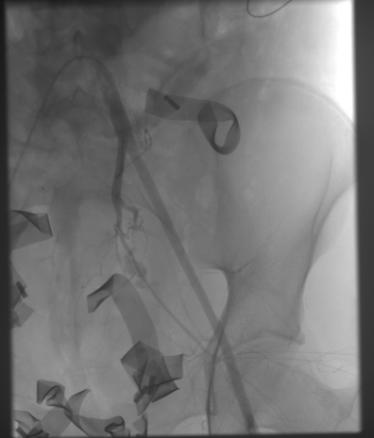
IR Embolization
NOT fast
Average time to IR across the country is about 4 hours
Time to IR if no surgery needed prior to IR is 2 hours

Slide 28
Complications
Bladder Injury
Urethral Injury
Infection
Rectal Perforation
Vaginal Perforation
Sexual Dysfunction
Greater than 50% of men have ED
Greater than 50% of women have dyspareunia
Women often have fertility issues

Slide 29
Questions?
rmiskimins@salud.unm.edu

