Slide 1
Ending the SUD, HCV, HIV, STI Epidemics in Indian Country
April 19, 2021
Jorge Mera, MD, FACP | ECHO Clinical Director | Northwest Portland Area Indian Health Board | jorge-mera@cherokee.org

Slide 2
Conflict of Interest Disclosure Statement
Dr. Mera does not have any conflicts of interest to report in relation to this presentation.

Slide 3
Learning Objectives
Participants recognize the interaction of the SUD epidemic in relation to the HCV, HIV and STIs epidemics in Indian Country
Participants can understand and explain the concept of a Syndemic
Participants describe interventions to prevent and control the HIV, STI, HCV and SUD Epidemic at the
Macro level (societal)
Micro level (health system leadership)
Individual level (health professional)

Slide 4
Outline
Clinical Case
The SUD | HCV | HIV | STI Syndemic
Example: Scott County, Indiana
The SUD | HCV | HIV | STI Syndemic in Indian Country
Interventions to Mitigate the Syndemic:
Societal (Macro), Health System (Micro), Health Professional (Individual)
Conclusions
Notes:
,

Slide 5
Clinical Case: Mr. S
Mr. S is a 24-year-old American Indian/Alaskan Native (I/AN) male who suffered a right femur fracture (MVA) 6 years ago. Unfortunately, pain management training or policies were not available in the institution, and he was discharge from the hospital with oxycodone hydrochloride for pain control.
Two years ago, his new medical provider refused to refill the oxycodone. Unfortunately, the provider was not trained in screening for substance use disorders (SUDs) nor did he have an MAT waiver. The patient then turned to his friends who gave him oxycodone, but later he had to purchase it in the streets.
One year ago, he started injecting heroin since it was cheaper. Unfortunately syringe service programs are not available where he lives, and he has been sharing needles and syringes.
Three days ago, he presented to the Emergency Department (ED) with opioid withdrawal symptoms (Nausea, vomiting, diarrhea, restlessness, abdominal pain). Fortunately, the ED medical provider was trained in SUD management and induced him with Buprenorphine/Naloxone and gave him a 3-day prescription, enough until he could be evaluated and placed on Medication Assisted Treatment (MAT). In addition, the provider was also trained in screening for STIs, HCV, and HIV PrEP, during the ED visit he was screened and tested positive for HCV. HIV and other STIs screens were negative and was referred to the ID clinic for HIV PrEP evaluation and HCV treatment.
“Using trauma terminology implies that the individual is responsible for the response, rather than the broader systemic force caused by the state’s abuse of power”
Linklater, R. (2014). Decolonizing trauma work : Indigenous stories and strategies. Black Point, Nova Scotia: Fernwood Publishing.

Slide 6
Missed Opportunities
Individual Provider
Orthopedic surgeon did not recognize that opioids are not the first line of treatment for management of pain in the outpatient setting
The patient’s PCP did not recognize that the patient has an SUD
Health System
Should have had guidelines/policies in place for pain management
Should have policies in place for Medication Assisted Treatment
Should have policies in place for screening for SUD, HIV, HCV and STIs
Society
Should recognize the syringe service programs are evidence-based practices
We Should Not be Relying on Fortune for Patient Care
Notes:
,

Slide 7
What can we do for Mr. S?
as a primary care health worker?
(Individual)
as health system Leadership?
(Micro)
As a Society
(Macro)

Slide 8
Outline
Clinical Case
The SUD | HCV | HIV | STI Syndemic
Example: Scott County, Indiana
The SUD | HCV | HIV | STI Syndemic in Indian Country
Interventions to Mitigate the Syndemic:
Societal (Macro), Health System (Micro), Health Professional (Individual)
Conclusions
Notes:
,

Slide 9
Syndemic
Core principles:
Clustering of two or more conditions in a specific population
Their synergism in producing excess burden of disease in a population
Precipitation and propagation by large scale behavioral, structural and social forces
Structural Factors
Social Factors
Behavioral Factors
HIV
HCV
SUD
STI
Singer, M. and Clair, S. (2003), Syndemics and Public Health: Reconceptualizing Disease in Bio‐Social Context. Medical Anthropology Quarterly, 17: 423-441. https://doi.org/10.1525/maq.2003.17.4.423
HIV: Human Immunodeficiency Virus
HCV: Hepatitis C virus
SUD: Substance Use Disorder

Slide 10
Syndemic
Linkage to Care
Screening
Quality of Care
HCV/HIV/STI
SUD Behavior Risk
Harm Reduction Strategies
Access to Care
Poverty
Domestic Violence
Mental Illness
Historical Trauma*
Cultural
Disconnection
Incarceration
others
Prevention
*Maria Yellow Horse Brave Heart Journal of Psychoactive Drugs Vol. 35, Iss. 1, 2003

Slide 11
Syndemic
Linkage to Care
Screening
Quality of Care
HCV/HIV/STI
SUD Behavior Risk
Harm Reduction Strategies
Access to Care
Poverty
Domestic Violence
Mental Illness
Historical Trauma*
Cultural
Disconnection
Incarceration
others
Prevention
*Maria Yellow Horse Brave Heart Journal of Psychoactive Drugs Vol. 35, Iss. 1, 2003

Slide 12
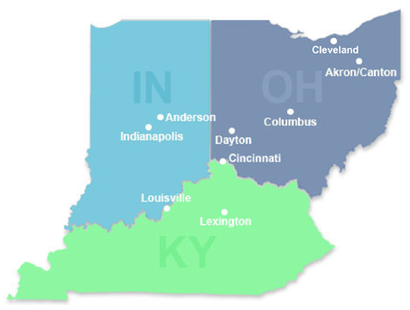
Indiana HIV Outbreak
From 2004-2013
In late 2014
By mid-January 2015
< 5 HIV infections reported annually in Austin, Indiana
3 new HIV diagnoses in Austin IN, 2 of them had shared needles
Through contact tracing ISHD identified 8 more new infections
As of June 14, 2015:
170 new HIV infections and 115 co-infected with HCV in a Community of 4200 people
All epidemiologically linked to Austin, IN
Infections were recent and from a single HIV strain
The source of infection: Injection of the opioid oxymorphone (semi-synthetic opioid analgesic)
Scott County: Among the state’s 92 counties,
ranked 92nd in a variety of health and
social indicators, including life expectancy

Slide 13
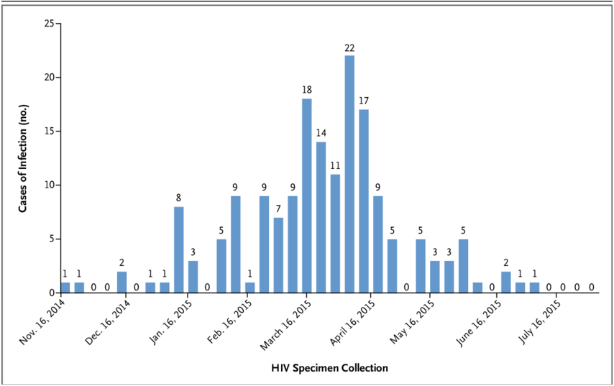
Indiana HIV/HCV Outbreak: Syndemic Risk Factors in Austin County
High poverty (19.0%)
Unemployment (8.9%)
Few affected persons were employed or insured
Education
Low educational attainment (21.3% no high school)
Little HIV awareness in the general population
Unaware of transmission risks and treatment benefits
No routine HIV education in schools (abstinence only)
Ranked lowest in the State for health indicators and life expectancy
SSP program not permitted by state law
No outpatient HIV/HCV care available
Limited addiction services, including MAT
How Was the Outbreak Controlled?
HCV/HIV/MAT treatment provided
One stop shop
Behavioral health treatment
SSP emergency authorization
SSP Authorized

Slide 14
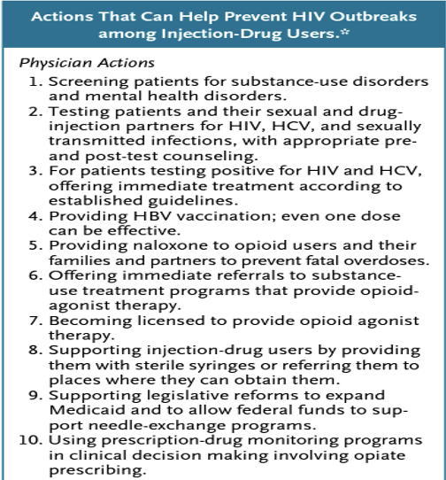
?
Actions That Can Help Prevent HIV Outbreaks among People Who Inject Drugs
“Four years after the United States received a wake-up call about the importance of harm reduction, the most vulnerable areas of the country remain asleep.
Despite the federal government’s goal of ending the HIV epidemic in the United States, it’s not clear that it will do what is necessary to address the spread of HIV and HCV in rural America. Health professionals can advocate for legal changes that authorize syringe-exchange programs and other lifesaving interventions.”
Threading the Needle — How to Stop the HIV Outbreak in Rural Indiana Steffanie A. Strathdee, Ph.D., and Chris Beyrer, M.D., M.P.H. NEJM 373;5 nejm.org july 30, 2015
N Engl J Med 2019; 380:1988-1990 DOI: 10.1056/NEJMp1901276

Slide 15
Outline
Clinical Case
The SUD | HCV | HIV | STI Syndemic
Example: Scott County, Indiana
The SUD| HCV | HIV | STI Syndemic in Indian Country
Interventions to Mitigate the Syndemic:
Societal (Macro), Health System (Micro), Health Professional (Individual)
Conclusions
Notes:
,

Slide 16
American Indian/Alaska Native (AI/AN) Statistics in the United States
573 Federally recognized tribes
5.2 million AI/AN alone or in combination
California and Oklahoma have the highest rate of AI/AN population
Hepatitis C in AI/AN in the US
HCV disproportionately affects AI/AN^{1,2}
The AI/AN HCV mortality rate is 10.8 deaths per 100,000, compared to 4.5 per 100,000 nationally.
From 2015 to 2016, incidence rates of acute HCV among AI/ANs rose from 1.8 to 3.1 cases per 100,000.
Rates of chronic liver disease and cirrhosis deaths are 2.3 times higher among AI/ANs than Whites.
Centers for Disease Control and Prevention. Surveillance for Viral Hepatitis: United States, 2016. Retrieved from https://www.cdc.gov/hepatitis/statistics/2016surveillance/commentary.htm
Center for Disease Control and Prevention. Deaths: Final Data for 2014. http://www.cdc.gov/nchs/data/nvsr/nvsr65/nvsr65_04.pdf
US Census Bureau. https://www.census.gov/www. Accessed Nov 2, 2019

Slide 17
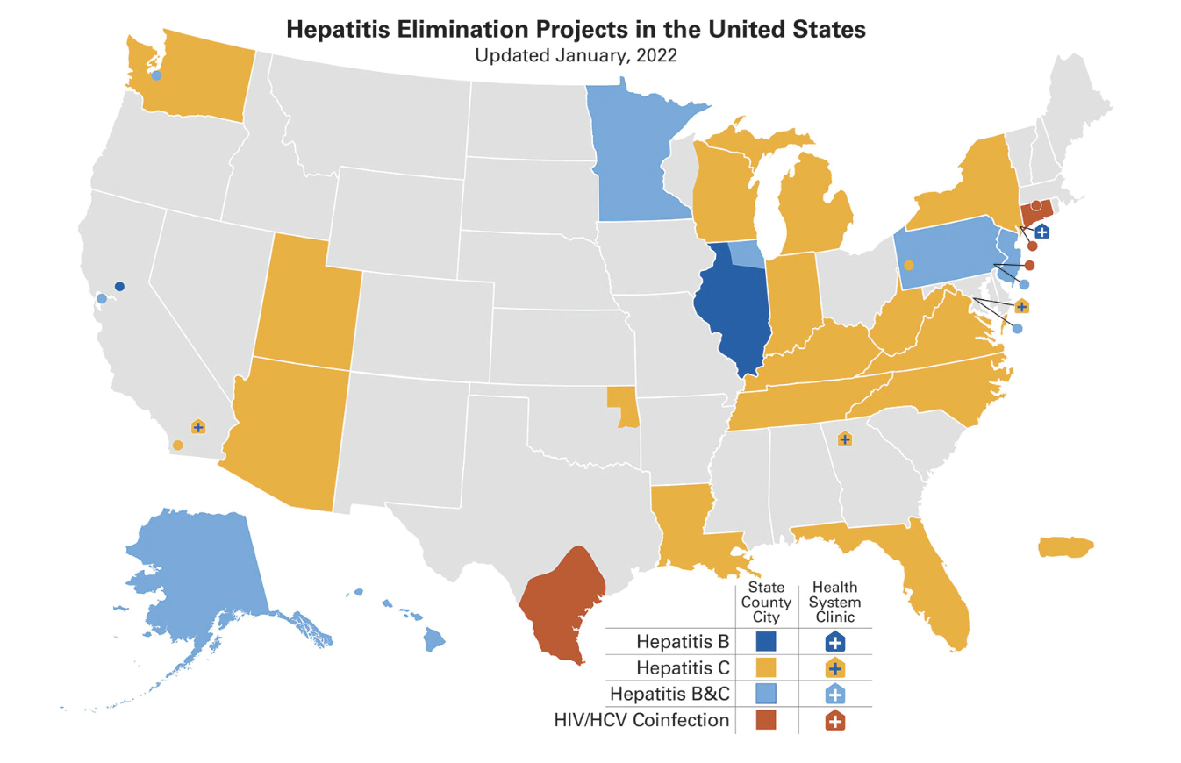
Mismatch between Hepatitis Elimination Programs and AI/AN Population
Most of the hepatitis elimination programs are in concentrated in the East Coast
Most of the AI/AN population is in the north and southwest
Walters, Karina L, Simoni, Jane M, & Evans-Campbell, Teresa. (2002). Substance Use Among American Indians and Alaska Natives: Incorporating Culture in an "Indigenist" Stress-Coping Paradigm. Public Health Reports (1974), 117(Suppl 1), S104–S117.

Slide 18
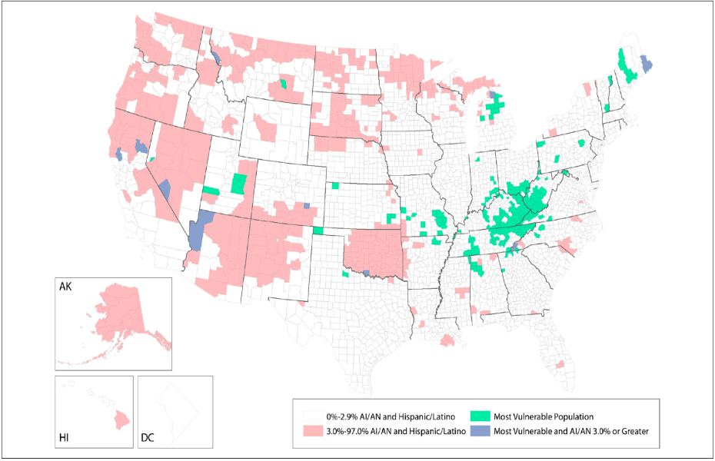
Trends in Indicators of Injection Drug Use, Indian Health Service, 2010-2014: A Study of Health Care Encounter Data
Representation of American Indian/Alaska Native (AI/AN) and Hispanic/Latino population, as a percentage of county population, by county, in 2010, and 220 counties deemed as most vulnerable to rapid dissemination of HIV or hepatitis C virus infection among persons who inject drugs in the United States, 2012-2013.
Data on 220 most vulnerable counties from Van Handel et al.
Data on American Indian/ Alaska Native population from the 2010 US Census
Overall national annual rates (per 10 000 adults) of diagnoses among American Indian/Alaska Native persons for hepatitis C virus (HCV) infection, opioid use disorder, arm cellulitis and abscess, and opioid-related overdose, Indian Health Service, 2010-2014. Rates of diagnoses represent 1 health care encounter per person per year. Data for HCV infections are for adults aged 18-35; all other data are for adults aged ≥18. Arm cellulitis was counted only among adults with no diabetes on or before the health care encounter for arm cellulitis visit (since 2001). Data source: National Patient Information Reporting System.
Evans ME, Person M, Reilley B, Leston J,. Trends in Indicators of Injection Drug Use, Indian Health Service, 2010-2014 : A Study of Health Care Encounter Data. Public Health Rep. 2020 Jul/Aug;135(4):461-471.

Slide 19
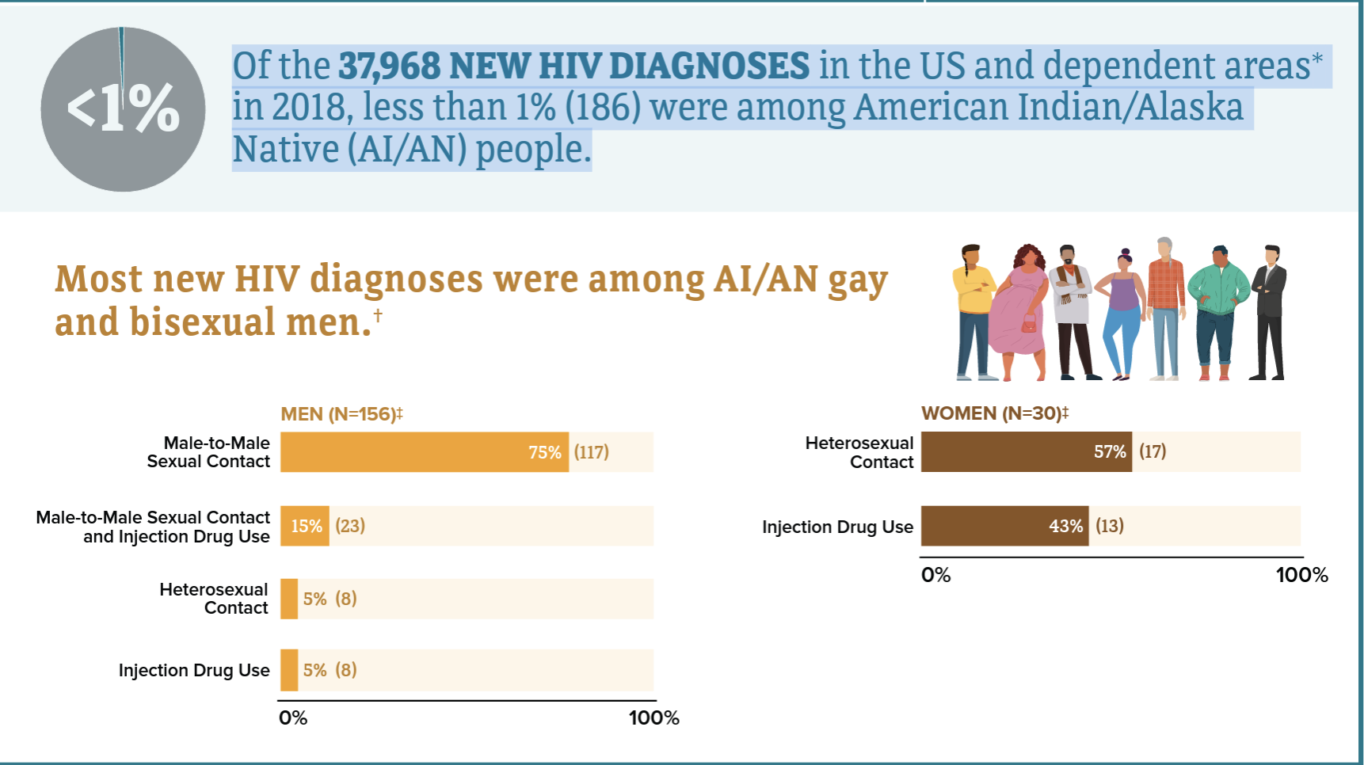
HIV in American Indian/Alaska Native Populations
In the U.S. in 2018, both male and female AI/AN had the highest percent of estimated diagnoses of HIV infection attributed to injection drug use, compared with all races/ethnicities.
Among men, 15% (23) of new HIV diagnoses were attributed to injection drug use, and 11% (21) were attributed to both male-to-male sex and injection drug use.
Among women, 43% (13) of new HIV diagnoses were attributed to injection drug use.

Slide 20
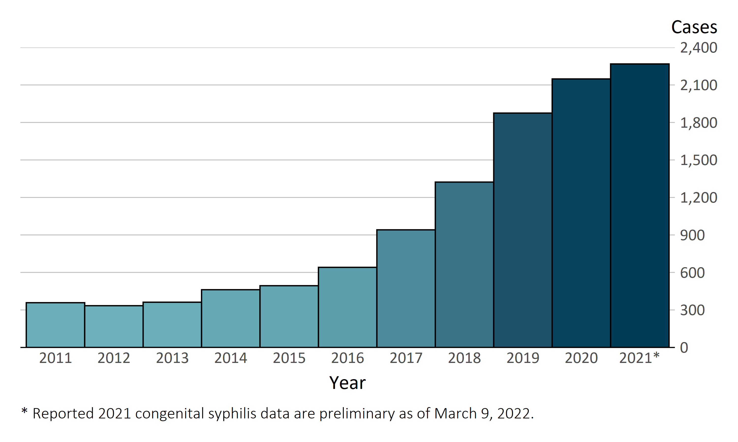
In the United States, 2,268 infants born in 2021* have already been reported as cases of congenital syphilis
Congenital Syphilis — Reported Cases by Year of Birth, United States, 2011–2021*

Slide 21
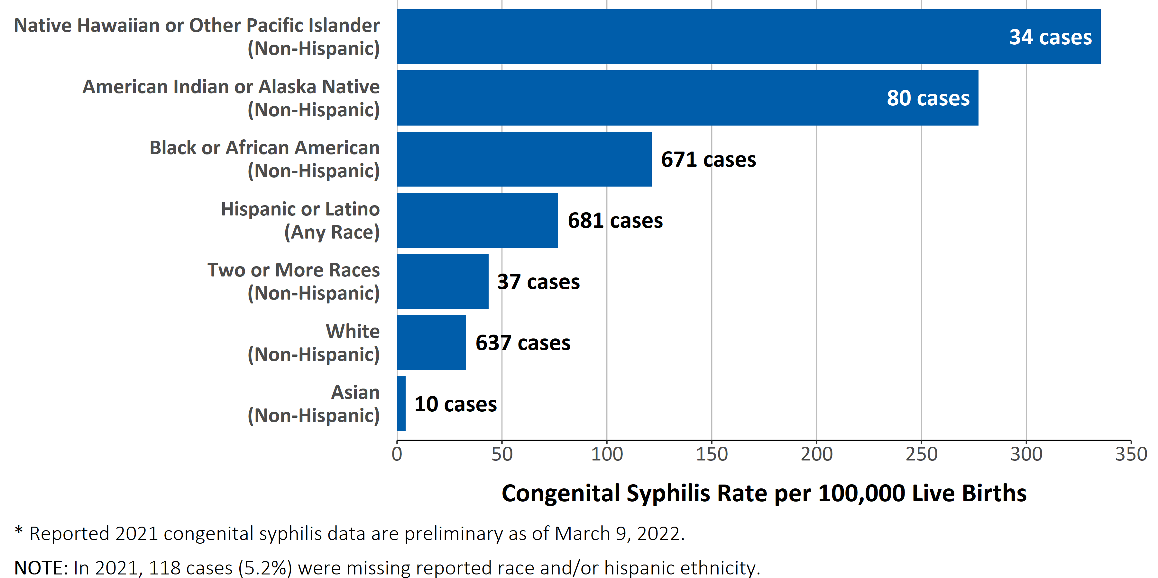
Racial and ethnic disparities in rates of reported congenital syphilis continued to persist in 2021*
Congenital Syphilis — Case Counts and Rates of Reported Cases by Race and Hispanic Ethnicity, United States, 2021*

Slide 22
Outline
Clinical Case
The SUD| HCV | HIV | STI Syndemic
Example: Scott County, Indiana
The SUD | HCV | HIV | STI Syndemic in Indian Country
Interventions to Mitigate the Syndemic:
Societal (Macro), Health System (Micro), Health Professional (Individual)
Conclusions
Notes:
,

Slide 23
SUD| HCV | HIV | STI Syndemic: Macro Level Interventions (Society)
National or Statewide Interventions
Decrease Injection Drug Use and/or make it safer
SSP services available
MAT services available
Behavioral health services
Eliminate social and structural determinates associated with IDU
Poverty (Decrease the economic inequality gap)
Lack of education
Racism
Stigma
Mass incarceration (Reform drug laws)

Slide 24
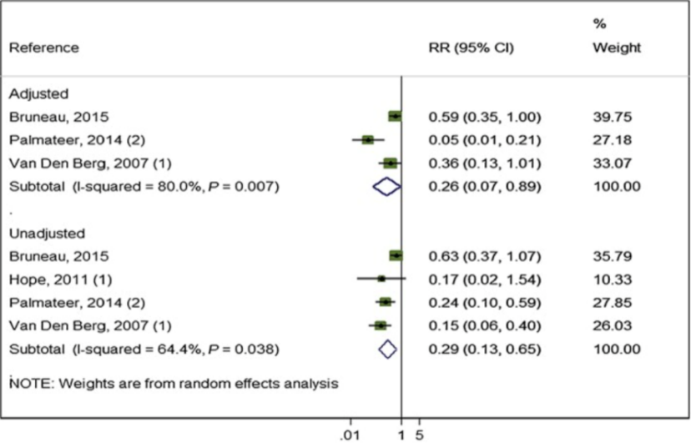
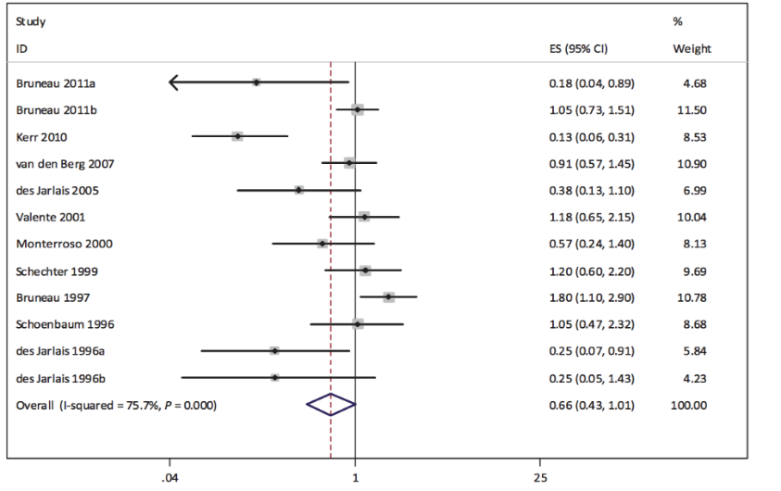
SSPs and OST Impact in reducing HCV and HIV transmission
Impact of OST combined with high‐coverage SSP from studies adjusting for confounders and all pooled estimates¹
4 studies, 3356 participants 518 HCV cases
Reduced HCV by 74%
Studies examining the association between SSP exposure and HIV incidence²
56% reduction in risk of HIV infection

Slide 25
Geographic Disparities in Access to Syringe Services Programs Among Young Persons With Hepatitis C Virus Infection in the United States
Number of lifetime PWID – 6.6 million
Number of persons injecting in past year - 775,000
334,000 (43%) living with HCV infection
270 SSPs in operation (early 2017)
Approximately 2,200 additional programs needed for proximal access to syringe services
Lauren Canary, Susan Hariri, Cecily Campbell, et al., Geographic Disparities in Access to Syringe Services Programs Among Young Persons With Hepatitis C Virus Infection in the United States, Clinical Infectious Diseases, Volume 65, Issue 3, 1 August 2017, Pages 514–517
Map of syringe services programs and young persons aged 15–29 years with current hepatitis C virus (HCV) infection identified by the Laboratory Corporation of America and Quest Diagnostics laboratories, July 2015 to June 2016. Dots represent individual cases of HCV infection. Abbreviation: SSPs, syringe services programs.

Slide 26
Harm Reduction in the Cherokee Nation a 10-year Struggle
2012-2015
SSP illegal in Oklahoma
MAT limited to Methadone Clinics
Treatment as prevention only option
2018
Certificate of need obtained from CDC
2019
2021
Oklahoma passes bill decriminalizing SSP
381 Tribal members on MAT
Paraphernalia laws in place
Cherokee Nation Council Approves SSP
MAT (buprenorphine) Expanded
19 primary care providers providers offering MAT
Possession of paraphernalia still illegal
MAT started by IM and ID Clinic
First SSP in Cherokee Nation to be open in June 2022
2022
SSP: Syringe Service Program, MAT: Medication Assisted Therapy, IM: Internal Medicine, ID: Infectious Disease

Slide 27
SUD| HCV | HIV| STI Syndemic: Micro Level Interventions (Health System)
Recognition of the problem by leadership
Policy development to address the problem
Definition of goals objective and targets
Strategic planning
Incentive
Notes:
,

Slide 28
CNHS EHE Epidemic Program Launched September 2019
CDC Four Key Strategies
Cherokee Nation EHE Focus
Improving HIV screening
Community and provider education
Innovative screening strategies
Increasing PrEP uptake
Community and provider education
Innovative PrEP uptake strategies
Optimizing the HIV Cascade of Care

Slide 29
CNHS EHE Epidemic Program Interventions
Understanding our leadership and our community
Advisory Board
Community and medical provider/pharmacist HIV awareness
Community: Public campaign and school education
Providers: workshops/ProjectECHO/Diversity training/LGBTQ training
General public, PrEP patients, and HIV patient surveys
HIV Screening expansion
Lab triggered screening in ED/UC, Home testing
HIV PrEP expansion
Expanding capacity to pharmacists and other medical providers
HIV Care improvement
Same day treatment
In-depth analysis of the Cascade of Care
Harm Reduction
Medication assisted treatment
Syringe service programs
Treatment as prevention
Electronic Health Care Reminder
HIV Screening Policy Change
Every 3 years for Ages 13 -54
Every 5 years for Ages 55-75

Slide 30
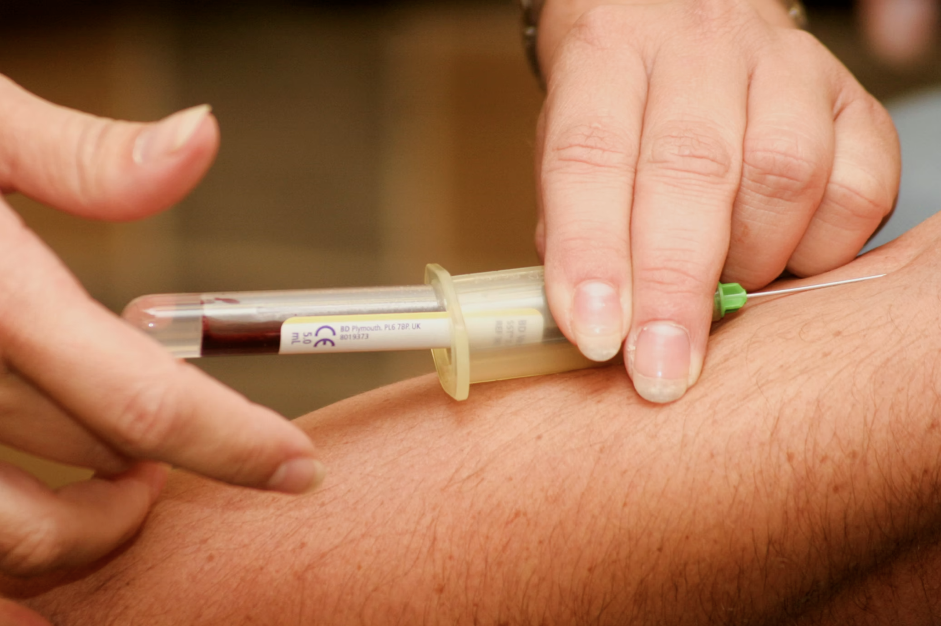
“Reflex Lab-triggered” HCV/HIV Screening
Patient presents to lab for routine/other phlebotomy
Example: Emergency department visit for pneumonia, sent for CBC and CMP, extra tube drawn for HCV antibody
Order for HIV antibody is added-on post phlebotomy if criteria met for screening
If screening is due
If there is signed informed consent in EHR
Process Completed by Hand
(not an automated process)
Results Sent Directly to HCV Program Staff
Source: Cherokee Nation Health Services, 2021

Slide 31
Provider Awareness and Education
PrEP and HIV Screening Workshops
Leadership support for providers to attend
PrEP projectECHO with NPAIHB
6 Sessions with cases and didactics
Infectious Disease ProjectECHO
Weekly meetings with cases and didactics
Pharmacist training by pharmacist
Patients come to pharmacy asking for PrEP
Pharmacists are familiar with managing DM, HTN, warfarin, and Hepatitis C
Training provided to 3 pharmacy clinics and 4 pharmacists
124 providers and allied health professionals attended
CNHS: Cherokee Nation Health Services, EHE: Ending the HIV Epidemic
NPAIHB: Northwest Portland Area Indian Health board

Slide 32
Impact of Interventions in HIV Screening, PrEP provider training and Number of Patients on HIV PrEP
Period | Percent of the Population Tested for HIV at Least Once | Number of PrEP Prescribers | Number of patients on PrEP
2015- 9/2019* | 34 % | 3 | 25
9/2019-9/2020* | 59% | 13 | 52
Change | 73% | 433% | 208 %
*. Eligible population defined as those who accessed the CNHS at a site where screening is offered HIV Screening offered:: Primary Care,
Pediatrics, Resident Clinic, Infectious Diseases Clinic, Urgent Care, Emergency Department, Inpatient Hospital Wards
Source: Cherokee Nation Health Services, 2021

Slide 33
Leadership Support and Integration of Services is the Key to Success
Source: Cherokee Nation Health Services, 2021

Slide 34
Clinical Case: Mr. S
Mr. S is a 24-year-old American Indian/Alaskan Native (I/AN) male who suffered a right femur fracture (MVA) 6 years ago. Unfortunately, pain management training or policies were not available in the institution, and he was discharge from the hospital with oxycodone hydrochloride for pain control.
Two years ago, his new medical provider refused to refill the oxycodone. Unfortunately, the provider was not trained in screening for substance use disorders (SUDs) nor did he have an MAT waiver. The patient then turned to his friends who gave him oxycodone, but later he had to purchase it in the streets.
One year ago, he started injecting heroin since it was cheaper. Unfortunately syringe service programs are not available where he lives, and he has been sharing needles and syringes.
Three days ago, he presented to the Emergency Department (ED) with opioid withdrawal symptoms (Nausea, vomiting, diarrhea, restlessness, abdominal pain). Fortunately, the ED medical provider was trained in SUD management and induced him with Buprenorphine/Naloxone and gave him a 3-day prescription, enough until he could be evaluated and placed on Medication Assisted Treatment (MAT). In addition, the provider was also trained in screening for STIs, HCV, and HIV PrEP, during the ED visit he was screened and tested positive for HCV. HIV and other STIs screens were negative and was referred to the ID clinic for HIV PrEP evaluation and HCV treatment.
“Using trauma terminology implies that the individual is responsible for the response, rather than the broader systemic force caused by the state’s abuse of power”
Linklater, R. (2014). Decolonizing trauma work : Indigenous stories and strategies. Black Point, Nova Scotia: Fernwood Publishing.

Slide 35
What can Leadership in the Health System do for Mr. S
Recognize
the problem and embrace it as a syndemic
Have
SUD/HCV/HIV/STI policies in place
Enforce Policies
Encourage, facilitate and motivate SUD, HCV, HIV and STI screening and treatment
Allow provider time
Create
Performance-based outcomes around SUD/HCV/HIV/STI
For training and participation in these activities
“Using trauma terminology implies that the individual is responsible for the response, rather than the broader systemic force caused by the state’s abuse of power”
Linklater, R. (2014). Decolonizing trauma work : Indigenous stories and strategies. Black Point, Nova Scotia: Fernwood Publishing.

Slide 36
What Can Society Do For Mr. S?
Addressing the root of the problem is critical for the elimination of present SUD/HCV/HIV/STI syndemic and the prevention of future ones
A coordinated approach between society, government, public health will be needed
“Using trauma terminology implies that the individual is responsible for the response, rather than the broader systemic force caused by the state’s abuse of power”
Linklater, R. (2014). Decolonizing trauma work : Indigenous stories and strategies. Black Point, Nova Scotia: Fernwood Publishing.

Slide 37
What can the Healthcare Worker do for Mr. S?
Vaccinate him for hepatitis A and B
Have an MAT license and continue buprenorphine/naloxone
Be comfortable prescribing HIV PrEP
Be comfortable prescribing HCV treatment
Educate your patient on safe injection practices
Refer to or advocate for Syringe Service Programs
Medication Assisted Treatment
PREP for PWUDs
HCV/HIV Testing and Treatment
Naloxone, Syringe Service Programs, and Safer Injection Practices
Mental Health Services
“Using trauma terminology implies that the individual is responsible for the response, rather than the broader systemic force caused by the state’s abuse of power”
Linklater, R. (2014). Decolonizing trauma work : Indigenous stories and strategies. Black Point, Nova Scotia: Fernwood Publishing.

Slide 38
CNHS: Barriers to Ending the Syndemic
Historical Trauma
Stigma
LGBTQ and Two-Spirit associated stigma
Syringe Service Programs
Lack of:
Public awareness
Outreach programs: Meeting patients where they are
Integration of services at the clinic, MAT programs and SSP programs
Injection Drug Use associated stigma
HIV associated stigma
COVID-19 Pandemic
performance-based outcomes related to HIV/HCV/SUD/STIs
“Using trauma terminology implies that the individual is responsible for the response, rather than the broader systemic force caused by the state’s abuse of power”
Linklater, R. (2014). Decolonizing trauma work : Indigenous stories and strategies. Black Point, Nova Scotia: Fernwood Publishing.

Slide 39
Recognize and Understand
The STI disparities in racial and ethnic minorities are not only driven by behavior
Structural and Socioeconomic factors play a major role
With a higher baseline rate of transmissible infections it is more likely that those in the community will be exposed to the infection.
Respond to STIs, HCV and SUD
When people are unable to seek or receive care because of socioeconomic barriers
Treatable diseases, like syphilis, HIV or HCV, persist at higher rates.
By ensuring that the resources go to the communities in highest need in a timely and efficient way.
Structural Factors
The lack of access to housing, transportation, health facilities, SSP programs
Social Factors
STIGMA, Lack of education, employment, access to healthy food, health coverage
Behavioral Factors
“Using trauma terminology implies that the individual is responsible for the response, rather than the broader systemic force caused by the state’s abuse of power”
Linklater, R. (2014). Decolonizing trauma work : Indigenous stories and strategies. Black Point, Nova Scotia: Fernwood Publishing.
HIV
STI
HCV
SUD

Slide 40
Conclusions
Ending the SUD/HCV/HIV/STI epidemics will be difficult if not embraced as a syndemic
Ending the SUD/HCV/HIV/STI HIV/HCV/SUD syndemic will require a multipronged approach
Political will and leadership support are essential
The efficacy of PrEP has been established, access to the most vulnerable populations is critical
Everyone with HCV mono-infected or Co-infected with HIV should be treated
Primary care providers should be at the forefront of harm reduction, STI, PrEP and HCV treatment. If they are not, nobody will.
Structural, Social and Behavioral factors need to be addressed
SUD services should be integrated into primary care and barriers for harm reduction services should be removed
Syphilis is taking a toll in AI/AN communities, zero tolerance for congenital syphilis should be the standard of care
“Using trauma terminology implies that the individual is responsible for the response, rather than the broader systemic force caused by the state’s abuse of power”
Linklater, R. (2014). Decolonizing trauma work : Indigenous stories and strategies. Black Point, Nova Scotia: Fernwood Publishing.

Slide 41
Questions?
Thank You
ᏩᏙ (Wado)
Disclaimer: All published and unpublished data and materials in this presentation and the accompanying discussion may not be used for any purpose without prior, express written permission of the authors and the Cherokee Nation IRB. No right to use the data, materials, or comments is provided or implied to any individual or entity for any purpose or in any manner.

