Slide 1
Bridging The Gap:
Trauma Care Outside of Level 1 Trauma Centers
Devon S. Callahan, M.D., F.A.C.S.
Allina Health Surgical Specialists, Abbott Northwestern Hospital, Minneapolis, MN
Acute Care Surgery, Division Chief
Trauma Medical Director, Abbott Northwestern Hospital
Lead Surgeon, General Surgery, Allina Health West Region
07.13.22

Slide 2
No financial disclosures

Slide 3
Objectives
Review capabilities of different levels of trauma centers
Discuss initial management and stabilization of traumatic injuries
Discuss novel ideas for stabilization outside of Level 1 centers.
2
2

Slide 4
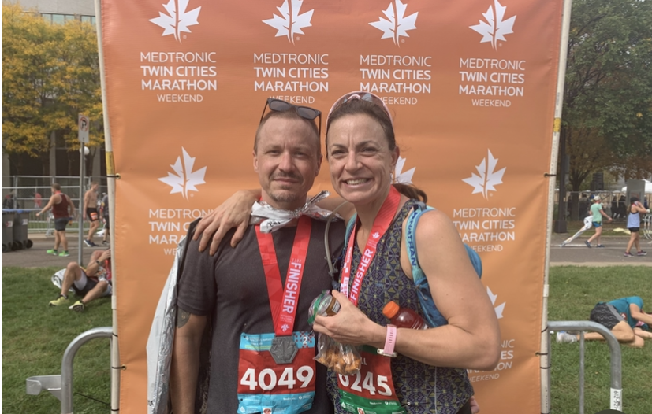
Background
Grew up in Minneapolis, MN
Undergrad/Med School: NYC
Training: LA County/Harbor UCLA Medical Center, LA, CA
Current Practice: Allina Health/Abbott Northwestern Hospital, Mpls, MN
3
2

Slide 5
Background
Abbott Northwestern Hospital
Quaternary referral and teaching hospital for the Allina Health System (12 hospitals, >90 clinics in MN and western WI)
686 hospital beds
46 Operating rooms
9 Cardiac Cath labs
73 ICU beds (med/surg, neuro, CV, OB)
4
2

Slide 6
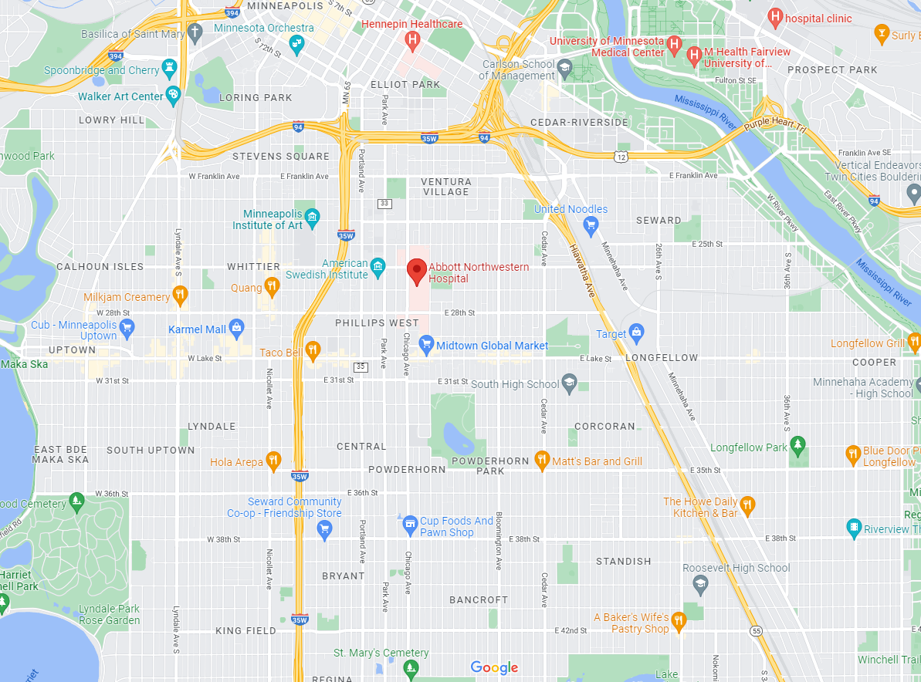
Background
5
2

Slide 7
Background
6
2

Slide 8
Background
7
2

Slide 9
Background
2020-2021
COVID 19 pandemic resulted in routine closure of 3 local Level 1 trauma centers in Mpls/St. Paul
2020
Protests following the murder of George Floyd
Increase in blunt and penetrating injuries around Abbott Northwestern
Inability for EMS to enter and transport patients from the area around Abbott Northwestern
2021-present
Severe staffing shortages have resulted in ongoing intermittent closure of local Level 1 trauma centers with regularity
8
2

Slide 10
How can we care for and stabilize traumatically injured patients normally cared for at a higher level trauma center?
9
2

Slide 11
Use of tourniquets in extremity trauma
Have existed for centuries
Were not routinely used until recently
7.8% of fatalities in the early stages of Iraq and Afghanistan were secondary to hemorrhage from extremity trauma
Similar to rate in Vietnam (7.4%)
In 2005, US Central Command mandated that all individuals deploying to combat theaters be equipped with tourniquets and hemostatic dressings
In 2011, deaths from extremity hemorrhage decreased to 2.6%
Estimated 1,000 to 2,000 lives saved as a result of this intervention
10

Slide 12
Started by the Committee on Trauma from the Am Coll of Surgeons in 2015
Result of previously noted military success, which was replicated in civilian populations
Further impetus was from Sandy Hook
Training involves compression and tourniquet application to individuals outside of the medical setting
11

Slide 13
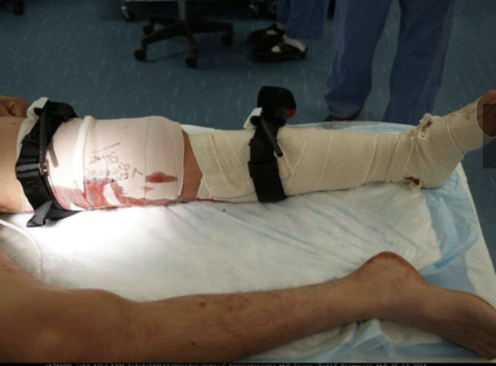
Hartford Consensus
Indications
pulsatile or ongoing hemorrhage from wound
Blood pooling on ground
Overlying clothes soaked with blood
Bandages becoming more soaked with blood
Traumatic amputation occurred
Prior bleeding with shock
Mistakes
Not using one when indicated
Using one with minimal or minor bleeding
Putting on too proximally to injury
Not making it tight enough
Waiting too long to apply
Not applying second tourniquet when needed (think leg/thigh)
12

Slide 14
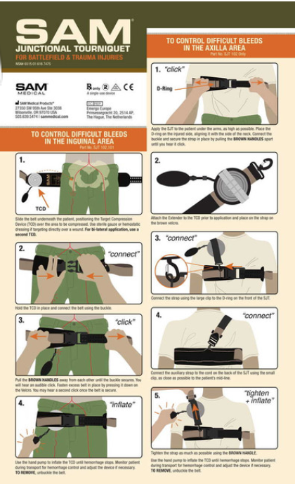
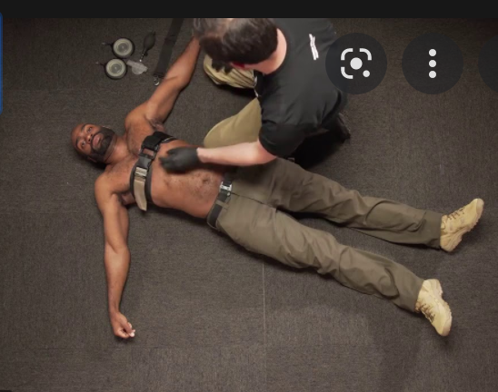
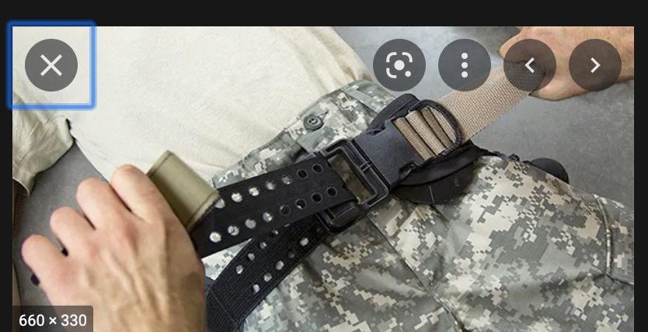
Junctional Tourniquets
Uses:
To obtain control of hemorrhage in areas not amenable to conventional tourniquet placement
12

Slide 15
Permissive hypotension
Conventional fluid resuscitation (ie w/ crystalloid) has been standard initial resuscitation for hypotensive trauma patients
This is known to have negative effects including:
Clot disruption
Dilutional coagulopathy
Hypothermia

Slide 16
Permissive Hypotension
Tran et al. Permissive hypotension versus conventional resuscitation strategies in adult trauma patients with hemorrhagic shock: A systematic review and meta-analysis of randomized controlled trials. J Trauma Acute Care Surg. 2018
5 trials, 1,158 patients
2 studies w/ penetrating injuries, 3 studies w/ penetrating + blunt injuries
Intervention arm (ie SBP 50-70, MAP 50 mmHg), Control arm (SBP 65-100, MAP 65 mmHg)
4 studies showed survival benefit in 30-day or in hospital mortality
3 studies insufficiently powered to detect survival benefit
Conclusion: permissive hypotension may offer a survival benefit over conventional resuscitation in patients with hemorrhagic injuries, and may reduce blood product utilization and blood loss.
The studies are underpowered and require higher quality/powered studies

Slide 17
Tranexamic Acid(TXA) in trauma
TXA mechanism of action
Blocks fibrin degradation by binding plasminogen
Promotes clot formation/stabilization
Historically used for hemostasis in various surgical procedures

Slide 18
Tranexamic Acid(TXA) in trauma
CRASH-2 Trial (The Lancet, 2013)
Evaluate effect of early admin of TXA on death and transfusion requirements in bleeding trauma pts
Multi-center RCT (274 centers, 40 countries)
~20k adult trauma pts w/ bleeding, presenting within 8h of injury
Primary endpoint: death in hospital within 1 month
Secondary endpoints: vascular occlusive events, surgical intervention, blood transfusions

Slide 19
Tranexamic Acid(TXA) in trauma
CRASH-2 Trial
Main outcomes:
Decreased all cause mortality (RR 0.91 [95% CI 0.85-0.97])
NNT = 125
Mortality decreased only if given <3h from injury
No difference in transfusion rates

Slide 20
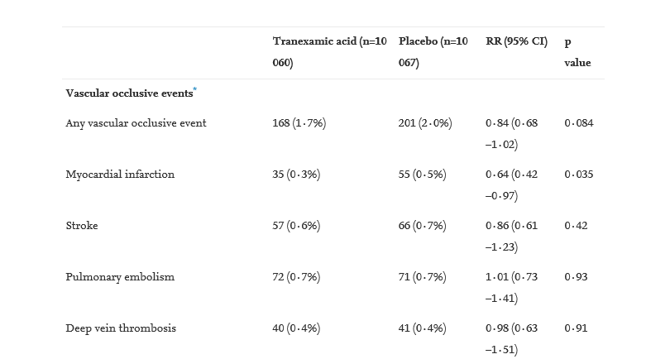
Tranexamic Acid(TXA) in trauma
CRASH-2 Trial

Slide 21
Tranexamic Acid(TXA) in trauma
Military Application of Tranexamic Acid in Trauma Emergency Resuscitation (MATTERs) Study (Arch Surg, 2012)
Retrospective review of 896 pts injured in combat comparing TXA vs. no TXA
Noted survival benefit for all cause mortality, particularly in the severely injured subgroup
Increased rate of VTE in TXA group

Slide 22
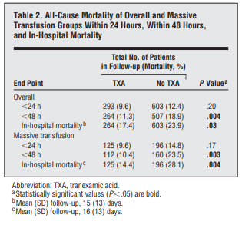
Tranexamic Acid(TXA) in trauma
Military Application of Tranexamic Acid in Trauma Emergency Resuscitation (MATTERs) Study

Slide 23
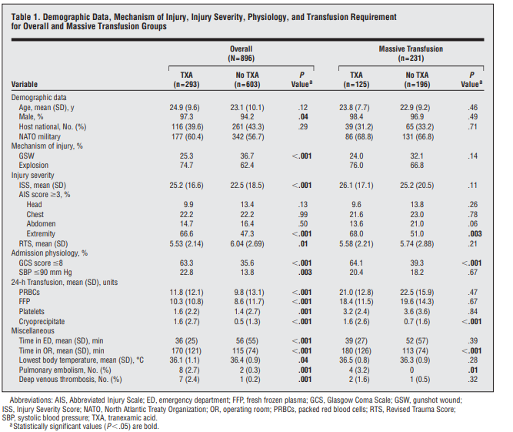
Tranexamic Acid(TXA) in trauma
Military Application of Tranexamic Acid in Trauma Emergency Resuscitation (MATTERs) Study

Slide 24
Tranexamic Acid(TXA) in trauma
Military Application of Tranexamic Acid in Trauma Emergency Resuscitation (MATTERs) Study

Slide 25
Tranexamic Acid(TXA) in trauma
Military Application of Tranexamic Acid in Trauma Emergency Resuscitation (MATTERs) Study

Slide 26
Tranexamic Acid(TXA) in trauma
Additional studies
Tranexamic acid use in severely injured civilian patients and the effects on outcomes: a prospective cohort study (Annals of Surgery, 2015)
Prospective cohort, 456 civilian pts
TXA showed survival benefit in pts p/w hemorrhagic shock
No benefit in the absence of shock
“…………it is difficult to recommend its use in nonshocked patients within mature civilian trauma systems”

Slide 27
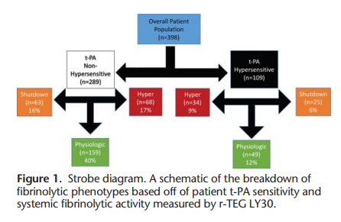
Tranexamic Acid(TXA) in trauma
Additional studies
Moore et al, 2013, J Trauma Acute Care Surg
Notes:
Samples collected in 1 hour after injury, only 25.6% were in hyperfibrinolysis

Slide 28
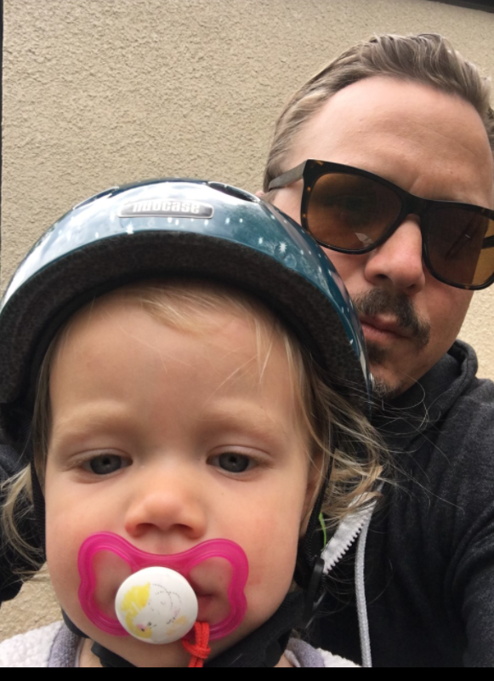
Traumatic Brain Injury
Most common cause of death in trauma

Slide 29
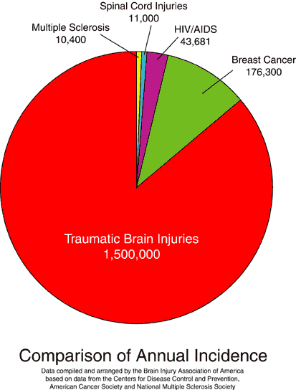
By the numbers…
100,000 people die from TBI and 500,000 more are permanently disabled
Approx 5.3 million Americans (> 2% US population) – are disabled following TBI
Notes:
Center for brain injury and repair – University of Pennsylvania

Slide 30
TBI – Pathophysiology
Primary brain injury – The Main Event:
Vasogenic cerebral edema defect BBB → permeability alterations
Cytotoxic cerebral edema – defect cell structure and regulation of ionic gradients
Secondary brain injury –
What we try and prevent
Notes:
Primary brain injury occurs at the time of trauma. Secondary injury is any physiological event that can occur within minutes, hours, or days after the initial injury and leads to further damage of nervous tissue. Such secondary insults may contribute to permanent neurological dysfunction. Hypotension (low blood pressure), hypoxia (inadequate oxygenation), intracranial hypertension (elevated pressure inside the head) and seizures are probably the most serious and frequently seen secondary injuries after head injury. Meaningful recovery of function after head injury is possible if secondary injuries are prevented or minimized.

Slide 31
TBI – Secondary Brain Injury
Secondary injury makes initial injury worse
Early intubation
Trauma center admission
Early resuscitation
Early CT scan and evacuation of space occupying lesion
ICU monitoring
Severe TBI mortality (1970s) → 50%
present → 36%
Notes:
Primary brain injury occurs at the time of trauma. Secondary injury is any physiological event that can occur within minutes, hours, or days after the initial injury and leads to further damage of nervous tissue. Such secondary insults may contribute to permanent neurological dysfunction. Hypotension (low blood pressure), hypoxia (inadequate oxygenation), intracranial hypertension (elevated pressure inside the head) and seizures are probably the most serious and frequently seen secondary injuries after head injury. Meaningful recovery of function after head injury is possible if secondary injuries are prevented or minimized.

Slide 32
Decreasing Secondary TBI
Prevent hypoxia
Prevent hypotension
Avoid fever
Avoid hypoglycemia
Normalize intracranial hypertension

Slide 33
Intracranial Pressure
Normal ICP??
0-10 mmHg
What level do we begin treating elevated ICP??
>20 mmHg
Main goal is to provide brain with adequate perfusion/oxygenation while it is trying to recover.

Slide 34
Lowering ICP
Head of bed elevation
Hypertonic saline
Sedation
Removal of unnecessary cervical collars
20% Mannitol 0.5-1 g/kg
(do not want serum osm >320) – maybe??

Slide 35
Lowering ICP
Head of bed elevation
Hypertonic saline
Sedation
Removal of unnecessary cervical collars
20% Mannitol 0.5-1 g/kg
(do not want serum osm >320) – maybe??

Slide 36
Removal of C-Collar in the altered patient
EAST Guidelines, 2015. Patel et al. J Trauma Acute Care Surg.
Systematic review
Obtunded blunt trauma pts, >16 yo
5 articles, 1,017 pts – no new deficits after c-collar removal
When coupled with MRI, 9% risk of missing stable c-spine injury (161 of 1,718 pts).
Normal CT C-spine has a 100% NPV for unstable c-spine injury, and 91% NPV for stable c-spine injury
“In obtunded adult blunt trauma patients, we conditionally recommend cervical collar removal after a negative high-quality C-spine CT scan result alone”

Slide 37
Lowering ICP
Paralysis
Barbituate coma
Ventriculostomy
Decompressive craniectomy

Slide 38
Questions/Comments?
Thank you.

