Slide 1
Stimulant-Associated Cardiomyopathy
Jonathan D Davis, MD, MPHS
Director, Heart Failure Program
Associate Professor | Division of Cardiology
San Francisco General Hospital
Department of Medicine | UCSF
jonathan.davis@ucsf.edu
April 18, 2023

Slide 2
Disclosures
None

Slide 3
Learning Objectives
Increase understanding of challenges patients with co-occurring stimulant use and heart failure face in receiving health care

Slide 4

Background

Slide 5
Which of the following is true:
Patients with stimulant-associated cardiomyopathy are at higher risk of dying than those with non-stimulant-associated cardiomyopathy
There is stigma associated with stimulant use that often negatively biases providers, further widening the gap in the care relationship.
Reduction in stimulant use improves cardiac function and reduces hospital admissions in patients
All of the above

Slide 6
People with stimulant-associated cardiomyopathy (SA-CMP)
Compared to matched controls:
Higher rates of mortality and acute care utilization (e.g., Emergency Department visits, hospital admissions)
Lower rates of consistent outpatient care engagement
Notes:
As compared to matched controls

Slide 7
Methamphetamine Effect | Cardiotoxicity
Myocardial Toxicity | Cardiomyopathy
 | Malignant arrythmias
Tachycardia, hypertension | Malignant HTN
 | Coronary vasospasm
 | Acute myocardial infarction
 | Aortic dissection
Pulmonary arterial hypertension | Right heart failure
 | Dysrhythmias
Neurotransmitter depletion | Sudden Cardiac death
Intravenous drug injection | Infective endocarditis
Modified from Paratz et al. Heart Lung Circ. 2016

Slide 8
Rising Prevalence
In California, methamphetamine-associated admissions increased 600%, from 1.2% of all hospitalizations in 2008 to 8% in 2018.
Patients with SA-CMP having almost 4 times the odds of 30-day HF readmission compared to HF from non-SA-CMP etiologies (OR 3.62, 95% CI 1.40 to 9.38).
Zhao SX, et al. Circ: Cardiovascular Quality and Outcomes. 2021;14(7)
Carter J, et al. AMERSA 41st Annual Conference. 2017
Notes:
At ZSFG, heart failure (HF) is one of the top contributors to hospital-wide 30-day readmissions

Slide 9
Rate of Methamphetamine Health Indicators in SF, 2005-2021
Substance Use Trends in San Francisco Through 2021. Available at:
https://sf.gov/sites/default/files/2022-10/Substance_Use_Report_SF_2021_FINAL.pdf
Notes:
At ZSFG, heart failure (HF) is one of the top contributors to hospital-wide 30-day readmissions

Slide 10
Barriers
The exact pathophysiology and incidence are unknown
Continued stimulant use drives disease progression and impedes medical care engagement
There are limited effective treatment options to reduce use.

Slide 11
Social Determinants and Other Barriers
Co-occurring mental health disease
Other substance use
Social determinant of health (SDOH) challenges
  e.g., expensive/insufficient housing options, income-generation limited by pre-employment screens, working multiple jobs

Slide 12
Treatment Options
Use of guideline-directed medical therapy (GDMT) for patients with HF with reduced ejection fraction (HFrEF) improves outcomes but is frequently suboptimal.
No FDA-approved medications for stimulant use disorder exist
Contingency management (CM) is a highly effective behavioral treatment that reinforces a target behavior through a reward-based system.

Slide 13
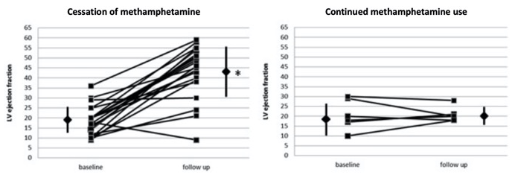
Cessation Associated with Improvement
Schürer S, et al. JACC Heart Fail. 2017 Jun;5(6):435-445.

Slide 14
Contingency Management (CM)
 | Add Something | Remove Something
Increase a behavior | Positive Reinforcement | Negative Reinforcement
Decrease a behavior | Positive Punishment | Negative Punishment

Slide 15
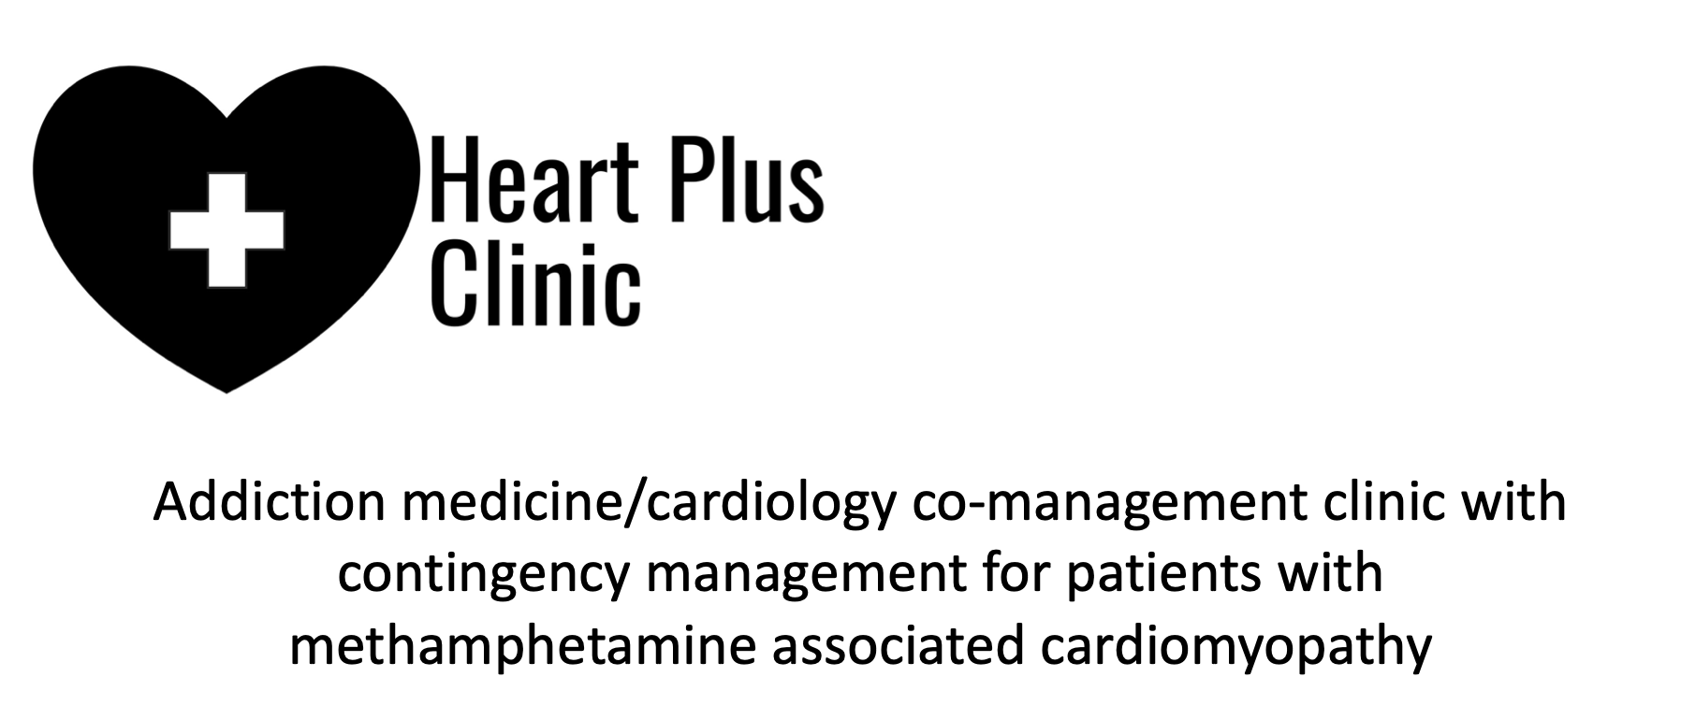

Slide 16
Co-Management Clinic Observations
Increase in outpatient care engagement with concomitant reduction in acute care utilization
Increase in GDMT usage with concomitant reduction in stimulant use.

Slide 17
Co-Management Clinic Observations, cont.
Patients were better able to engage with outpatient resources for SDOH, including case management, social work, and housing and food service programs once they achieved clinical stability.
They were empowered to take control of their health and in knowing that health care providers cared about their wellbeing.

Slide 18

Practical Tips at the Bedside
Do not discuss a person’s substance use in front of friends or family members without their consent
Use strengths-based, person-first charting
Find ways to affirm your patients
Teach them about the good prognosis with treatment of their HF and their stimulant use disorder

Slide 19


Thank you!
jonathan.davis@ucsf.edu
@JonathanDavisHF

