Slide 1
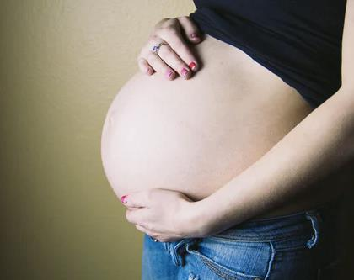
Pregnancy & Trauma
Britt Guest, DO
UCLA/EM:RAP AIME Fellow
UCLA Clinical Instructor
Notes:
We are going to talk about some of the physiological changes of pregnancy and how that effects our approach to treating pregnant trauma pts

Slide 2
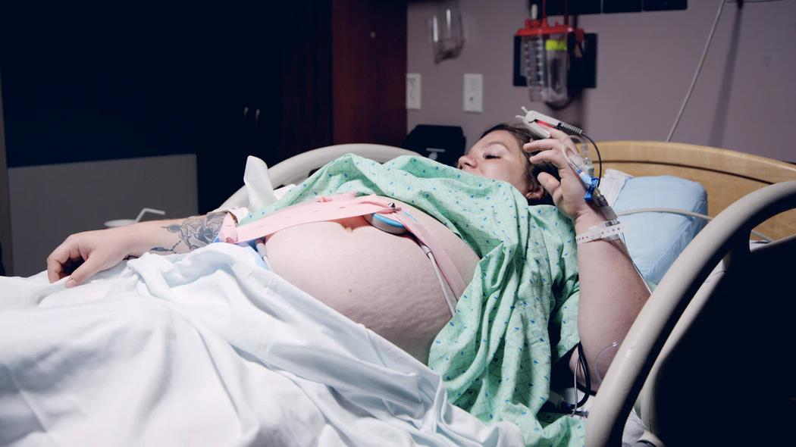
Why is this important
Trauma affects 1 in 12 pregnancies
Trauma is the leading non-OB cause of maternal death
Notes:
Trauma in a pregnancy pt has a high incidence of morbidity and mortality

Slide 3
Mechanism of Injury | Prevalence (per live births)
Domestic Violence | 8,307/100,000
Motor Vehicle Accidents | 207/100,000
Falls | 49/100,000
Penetrating Trauma | 3.27/100,000
Homicide | 3/100,000
Burns | 0.17/100,000
Notes:
What type of trauma do pregnant women experience
Systematic review from the American Journal of Obstetrics and Gynecology that looked at data regarding trauma in pregnancy from 1990-2012
When they looked at the prevalence of different types of injury mechanisms in pregnant pts what they found was domestic violence was by far the most common

Slide 4
What makes trauma in pregnancy different?
Two patients to care for
Physiological changes
Low mechanism injury should be treated like major trauma
Notes:
Perform primary/secondary survey similar to non-pregnant pt.
In pregnancy there are many physiological changes that results in significant hemodynamic changes that we must be aware of when treating a pregnant trauma patient….

Slide 5
Airway
Edema with friable mucosa
Capillary engorgement
Fluid Retention
High risk of aspiration
Notes:
Capillary engorgement of the mucosa throughout the respiratory tract causes swelling of the nasal and oral pharynx, larynx, and trachea, resulting in difficulty with nasal breathing, epistaxis, and voice changes (8, 9).
Elevated estrogen levels and an increase in blood volume associated with pregnancy may contribute to the mucosal edema

Slide 6
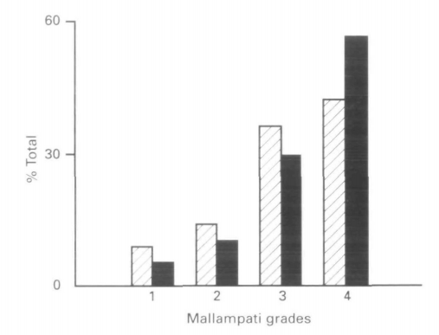
= 12 weeks
= 38 weeks
Notes:
This study is from the British journal of anesthesia that noticed that there was a higher rate of failed/difficult intubation in pregnant woman and they wanted to know why.
In this study they compared the mallampati score of 242 pregnant women at 12 weeks and 38 weeks of gestation.
As shown in the graph - at 38 weeks the number of grade 4 cases had increased by 34%
They found that as the women were further along in their pregnancy their mallampati score increased – which correlates with a a more difficult airway
This is likely due to a combination of fluid retention and increased pharyngeal edema that occurs during pregnancy
https://www.bjanaesthesia.org.uk/article/S0007-0912(17)41185-8/pdf

Slide 7
Aspiration
Progesterone relaxes smooth muscle
Lower esophageal tone
+
Delayed gastric emptying
Pearl: place orogastric tube to
decompress stomach
Notes:
Increased intragastric pressure from gravid uterus
Pearl: after intubation - orogastric tube should be placed for gastric decompression and mitigation of continued aspiration risk.

Slide 8
What about cricoid pressure?
Bottom line – it’s controversial
If used, apply light pressure as too much force and obscure view or make it difficult to bag
Notes:
The Obstetric Anaesthetists' Association and Difficult Airway Society have developed the first national obstetric guidelines for the safe management of difficult and failed tracheal intubation during general anaesthesia.
Cricoid pressure during rapid sequence induction has long been debated [77]. Cricoid pressure is used almost universally in the UK during general anaesthesia for caesarean section [78], although practice varies in other countries [79]. Current evidence supports applying 10 N force initially and then increasing to 30 N after loss of consciousness [80], as too much force (e.g. 44 N) is associated with airway obstruction

Slide 9
Increased minute ventilation
Decreased functional residual capacity
Breathing

Slide 10
Increased Minute ventilation
Min ventilation = RR x TV
Amount of air entering the lung in 1 min
In pregnancy O2 demand increases
Min ventilation = RR x TV
50%
10%
40%
Notes:
Minute ventilation is the amount of air inhaled into the lung (or exhaled) in 1 min
In order to meet the oxygen demand of the growing fetus, mom increases her minute ventilation by increasing her tidal volume and rr so that she can inhale more oxygen over the course of 1 min

Slide 11
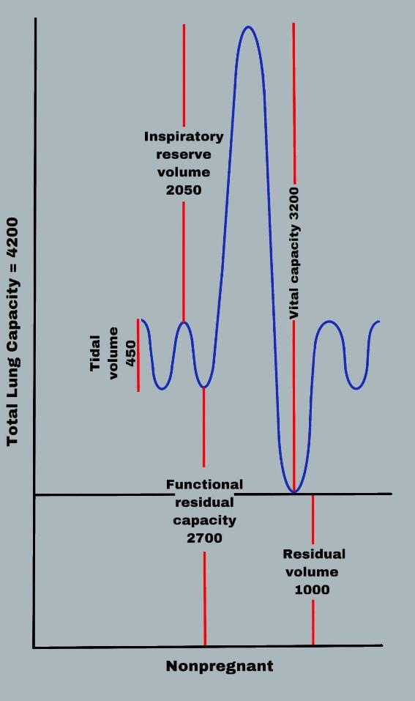
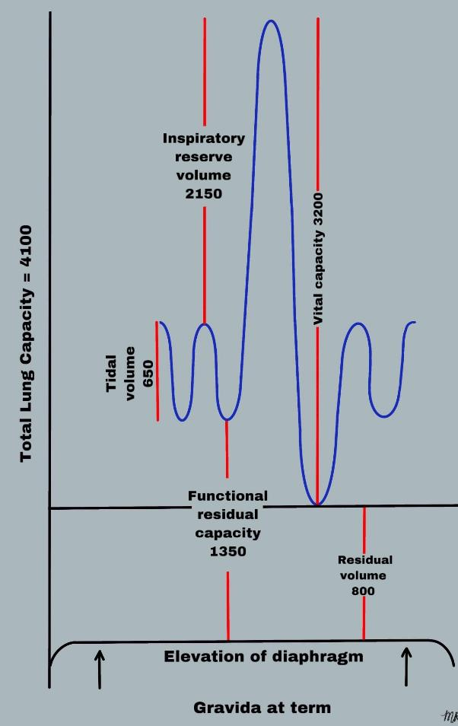
Pearl: Physiological breathlessness of pregnancy is very common BUT
it can also be the presenting symptom of serious cardiac or pulmonary injury
Notes:
Lung function graph
During pregnancy the TV increases from about 450 to 650, RR rate increases minimally
Women inhales deeper and slightly faster creating this appearance of physiological shortness of breath
Physiological breathlessness of pregnancy is experienced by the majority of pregnant women but it can also be the presenting symptom of serious underlying cardiac or pulmonary injury
If sob is associated with cough, chest pain, bruising or hypoxia…That is not normal Physiologic dyspnea and you must take that seriously and further evaluated for injury to the heart and lungs.

Slide 12
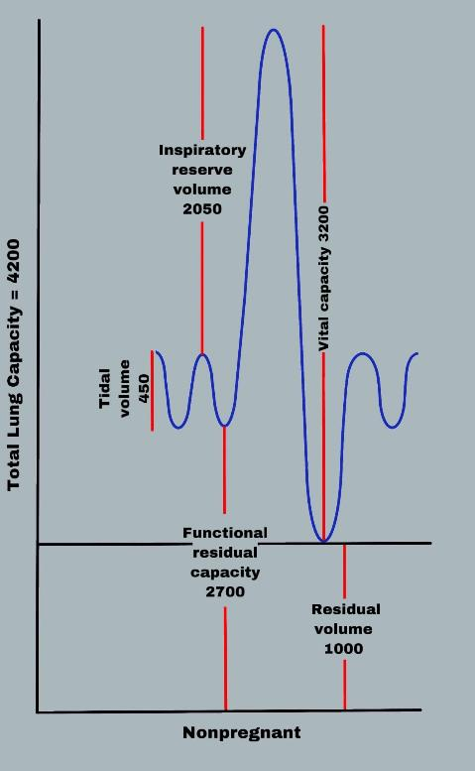
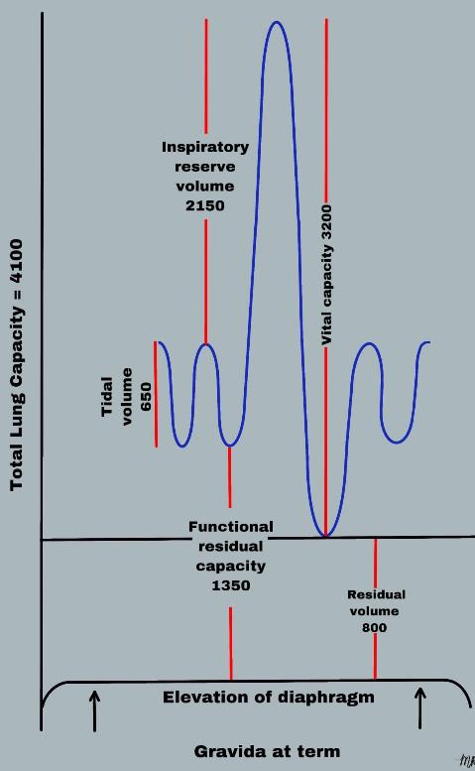
Decreased Functional Residual Capacity (FRC)
What is FRC???
Volume of air left in lungs after
normal exhalation
Gravid uterus pushes up on diaphragm resulting decreased FRC (20%)
Notes:
Average 70 kg person has a FRC of about 2700 mL -> 1,350 in pregnancy
Decreased FRC (decreased amount of air left in lung)
Increased amount of O2 used up by fetus – baby is pulling lots of O2 out of blood
increase in oxygen consumption and decreased FRC mean that pts become hypoxic very quickly during episodes of apnoea or hypoventilation
Fetus is very sensitive to hypoxia and All pregnant trauma patients should receive O₂ supplementation to maintain saturation >95%.
Less residual volume left in lung after exhale
Baby sensitive to hypoxia – maintain moms O2 about 95%

Slide 13
Decreased FRC
+
Increased O2 consumption
=
rapid onset hypoxia
Fetus is very sensitive to hypoxia
Pearl: pregnant trauma patients should receive O₂
supplementation to maintain saturation >95%.
Notes:
Decreased FRC (decreased amount of air left in lung)
Increased amount of O2 used up by fetus – baby is pulling lots of O2 out of blood
increase in oxygen consumption and decreased FRC mean that pts become hypoxic very quickly during episodes of apnoea or hypoventilation
Fetus is very sensitive to hypoxia and All pregnant trauma patients should receive O₂ supplementation to maintain saturation >95%.
Less residual volume left in lung after exhale
Baby sensitive to hypoxia – maintain moms O2 about 95%

Slide 14
Difficult Airway
Tips + Tricks
Most experienced physician
preoxygenate (dual)
+/- cricoid pressure
Smaller tube (6.5 mm)
Suction, back-up
Edema and easy bleeding
Rapid onset hypoxia
Aspirate
Notes:
This is going to be a difficult airway (list) but you have some tools in your toolkit to help make prepare you as best as possible for this challenging intubation
Hypoxia (increased o2 demand from fetus and decreased residual volume of air in the lung)
Have you back ups, bougie, consider slightly smaller tube
Have suction for aspiration
Effect of progesterone and general fluid retention – might need smaller ETT

Slide 15
Circulation
Growing fetus = increased o2 demand
Mom meets new demand by…
Increase min ventilation
Increase O2 carrying capacity
(blood volume)
Increase cardiac output
Notes:
Pull more o2 into lungs
Make more blood
Push more blood out of heart

Slide 16
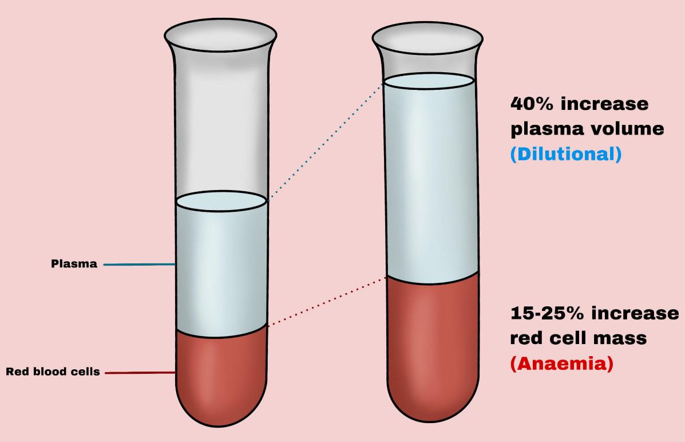
Blood Volume
Total blood volume
increases by 50%
Pearl: This results in a dilutional anemia
Notes:
Total blood volume increases by 50%
Plasma volume is the first blood component to increase – increases by 40% in third trimester, which is an increase by about 1,500 mL
Red blood cell mass increases by about 25% (350 mL)

Slide 17
Effects of Blood Loss
Pregnancy
increased blood vol (2L)
Pregnant women can loose more blood
before they show vital sign abnormalities
Blood loss (%) | Blood loss (mL) | Clinical Findings
15-20 | 1,200 – 1,500 | NONE
20-25 | 1,500 – 2,000 | RR 14-20, HR 100-120, BP slightly low
> 25% | > 2,000 | RR 20-30, HR >120, hypotension, oliguria
Notes:
https://academic.oup.com/bjaed/article/14/2/69/271445
You increased the blood volume by 50% - what implication does this have on a bleeding pregnant trauma pt
This is an article from the British Journal of Anesthesia and it reviews the cardiovascular changes seen in pregnancy
After loosing up to 1.5L of blood a non-pregnant pt is already in Stage 2 hemorrhagic shock –hypotensive, tachycardic, tachcipenic, anxious – but because the increased blood volume in pregnant pts they can loose a significant amount of blood and not show any vital sign abnormalities
Might not see the blood loss if retroperitoneal or placental abruption (see vaginal bleeding and contraction)– can’t pick this up on FAST
Pregnancy you have a HR of 100 ok, >110 abnormal
Mild hypotension can be normal in pregnancy (2nd trimester and then back to normal), but if you see hypotension with tachycardia in trauma pt, treat as bleed until proven otherwise
Because pregnancy is associated with an increase in blood volume, the actual amount of blood loss that results in clinical signs of response is greater in pregnant women than in nonpregnant women.
Tachycardia and hypotension may be late signs d/t increased blood volume
Pregnancy pts at baseline have mild tachycardia and hypotension (mid pregnancy) – can this mask severe blood loss)

Slide 18
Signs of hypovolemia and hemorrhage may be late findings in a pregnant trauma patient due to the increase in blood volume.
Notes:
Signs of hypovolemia and hemorrhage, such as significant tachycardia and hypotension, may be late findings in pregnancy due to the increase in maternal blood volume.
Pregnancy you have a HR of 100 ok, >110 abnormal
Mild hypotension can be normal in pregnancy (2nd trimester and then back to normal), but if you see hypotension with tachycardia in trauma pt, treat as bleed until proven otherwise

Slide 19
Now that mom has made more blood, how does it circulate?
1 . Increased Cardiac Output (CO)
CO = HR X SV
40%
2. Decreased Systemic Vascular Resistance (SVR)
uterine vascular bed is a low-resistance system
and vessels maximally dilated
Fetus receives 20%
of mom’s CO
Notes:
Now that mom has made more blood, how does it circulate
Moms HR increased minimally and SV increase more
There is increased blood flow to the uterus and by term the baby receives 20% of mom’s cardiac output
To maintain arterial pressure (AP) the mother increased
Decreased systemic vascular resistance – progesterone and estrogen = peripheral vasodilators
Significant decrease in utuerus -uterine vascular bed is a low-resistance system. uterine vessels appear to be maximally
dilated and, therefore, exhibit minimal autoregulation.
This is usually fine as long as moms BP stays stable
Because the uterine blood flow is not autoregulated, maternal hypotension can lead to fetal distress.
Fetus does not tolerate maternal hypotension well (can’t dilate more to shunt blood to uterus) When moms BP drop, then uterine arteries can’t dilate more (no more blood and be shunted to uterus), uterus blood flow is very sensitive to moms bp
Treat hypotension with volume replacement
-only use pressors if persistent hypotension – pressors reduce utrerine blood flow
https://www.ahajournals.org/doi/10.1161/CIR.0000000000000300?url_ver=Z39.88-2003&rfr_id=ori:rid:crossref.org&rfr_dat=cr_pub%20%200pubmed
Vasoconstriction to other maternal organs before vasoconstriction to fetus

Slide 20
Clinical significance
Fetus does not tolerate maternal hypotension well
Uterine vessels are maximally dilated and exhibit minimal auto-regulation
When moms BP drops the uterine
arteries can not dilate more
FETAL
DISTRESS
Pearl: Treat hypotension with volume replacement, only use vasopressors for persistent hypotension
Notes:
Fetus does not tolerate maternal hypotension well (can’t dilate more to shunt blood to uterus)
uterine vessels appear to be maximally dilated and, therefore, exhibit minimal autoregulation.
This is usually fine as long as moms BP stays stable BUT because the uterine blood flow is not autoregulated, maternal hypotension can lead to fetal distress.
When moms BP drop, then uterine arteries can’t dilate more (no more blood and be shunted to uterus), uterus blood flow is very sensitive to moms bp
Volume replacement is preferable to vasopressors for blood pressure support since vasopressors can reduce uterine blood flow [12]. Vasopressors can be administered to treat persistent hypotension refractory to fluid administration.
Increased pelvic blood flow during pregnancy results in an increased risk of retroperitoneal hemorrhage

Slide 21
Abdominal Trauma
By 12 weeks the uterus becomes
intra-abdominal organ
Uterus pushes spleen and liver against ribs
Uterus becomes mores susceptible to injury
Placental
Abruption
Notes:
The uterus is protected by the bony pelvis during the first 12 wk of pregnancy. Beyond 12 wk, the uterus becomes an intra-abdominal organ and is more vulnerable to injury.
Uterus pushes spleen and liver against ribs, become more vulnerable to injury
The uterus is very sensitive and even low speed minor trauma can lead to placental abruption – where the placenta separates from the uterus
Minor trauma (eg, low-speed motor vehicle crashes [MVCs]) in a pregnant woman can lead to serious consequences (eg, placental abruption) in the mother and fetus.

Slide 22
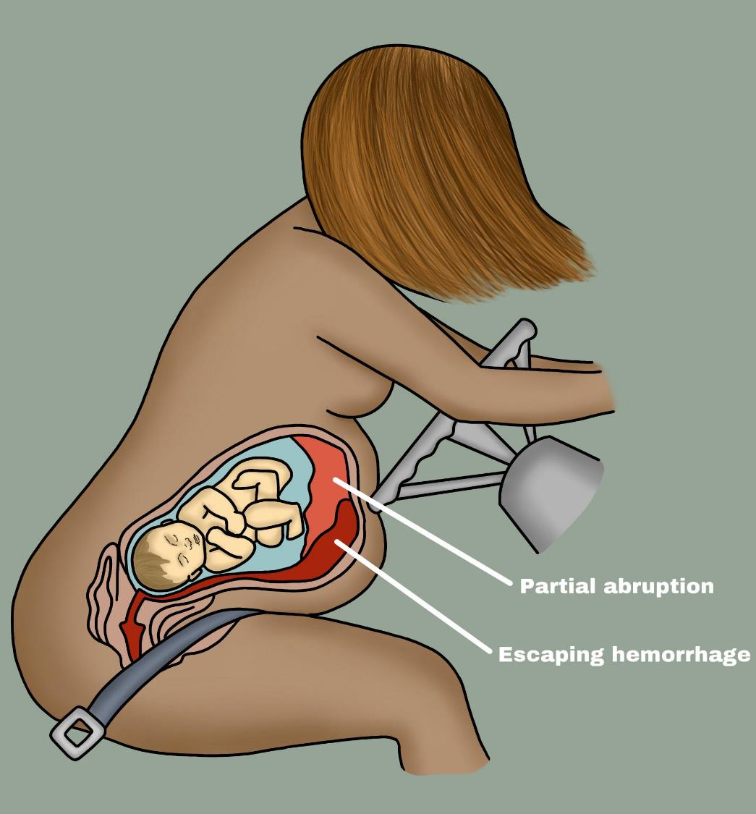
Placental Abruption
Sheer force + moms body folding
Can occur in low mechanism injuries
Pts with abdominal or back pain, vaginal bleeding,
uterine tenderness or contractions should be
evaluated for abruption
CT is the imaging of choice
Pearl: CT should not be delayed due to
concern for fetal radiation exposure
Notes:
Sheer force + moms body folding -> increased intra-abdominal pressure -> leading to abruption
Higher risk in sever trauma requiring hospitalization, but, this occurs in lower mechanism injuries and you can not necessarily predict who will develop this just based on mechanism alone
Very high risk of maternal (c-sec, postpartum hem, transfusion) and fetal (perterm birth, intraut growth retardation, low birth wt, cerebral palsy) morbidity and mortality
Abruptions can occus along the posterior aspect of the uterus and therefore, an US exam alone is not realiable Onset of presentation can occur as late as 5 d. Any pt with abdominal pain, back pain, vb, uterine ttp, contractions should be evaluated for abruption

Slide 23
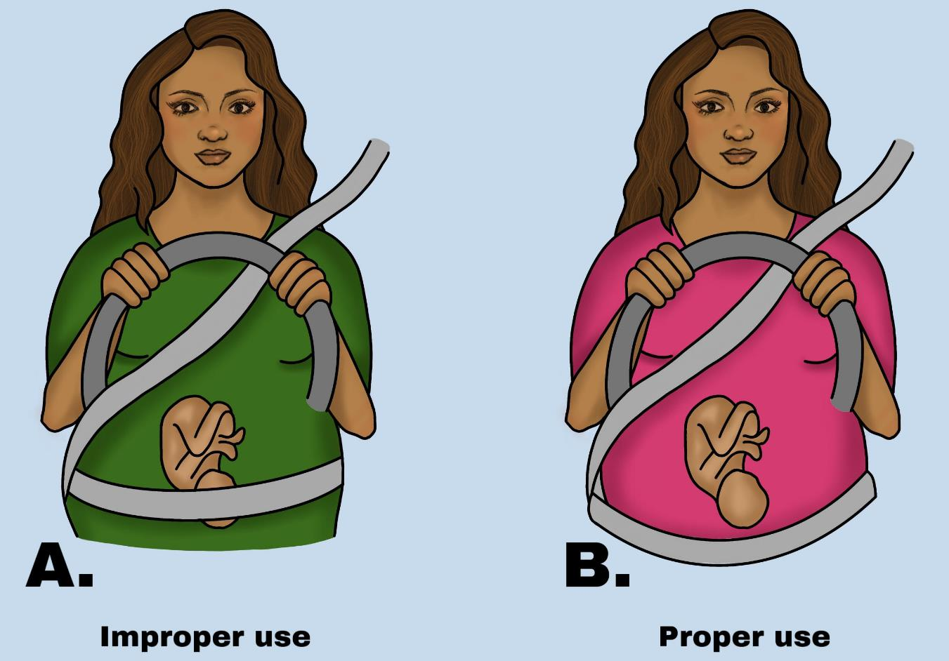
Improper seat belt placement results in 3-fold increase
transmitted force through the uterus
Notes:
lap belt should be placed below your belly, touching your thighs, and low and snug on your hip bones.
Improper seat belt placement results in 3-4 fold increase transmitted force through the uterus

Slide 24
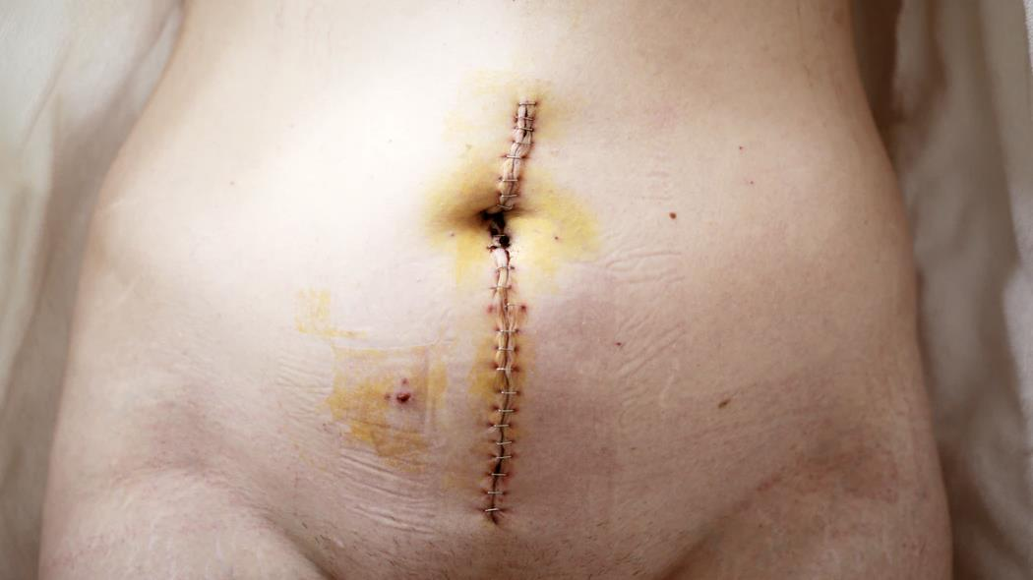
Perimortem Cesarean Delivery (PMCD)
Notes:
Now I know this is a tough topic and I hope you never find yourself in this position but it is crucial to know how to manage the pregnant patient who goes into cardiac arrest.
Of course we all want to save both mom and baby but we have to remember her that our primary goal is to stabilize the mother first, as fetal outcomes are directly correlated with maternal resuscitation.

Slide 25
Maternal Cardiac Arrest - Follow standard ACLS algorithms
Chest compressions rate and depth same as in non-regnant
No evidence for more cephalad position of hands
No modification to defibrillation protocol, use same amount of energy
Early airway intervention, mom becomes hypoxic quickly
Notes:
This is the first scientific statement from the American Heart Association on maternal resuscitation from 2015. This document will provide readers with \guidelines and recommendations for all aspects of maternal resuscitation.
Chest compressions rate (100/min) and depth (2 cm) same as in non-regnant
Previous guidelines recommended placing the hands slightly higher on the sternum in the pregnant patient. There is no evidence to support more cephalad position of hands for chest compressions; thus, the hand position should remain the same as for a non-pregnant patient.
Defibrillation and cardioversion shocks to the maternal chest would be expected to pass minimal energy to the fetus and is considered safe in all stages of pregnancy. The energy required for defibrillation is the same as current recommendations for the non-pregnant patient. There is no evidence indicating that maternal defibrillation could lead to adverse fetal outcomes.
Uterus pushed up on lungs and causes decreased function residual capacity (not a lot of extra air left in lung) + increased o2 demand from baby = mom becomes hypoxic quick. BVM with 100% O2 and early intubation – prepare for difficult airway- aspiration, edema and friable (hormones)
If a fetal scalp electrode is in place to monitor the fetal heart rate, it is reasonable to disconnect the electrode from the power source before shock; however, maternal defibrillation should not be delayed

Slide 26
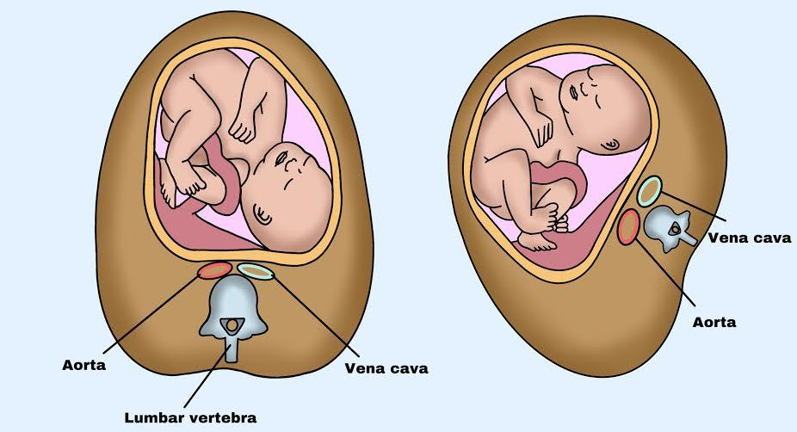
IVC and Aorta Compression
Increase afterload
Decrease venous return
In supine position the
CO decreases 25%
Left uterine displacement
relieves this compression
Notes:
When you have a pregnant patient in cardiac arrest it is important to take into account the effects that the enlarged uterus has on maternal circulcation
The effects of uterine compression on the vasculature can be seen as early has 12-14 weeks gestational age
maternal position has a great impact on intravascular pressures and cardiac output and pts can become hypotensive in supine position - CO in supine position is reduced by 25%
Class 1 recommendation by the AHA
uterus can produce increased afterload through compression of the aorta and decreased cardiac return through compression of the inferior vena cava, starting at ≈12 to 14 weeks of gestational age.¹³ As a result, the supine position, which is most favorable for resuscitation, can lead to hypotension
Gravid uterus can compress aorta (increase afterload) and compress IFV (decreased venous return) – this starts as soon as 12-14 weeks
maternal position has a great impact on intravascular pressures and cardiac output and pts can become hypotensive in supine position - CO in supine position is reduced by 25%

Slide 27
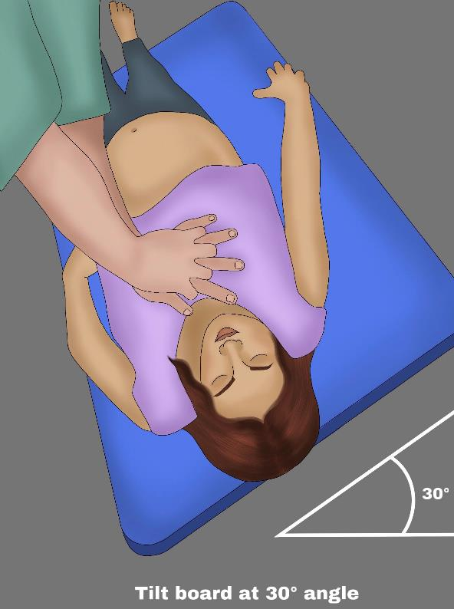
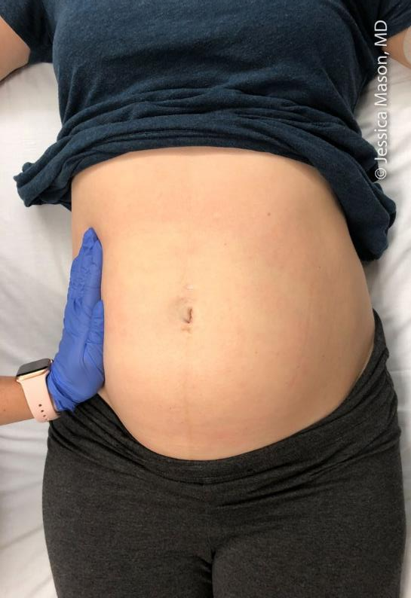
Left Uterine Displacement Manual vs Tilt
Cons to tilt:
Pt slides off board
Heart shifts lateral - CPR less effective
IVC compression still occurs
Airway management more difficult
PEARL: Continuous manual LUD should be performed in
all pregnant woman in cardiac arrest (Class I)

Slide 28
PMCD Indications
Decision should be made in conjunction with family, obstetrician, and neonatologist
Indications:
Fetus has a reasonable chance of viability (> 20 weeks)
Maternal cardiac arrest after 4 min of unsuccessful CPR
Capability to deliver and resuscitate neonate
Notes:
PMCD
Decision should be made in conjunction with family, obstetrician, and neonatologist.
Indications
Maternal cardiac arrest after 4 min of unsuccessful CPR
the gravid uterus is thought to interfere with maternal hemodynamics,
the fetus has a reasonable chance of viability (22-23 wk is the lower limit of neonatal viability, and early delivery can minimize the risk of anoxic brain injury to the fetus), and
Capability to deliver and resuscitate neonate

Slide 29
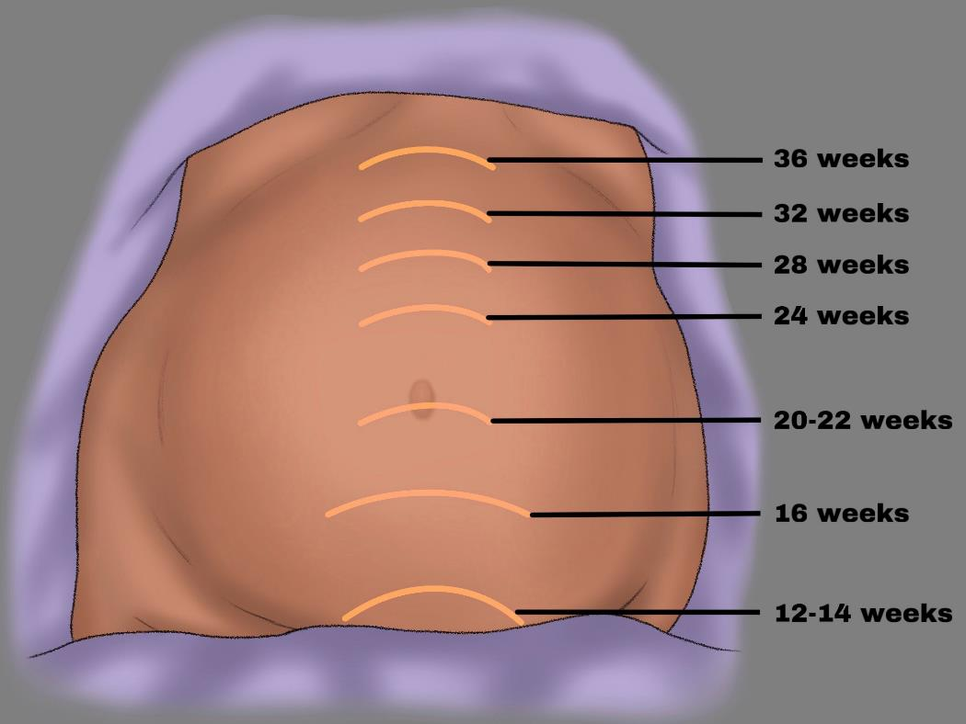
Fetal Viability
> 20 weeks is considered viable and PMCD should be considered
Notes:
Assess fundal height, should be at or above the umbilicus

Slide 30
Maternal cardiac arrest
4-minute resuscitation
No ROSC
Initiate PMCD
(deliver baby in 1-minute)
Delivery should be performed at the location of the cardiac arrest and NOT in the OR.
CPR is continuing during PMCD
Notes:
The 4 min mark is based off of anoxic brain injury for the fetus
Studies show that there is a 50% maternal and neonatal injury-free survival is approximately 25 min
If you think of this procedures as a resuscitative hysterotomy, it will continue to hold benefits to the mother
Remmeber: Takes pressure off IVC and improves maternal venous return, decreased pressure on diaphragm and improves respiration

Slide 31
“4 Minute Rule”
Delivery should be completed within 5 min of maternal cardiac arrest
Notes:
The AHA, the European Resuscitation Council, and the Society for Obstetric Anesthesia and Perinatology have adopted the “4-min rule,” which refers to the initiation of PMCD within 4 min of maternal cardiac arrest without a return of spontaneous circulation, with the objective of delivery within 5 min. This guideline is based on the presumed onset of anoxic brain injury to the fetus after 4-6 min of maternal cardiac arrest. However, a review of published literature suggests that most PMCD deliveries (<8-10%) cannot be accomplished within 5 min of maternal arrest and that the threshold for 50% maternal and neonatal injury-free survival is approximately 25 and 26 min, respectively. Therefore, PMCD should be performed as quickly as possible once the decision has been made, even if delivery cannot be accomplished within 1 min.
Mother arrests -> resuscitate for 4 min -> no ROSC -> initiate PMCD and deliver baby in 1 min (ideally)

Slide 32
Performing a PMCD
Notes:
Steps:
Pt placed in the left lateral decubitus position
Using a 10 blade a vertical incision is made from xiphoid to pubic symphysis through all the layers of the abdominal wall
Manually retract the bladder (ideal if bladder can be decompressed by placing foley)
Next, make another small vertical incision in the fundus of the uterus
Use scissors to extend the incisson (careful not to cause penetrating trauma to the fetus and avoid the placenta if possible)
Suction baby, clamp and cut cord, another team initiates neonatal resuscitation
Pack open uterus and abdomen
Continue ACLS (ant ATLS efforts). If patient achieves ROSC then she should be taken to the OR for closure

Slide 33
Perimortem cesarean delivery (PMCD)
Primary goal is to stabilize the mother first, as fetal outcomes are directly correlated with maternal resuscitation.
Maternal cardiopulmonary arrest -> Start CPR
Apply manual left uterine displacement
Check fundal height (EGA > 20 weeks?)
Call obstetric and neonatology/pediatrics
Initiate PMCD if maternal spontaneous circulation has not returned within of 4 minutes of CPR
Notes:
Primary goal is improvement of maternal resuscitation
Takes pressure off IVC and improves maternal venous return, decreased pressure on diaphragm and improves respiration
Best chance of saving baby is to save mother

