Slide 1

Indian Country ECHO:
Cannabis Use in Pregnancy through Postpartum
Kristin Prewitt, MD MPH, Addiction Medicine Fellow
Department of Obstetrics and Gynecology
Oregon Health & Science University
Jamie Lo, MD MCR, Associate Professor
Department of Obstetrics and Gynecology
Division of Maternal Fetal Medicine
Oregon Health & Science University
Division of Reproductive and Developmental Sciences
Oregon National Primate Research Center
May 21, 2024
Notes:
Thank you for the opportunity for us to speak today.
Kristin:
Jamie: I am a reproductive biology physician scientist at OHSU and my lab is at the Oregon National Primate Research Center. My clinical background specializes in high-risk pregnancies, fetal development, genetics and female reproductive health. My research focuses primarily on environmental exposures, particularly substance use, and its impact on reproductive health, especially placental and fetal/offspring outcomes. Most recently, I have turned to studying cannabis, the drug of choice that I am seeing all the time in my patient population.

Slide 2
Conflicts of Interest or Disclosures
None
Notes:
I have no relevant disclosures or conflicts of interest

Slide 3

Learning Objectives
Participants will be able to:
Discuss effects of cannabis use prior to conception
Describe the impact of prenatal cannabis exposure on offspring development
Explain ways to counsel patients regarding cannabis use in pregnancy and lactation
Notes:
I have no relevant disclosures or conflicts of interest

Slide 4
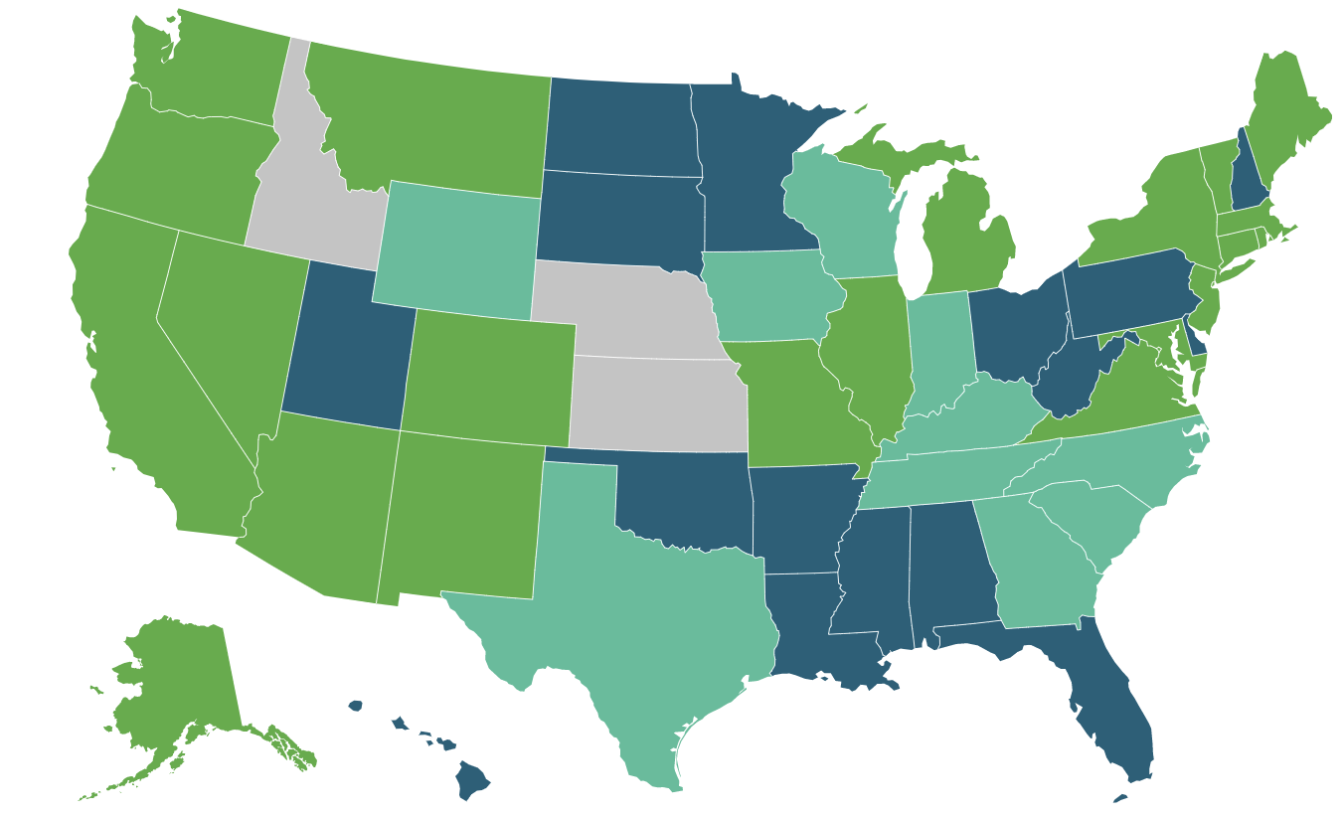
Cannabis Legalization
Cannabis is the most commonly used illicit drug in the US and world
38 states and Washington DC have legalized medical cannabis
21 states and Washington DC have legalized recreational cannabis
References: https://thehill.com/homenews/nexstar_media_wire/3789873-where-will-cannabis-be-legal-in-2023/ Accessed February, 2024
Notes:
Cannabis first became legal for medical use in the 1990s in a handful of states, and recreational cannabis was first legalized in 2012 in Colorado and Washington State.
Since that time, cannabis has become legal in several states and currently medical cannabis is legal in 38 states and in Washington DC, and recreational cannabis is legal in 21 states and Washington DC.
This legalization trend has promoted widespread cannabis’ availability and perceived safety.

Slide 5
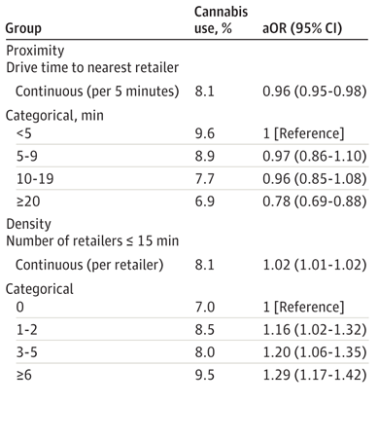
Geospatial Availability and Use
Increased legalization of recreational cannabis, increases retailer density
Studies show use correlates with accessibility
2021 cross sectional study on association between cannabis use in pregnancy and retailer proximity within Kaiser Northern California patients shows more use with geospacial density​
References: Everson et al. American Journal of Public Health 2019, Young-Wolff et al. JAMA Netw Open. 2021
Notes:
With increased legalization of recreational cannabis, the geographic accessibility of cannabis dispensaries and retailers has increased, leading to easier access and geospacial availability of cannabis. Previous studies have shown that use after legalization does not immediately increase but is related to retailer proximity and density.

Slide 6
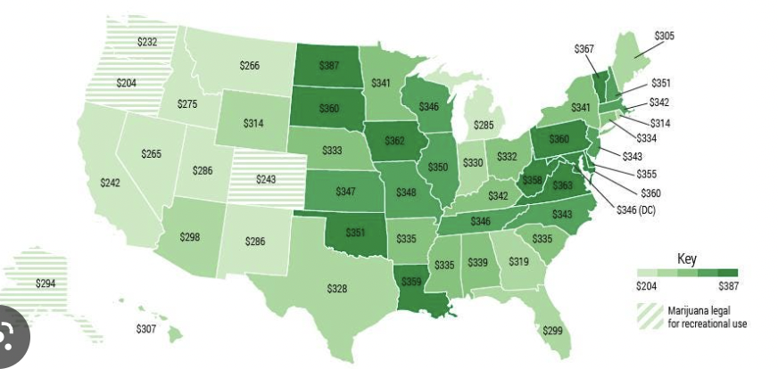
Cost of Weed Per State
References: https://www.forbes.com/sites/frankbi/2015/05/12/the-most-and-least-expensive-states-to-buy-marijuana/?sh=220c090555ee Accessed January 5, 2023
Notes:
In addition to the widespread availability, especially in Oregon. The cost of weed per ounce in Oregon is the cheapest compared to any other state in the US.
DO NOT READ:
In 2018, tax revenue from cannabis sales in Oregon were 94.4M, in Washington $319M, in California $300M and in Colorado it was $266.6M

Slide 7
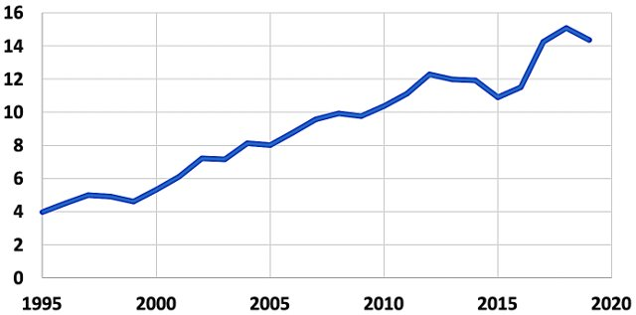
Potency of THC
3 FOLD
INCREASE
% THC​
Year
Reference: Potency Monitoring Program, Quaterly Report #146, drugabuse.gov​
Notes:
- Along with increasing daily use, we also know that contemporary cannabis products and edibles all have higher quantities of THC then when much of the older cannabis research was performed.
- Cannabis potency has increased from about 4% in the 1980s to an average of 15% today which is greater than a 3 fold increased (CLICK)
- Cannabis extracts, used in dabbing and edibles, can contain an average of 50% and up to 90% THC

Slide 8
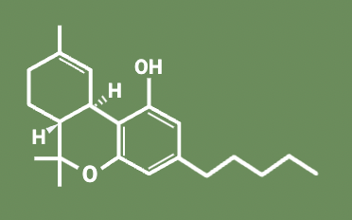
What is Cannabis?
Cannabis sativa plant​
Contains over 600 chemicals
Delta-9-tetrahydrocannabinol (THC): main psychoactive component​
Small and highly lipophilic​
Rapidly distributed to the brain and fat​
Metabolized by the liver​
Half-life is 20-36hrs to 4-6 days​
Can be detectable up to ~30 days
Notes:
- Cannabis or Marijuana refers to the dried flowers of the Cannabis sativa plant, which contains pharmacologically active compounds that interact with endogenous cannabinoid receptors in the human body
- The medicinal and psychoactive properties of cannabis are mediated by compounds called cannabinoids, the cannabis plant contains over 600 chemicals
- THC, the main psychoactive component, is a small and highly lipophilic molecule that is distributed rapidly to the brain and fat.
​
​
​
​

Slide 9
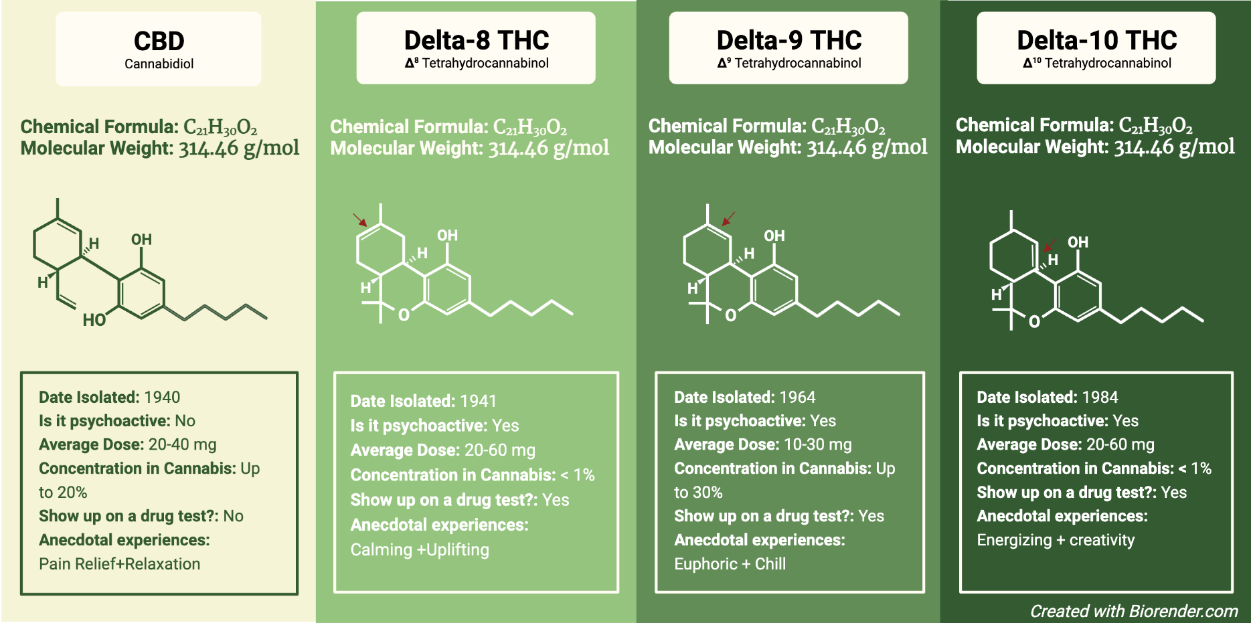
Delta-8, Delta-9, Delta-10 THC
Notes:
So when we think of cannabis, we typically think of delta 9-THC. However there are 2 additional forms of THC called Delta 8 and delta 10, which are molecularly different based on the location of the double bonded carbon chain.
While lawmakers have specified that hemp is only federally legal if it contains no more than 0.3 percent delta-9 THC, the most commonly known and naturally occurring cannabinoid, there’s generally a lack of rules governing delta-8 THC and delta-10 THC, which can be synthesized using CBD from legal hemp.
Delta 8 THC can currently be purchased online and is sold in stores--- delta 8 is has not been evaluated or approved by the FDA. Often times, this product is labeled as a hemp product. Delta-8 THC has psychoactive and intoxicating effects, similar to delta-9 THC
Little research has been done on delta 10, while some studies indicated that it may have psychoative effects, they appear less potent than delta 9 or delta 8. However, similarly it is not regulated by the FDA.

Slide 10
Forms of Cannabis
Inhaled ​
Smoking, vaporizing, dabbing​
Quickest method, less chance of overconsumption​
Oral or gastrointestinal (GI) absorption​
Oral: Drops, tinctures, sprays, lollipops, strips​
GI: Edibles, candies, drinks, snacks, capsules​
Delay in onset of symptoms​
Higher likelihood of overconsumption​
​
Skin absorption​
Topicals: Balms, lotions, salves, bath soaks​
Transdermals: Patches and gels​
Suppositories​
Oils and waxes that can be used rectally or vaginally​
Vaginal suppositories have similar onset times to oral absorption​
Rectal suppositories not as readily absorbed, less psychoactive​
Method | Onset (min) | Duration (hrs)
Inhaled | 1-3 | 1-3
Oral | 10-25 | 1-3
Ingested | 30-90 | 6-8
Topical | 15-30 | 3-6
Transdermal | 15-30 | 6-8
Vaginal sup. | 20 | 3-6
References: Cannabis Clinicians Colorado 2016​
Notes:
Inhaled cannabis (CLICK) is the quickest method for THC to enter systemically and includes smoking, vaporizing and dabbing.
Smoking provides a rapid onset (1-3 min) and short duration (1-3 hrs) of symptoms, which results in a lesser chance of overconsumption.
Oral absorption (CLICK) includes drops, tinctures, sprays, lollipops, or breath strips and can take approximately 20 minutes before symptoms occur and can last 1 to 3 hours.
In contrast, GI absorption includes edibles, candies, drinks, snacks and capsules that require digestion before an effect is felt, which can range from 30 to 90 minutes after consumption, lasting 6 to 8 hours. Because of the delay in onset of symptoms, these methods lend to a higher likelihood of overconsumption.
Edibles are very popular, especially in pregnancy, because they are palatable, discreet and effects can for last hours.
There are other methods such as skin absorption (CLICK) through topicals and transdermals.
Topicals are non-psychoactive and include balms, salves, and lotions, which do not enter the bloodstream and thus do not result in a positive urine drug screen . Patches used are time-released, measured doses of which, some can be cut into smaller pieces if a lower dose is desired.
Additionally, there are suppositories (CLICK) made from oils and waxes that can be applied rectally or vaginally.
Vaginal suppositories have similar onset times to oral absorption, but rectal suppositories are not as readily absorbed into the bloodstream and thus are less psychoactive

Slide 11
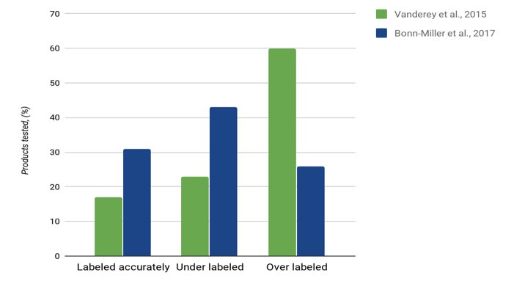
Accuracy of Labeling
THC PRESENT
IN 1 OUT OF 5
CBD-ONLY PRODUCTS
References: Vanderey et al. 2015, Bonn-Miller et al. 2017​
Notes:
We are briefly going to talk about accuracy of CBD and THC labeling.
It is important to highlight that CBD is not regulated by the FDA. And therefore there are no rules regarding quality standards or requiring accurate labels
This slide is a visual representation of two studies published in the journal JAMA that purchased edibles from internet dispensaries and compared the amount of THC and CBD obtained through testing to the amount listed on the label.
As you can see, only 17% in one study and 31% in the other were accurately labeled, with 23% and 43% of samples respectively under labelled. Meaning… they contained more CBD or THC than advertised. ​
Additionally, THC was present in 21.4% of the products labeled CBD only (CLICK).
So… it’s important to note that while one might think they are using CBD only products, they may in fact be ingesting THC as well. ​
As the majority of current research is focused on THC, for the remainder of this talk when we refer to cannabis use, we are referring to THC use.

Slide 12
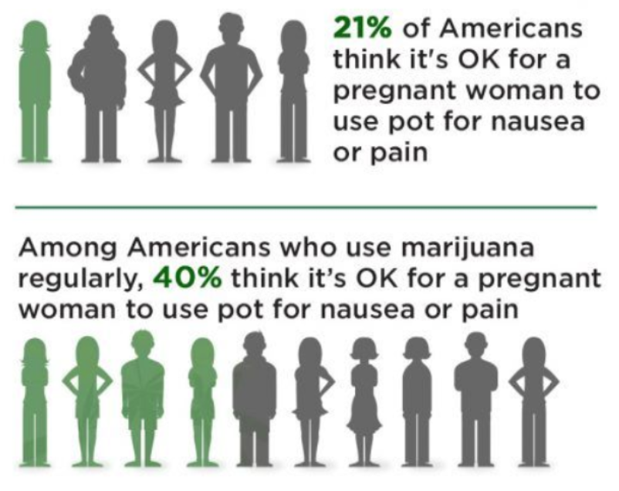
Perceived Safety
References: Yahoo Survey (2017)
Notes:
Due to legalization, there is a perceived safety from patients which has led to increased use of cannabis.
- A contributor to the increased incidence of prenatal cannabis use is an increasing perception of safety. This is demonstrated by Yahoo survey of the American population, which found that (CLICK) 21% of Americans felt it is ok for pregnant people to use cannabis for nausea or pain. Amongst Americans who use cannabis, (CLICK) 40% felt it was acceptable for patient people to use cannabis for nausea or pain in pregnancy.​
- Some of this perception of safety may come from the expanding legalization, and some may come from an interpretation of the literature in which perinatal outcome data are limited and heterogeneous. ​

Slide 13
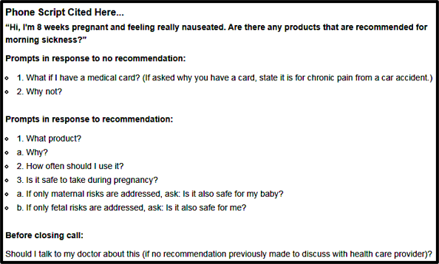
Where Do Our Patients Get Information?
Statewide cross-sectional study of dispensaries in Colorado (n=400)
Mystery shopper study, caller was 8 weeks pregnant with nausea
Nearly 70% had a product recommendation, predominantly edibles
65% based recommendations on personal opinion
32% recommended discussing with OB provider without prompting
Notes:
So how do our patients get accurate information?
Of the sources that patients and people turn to, getting information from cannabis dispensaries is one resource.
This study took a mystery caller approach in which 400 dispensaries were contacted by a '8 week pregnant person with nausea'. Of the dispensaries contacted, 37 percent were licensed for medical sales, 28 percent for retail sales and 35 percent for both.
- The majority, 69 percent (277 out of the 400), recommended treatment of morning sickness with cannabis products.
- Frequency of recommendations differed by license type (medical 83 percent, retail 60 percent, both 61 percent.)
- The majority (65 percent) based their recommendation for cannabis use during pregnancy on “personal opinion” according to the study. Only 32% recommended discussing cannabis use with an OB provider without prompting.

Slide 14
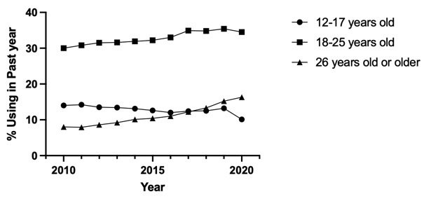
Trends in Cannabis Use
34.5%
18-25 years old
29.8%
16.3%
26 years old or older
12-17 years old
7%
Reference: National Survey on Drug Use and Health 2020
Reference: The National Survey on Drug Use and Health 2020
Notes:
This graph highlights the trend of cannabis use. the recent National Survey on Drug Use and Health data from 2020, cannabis use is highest in young adults aged 18 to 25 and the most dramatic rise in use is in adults over 26

Slide 15
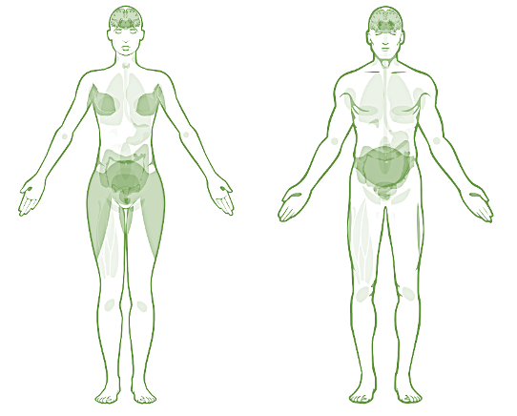
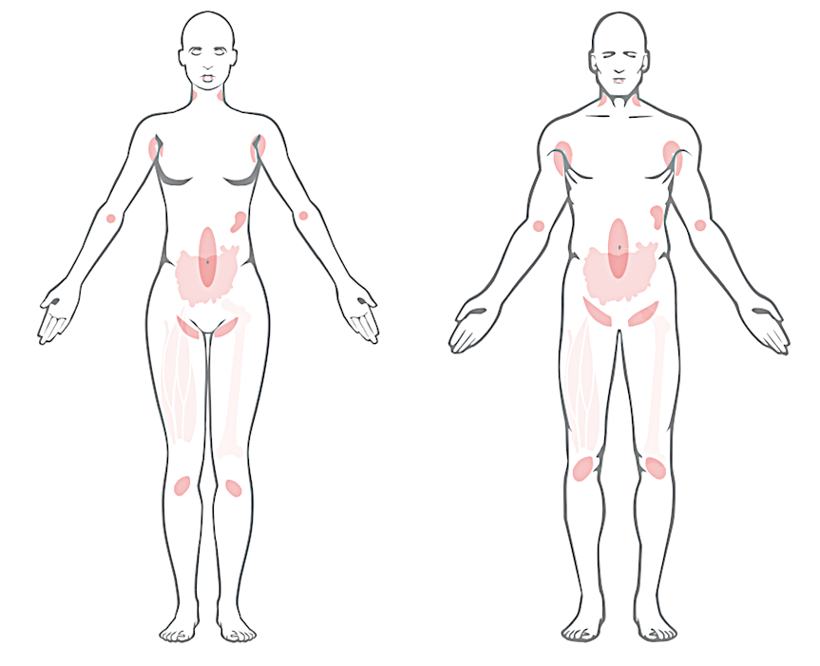
Cannabinoid Receptor Expression
CB1
Widely distributed expression; enhanced expression in CNS, PNS, endocrine tissues, adipocytes
CB2
Enhanced expression in lymphoid tissues and immune-derived cells, intestinal tissues
breasts
placenta, endometrium, fallopian tubes
testis
epididymis,
prostate,
seminal vesicles
References: Human Protein Atlas (https://www.proteinatlas.org/ENSG00000118432-CNR1/tissue)
Notes:
These cannabinoids mediate the medicinal and psychoactive properties of cannabis by binding to endogenous receptors in the endocannabinoid system (ECS), which is a widespread neuromodulatory system.
The figure on left shows the distribution of the CB1 cannabinoid receptor (in green) which is expressed throughout the body and most abundant in endocrine tissues, the nervous system, musculature, and adipocytes.
The figure on the right shows the distribution of CB2 (in blue) – which is more enhanced in immune related cells and the gastrointestinal system.
As shown here, these receptors are expressed in the male and female reproductive tract, the placenta, and major fetal organs, suggesting that the endocannabinoid system plays a role in regulating reproduction and development.

Slide 16
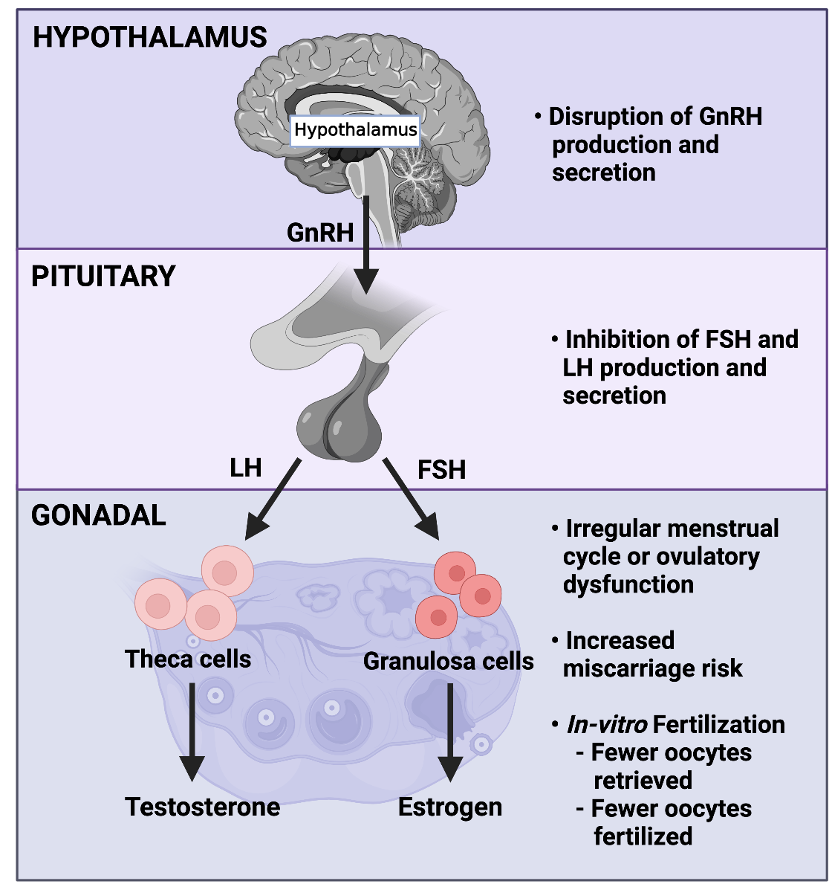
Cannabis Use Prior to Conception
Prior human studies are limited by:
  Self-report
  Small sample size
  Recruited from those undergoing assisted reproductive technology
Reference: Nassan et al. 2019; Wise et al. 2018; Klonoff-Cohen et al. 2006; Asch et al. 1980
Notes:
First, I would like to quickly review the existing literature on this subject which is heterogenous due to confounders and a small sample size.
Overall, published findings largely support possible disruption to gonadotropin releasing hormone, follicle stimulating hormone and luteinizing hormone production and secretion, impact on ovulation resulting in ovulatory dysfunction and anovulation, increased miscarriage risk and time to conception, and an impact on in-vitro fertilization success, including fewer oocytes retrieved and fertilized

Slide 17
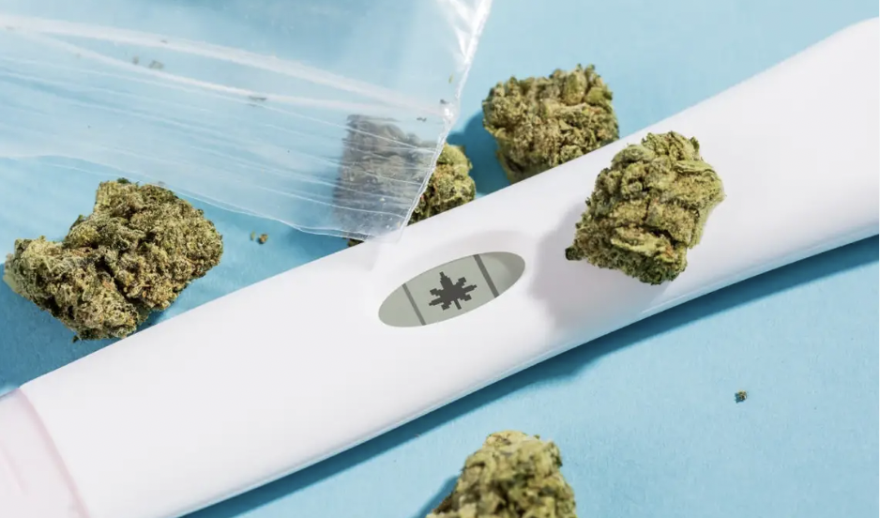
Take Home Points
For most couples, cannabis use likely will not affect their ability to conceive but for couples with subfertility or infertility, it could be a contributing factor
Impact the body’s natural hormone cycles
Increase the risk for miscarriage
Exacerbate existing infertility factors
https:Insider.com
Notes:
In summary, for most couples, cannabis use by either partner will likely not significantly affect time to pregnancy However, for couples with infertility, the changes in ovulatory function and sperm count associated with smoking marijuana could compound their difficulty with conceiving
THC can negatively impact existing infertility issues because of the cannabis can impact the body’s biophysical communication processes. The endocannabinoid system influences almost every aspect of the female reproductive system, from hormone levels and ovulation to tubal transport and the implantation of fertilized eggs into the uterine lining.
The literature suggests that THC can impact female hormone cycles, increase the risk for miscarriage, and exacerbate existing infertility factors.

Slide 18
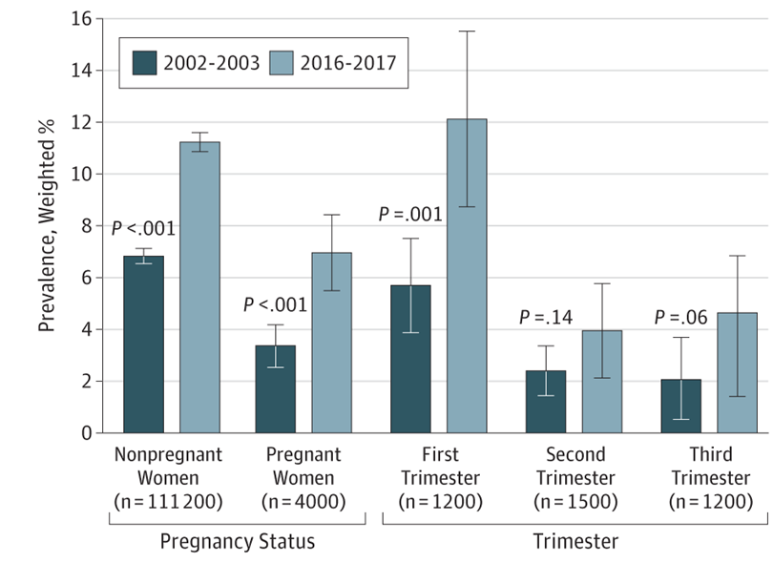
Prenatal Use in Pregnancy
Prevalence of past-month cannabis use
​Self-reported prevalence of use in pregnancy ranges from 2-5% to 30%​
Frequency of use in the year before and during pregnancy has increased from 2009 to 2017, daily use increasing most rapidly​
References: ACOG 2015; Martin et al. 2015; El Marroun et al. 2011; van Gelder et al. 2010; Passey et al. 2014; Beatty et al. 2012; Ko et al. 2014; Volkow et al. 2017; Jarlensk et al.i 2017; Brown et al. 2016; Brown et al. 2017; Young-wolff et al. 2019; Young-Wolff et al JAMA 2017 https://www.everydayhealth.com/pregnancy/marijuana-use-morning-sickness-symptoms/; Rodriguez et al. BJOG 2019, ​
Notes:
- The incidence of cannabis use in pregnancy is on the rise. In the literature, the self-reported prevalence in pregnancy ranges from 2 to 30% amongst different populations
The figure on the right is from a study looking at the prevalence of prenatal cannabis use. The dark blue column reflects prevalence of use in 2002-2003 and the light blue reflects use more than a decade later. As you can see, rates of cannabis use in pregnancy and by trimester are higher now than 20 years ago.
With the recent changes in cannabis legalization, there has been an increased prevalence of use in pregnancy in part due to increased availability and perceived safety.
Most commonly it is used in pregnancy to treat nausea, sleep, stress and pain
The self-reported prevalence in pregnancy ranges typically from 2-5% but can be up to 30% in certain populations
the figure on the right highlights the increasing rates of cannabis use in pregnancy, especially when compared to 20 years ago.
Additionally, COVID has affected people in several ways, such as more people seeking strategies to combat stress including increased cannabis use. During the pandemic, the incidence of cannabis use in pregnancy has gone up 25%

Slide 19
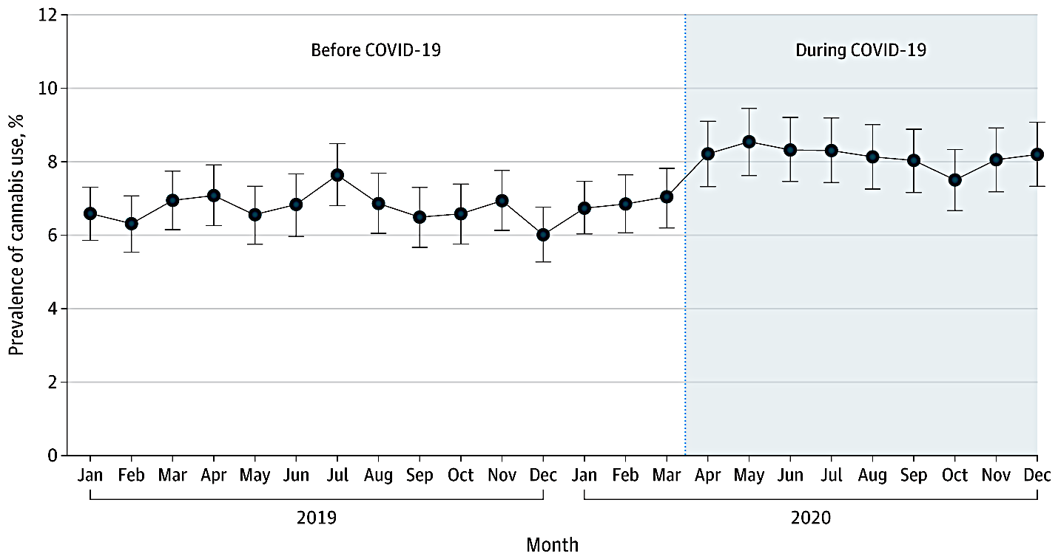
Rates of Prenatal Cannabis Use Pre- and Post-COVID 19
Reference: Young-wolff et al. JAMA 2021
Notes:
Additionally, COVID has affected this country in various ways, often people have sought strategies to combat stress and social constraints.
Within California,cannabis retailers were considered an essential business and remained open during the pandemic and even had record sales in 2020.
Within the Kaiser Northern California Hospital system, they looked at rates of prenatal cannabis use prior to and during the COVID-19 pandemic.
Before the pandemic (CLICK), the standardized rate of prenatal cannabis use was 6.75% of pregnancies and that rate increased to (CLICK) 8.14% of pregnancies during the pandemic.
This suggests that prenatal cannabis use has increased by 25% during the pandemic vs. during the 15 months before the pandemic.

Slide 20
Perceived Benefits
Survey respondents – WIC mothers | Ever use % (n) | Current use % (n) | Past use % (n)
To help with depression/anxiety/stress | 35% (164) | 63% (60) | 28% (103)
To help with pain | 29% (135) | 60% (57) | 21% (78)
To help with nausea/vomiting | 23% (108) | 48% (46) | 17% (62)
For fun/recreation | 59% (277) | 39% (37) | 65% (240)
Other reason | 16% (75) | 14% (13) | 16% (58)
References: Albanese et al. Monitoring Health Concerns Related to Marijuana in Colorado, 2014​
Notes:
- In part, the rising prevalence of use in pregnancy is due to the perceived benefits. Because cannabis is derived from the cannabis plant, it is often perceived as natural and safe.
- Above are a list of the reported and perceived benefits people report in pregnancy, namely it is used to manage some of the most common symptoms in pregnancy.
- A prior study found that 96% of pregnant people who used cannabis were self medicating for pregnancy induced nausea
- A lot of patients have reported uncertainty regarding the specific health risks, including a lack of information about explicit harms to the fetus, especially when compared to the known risks of substances including tobacco, alcohol and other recreational drugs. This has led people to believe tobacco or alcohol could be more dangerous in pregnancy than cannabis.

Slide 21
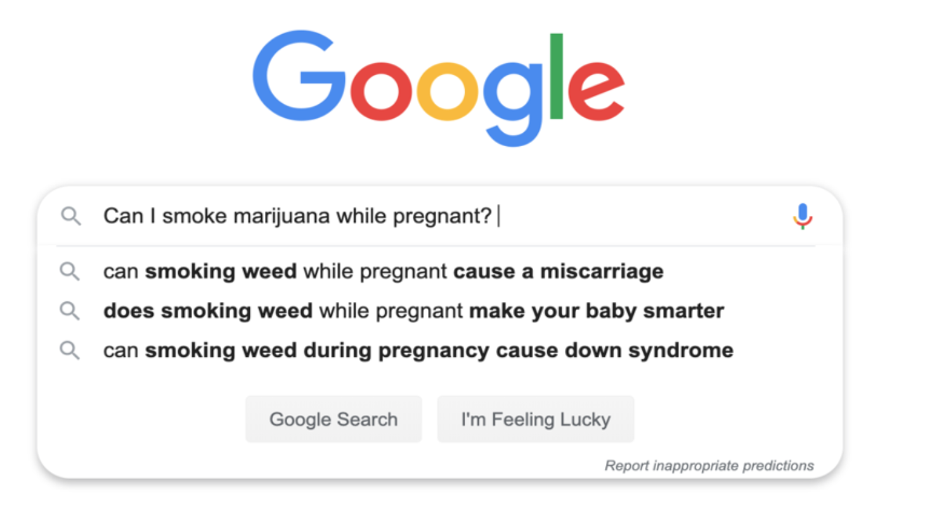
Where Do Patients Get Their Information?
Limited health care counseling
Internet searches
Parenting blogs, online groups
Dispensaries
Notes:
Prior studies have demonstrated insufficient counseling in obstetric visits. One study examined 468 audio recorded first obstetric encounters in which approximately 19% disclosed cannabis use, within these only in half did a healthcare provider respond to cannabis use disclosures or offer counseling. When counseling was offered it consisted of general statements without specific information or risks or outcomes.
So if our patients don't feel like they are getting adequate information at their obstetric visits, where else are they looking?
To the right is an image after performing a google search. Often people look to internet searches to provide them information. These internet searches include parenting blogs and online groups including those on facebook. In addition to the internet, some have turned to calling dispensaries for information to avoid stigma that may come when asking their healthcare providers.

Slide 22
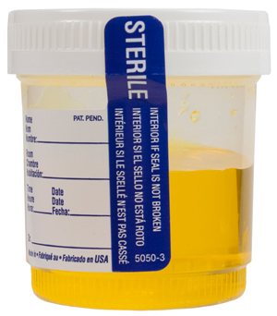
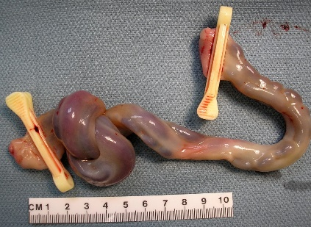
Methods for Testing in Pregnancy
Maternal
  Serum (2-3 days)
  Urine (2-3 days for occasional and weeks in chronic user)
  Hair (Up to 90 days)
Neonatal
  Umbilical Cord Homogenate
    Send out lab
    Easier to collect than meconium
  Meconium
    Identifies maternal cannabis use >24w
Reference: Colorado.gov; Colby et al. Clin Biochem 2017; Scroggin et al. MSACL 2018; ARUP Laboratories
Notes:
Because there are many different vehicles of marijuana used, I want to take a moment to talk about the methods for marijuana testing in pregnancy. This is because testing can be affected by BMI, frequency of use, when marijuana was last used, and the delivery vehicle of marijuana used.
In regards to the maternal methods for testing, these include include serum (which can detect use in the past 2-3 days), urine (which detects occasional use in the last 2-3 days or the past few weeks in the chronic user) and hair (which detects use up to 90 days prior).
Neonatal methods for testing include umbilical cord homogenate and meconium.
Umbilical cord homogenate is a send out lab and is easier to collect than meconium. Of note, THC deposits evenly across the length of the cord so it doesn’t matter which segment of cord is sent.
It is important to know that meconium may be more sensitive than cord homogenate testing, but it is only available after 24 weeks gestation, is usually passed within 48hrs of birth, and often requires coordinated effort for collection.

Slide 23

Limitations of the Urine Drug Screen
Are often immunoassays that detect the major urinary metabolite of THC (11-nor-delta-9-tetrahydrocannabinol-9-carboxylic acid)
Prone to false positives
  NSAIDs and PPIs have been reported to cause false positives on drug screens
  If a false positive or negative is suspected, confirmatory testing is with gas chromatography-mass spectrometry or liquid chromatography-tandem mass spectrometry
Synthetic or designer cannabinoids are not detected by urine drug screens
Reference: Chocron et al. BMJ 2019; Wu et al. BMJ 2019
Notes:
Of note, there are limitations to urine drug screening for marijuana. These tests are often immunoassays that detect the major urinary metabolite of THC.
As such, this test is prone to false positives that might lead to the incorrect diagnosis or a delay in the right diagnosis.
It is important to also know that in the past, NSAIDs and PPIs have been reported to cause false positives on drug screens.
If a false positive or negative is suspected, confirmatory testing is with gas chromatography mass spectrometry or liquid chromatography-tandem mass spectrometry
Additionally, synthetic or designer cannabinoids are not detected by urine drug screens

Slide 24
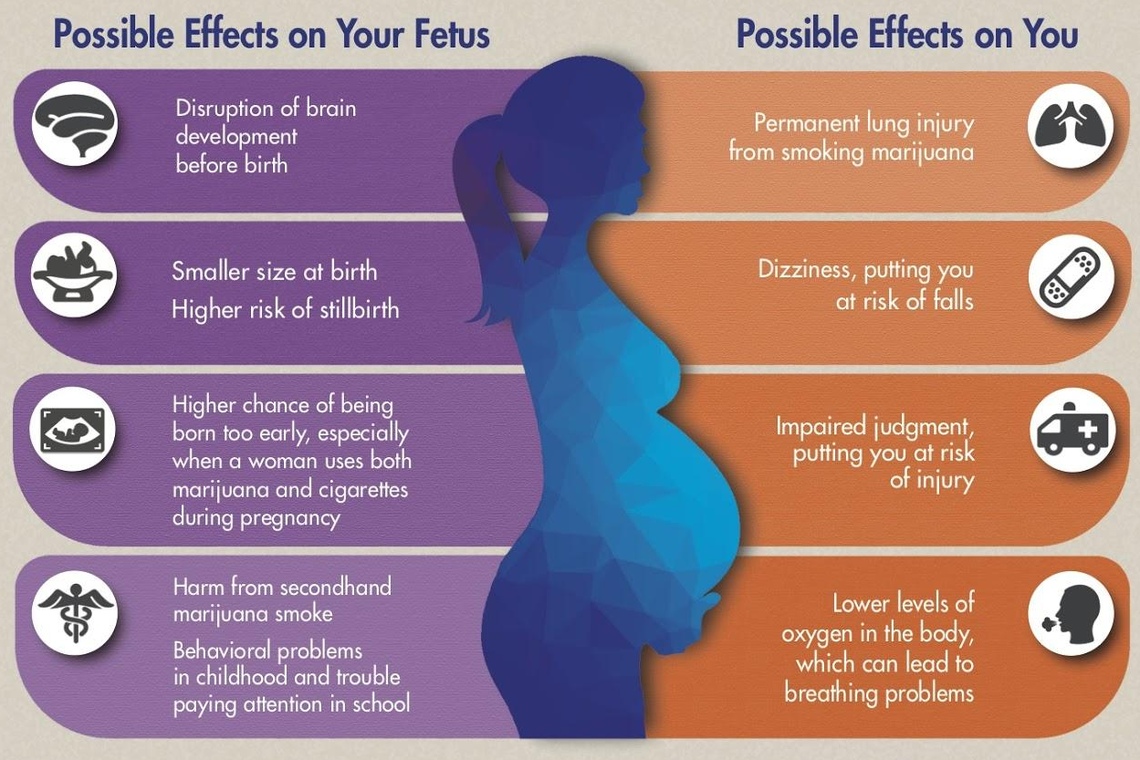
Outcomes of Prenatal Cannabis Exposure
Maternal​
Increased risk of anemia​
Increased cyclic vomiting and/or hyperemesis syndrome​
Fetal/Neonatal​
Fetal growth restriction and lower birth weight​
Preterm birth​
Stillbirth and miscarriage​
Increased NICU admissions​
Altered neurodevelopment​​
ACOG; Hayer et al., 2023; Lo et al., 2023
Notes:
Kim: Let's transition to talk about how to counsel our patients regarding the impact of cannabis on pregnancy. ACOG recently published provider references for MJ use in pregnancy, including this infographic which summarizes the available data on MJ use in pregnancy. ​
- Maternal outcomes that have been reported include increased risk of anemia, decreased oxygenation, and also cyclic vomiting and/or hyperemesis syndrome. ​
- The main fetal and neonatal outcomes that ACOG highlights are:
Fetal growth restriction and small for gestational age ​
Preterm labor and preterm birth​
Stillbirth and miscarriage​
Increased NICU admissions​
Altered neurodevelopment​
- Ultimately, to date, no amount of cannabis has been proven safe to use during pregnancy.

Slide 25
Cannabinoid Hyperemesis Syndrome
Refractory cyclic nausea/vomiting with abdominal pain in regular users
Retrospective study (n=1,571), 6% of patients presenting to ER with recurrent emesis had CHS
Unclear etiology
Compulsively take hot showers/baths for relief
Long term therapy is cannabis cessation
  Complete and permanent resolution ≤2 weeks weaning
Symptom | Incidence
Severe cyclic nausea and vomiting over months | 100%
Abdominal pain | 85.1%
≥ weekly cannabis use | 97.4%
Regular cannabis use >1 yr | 74.8%
Compulsive hot showers or baths for relief | 92.3%
Age <50yo at time of evaluation | 100%
Reference: Chocron et al. BMJ 2019; Wu et al. BMJ 2019; Sorensen et al.J Med Toxicol 2017
Notes:
Kim: As I highlighted in the prior slide, chronic cannabis use can be associated with increased hyperemesis. A condition that can be confusing in pregnancy and difficult to diagnosis is Cannabinoid Hyperemesis Syndrome.
This was first described in 2004. It is paradoxical cyclic vomiting that occurs in patients with a history of chronic cannabis use. The classic presentation is severe nausea, intractable vomiting, abdominal pain, and abnormal bathing behaviors aka compulsive hot showers or baths for relief. Additional symptoms include agitation, diaphoresis, tachycardia, postural hypotension, subjective fevers/chills, and weight loss.
It is also unresponsive to anti-emetics and episodes usually last 24-48 hours at a time, but will recur if cannabis use is continued
The etiology behind this syndrome is unclear. There have been various hypotheses, but none have been been validated.
One interesting feature of cannabinoid hyperemesis syndrome is that patients engage in compulsive bathing, often seen as showering in hot water for hours at a time and multiple times per day appears to provide symptomatic relief
The long term treatment is cessation from cannabis use – when this occurs, within 2 weeks patients will have complete and permanent resolution of symptoms

Slide 26

Prenatal Cannabis Use and Offspring Outcomes
Infancy​
Decreased ability to self-soothe​
Sleep disturbances ​
Childhood​
Poorer memory, verbal reasoning skills​
Less attentive, more impulsive and hyperactive​
Symptoms of depression, anxiety
Adolescence​
Continued hyperactivity, impulsivity, inattention​
Reduced school performance​
More likely to try & use cannabis earlier​
​
​
References: Thompson et al. Obstetrical & Gynecological Survey 2019; https://resources.beststart.org/wp-content/uploads/2019/01/A30-E.pdf, Huizink et al. 2014, Day et al 1994., Fried et al. 1995​
Notes:
The current available literature does support an association between prenatal cannabis exposure and a number of adverse childhood health outcomes.
This includes potential childhood outcomes ​such as decreased memory and verbal reasoning skills; children who are less attentive, more impulsive and hyperactive; and increased symptoms of depression and anxiety
In adolescence, the increased inattention, hyperactivity and impulsivity remains in addition to decreased school performance.
Ultimately, to date, no amount of cannabis has been proven safe to use during pregnancy.

Slide 27
Offspring Vulnerability to Drug Addiction
The endocannabinoid system regulates dynamic changes in the mesolimbic dopamine pathway and reward-associated behaviors
Cannabis exposure in the prenatal and postnatal period can potentially disrupt normal development and increase vulnerability to drug addiction
Post-mortem human second trimester fetal brains prenatally exposed to marijuana had decreased dopamine receptors, especially males, and was dose-dependent
Animal studies noted that offspring prenatally exposed to THC have enhanced heroin-seeking profiles
References: Hurd et al. J Neurosci 2019; Hurd et al. Neurotoxicol Teratol 2005; Spano et al. Biol Psychiatry 2007; Tortoriello et al. EMBO 2014
Notes:
Aside from impacts to offspring neurodevelopment, prenatal marijuana exposure can also affect offspring vulnerability to drug addiction.
The endocannabinoid system regulates dynamic changes in the mesolimbic dopamine pathway and reward-associated behaviors
Thus, cannabis exposure in the prenatal and postnatal period can potentially disrupt normal development and increase vulnerability to drug addiction
A prior study of post-mortem human second trimester fetal brains from elective terminations performed between 17-22 weeks was notable for decreased dopamine receptors in marijuana exposed fetuses, especially males, that was dose-dependent
In adult rat offspring that were prenatally exposed to THC, a prior study found that there was enhanced heroin-seeking profiles and there was altered expression of CB1, dopamine, and glutamate receptor genes in the striatum of the brain

Slide 28
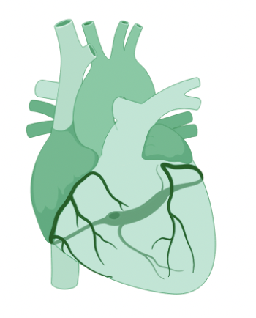
Prenatal cannabis exposure can adversely impact the offspring cardiac system
In human studies, continued maternal cannabis use in pregnancy
was associated with fetuses with smaller aortic diameters
Fetal cardiac anomalies (e.g., VSD, Ebstein anomaly) have been previously reported
In animal studies , maternal THC use was associated with fetal myocardial hyperplasia, valve thickening, ventricular septal defect, decreased heart-to-body weight ratio at birth, and impaired cardiac function early in life.
References Lee et al. 2021 Scientific Reports; Robinson et al. 2022 Cannabis and Cannabinoid Research; El Marroun et al. 2010 Early Hum Dev; van Gelder et al. 2010 Drug Alcohol Depend. ; Williams et al. 2004 Birth Defects Research; Downing et al. 2009 Cardiology in the Young
Notes:
Some human and preclinical studies have reported an association between maternal cannabis use during pregnancy and offspring cardiac outcomes
In a prior human study, continued maternal cannabis use was notable for fetuses with smaller aortic diameters on ultrasound
Cardiac anomalies have been inconsistently linked to prenatal cannabis exposure, but include ventricular septal defect and Ebstein’s anomaly
In a mouse model, in utero THC exposure was associated with fetal myocardial wall and valve thickening, and decreased left ventricular fraction.
Similarly, In rats a decreased heart-to-body weight ratio was observed at birth with signs of impaired cardiac function early in life such as increase wall thickness and decreased cardiac output.

Slide 29
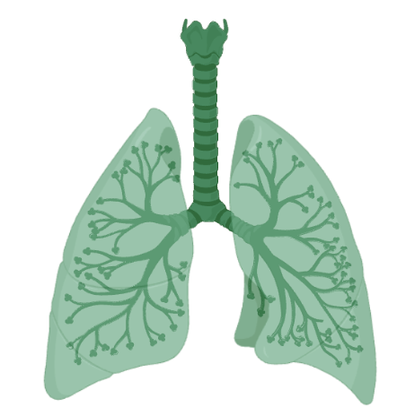
Limited data on in utero cannabis use and offspring respiratory health
CB1 receptor expression are present on airway epithelial cells, alveolar type II cells, parenchymal cells and vascular cells
THC can inhibit lung angiogenesis
Prenatal cannabis use is linked to increased M2 macrophage polarization and levels of childhood secretory immunoglobulin A
Decreased lung volume
References: Molnar et al. 2018 Neurotoxicol Teratol; Krasteva et al. 2010 Biotechnology and Biotechnological Equipment; Kicman et al. 2021 Eur J Pharmacol; Turcotte et al. 2016 Front Pharmacol; Wenzel et al. 2013 PNAS; Staiano et al. 2016 J Leukoc Biol; Ramer et al. 2014 Biochem Pharmacol
Notes:
In lung, CB1 receptor expression has been reported in airway epithelial cells, alveolar type II cells, parenchymal cells, and vascular cells.
Prenatal THC exposure has also been reported to inhibit lung angiogenesis, which could affect alveolar and capillary development, and gas exchange in lung.
Prior studies also suggest that THC can increase M2 macrophage polarization and prenatal THC exposure has been linked to increased levels of childhood Secretory Immunoglobulin A, which can be implicated in chronic airway diseases like asthma

Slide 30
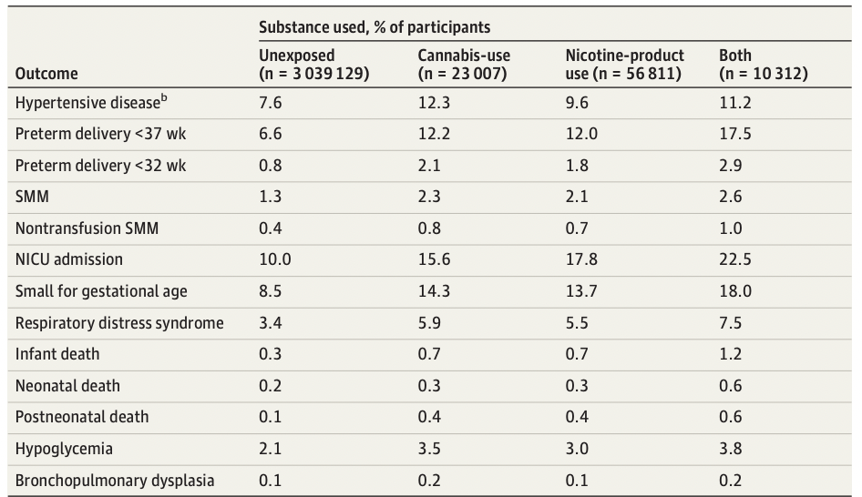
Cannabis and Nicotine-product Co-Use
Co-use of nicotine and cannabis vs. none is associated with a 4-fold increased risk in infant death, and nearly a 2-fold increased risk vs. use of nicotine or cannabis alone
Reference: Crosland et al. JAMA Network Open 2024

Slide 31
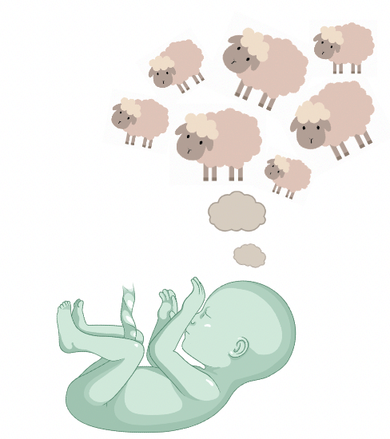
In utero cannabis exposure impacts circadian regulation and offspring sleep
Endocannabinoid system plays a role in circadian regulation
Sher et al. (1988) Maternal Health Practices and Child Development (HPCD)
  Neonatal EEG analysis (n=55 newborns) noted prenatal cannabis exposure was associated with increased motility and disruptions in sleep and arousal
  At 3 years of age (n=48) findings persisted with increased nocturnal arousal, more awake time after sleep onset and lower sleep efficiency
Winiger et al. (2020) ABCD study, 11,875 children ages 9-10 yo
  Prenatal cannabis exposure was associated with symptoms of disorders of initiating and maintaining sleep, disorders of arousal, and sleep wake
  Frequency of prenatal cannabis use was associated with disorders of somnolence (p=0.03)
References: Scher et al. 1988 Pediatr Res; Dahl et al. 1995 Arch Pediatr Adolesc Med; Winiger et al. 2020 Sleep health
Notes:
The endocannabinoid system plays a role in circadian regulation and studies have shown that in utero exposure to cannabis can impact this.
Results from the Maternal Heatlh Practices and Child Development study performed EEG analysis on 55 neonates and found that prenatal cannabis exposure was associated with increased motility and disruptions in sleep and arousal that persisted at 3 years of age (n=48), including increased nocturnal arousal and more awake time after sleep onset and lower sleep efficiency
The more recent adolescent brain cognitive development or ABCD study of 11,875 children ages 9-10yo, prenatally cannabis exposure was associated with symptoms of disorders of initiating and maintaining sleep, disorders of arousal, and sleep wake disorders. Frequency of prenatal daily cannabis use was also found to be significantly associated with disorders of somnolence (p=0.03)
Sleep Disturbances
Studies into the role of the ECS in sleep, as well as the potential for cannabis to alleviate symptoms of sleep disorders have suggested a role for the ECS in circadian regulation (108, 109). In the Maternal Health Practices and Child Development MHPCD cohort, neonatal electroencephalogram (EEG) analysis found that prenatal exposure to cannabis was associated with increased motility and disruptions in sleep and arousal (110). These disturbances persisted at 3 years of age, with exposed children exhibiting increased nocturnal arousal, more awake time after sleep onset, and lower sleep efficiency (111). However, these studies included a relatively small sample size, with 55 newborns initially assessed and 48 children assessed at 3 years of age, including non-exposed controls. More recently, child sleep outcomes were assessed in the ABCD cohort using 11,875 exposed children ages 9–10 (112). This study also controlled for multiple covariates, including mother's education, household income, parental marital status, race, and child sex. The investigators found that maternal report of cannabis use was significantly associated with symptoms of disorders of initiating and maintaining sleep, disorders of arousal, sleep wake disorders, disorders of excessive somnolence, and a summed sleep disorder score as measured by the Sleep Disturbance Scale for Children (SDSC) (112). Furthermore, children of mothers who reported daily use of cannabis during pregnancy were at increased risk of symptoms of disorders of excessive somnolence. These findings are highly suggestive of a long-lasting impact of in utero exposure to cannabis on circadian regulation, though further cross-study replication of these findings is needed. Additionally, there is a paucity of animal studies to address these effects and their possible neurophysiological mechanisms. Therefore, a causal link remains elusive and requires more controlled investigation.
For this purpose, they used data from the Adolescent Brain Cognitive Development Study (ABCD Study). They analyzed sleep outcomes in relation to prenatal maternal cannabis use in 11,875 children ages nine to 10.
Part of the ABCD Study included an extensive questionnaire. Mothers were asked questions about marijuana use during pregnancy, how much they used, and how frequently. Additionally, mothers completed a survey about their children’s sleep patterns.
A staggering number of about 700 women reported they used marijuana when pregnant. Regarding frequency, 184 subjects used took cannabis daily, and 262 women used marijuana at least twice a day.
To get more accurate results, scientists also took into account other parameters such as education, marital status, race, and income. Even when they assessed all these factors, a certain pattern emerged.
Results showed that any kind of prenatal cannabis use was significantly associated with symptoms of disorders of initiating and maintaining sleep. Cannabis use also contributed to sleep-wake disorders, disorders of excessive somnolence (sleepiness, drowsiness). Women who used marijuana frequently were more likely to report somnolence in children. Their kids experienced difficulties waking up in the morning and were excessively tired during the day.
More precisely, children whose mothers used cannabis during pregnancy experienced sleep-related difficulties for as much as a decade. The study confirms that marijuana use in pregnancy has a long-term impact on the baby and affects their sleep pattern. Scientists recommend abstinence from marijuana use throughout pregnancy. Cannabis use rehab centers in North Texas, like Stonegate Center, could be the best solution for marijuana users who feel like they wouldn’t be able to stop using cannabis on their own.
The consequences of marijuana use during pregnancy go beyond impaired sleep cycle in children. Keep in mind that sufficient sleep is vital for proper growth, development, and general health of children.

Slide 32


National Society Recommendations
American College of Obstetrics and Gynecology (2018) ​
Before pregnancy and in early pregnancy, patients should be asked about tobacco, alcohol and other drugs used for nonmedical reasons​
Patients reporting cannabis use should be counseled regarding potential adverse health effects and encouraged to quit
Ob-gyns should not prescribe for medicinal purposes to pregnant or lactating women​
Insufficient evidence for effects on nursing infant​
American Society of Reproductive Medicine
Recommends patients abstain from cannabis use if intending to conceive
Notes:
The American College of Obstetricians and Gynecologists came out with a committee opinion regarding cannabis use in pregnancy in 2017 and advised against using when contemplating pregnancy, during pregnancy and when breastfeeding due to insufficient evidence on its effects
Ultimately the global stance is the recommendation for cessation.
Similarly, the Society of Maternal Fetal Medicine and American Academy of Pediatrics also issued similar recommendations
The American society of reproductive Medicine also recommends patients abstain from cannabis use if intending to conceive.

Slide 33

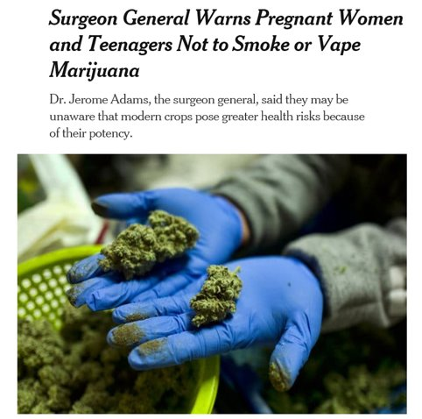
“No amount of marijuana use during pregnancy or adolescence is safe.” ​
Notes:
In August of 2019, the Surgeon General Dr. Jerome Adams issued a public advisory discouraging cannabis use in pregnancy. ​
He emphasized the potential harmful health effects associated with the increasing potency of cannabis and the growing public self-perception of safety.​
- Within the advisory (CLICK) it is stated that “No amount of marijuana use during pregnancy or adolescence is known to be safe.”

Slide 34
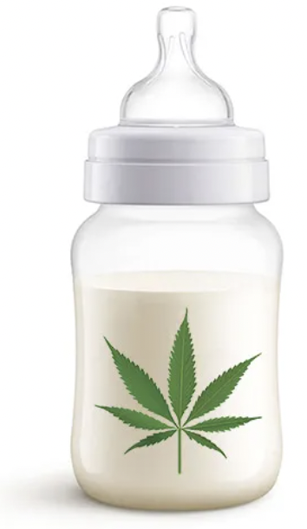
Transfer of Cannabis in Breastmilk
84% of women who used while pregnant continued while breastfeeding​​
About 2.5% of inhaled cannabis is transferred into breastmilk
56% of new parents did not know THC is transferred to breast milk​
Only 30% of patients report receiving postnatal counseling on THC in breast milk​
Exposed infants scored poorly on Psychomotor
Developmental Index​
References: Baker et al., 2018; Astley et al. 1990, Bertrand et al. 2018
Notes:
While prior studies have noted that 84% of people who use while pregnant continue to use while breastfeeding – other people wonder if they stop in pregnancy, would it be safe to restart postpartum while breastfeeding.
In general, the excretion of medications into human milk depends on drug’s chemical factors. For THC specifically it is highly soluble in fat and is small, allowing it to transfer into human milk which has been confirmed by various studies. There is limited information about how the amount transferred is related to the concentration of THC, frequency of use or concentration in the maternal plasma.
Prior studies have noted that exclusively breastfed infants ingest approximately 2-3 % of the maternal dose, although the studies are very limited. Infants that have been exposed to THC through breastfeeding have been associated with worsened scores on postnatal developmental screening.
Patients report that over half did not know THC was transferred into breast milk and only 30% report receiving postnatal counseling on THC in breast milk

Slide 35


Professional Breastfeeding Guidelines
“ACOG recommends that women who are pregnant, planning to get pregnant, or breastfeeding not use marijuana.”
“Limited data reveal that THC does transfer into human milk, and there is no evidence for the safety or harm of marijuana use during lactation.”
“At this time, although the data are not strong enough to recommend not breastfeeding with any marijuana use, we urge caution.”
American Academy of Pediatrics
Notes:
Kim: ACOG, AAP, and ABM all have professional stances on breastfeeding while using THC. All recommend abstaining from use, although the parent be encouraged to breastfeed. In general, if a patient is using THC, the recommendation is that the benefits of continuing to breastfeed are more than not breastfeeding.

Slide 36
Harm Reduction Approaches
“Harm reduction is the idea that since we cannot completely eliminate risk and harm, we should do our best to minimize them.”
National Harm Reduction Coalition & Academy of Perinatal Harm Reduction
Consider substituting form of cannabis used
Avoid synthetic cannabis or cannabis concentrates
If inhalation, use a vaporizer to avoid risk of exposure to pyrolytic compounds
Do not mix cannabis with tobacco
Do not use a cigarette filter when using
References: Lucas et al., 2018; Winstock et al. 2010; Lau et al. 2015
Notes:
So we understand that medical organizations recommend that the safest option to avoid all harm is cessation. However, not all patients are ready to stop use or feel that stopping is the best option for them. This introduces the model of harm reduction. Harm reduction is the idea that since we cannot completely eliminate risk and harm, we should do our best to minimize them. This definition is from the National Harm Reduction Coalition & Academy of Perinatal Harm Reduction.
More specific harm reduction strategies for cannabis use include considering substituting the route of cannabis used. Avoiding synthetic or cannabis concentrates. Changing the mode of inhalation to using a vaporizor. Not mixing cannabis with tobacco or avoiding using a cigarette filter.

Slide 37
How are we doing now?
Holland et al (2016) - Audio-recorded patient health encounters (n=468)
  Evaluated obstetric provider (n=47) response to disclosure of marijuana use during the first prenatal visit
  90/460 (19%) patients reported marijuana use at OB intake
  Half the time provider did not respond to marijuana disclosure
  When discussed, response was:
    Non-specific
    Focused on legal and procedural consequences (i.e. toxicology screens and social services)
    Did not focus largely on health or medical implications
Reference: Holland et al, Obstet Gynecol 2016
Notes:
So with all of this, how are we doing now?
A prior study by Holland in 2016 evaluated responses from 47 obstetric providers to a patient’s disclosure of marijuana use during the first prenatal visit.
A total of 19% of patients reported marijuana use at their prenatal visit and half of providers (48%) did not respond to this disclosure.
Amongst the providers that did respond, the response was non-specific and focused on legal and procedural consequences, such as toxicology screens and social services. There was less of a focus on maternal and offspring health implications

Slide 38

How are we doing?
“…You know how it alters your mind when you have it, how it makes you feel, so think about what it is doing to the baby that is not even formed quite yet. It gets the effects as well. And we don’t want to do that to the baby.”
“Um….the issue with marijuana specifically is just that it is illegal. So at the time of delivery, they will do a urine drug test because you have a history of using it. If it is positive, at the time of delivery, they will often have you, like force you to talk to child protective services because it is a risk factor.”
Reference: Holland et al, Obstet Gynecol 2016, https://weedseedshop.com/en/blog/marijuana-pregnancy-ok-not/
Notes:
Some examples of provider responses include, “…You know how it alters your mind when you have it, how it makes you feel, so think about what it is doing to the baby that is not even formed quite yet. It gets the effects as well. And we don’t want to do that to the baby.”
Another provider was recorded saying: “Um….the issue with marijuana specifically is just that it is illegal. So at the time of delivery, they will do a urine drug test because you have a history of using it. If it is positive, at the time of delivery, they will often have you, like force you to talk to child protective services because it is a risk factor.”

Slide 39

Talking With Pregnant Individuals
No known benefits of cannabis use in pregnancy
THC crosses the placenta and is found in breastmilk and there are known adverse effects associated with cannabis use in pregnancy and with breastfeeding
Cannabis use can be addictive and there are no known “safe” amounts of cannabis in pregnancy
There are other treatments to common ailments in pregnancy (i.e. nausea, anxiety) that have better safety data
Reference: Colorado Departemnt of Public Health & Environment
Notes:
I hope that I have demonstrated that the landscape regarding cannabis use in this country has shifted, and therefore as providers, we must be adaptable in our approach to cannabis use in pregnancy.
Legalization is increasing, which has resulted in expanded access and increased use. Potency is increasing, meaning that much of our understanding of the risks of MJ use is based on outdated data.
The public, especially those who use marijuana, have a tendency to perceive MJ use as safe and non addictive, however MJ is recognized as an addictive substance and the American Psychiatric Association DSM has established MJ substance-use disorder.
Women are using MJ in pregnancy, often because they perceive it as a “safer” choice for managing common symptoms/conditions of pregnancy - however we have data demonstrating that there are adverse effects to MJ use in pregnancy.
We as providers need to recognize that our silence on this issue validates perceived safety and acceptance of MJ use in pregnancy and prevents women from accessing accurate information. We should all feel empowered to ask women about MJ use in pregnancy and provide counseling to patients regarding their use, and make referrals to treatment.
So, in the meantime, what do we tell patients? I have summarized talking points that can be used in discussion with patients. (READ SLIDE)

Slide 40

Bottom Line
Trends show increasing prevalence of cannabis use especially in reproductive age individuals
There is no established safe level of cannabis preconception or in pregnancy, but the evidence suggests potential harm
Patients get information from dispensaries and online.
There is space for more research and more effective strategies for harm reduction
Notes:
So let's review the bottoms lines:
READ SLIDE

Slide 41
Provider Resources
SAMHSA– Substance Use and Mental Health Services Administration
STEM (Systematically Testing the Evidence on Marijuana) - www.cannabisevidence.org
Colorado Cannabis – www.cannabis.colorado.gov
Canada Cannabis - https://www.canada.ca/en/health-canada/services/drugs-medication/cannabis.html
CDC - https://www.cdc.gov/marijuana/pdf/marijuana-pregnancy-508.pdf

