Slide 1
Alcohol and Opioids

Slide 2
Objectives
Discuss the presentation and complications of acute alcohol intoxication
Review alcohol withdrawal syndrome and management
Identify opioid withdrawal
Become familiar with the medications that exist for opioid dependence

Slide 3
Case 1
You are dispatched to an unknown age patient found down outside on a lawn.
Scene is safe
Patient is seen slumped on the lawn. Approximately 50s male. A friend found him when she was leaving the same party.
As you approach, you hear sonorous respirations, patient grunts when you shake him

Slide 4
Priorities/Primary Survey
Airway:
Breathing:
Circulation:
Disability: moves everything to pain, doesn’t answer questions
Exposure/rapid trauma assessment: abrasion to forehead
Vitals: 160/90 96 15 EtCO2 40

Slide 5
OPQRST/SAMPLE history
S- Friend just found the patient outside of the party. She didn’t know he was feeling poorly or any other details from earlier during the day. She does think that he drinks a lot on a regular basis.
A- none
M- unknown
P- none
L- party
E- Everybody has been at the party for a while (came over right after work). She isn’t sure how much he drank tonight. He seemed okay before he left but she left about 30 minutes after he did and just found him here.
Notes:
OPQRST will be hard to get since he can’t provide information
O- onset
P- provoking
Q- quality
R- radiation
S- severity
T- timing

Slide 6
What could be going on?
Environmental related illness
Hypoglycemia
Trauma
Syncope
  Cardiac dysrhythmia
Intoxication- with…

Slide 7

Acute intoxication

Slide 8

A little science
Meet GABA receptor
GABA

Slide 9
When activated, it slows everything down
Inhibitory
GABA

Slide 10
What things activate the Gaba receptor?
Barbiturates
Benzos
Alcohol
GABA
Slower Speech, Movement, Thinking, Coordination

Slide 11
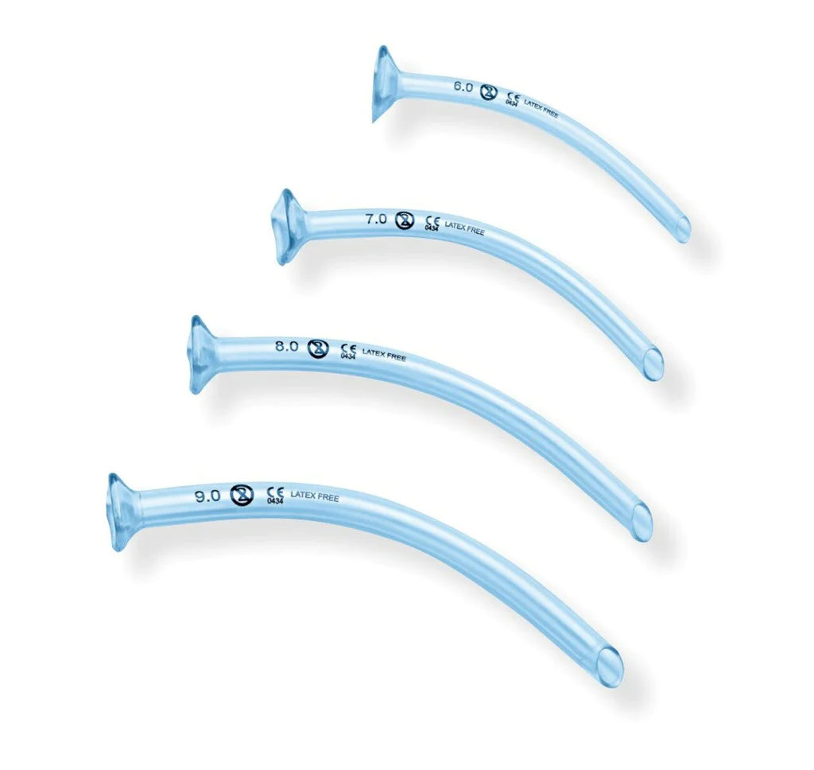
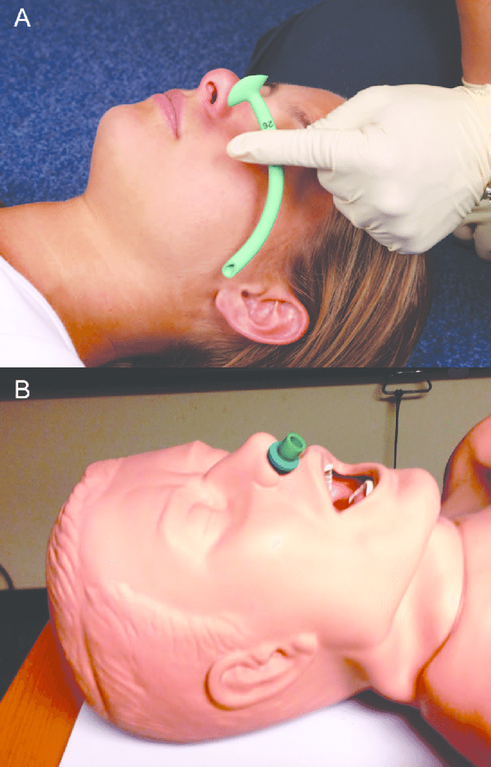
What end up being management priorities?

Slide 12
What about if this isn’t just a party problem?
Alcohol
Risks to patients that chronically use alcohol
GABA

Slide 13


Alcohol
Alcohol
Alcohol
GABA
GABA
GABA

Slide 14

Definition of Abuse
7 drinks per week or 3+ drinks per occasion
14 drinks per week or 4+ drinks per occasion

Slide 15
Body Systems affected by Chronic Alcohol Use
Liver
Clotting Factors
Heart
Potassium
Glucose Storage
Brain
Electrolytes
Magnesium
Holiday Heart
Dysrhythmias
Atrophy/shrinks

Slide 16
The problems
Liver
Clotting Factors
Heart
Potassium
Glucose Storage
Brain
Electrolytes
Magnesium
Holiday Heart
Dysrhythmias
Atrophy/shrinks
Liver
Bleeding
Heart
Hypoglycemia
Brain
Electrolytes
Dysrhythmias
Heart failure
Dysrhythmias
Increased risk of hemorrhage
Acid/Base problems

Slide 17

Found down intoxicated:
ABC’s
Trauma exam
Glucose
EKG
Clearly communicated/ documented mental status

Slide 18
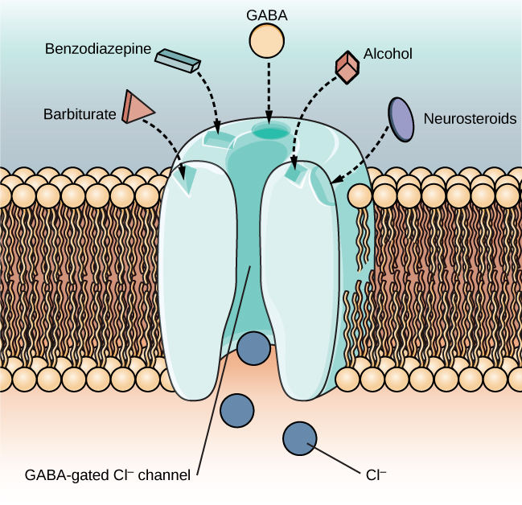

Alcohol Binds the GABA Receptor Which Is Inhibitory
Chronic Alcohol use makes this more complicated
Sluggish movement, slurred speech, slow reaction time
Notes:
Enhancement of this complex chloride channel system contributes to anticonvulsant, sleep-inducing, antianxiety, and muscle relaxation effects of all GABA-boosting drugs. Acutely administered alcohol produces a release of GABA, and continued use increases density of GABA_{A} receptors, whereas alcohol withdrawal states are characterized by decreases in GABA-related activity. Equally important is the ability of acute alcohol to inhibit postsynaptic N-methyl-D-aspartate (NMDA) excitatory glutamate receptors, whereas chronic drinking and desistance are associated with an upregulation of these excitatory receptor subunits. The relationships between greater GABA and diminished NMDA receptor activity during acute intoxication and diminished GABA with enhanced NMDA actions during alcohol withdrawal explain much of intoxication and withdrawal phenomena

Slide 19
Paramedic diversion

Slide 20
Your patient goes from minimally responsive to not responsive at all
While you start bagging the patient and your partner checks for a pulse. What do you think is going on?
  Airway?
  Glucose?
  Trauma?
  EKG?

Slide 21
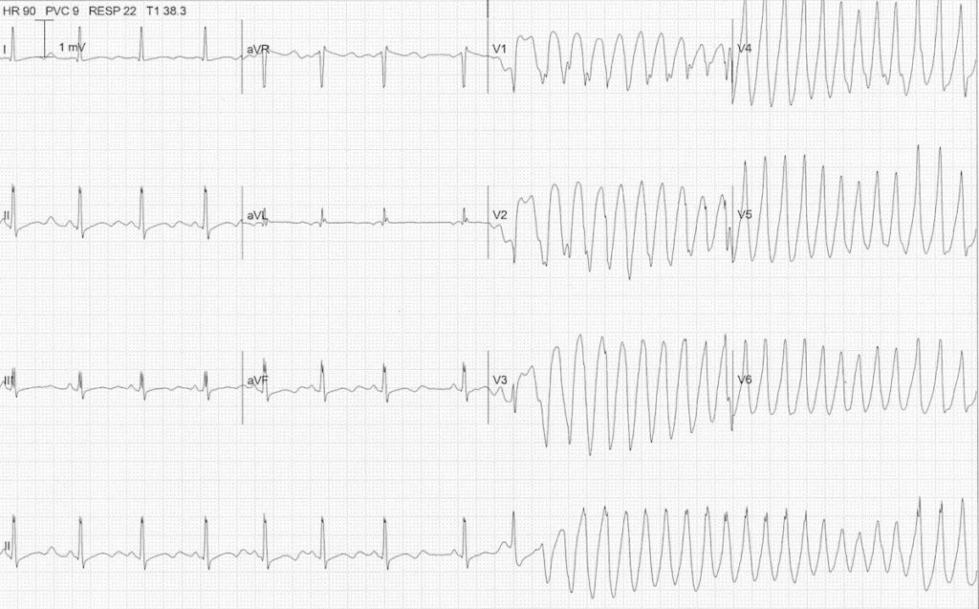
what happened here?

Slide 22
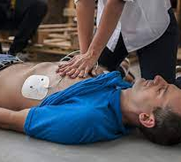
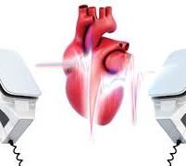
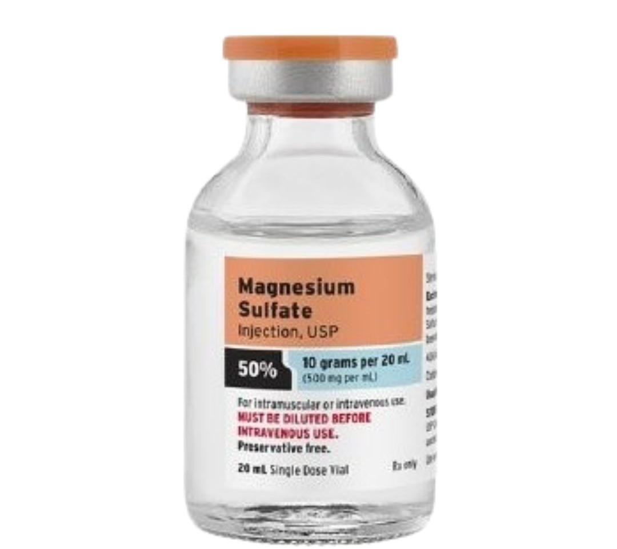
Treatment?

Slide 23
Case 2
Dispatched to 67 yo female at home on for sick call on Memorial Day weekend.
Family member meets you at the door. They are in from out of town and got in yesterday to stay with grandma.
They are worried, she seems really weak, and shaky and they thought she had a seizure but aren’t sure.
Patient is laying on the couch and looks up as you approach.

Slide 24

More info
Vitals: 180/110 110 18 94% RA 97.3 F
SAMPLE/OPQRST
What might be going on…
Notes:
S- patient feels weak and dizzy A- none M- none P- none per patient, family states “mom, you drink too much usually” L- lunch E-
O- about 8 hours ago P- nothing Q- weakness, anxious, R- none S- bad T- getting worse

Slide 25
Alcohol Withdrawal

Slide 26

Alcohol
Glutamate
GABA

Slide 27
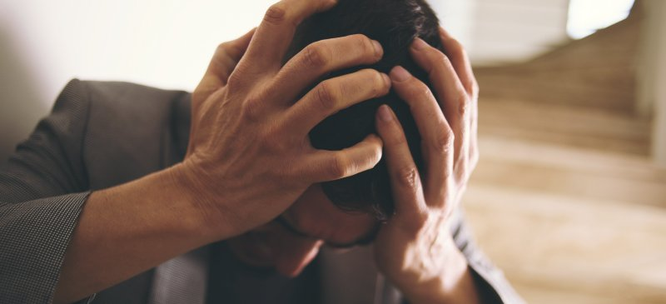
Withdrawal Signs And Symptoms
Hypertension
Tachycardia
Diaphoresis
Tremulousness
Anxious
Agitated

Slide 28

Delirium Tremens
Confusion
Seizures
Hallucinations
Formication
Autonomic Hyperactivity
Fever
30% mortality if untreated

Slide 29
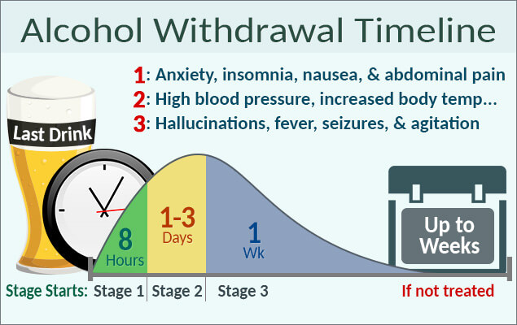
Patients Don’t Read The Textbook

Slide 30
What exam findings would be helpful to identify withdrawal
https://www.youtube.com/watch?v=xuwdvBXcr30
Tremor
Vitals
  Hypertension (high diastolic)
  Tachycardia
Feels like the last time I had withdrawal

Slide 31
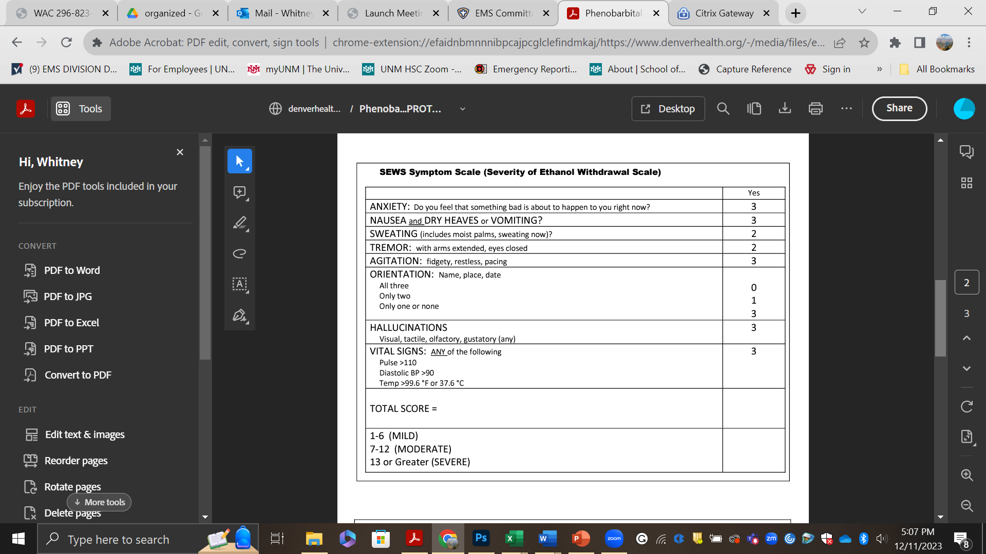

CIWA//SEWS…

Slide 32

It’s All About Balance

Slide 33
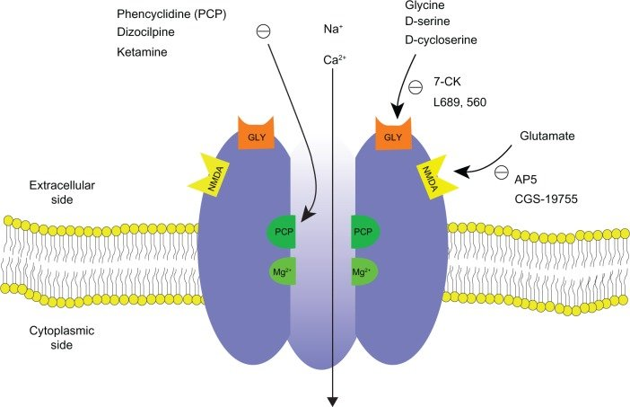
NMDA Receptors Are Excitatory
The Main Neurotransmitter is Glutamate
Glutamate

Slide 34
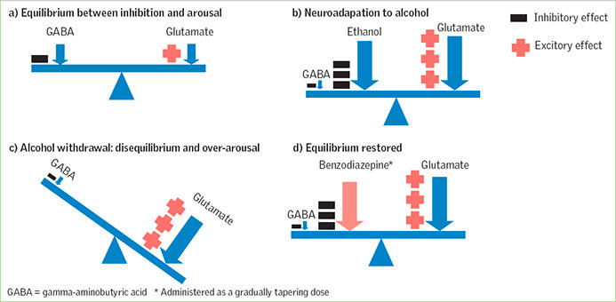
Homeostasis

Slide 35
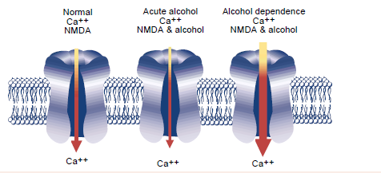
NMDA Receptor Becomes More Sensitive in Alcohol Dependence

Slide 36
Acute Withdrawal

Slide 37
Alcohol Withdrawal Can Kill People
Agitation, Anxiety, Delirium, Seizures

Slide 38
Benzos Treat Withdrawal

Slide 39
Management
Suspect it/identify it
Anticipate seizures
Intermediate:
  IV access
  IV fluids
  Antiemetic
Paramedic:
  Benzos

Slide 40

Chronic Alcohol Use Worsens Depression
People with alcohol dependence are 3.7 times more likely to have major depressive disorder
Notes:
Alcohol Res. 2019; 40(1): arcr.v40.1.01.
Published online 2019 Oct 21. doi: 10.35946/arcr.v40.1.01
PMCID: PMC6799954
PMID: 31649834
Alcohol Use Disorder and Depressive Disorders
R. Kathryn McHugh and Roger D. Weiss
Author information Copyright and License information Disclaimer

Slide 41
Case 3
Dispatched to 37 yo male with nausea/vomiting and chills
On arrival patient states he is in withdrawal
  What are the things he could be withdrawing from?

Slide 42

Primary survey+
Patient is alert but looks uncomfortable
ABC’s intact
OPQRST/SAMPLE
On observation
  Patient seems anxious
  You notice him yawn a couple of times
  Has goosebumps
  No tongue fasciculations
Notes:
Has tried to quit before. He would like to try again.

Slide 43
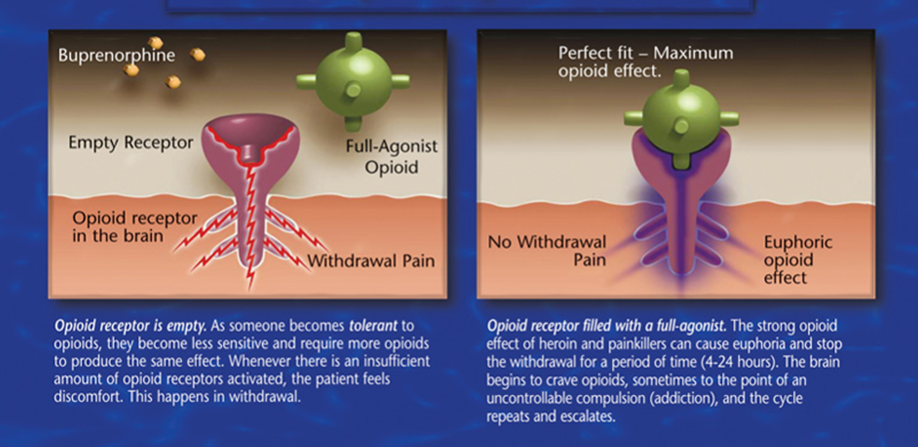
Opioid Dependence

Slide 44

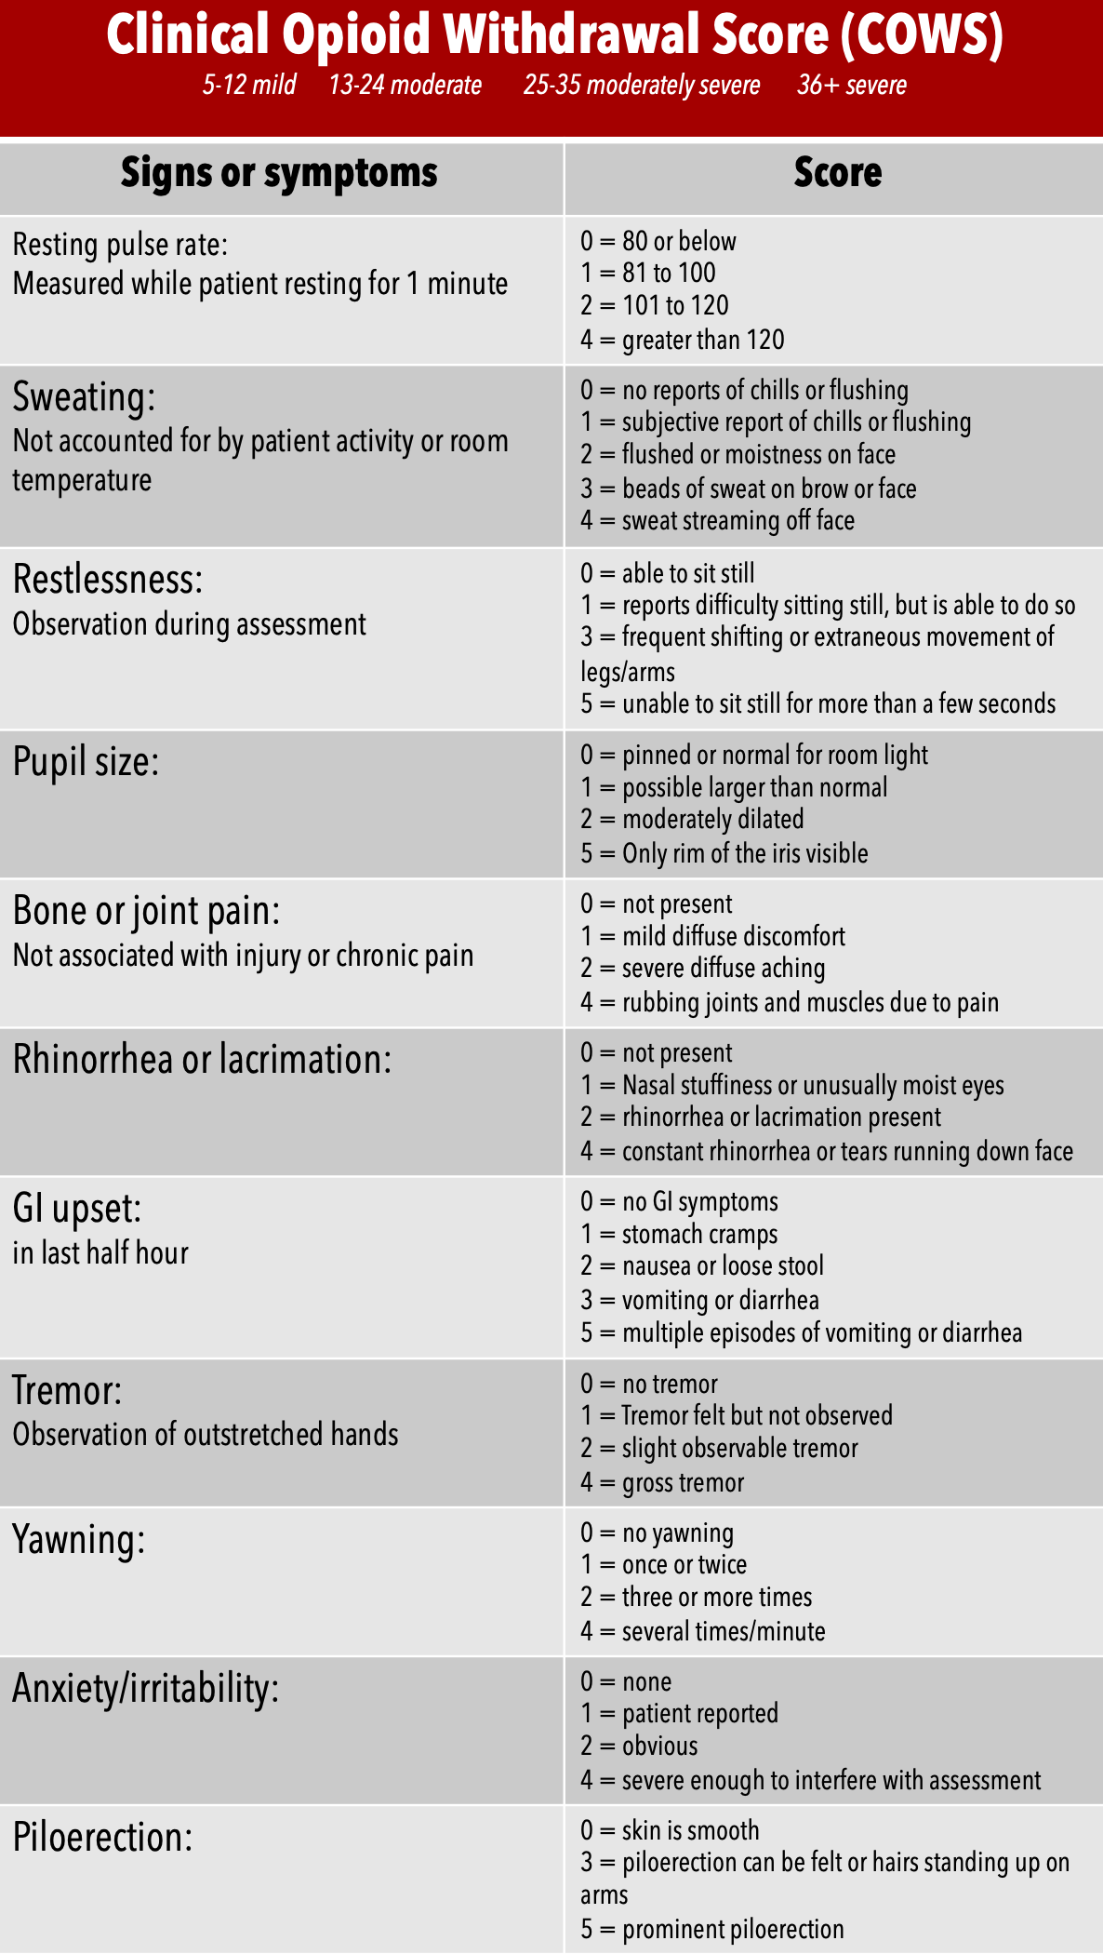

COWS

Slide 45
Symptomatic meds
Antiemetics
IV fluids
Clonidine
Benzodiazepines*

Slide 46
What can the hospital offer?
Buprenorphine induction
Connection to resources
Evaluation of other causes of symptoms

Slide 47

What are the available community resources

Slide 48

Medications for Opioid withdrawal/treatment

Slide 49
Buprenorphine
Partial agonist to opioid receptor
Weaker opioid with ceiling effect
Usually a sublingual administration (pill or strip)
Combined with naloxone (Suboxone)
Taken appropriately, buprenorphine effects predominate
Crushed and injected, naloxone effects predominate
Advantages:
Can be prescribed
Less abuse potential
Notes:
Because it is only a partial agonist it can only reach a certain potency and then more doesn’t do anything. Decreased abuse potential
Could talk here about induction into MAT, patients need to be in withdrawal etc.

Slide 50
Buprenorphine effects

Slide 51
Methadone
Long acting opioid, full agonist
Blunts the effect of taking elicit opioids
No ceiling. More helpful in patients with higher use
Addictive, higher risk of abuse
Usually dispensed daily to patient- Sundays*
Liquid, wafer, powder forms
Prolonged QT
Notes:
Patients frequently get Sunday dose on Saturday. Might have it with them.

Slide 52
Challenges
Pain control in trauma or painful conditions
Risk for abuse- sort of
Challenges with regular access (especially methadone)
Stigma

Slide 53

Why is this good?
It reduces the risk of death from opioids by up to 50%
Some agencies are using buprenorphine in the field
Part of an effective opioid cessation program
It is effective (especially buprenorphine) for acute withdrawal

Slide 54
Summary- 3 groups
Intoxication/Chronic alcohol use
  Name 3 things patients are at risk for
  Name 3 things you should always do for the intoxicated found down
Withdrawal
  Name 3 findings on physical exam that suggest withdrawal
  What is the treatment for withdrawal in the field (check the guideline)
Medication Assisted therapy
  Name 3 symptoms of opioid withdrawal
  Name 2 medications used to treat opioid dependence

Slide 55
Questions??

