Slide 1
Verbal De-escalation and management of patients with agitation
Scott Simpson MD MPH
Trauma Rounds ECHO
10 July 2024

Slide 3
Disclosures
No disclosures from ineligible companies
Royalties from a clinical textbook from Taylor & Francis

Slide 4
Objectives
Describe key principles in identifying agitation
List one technique for verbal de-escalation
Identify one resource for additional training in de-escalation

Slide 5
workplace violence (WPV) in healthcare
Perception ≠ QI data
Verbal abuse is almost universal
Both male and female perpetrators
Psychiatric and ED spaces are highest risk.
~1/3 are victims of physical violence
Patients and others may be perpetrators
Sexual harassment is common.
Ma 2023 (NBK592384); Khatib 2023 (36834370)

Slide 6
Interventions to reduce WPV in healthcare
Reporting events
Training in de-escalation
Leadership
Security presence
Physical space
Staff support
Ma 2023 (NBK592384); Khatib 2023 (36834370)

Slide 7
Psychiatric service interventions on wpv
Proactive consultation-liaison psychiatry based on risk assessments
Multidisciplinary threat assessment teams
Training by psychiatry teams
Electronic medical record risk stratification?
Assaultive episode
20 points (High risk)
Attends outpatient appointment
-1 point
Medication refill
-1 point
6 months without assault
-5 points = 13 points (Medium risk)
Abernathy 2024 (38723665); risk scoring model by Betts 2024

Slide 8
What is verbal-de-escalation
“A form of treatment in which the patient is enabled by rapidly develop his own internal locus of control.”
Objectives of de-escalation
Ensure the safety of the patient, staff, and others
Help the patient manage, or regain control of, his emotions, distress, and behaviors
Avoid coercive interventions, which may escalate agitation
Richmond 2012 (22461967)

Slide 9
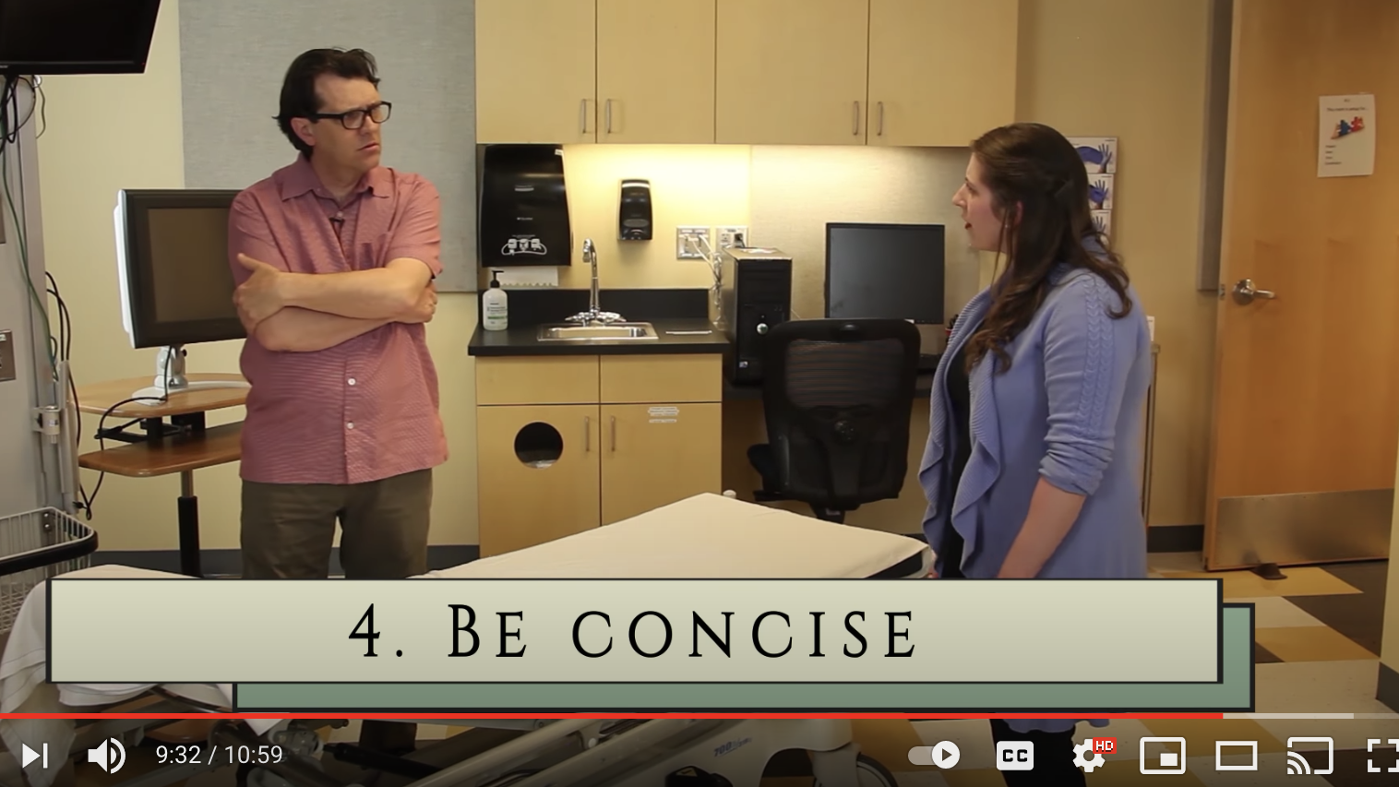
tinyurl.com/verbaldeescalation

Slide 10
Identifying agitation with the bars
Chapter 1: @ 3:44 (3m)
https://www.youtube.com/watch?v=musgq94q8GQ

Slide 11
Utility of objective agitation assessment
Simpson 2016

Slide 12
Elements of verbal de-escalation
Setting the stage
Respect personal space
Don’t be provocative
Establish verbal contact
Be concise and repetitive
Working with the patient
Identify wants and feelings
Listen closely to what the patient is saying
Agree—or agree to disagree
Resolve the situation
Set clear limits
Offer choices and optimism
Debrief the patient and staff

Slide 13
Applying the elements of verbal de-escalation
Chapter 2 (11m)
https://www.youtube.com/watch?v=8Gmf0LRJbR8&t=0s

Slide 14
Elements of verbal de-escalation
Setting the stage
Respect personal space
Don’t be provocative
Establish verbal contact
Be concise and repetitive
Working with the patient
Identify wants and feelings
Listen closely to what the patient is saying
Agree—or agree to disagree
Resolve the situation
Set clear limits
Offer choices and optimism
Debrief the patient and staff

Slide 15
Agitation narrows the patient’s perception
Patient

Slide 16
Agitation narrows the patient’s perception
Patient

Slide 17
Agitation narrows the patient’s perception
Patient

Slide 18
Medical students’ response to training

Slide 19
Advanced skills
Managing the team
One person talks at a time
Countertransference
Talk with others
Be ready to direct the team
Tap out
Debrief
Understand strong reactions are expected and healthy…
…Until they affect your work

Slide 20
A note on validation
Validate what is said
Validate feelings
Validate the odds
“…in order to understand what someone is telling you, it is necessary for you to assume the person is being truthful, then imagine what could be true about it.” – George Miller

Slide 21
Managing the team
One person talks
Direct the team
Tap out
Debrief
Debriefing
Is everyone ok?
What happened?
What went well?
What can we do better?

Slide 22
Managing your emotions
Talk with others
Know strong reactions are normal and healthy
Recognize when they’re not

Slide 23
Keep emotions in check
Provider awareness
“Am I doing this because of my reaction to the patient, or am I doing this because it is in the patient’s best interest*?” *or the safety of myself or staff
Using emotional reaction to guide care
GOAL
ASK
AVOID
Notes:
Reflect on your own emotional reaction and talk with team members.
Discuss (or think) ahead of time about how you are going to approach the situation.
Feeling frustrated/hopeless may be a sign of empathy

Slide 24
Contact information
Scott Simpson MD MPH
Director, Division of Community, Population, and Public Mental Health
Professor, Department of Psychiatry
scott.simpson@cuanschutz.edu

