Slide 1


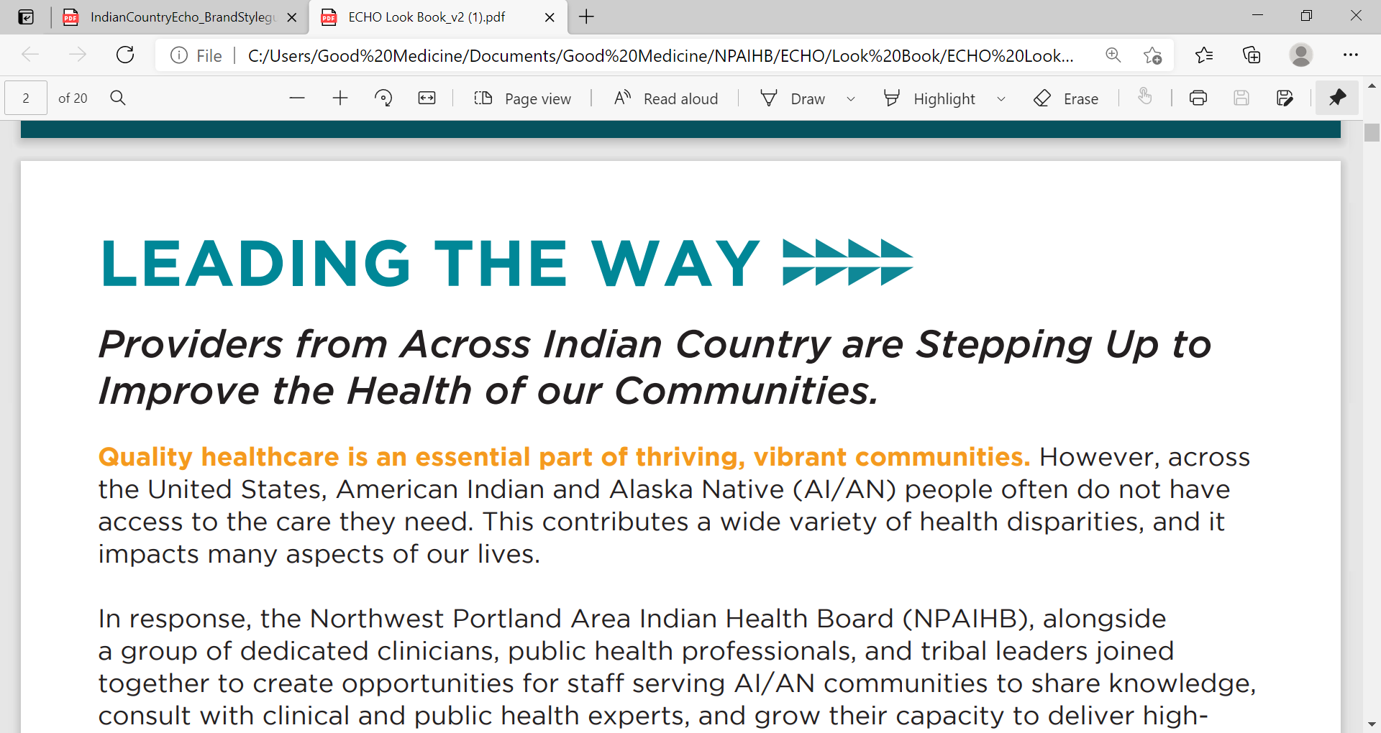
Supporting Pregnant and Parenting People, Partners, and Families
Jessica Leston, MPH
Partner/Owner-Raven Collective
Substance Use Management Resources for I/T/U Providers

Slide 2

WHY should we listen?
Substance Use Disorder impacts pregnant and parenting people, infants, and families
The rate of child removals attributable primarily to parental substance use increased from 18.5% in 2000 to 35% in 2020
American Indians and Alaska Natives (AI/AN) have disproportionally higher rates of children that enter foster care each year, in part due to parental substance use
Notes:
Too many children have been and continue to be separated from their parents and pulled into the child welfare system, in part due to parental substance use.
As a result, many of these families and communities have learned not to trust the child welfare system, even when it offers the support they need.
Many pregnant people with SUD are reluctant to engage in treatment for fear of mandatory referrals to child welfare.
This often leads to missed opportunities to prevent unnecessary foster care placements through connecting pregnant people and families to treatment and other resources.

Slide 3

Child Abuse Prevention and Treatment Act (CAPTA)
Federal law enacted in 1974
Goal: provide services and supports for infants with prenatal exposure, those experiencing substance use disorders and their families
Family focused plan to meet the needs of parent(s), infant(s), families
Notes:
CAPTA is the key federal legislation addressing child abuse and neglect - CAPTA is a State requirement.
The law provides federal funding to states to support the “prevention, assessment, and treatment” of child abuse, in exchange for states’ fulfillment of certain requirements.
One such requirement is that states enact laws mandating that certain professionals report known or suspected child abuse to a child protective services agency.
In 2016, the Comprehensive Addiction and Recovery Act (CARA) provision of CAPTA that says that substance-exposed infants needs a plan of safe care – which is a family focused plan to address the needs of both the infant and parent(s).

Slide 4

Notifying vs Reporting
to Child Protective Services
Substance exposed infant notification is required by CAPTA
Consider notifying (and not reporting) if the individual experiencing an SUD is stable and engaged in treatment
Visit childwelfare.gov/state-resources to learn more about your state’s policies
Notify
Report
Suspicions of abuse or neglect
Prenatally exposed to substances
Concerns about safety of the child
Identifies the individual
No personally identifying information
No concerns about safety or well-being
Notes:
Issue around Notification vs Report.
States differ in their policies on mandatory reporting requirement.
Some states have done some work to separate out the difference between a report and a notification but many states do not distinguish between them.
Under CAPTA Healthcare providers involved in the delivery of care of an infant born substance exposed must notify child protective services which is different than making a report of child abuse or neglect.
As a healthcare provider, when may you consider notifying CPS vs. reporting?
You may think of a parent who is very stable in recovery on Suboxone or Methadone but their newborn experiences withdrawal symptoms.
There isn’t that risk or safety issue, there is no need for CPS intervention, then make a notification.
One key difference in a notification vs a report is that there is no personally identifying information in a notification.
Still have that family care plan that is developed and overseen by the provider.
Visit childwelfare.gov/state-resources to learn more about your state’s policies

Slide 5

Key Values
Having SUD in pregnancy is not, by itself, child abuse or neglect.
Criminalizing SUD in pregnancy is ineffective and harmful.
Everyone has the right to effective treatment.
Encourage prenatal care, treatment, and recovery support.
  Barriers to access should be addressed, mitigated, and eliminated where possible.
Improving effective communication and coordination of public health, criminal justice systems, treatment and early childhood systems can optimize outcomes and reduce disparities.
Notes:
Some of the key values in supporting and optimizing outcomes for pregnant and parenting people, partners, and families begins with understanding that
1. Having SUD in pregnancy is not, by itself, child abuse or neglect.
2. We need to take a Non-punitive approach. Criminalizing SUD in pregnancy is ineffective and harmful as it prevents pregnant people with SUD from seeking and receiving the help they need.
3. Everyone has the right to effective treatment
4. Pregnant people using substances should be encouraged to access prenatal care, treatment and recovery supports.
5. Improving coordination of public health, criminal justice systems, treatment and early childhood systems can optimize outcomes and reduce disparities.

Slide 6


Framework
Prevention and treatment strategies for pregnant and parenting people with substance use disorders
Connect families to supports and services
Compassionate, culturally-responsive, trauma-informed care
Notes:
Given the more than half of foster care placements are associated with parental substance use there are often missed opportunities to connecting pregnant and parenting people to treatment and other resources.
Improving access to treatment for pregnant people = improving outcomes for both parents and infants.
Goal: Prevent unnecessary foster care placements, Support Families, and Keep Families Together.
Services to Support Family Reunification when families are separated as well as continued support and services even after they successfully reunify.

Slide 7
Framework
Policies and procedures that
  Support access and engagement in substance use treatment.
  Strengthen families and promote child and family well-being.
Services for children that
  Address their medical and developmental needs and experiences of trauma.
  Reestablish trusting bonds with their families.
Linking Child Protective Services with partners in the community to build support for and resilience within families before crises occur.
Notes:
When it comes to leadership, we need those policies and procedures that support access to SUD treatment.
We need access to medications for SUD and staff who are trained in SUD treatment within our tribal hospitals and in our communities.
Equally important is having services for children who have been affected by prenatal SUD.
Link CPS with partners in community to build support and family-friendly approach.
Fear of CPS harms families, it impacts how people engage with service providers and whether they access services and supports.
Continue to share those success stories - there is some really great work being done in tribal communities in SUD, not only in treatment but also prevention and building healthier communities.

Slide 8

Resources

Slide 9

Providers Guide
AI/AN pregnant and parenting people experiencing substance use disorders and their infants, partners, and families benefit from high-quality healthcare that is:
  Evidence-based
  Culturally-responsive
  Trauma Informed
  Holistic in nature
  Attuned to individual and family needs, and
  Part of an integrated network of social, cultural, spiritual, and community-based supports.
Notes:
The Northwest Portland Area Indian Health Board (NPAIHB), alongside Indian Health Service, Tribal, and Urban Indian (I/T/U) healthcare providers, and AI/AN individuals impacted by Substance Use Disorders came together to create Family Care Plans Toolkit (formerly Plans of Safe Care) which includes a guide for providers, patient fact sheets, poster, care coordination plan, and animated video.
The Providers Guide was created to support IHS/Tribal/Urban clinicians in providing SUD care to American Indian and Alaska Native pregnant and parenting people.
Offers healthcare providers recommendations for three potential points of intervention- prenatally, during birth, and postnatally.

Slide 10
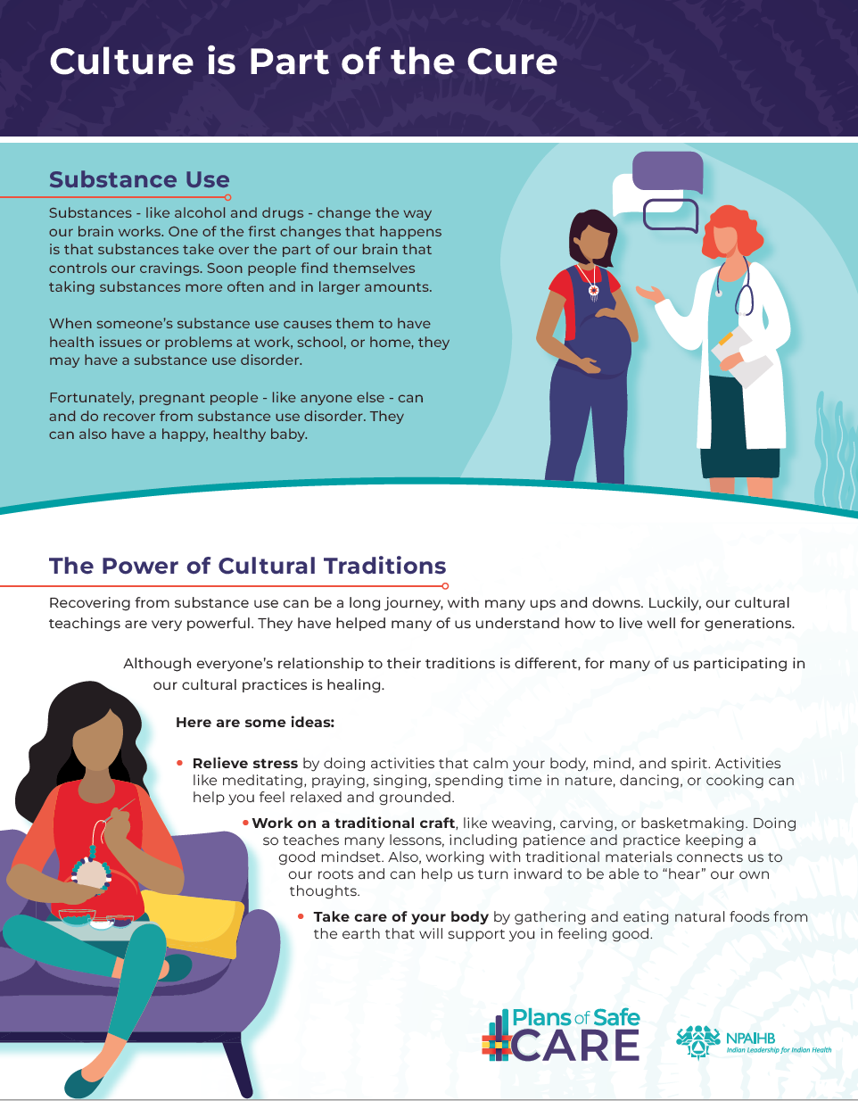
Patient and Family Fact Sheets
The Truth About Substance Use and Pregnancy
Getting Help for Substance Use During Pregnancy
Getting Help for Substance Use – For New Parents
Supporting Something with a Substance Use Disorder
Culture is Part of the Cure
Notes:
A variety of handouts for AI/AN PPP and their supports (including 5 patient and family fact sheets, a educational poster, family wellness plan)

Slide 11

Educational Poster
Notes:
Educational poster recognizing how AI/AN people are living their ancestors’ prayers

Slide 12
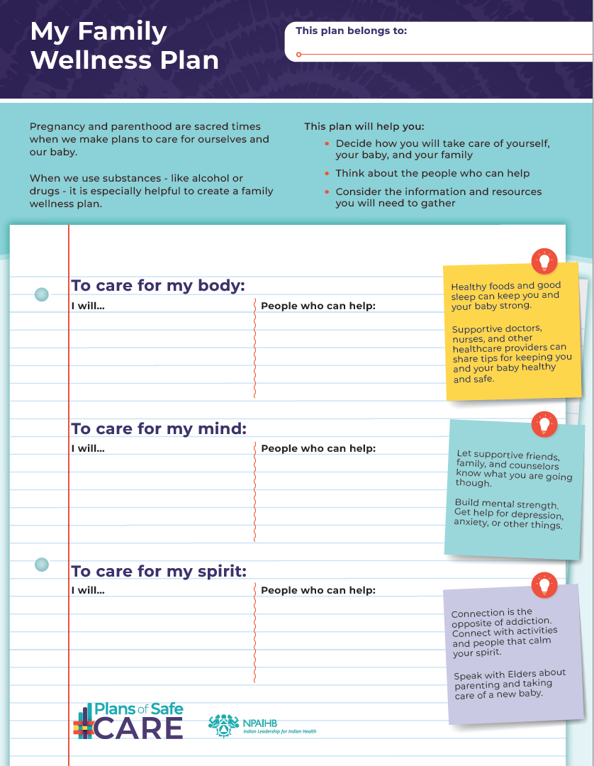
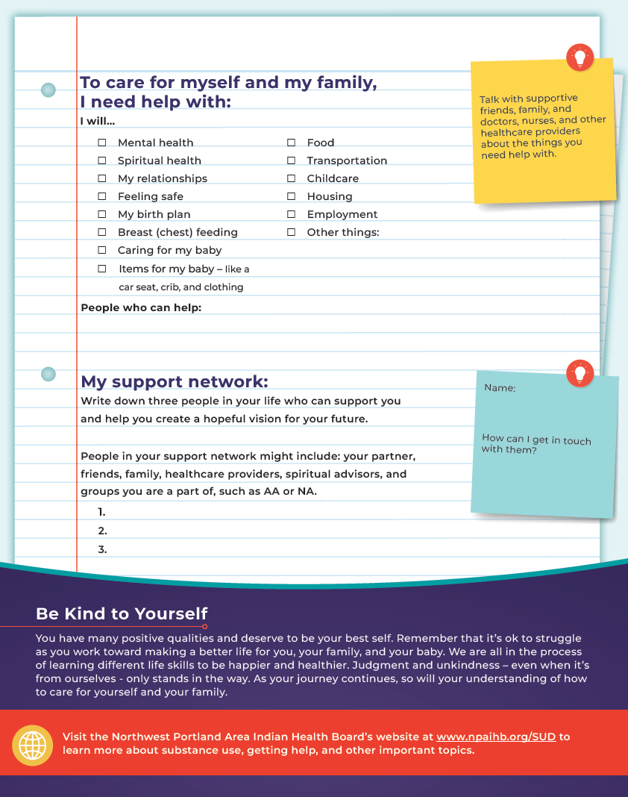
My Family Wellness Plan
Notes:
A family wellness plan template
Created for pregnant and parenting people to reflect and identify their individual needs and supports
Although a family wellness plan is a personalized plan for the pregnant or parenting person, it can also be a tool for providers for care coordination to medical, social, cultural, and spiritual care

Slide 13
Care Coordination Plan
Developed prenatally and updated postnatally with the pregnant person and involved caregivers
Goal: ensure infants and families are connected to supportive services in their communities
Share care coordination plan with
  parent(s)/caregiver(s)
  primary provider(s)
  delivering facility
Notes:
To facilitate communication and follow-up between primary providers and delivering facility

Slide 14
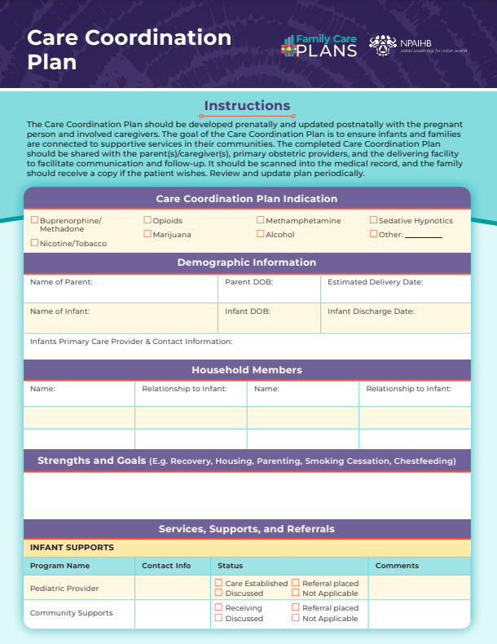
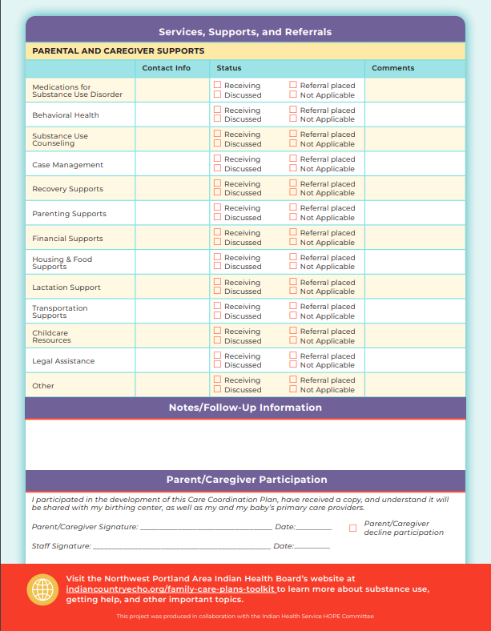
Care Coordination Plan
Notes:
Indication
Demographic Information
Strength and Goals section
Services, Supports, and Referrals
Infant
Parents and Caregivers
Notes/Follow-up
Scanned into medical record
Family should receive a copy if patient wishes

Slide 15
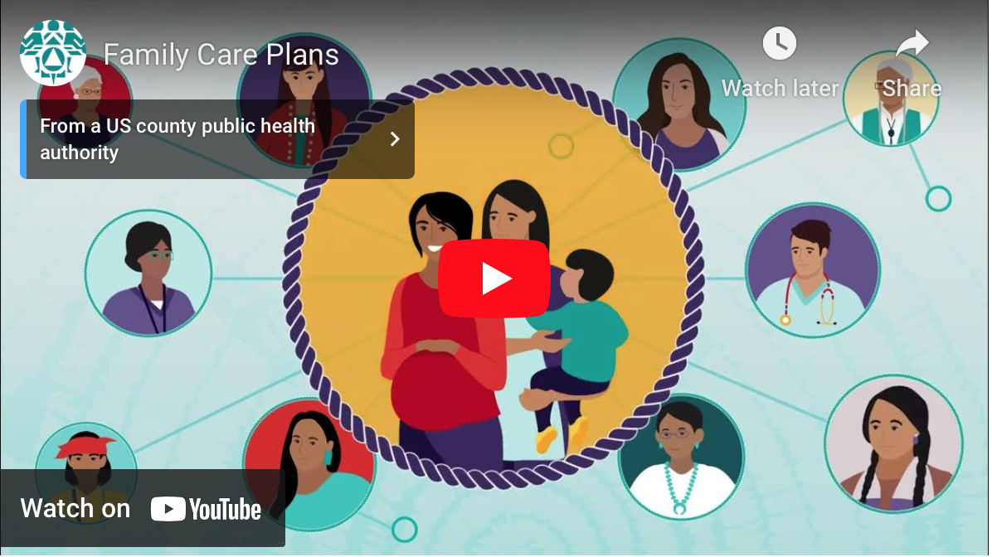
Family Care Plans Video

Slide 16
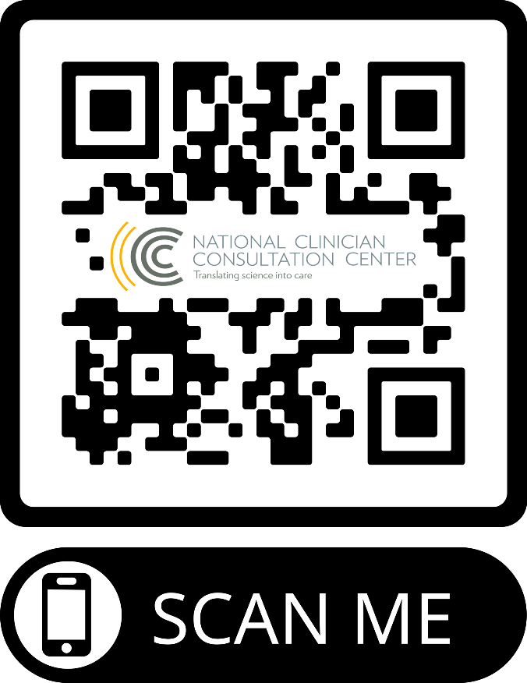
Substance Use Warmline
Notes:
The Substance Use Warmline (1-855-300-3595) offers on-demand Clinician-To-Clinician support for IHS providers managing alcohol and substance use disorders.
The Warmline is available Monday through Friday from 6am to 5pm Pacific Standard Time (PST) (9AM-8PM EST/8AM-7PM CST) for all health care providers in IHS federal, tribal, and urban facilities.
Calls are answered by trained clinical support specialists with diverse experience and substantial training in substance use disorder interventions.
The overall purpose of the Warmline is to maximize clinical services offered to patients, families, and communities facing substance use disorder.

Slide 17
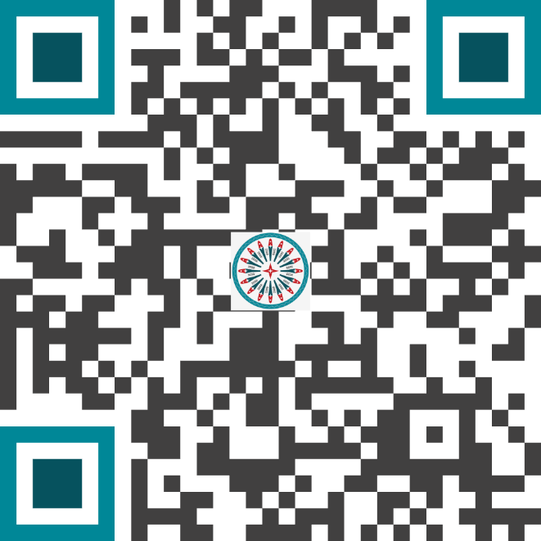
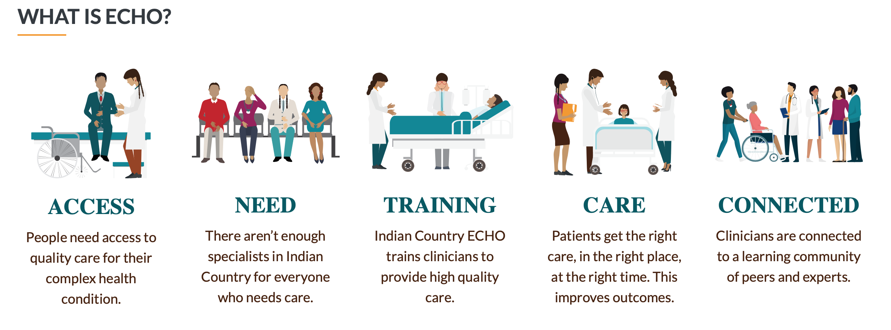
Substance Use Disorder ECHO
Watch these expert presentations on effectively treating PPP with SUDs.
Notes:
1) SUD ECHO Program
1st Thursday of the Month @11AM PT
Midwest Tribal ECHO – 1st and 3rd Wednesday @10AM PT
2) Advancing Pharmacist Roles in Substance Use Disorder Treatment and Recovery Teams ECHO Program
3rd Tuesday of the month @10am PT
Focusing on the management and treatment of patients with Substance Use Disorders
Didactic sessions and patient cases
Continue learning, knowledge sharing, and support treating and managing SUD
CE offered

Slide 18







Red Lake Nation Recovery Videos
Community Healing
Best Practices
Sharing Our Stories
Living a Beautiful Life in Recovery
Notes:
By sharing stories of community healing we can better understand and serve our relatives that are experiencing SUDs. Watch the Red Lake Recovery Videos to learn how local champions came together to heal the community.
Provider Video: Community Healing - Best Practices
The Red Lake Nation’s approach to serving and supporting community members who experience SUD and how they are restoring hope and healing the community. By focusing on a community-based, person-first approach, they save lives and restore families.
Patient Video: Sharing Our Stories - Living a Beautiful Life in Recovery
Recovery is possible. Hear inspiring recovery stories!

Slide 19
LEARN MORE
about Substance Use Disorders
  Indian Country ECHO
  UCSF National Clinical Consultation Center
  IHS HOPE Committee’s website
Notes:
Grand Rounds Session on Comprehensive Care of SUD and Pregnant and Parenting People
Tuesday, August 15th

Slide 20
References
The White House Executive Office of the President Office of National Drug Control Policy. Substance Use Disorder in Pregnant: Improving Outcomes For Families. Available from: https://www.whitehouse.gov/wp-content/uploads/2021/10/ONDCP_Report-Substance-Use-Disorder-and-Pregnancy.pdf#:~:text=Criminalizing%20SUD%20in%20pregnancy%20is%20ineffective%20and%20harmful,or%20disability%20is%20a%20violation%20of%20civil%20rights.23
Child Abuse Prevention and Treatment Act. Available from: https://www.acf.hhs.gov/sites/default/files/documents/cb/capta.pdf
CAPTA Reauthorization Act of 2021. Available from: https://www.help.senate.gov/imo/media/doc/052621%20CAPTA%20117th%20Section-by-Section.pdf
U.S. Department of Health and Human Services, Administration for Children and Families, Administration on Children, Youth and Families, Children’s Bureau. (2020). Preliminary FY 2020 estimates as of October, 04, 2021. (AFCARS Report No. 28). Available from: https://www.acf.hhs.gov/sites/default/files/documents/cb/afcarsreport26.pdf
National Council of Juvenile and Family Court Judges, Disproportionality Rates for Children of Color in Foster Care (Fiscal Year 2014). Available from: https://www.childwelfare.gov/pubpdfs/about.pdf
The Child Abuse Prevention and Treatment Act: Keeping children safe and strengthening families in communities. 2019. Available from: https://www.casey.org/media/CAPTA-Paper_web.pdf
National Center on Substance Abuse and Child Welfare. Children and Families Affected by Parental Substance Use Disorders (SUDs). Available from: https://ncsacw.acf.hhs.gov/topics/parental-substance-use-disorder.aspx
National Clinician Consultation Center. Substance Use Warmline. Available from: https://nccc.ucsf.edu/clinician-consultation/substance-use-management/
Indian Country ECHO. Substance Use Disorder ECHO Program. Available from: https://www.indiancountryecho.org/program/substance-use-disorder/

Slide 21
Contact Information
Sherry Daker, PharmD, MHA
Sherry.Daker@ihs.gov

