Slide 1


Addressing the Syndemic: Comprehensive Syndemic Facility Assessments
(with a bonus syphilis overview)
Ashley Hoover, MPH
Northwest Portland Area Indian Health Board (NPAIHB)
Indian Country ECHO Ending the Syndemic: Fentanyl + OUD Training
July 26, 2024

Slide 2


Background
Notes:
First, a little background on the origin of the assessment tool we used. In January of 2022, a CDC team including several EIS officers was invited by a tribal nation to assist with an investigation of an outbreak of syphilis. During this investigation a facility assessment survey tool was implemented to evaluate capacity, preparedness, best practices and areas for improvement in response to syphilis and other STI outbreaks. Around the same time, we adapted this assessment for use among IHS, tribal and urban Indian clinics in the pacific northwest region, specifically in Oregon, Washington and Idaho states, and some of that information will be presented here.

Slide 3
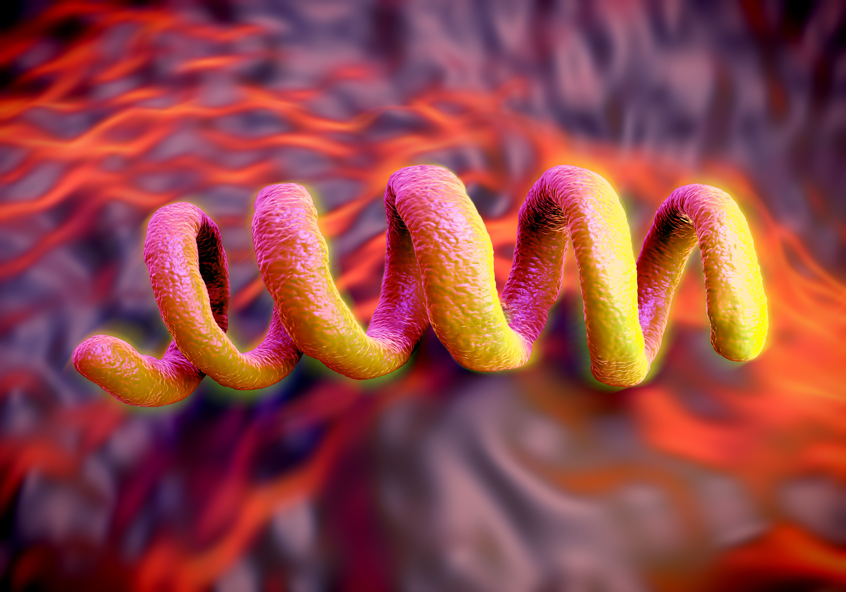
Syphilis epidemiology is changing
Notes:
In addition to rising total cases of syphilis we’re also seeing some shifts in the classic epidemiology of syphilis. Before I get into the next few slides with graphs, I again want to emphasize that the point of this is not to exclusively identify disparities among AI/AN but to inform us how to best direct screening and treatment efforts to the communities we serve.

Slide 4
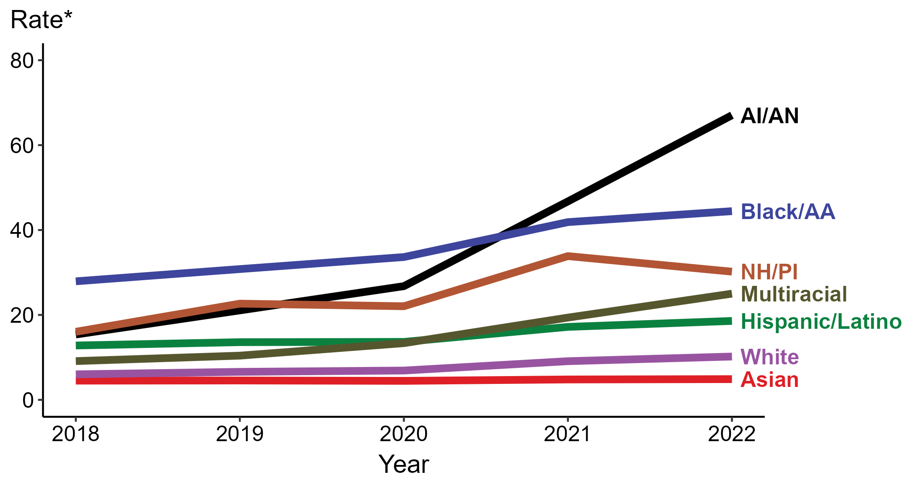
Primary and Secondary Syphilis — Rates of Reported Cases by Race/Hispanic Ethnicity, United States, 2018–2022
* Per 100,000
ACRONYMS: AI/AN = American Indian or Alaska Native; Black/AA = Black or African American; NH/PI = Native Hawaiian or other Pacific Islander
Notes:
In 2022, the highest rate of reported primary and secondary syphilis cases per 100,000 persons was among non-Hispanic American Indian or Alaska Native persons (67.0), followed by non-Hispanic Black or African American persons (44.4).
During 2021 to 2022, the greatest increase in rate of reported primary and secondary syphilis cases per 100,000 persons was among non-Hispanic American Indian or Alaska Native persons (46.7 to 67.0; 43.5% increase). Non-Hispanic American Indian or Alaska Native persons also had the greatest five-year increase in rate of reported primary and secondary syphilis (15.4 to 67.0; 335.1% increase from 2018).
During 2021 to 2022, the only decrease in rate of reported primary and secondary syphilis cases per 100,000 persons was among non-Hispanic Native Hawaiian or other Pacific Islander persons (33.9 to 30.2; 10.9% decrease). There were no decreases in the rate of reported primary and secondary syphilis among any race or Hispanic ethnicity group during 2018 to 2022.
This report includes data from years that coincide with the COVID-19 pandemic, which introduced uncertainty and difficulty in interpreting STI surveillance data. See Impact of COVID-19 on STIs for more information.
See Technical Notes (https://www.cdc.gov/std/statistics/2022/technical-notes.htm) for information on syphilis case reporting, race/Hispanic ethnicity categorization, and reporting of race/Hispanic ethnicity for STI cases. Table A1 (https://www.cdc.gov/std/statistics/2022/tables/a1.htm) provides information on unknown, missing, or invalid values of select variables.
Data for all figures are available at https://www.cdc.gov/std/statistics/2022/data.zip. The file “PS Syphilis - Rates by Race Hispanic Ethnicity (US 2018-2022).xlsx” contains the data for the figure presented on this slide.

Slide 5
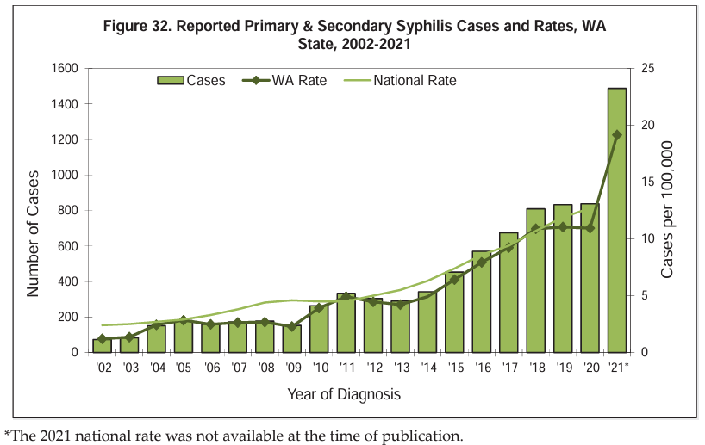
Source: Washington State Department of Health STI Epidemiological Profile, 2023

Slide 6
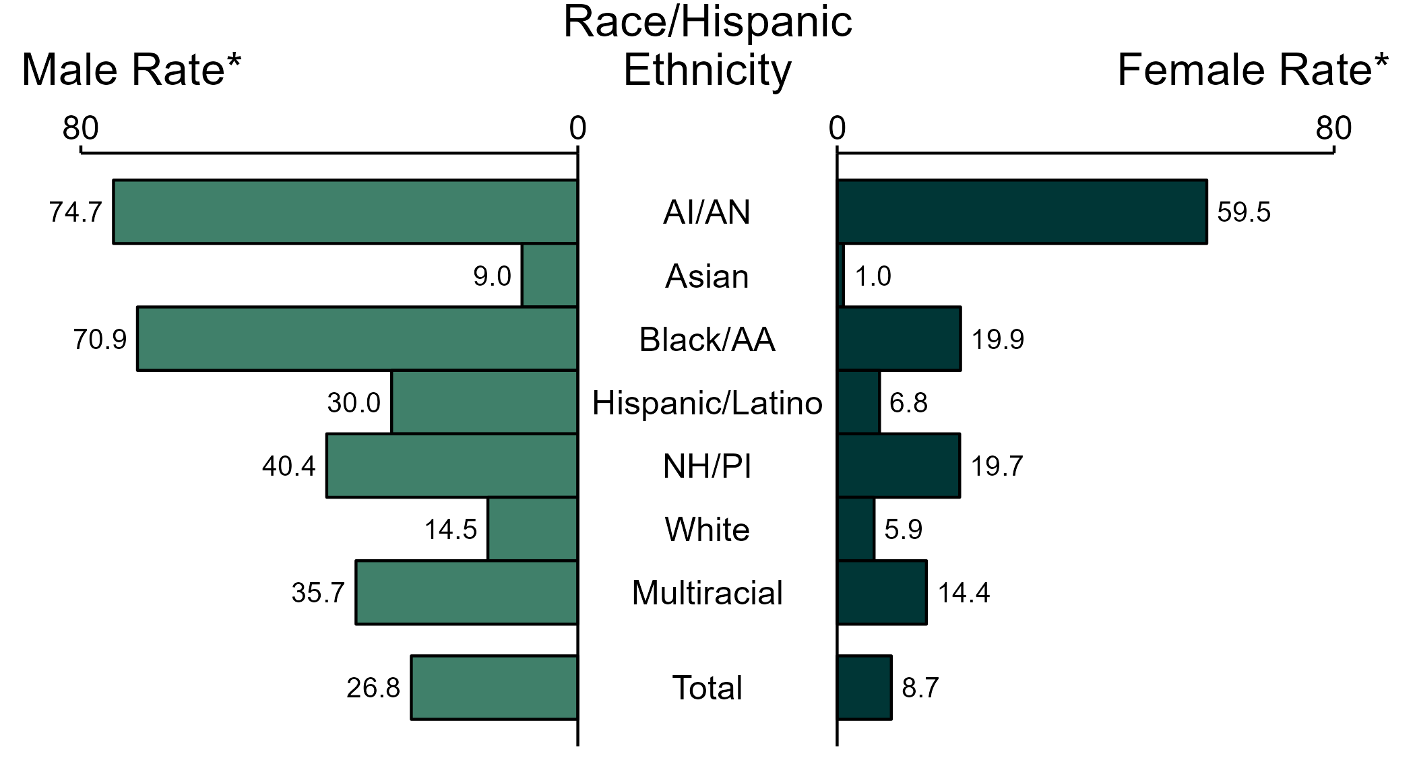
Primary and Secondary Syphilis — Rates of Reported Cases by Race/Hispanic Ethnicity and Sex, United States, 2022
* Per 100,000
ACRONYMS: AI/AN = American Indian or Alaska Native; Black/AA = Black or African American; NH/PI = Native Hawaiian or other Pacific Islander
NOTE: Total includes all cases including those with unknown race/Hispanic ethnicity.
Notes:
In 2022, the rate of reported primary and secondary syphilis was higher among men (26.8 per 100,000) compared to women (8.7 per 100,000).
Among men, non-Hispanic American Indian or Alaska Native men had the highest rate of reported cases of primary and secondary syphilis (74.7 per 100,000), followed by non-Hispanic Black or African American men (70.9 per 100,000) and non-Hispanic Native Hawaiian or other Pacific Islander men (40.4 per 100,000). Among women, non-Hispanic American Indian or Alaska Native women also had the highest rate of reported cases of primary and secondary syphilis (59.5 per 100,000), followed by non-Hispanic Black or African American women (19.9 per 100,000) and non-Hispanic Native Hawaiian or other Pacific Islander women (19.7 per 100,000).
Using non-Hispanic White persons as the referent category, the greatest relative racial disparity in rates of reported primary and secondary syphilis across both sexes was observed among non-Hispanic American Indian or Alaska Native women, with a rate ratio of 10.0 times that of non-Hispanic White women. Among men, the greatest relative disparity was observed among non-Hispanic American Indian or Alaska Native men as well, with a rate 5.2 times that of non-Hispanic White men.
This report includes data from years that coincide with the COVID-19 pandemic, which introduced uncertainty and difficulty in interpreting STI surveillance data. See Impact of COVID-19 on STIs for more information.
See Technical Notes (https://www.cdc.gov/std/statistics/2022/technical-notes.htm) for information on syphilis case reporting, race/Hispanic ethnicity categorization, and reporting of race/Hispanic ethnicity for STI cases. Table A1 (https://www.cdc.gov/std/statistics/2022/tables/a1.htm) provides information on unknown, missing, or invalid values of select variables.
Data for all figures are available at https://www.cdc.gov/std/statistics/2022/data.zip. The file “PS Syphilis - Rates by Race Hispanic Ethnicity and Sex (US 2022).xlsx” contains the data for the figure presented on this slide.

Slide 7
“The Great Pretender”
Notes:
So, first, let’s do a review of syphilis.
Syphilis is a sexually transmitted infection (or STI), caused by the spirochete bacterium Treponema pallidum, the image of which is shown here.
Syphilis is spread through vaginal, anal, or oral sex.
* Many refer to syphilis as “The Great Pretender”, as its symptoms vary and can look like many other diseases.
[1] https://www.cdc.gov/std/syphilis/stdfact-syphilis-detailed.htm

Slide 8
Clinical stages
      Syphilis goes through several stages.
      Stages start with primary, then may not progress linearly.
      Characterized by episodes of active disease interrupted by periods of latency.
      Signs/symptoms and transmission risks vary by stage.
Notes:
The clinical stages of syphilis can be overwhelming, but there are a few main points.
The first is that syphilis goes through several stages. Generally, the progression of syphilis is thought to be primary, then secondary, then tertiary. But you can go in and out of latent stages and neurosyphilis can happen at any stage.
And, the signs and symptoms, as well as the transmission risks, vary by syphilis stage.
[1] https://www.cdc.gov/std/syphilis/stdfact-syphilis-detailed.htm

Slide 9
Clinical Stages
Symptoms go away even if untreated!
Primary
Secondary
Latent
Tertiary
Painless ulcer or chancre
Rash
Mucocutaneous lesions
Lymphadenopathy
NO SYMPTOMS
Cardiovascular
Gumma lesions (skeletal, mucosal, ophthalmic)
10-90 days after infection
Patient may never be aware
Usually occurs 3 to 6 weeks after primary syphilis
Patients may only have one subtle skin change
Neurosyphilis can occur at any stage.
Notes:
30% of untreated people with syphilis progress to tertiary syphilis in five to 30 years and is marked by lesions of the cardiovascular system
Primary and secondary syphilis are the most infectious stages and indicate recent acquisition of syphilis. They are often lumped together and referred to as “P&S Syphilis.
Latent syphilis is asymptomatic with no visible signs or symptoms. 60 to 85% of people are asymptomatic for years without treatment.
_____________________
Neurosyphilis can occur at any stage and can include meningitis-like symptoms, partial paralysis, and dementia. And again, I want to reinforce this point: neurosyphilis can occur at any stage of syphilis. So, it’s important to consider an evaluation for signs and symptoms when you’ve diagnosed syphilis.
when you diagnosis a person with primary or secondary syphilis, please do a thorough evaluation for signs and symptoms of neurosyphilis.

Slide 10
Clinical Stages
Primary
Secondary
Latent
Painless ulcer or chancre
Rash
Mucocutaneous lesions
Lymphadenopathy
NO SYMPTOMS
EARLY LATENT
<=1 year since infection
LATE LATENT
>1 year since infection
EARLY SYPHILIS
Primary, Secondary, or Early Latent
(greatest potential for
transmission in pregnancy)
Notes:
Now I won’t get into the visual clinical manifestations of syphilis in this discussion, but can absolutely provide that slide deck for any and all that are interested that goes into greater detail around clinical manifestations for all stages of syphilis, including a guideline for screening for ocular syphilis. Here, I’d like to simply show an overview of the various stages and their symptoms.
Early syphilis is a term that includes primary, secondary, and early latent stages. These have the greatest potential for vertical transmission.

Slide 11
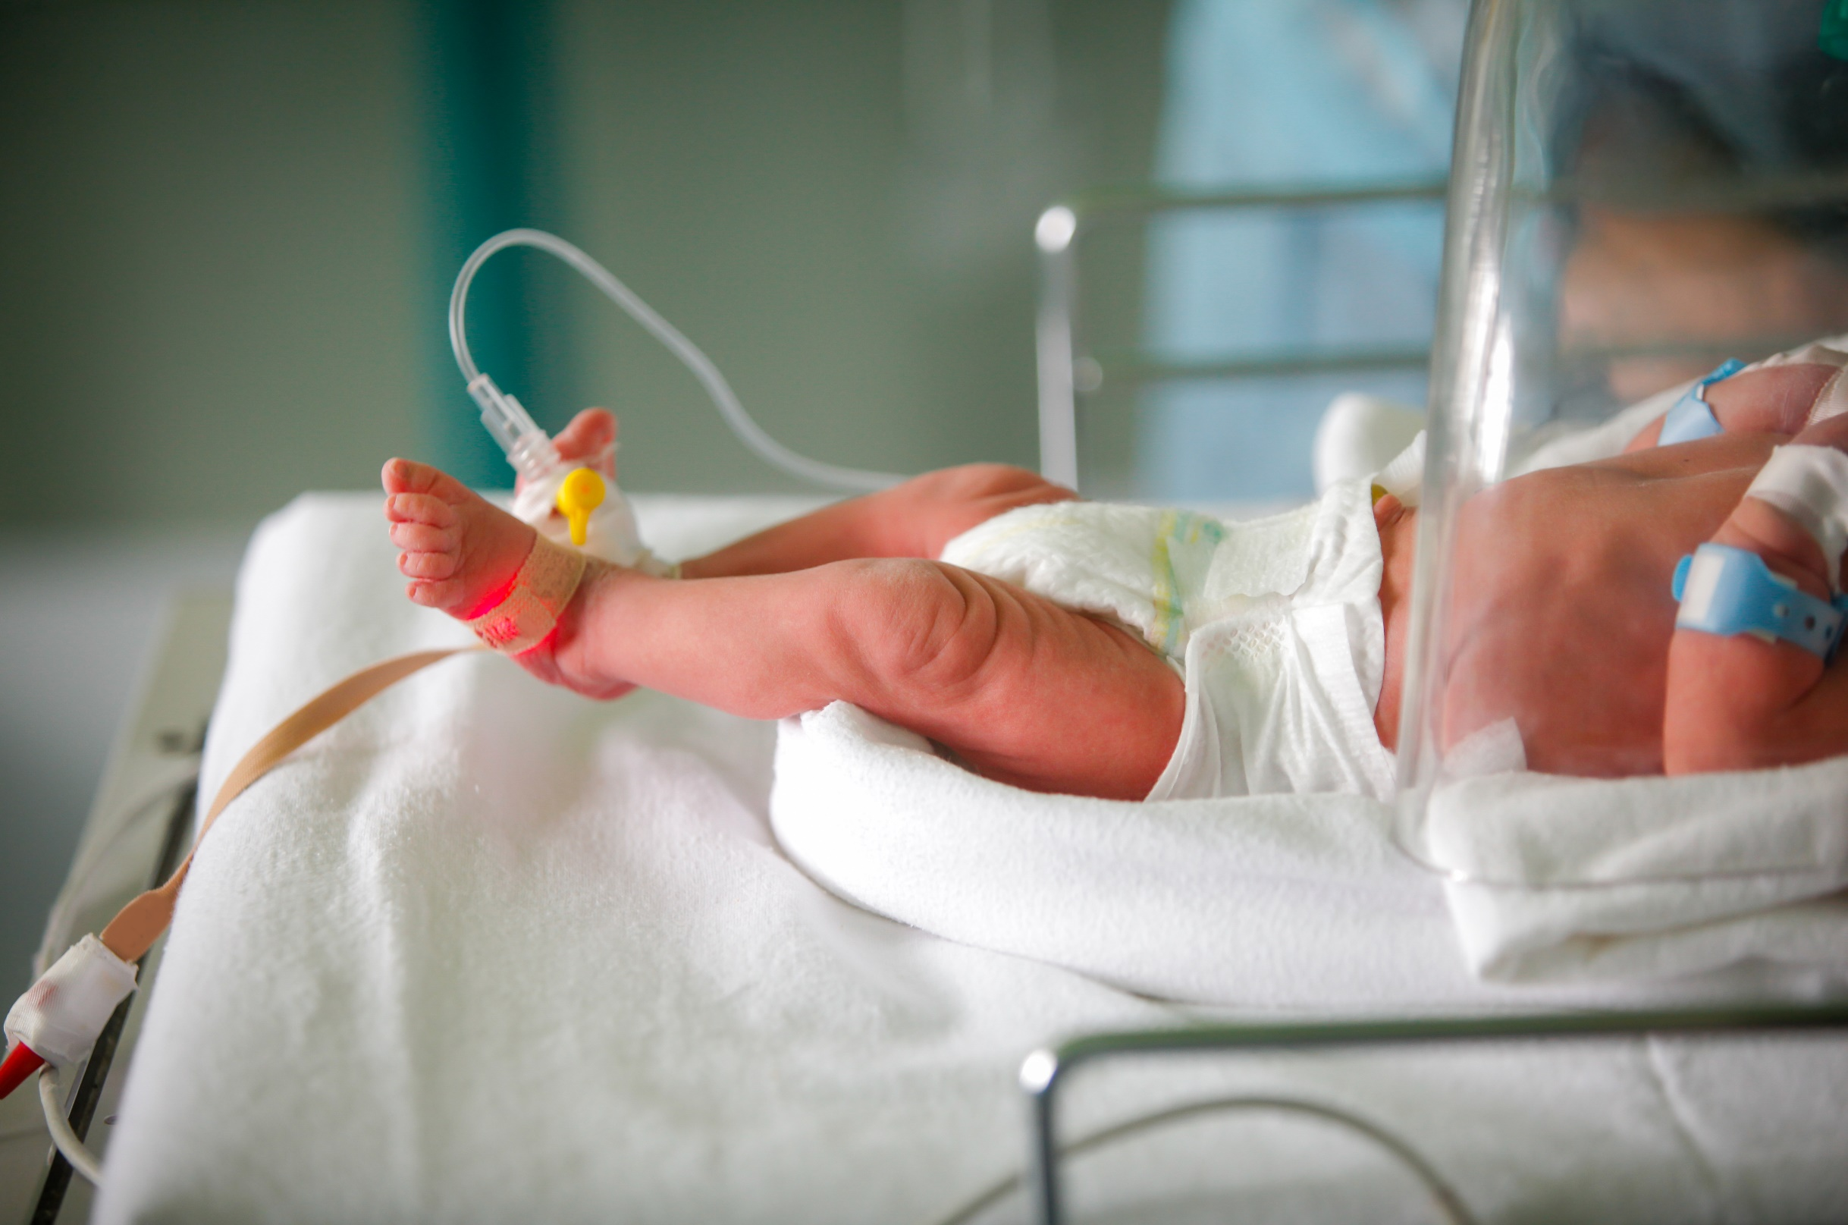
Congenital syphilis (CS)
Notes:
Syphilis can also spread through the placenta from a mother with syphilis to her unborn baby, referred to as congenital syphilis.
Congenital syphilis is uniquely devastating. It can result in permanent and lifelong disability, and pre and post-natal deaths.
Each case of congenital syphilis is essentially a sentinel event. When congenital syphilis occurs, it indicates a significant amount of syphilis spreading in the larger community.
Data show both syphilis and congenital syphilis rates have increased almost every year across the country, since 2015.
--------------------------------------
Placentas often have signs of infection and inflammation.
***
Congenital Syphilis (CS) is devastating and indicates a significant amount of syphilis spreading in a community.
While we care about and want to treat all syphilis, congenital syphilis is uniquely devastating. It can result in permanent and lifelong disability, and pre and post-natal deaths. Each case of congenital syphilis is essentially a sentinel event. When congenital syphilis occurs, it indicates a significant amount of syphilis spreading in the larger community
Maternal screening is important
Maternal Screening for Syphilis
All pregnant women should be tested for syphilis early in pregnancy at the first prenatal visit or at the time of pregnancy confirmation
In high prevalence areas or who are at high individual risk*, retesting at 28 weeks and delivery is recommended. High-risk* pregnant women should be screened at delivery.
No mother or baby should be discharged from the hospital without documentation of maternal syphilis testing (during pregnancy and/or delivery)
Women who experience a fetal death at ≥20 weeks should be tested for syphilis.
*Examples of high risk: multiple prior STIs, recent incarceration, substance misuse, homelessness, transactional sex
Something about congenital syphilis – risk to baby
https://www.cdc.gov/ncbddd/birthdefects/surveillancemanual/quick-reference-handbook/congenital-syphilis.html

Slide 12
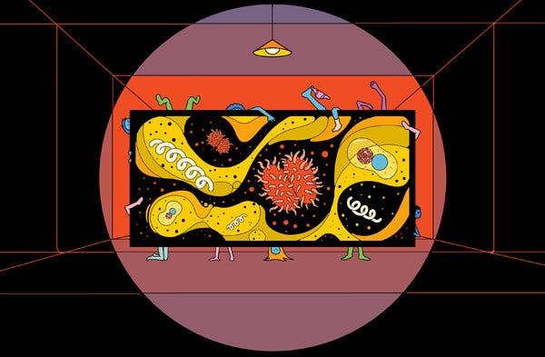
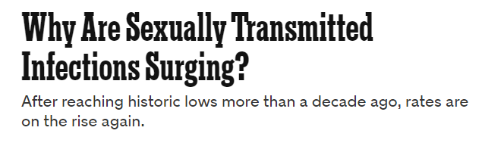
“When women who are engaging in substance abuse become pregnant, they frequently avoid prenatal care for fear of being drug-tested and potentially losing custody of the child. That means many of them aren’t tested for syphilis and don’t receive the treatment that would prevent their baby from getting it.”
Notes:
The intersection between women with syphilis and substance use has important implications, especially when seeking care during pregnancy. this NY times magazine article reported on this recently…
Now we’ll look at congenital syphilis epidemiology

Slide 13
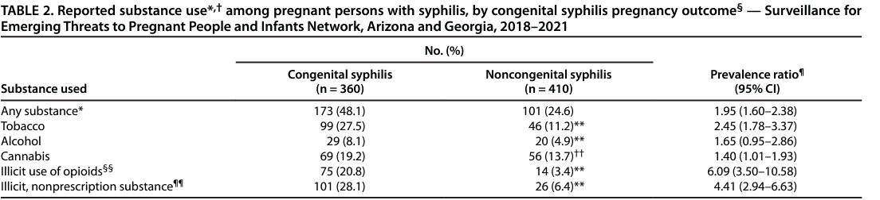
Intersecting epidemics:
substance use and syphilis
Substance Use Among Persons with Syphilis During Pregnancy — Arizona and Georgia, 2018–2021
 | Adjusted Prevalence Ratio
Any high-risk substance use [HRSU]
Women | 2.63 [2.39-2.90]
Men who have sex with women [MSW] | 1.38 [1.31-1.46]
Men who have sex with men [MSM} | 1.30 [1.26-1.34]
Carlson JM, Tannis A, Woodworth KR, et al. Substance Use Among Persons with Syphilis During Pregnancy — Arizona and Georgia, 2018–2021. MMWR Morb Mortal Wkly Rep 2023;72:63–67. DOI: http://dx.doi.org/10.15585/mmwr.mm7203a3
Notes:
*Illicit use of opioids includes prescription opioids not taken as prescribed, fentanyl, and heroin.
¶¶ Illicit nonprescription substance includes other illicit, nonprescription substances (e.g., cocaine, methamphetamines, inhalants, or hallucinogens such as LSD or PCP).

Slide 14
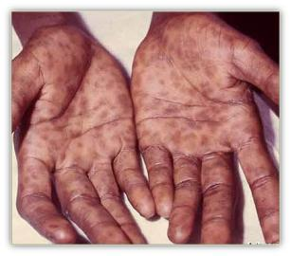
Vertical transmission is highest with early stages of maternal syphilis, specifically secondary syphilis.
Cooper, Sanchez. Congenital Syphilis. Seminars in Perinatology. 2018.
Notes:
Vertical transmission of syphilis is highest with early stages of maternal syphilis, specifically secondary syphilis.
Though again, vertical transmission of syphilis can occur at any stage.

Slide 15

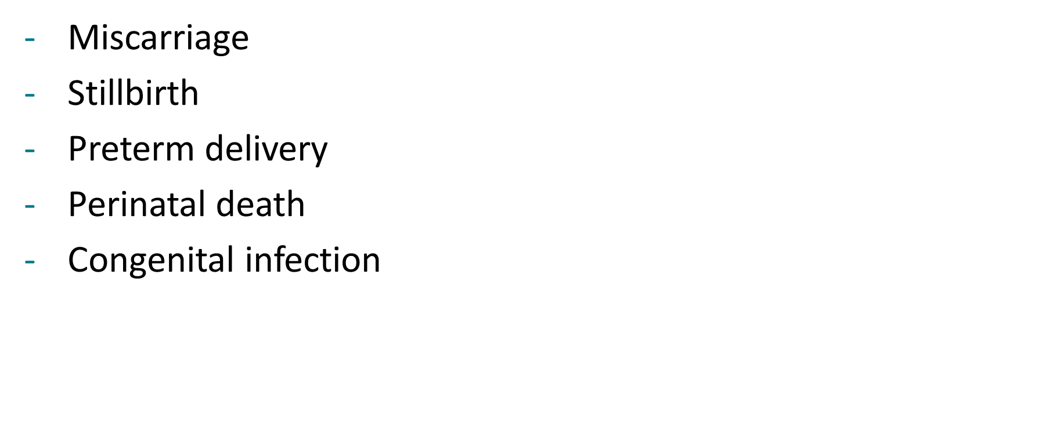
Syphilis during pregnancy
is associated with
Gomez et al. Untreated Maternal Syphilis and Adverse Outcomes of Pregnancy. Bulletin of the WHO. 2013.
Notes:
Syphilis during pregnancy is associated with miscarriage, stillbirth rate, preterm delivery, increased risk of perinatal death, and congenital infection.
Infants with congenital syphilis who survive can experience lifelong physical and neurologic problems due to chronic inflammation and scarring.

Slide 16

Timely* diagnosis and treatment of maternal syphilis can prevent congenital syphilis.
*Timely = initiated at least 30 days before delivery
Notes:
We know that timely identification and adequate treatment of maternal syphilis can prevent these terrible consequences of congenital infections.
Which is very important as we transition to a discussion of recent trends in syphilis diagnoses. Congenital syphilis is often considered the “tip of the iceberg” of a whole host of social challenges surrounding STIs.

Slide 17
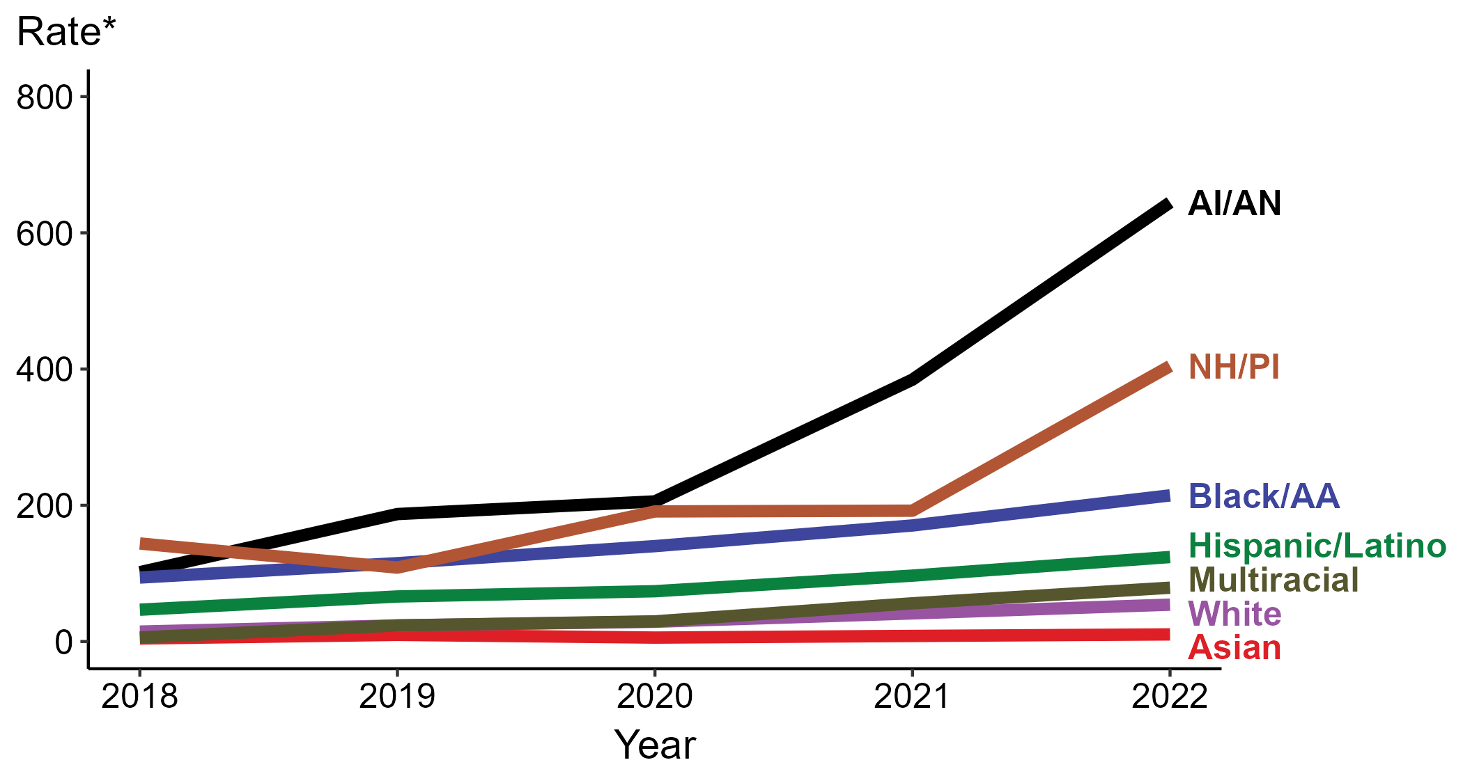
Congenital Syphilis — Rates of Reported Cases by Year of Birth, Race/Hispanic Ethnicity of Mother, United States, 2018–2022
* Per 100,000 live births
ACRONYMS: AI/AN = American Indian or Alaska Native; Black/AA = Black or African American; NH/PI = Native Hawaiian or other Pacific Islander
Notes:
In 2022, there were a total of 3,755 cases of congenital syphilis reported for a rate of 102.5 per 100,000 live births.
In 2022, the highest rate of reported cases of congenital syphilis per 100,000 live births was among mothers who were non-Hispanic American Indian or Alaska Native (644.7), followed by mothers who were non-Hispanic Native Hawaiian or other Pacific Islander (404.4).
During 2021 to 2022, the greatest increase in rate of reported cases of congenital syphilis per 100,000 live births was among mothers who were non-Hispanic Native Hawaiian or other Pacific Islander (192.1 to 404.4; 110.5% increase). Mothers who were non-Hispanic and of multiple races had the greatest five-year increase in rate of congenital syphilis (5.9 to 79.0; 1,239.0% increase from 2018).
There were no decreases in the rate of reported cases of congenital syphilis per 100,000 live births among any race or Hispanic ethnicity group during 2021 to 2022. There were also no decreases in the rate of congenital syphilis among any race or Hispanic ethnicity group during 2018 to 2022.
This report includes data from years that coincide with the COVID-19 pandemic, which introduced uncertainty and difficulty in interpreting STI surveillance data. See Impact of COVID-19 on STIs for more information.
See Technical Notes (https://www.cdc.gov/std/statistics/2022/technical-notes.htm) for information on syphilis case reporting, race/Hispanic ethnicity categorization, and reporting of race/Hispanic ethnicity for STI cases.
Data for all figures are available at https://www.cdc.gov/std/statistics/2022/data.zip. The file “CS - Rates by Race Hispanic Ethnicity of Mother (US 2022).xlsx” contains the data for the figure presented on this slide.

Slide 18
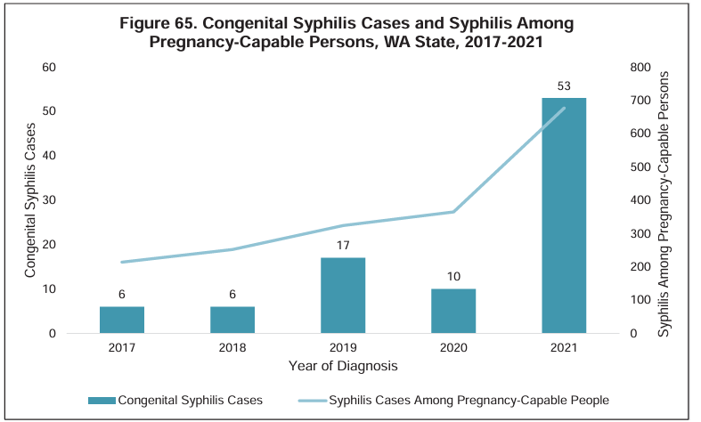
Source: Washington State Department of Health STI Epidemiological Profile, 2023

Slide 19
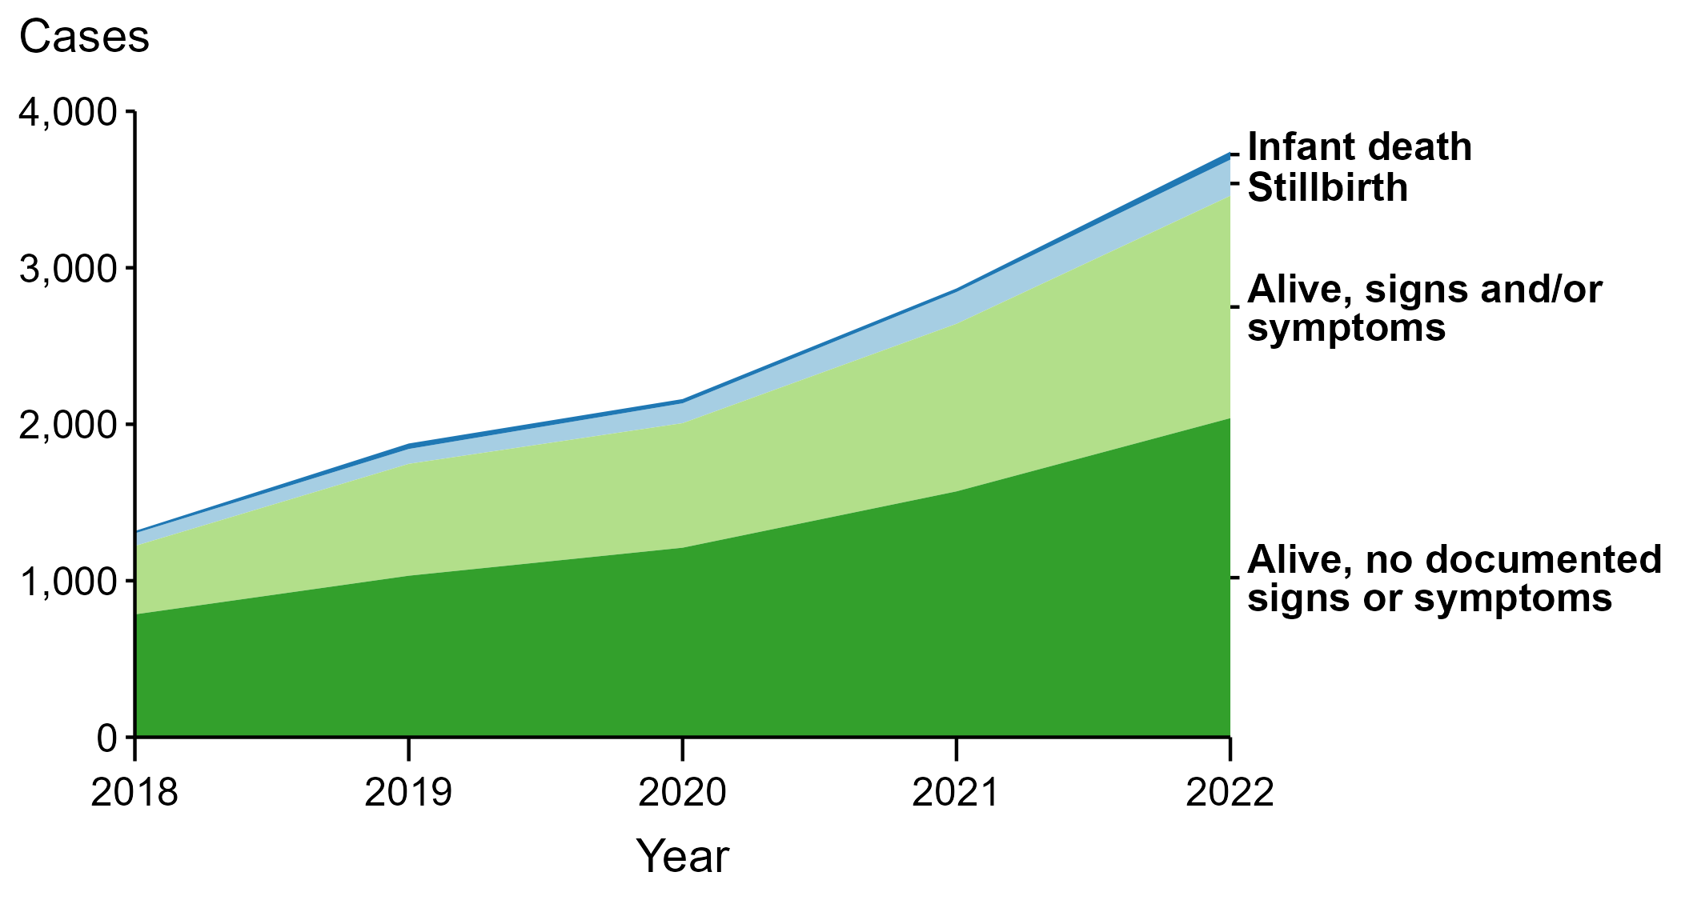
Congenital Syphilis — Reported Cases by Vital Status and Clinical Signs and Symptoms* of Infection, United States, 2018–2022
* Infants with signs and/or symptoms of congenital syphilis have documentation of at least one of the following: long bone changes consistent with congenital syphilis, snuffles, condylomata lata, syphilitic skin rash, pseudoparalysis, hepatosplenomegaly, edema, jaundice due to syphilitic hepatitis, reactive CSF-VDRL, elevated CSF WBC or protein values, or evidence of direct detection of T. pallidum.
NOTE: Of the 11,999 congenital syphilis cases reported during 2018 to 2022, 33 (0.3%) did not have sufficient information to be categorized.
Notes:
In 2022, there were a total of 3,755 cases of congenital syphilis reported for a rate of 102.5 per 100,000 live births.
In 2022, 51 congenital syphilis cases (1.4%) were infant deaths, 231 cases (6.2%) were stillbirths, 1,421 cases (37.8%) were born alive with congenital syphilis-related signs or symptoms, 2,039 cases (54.3%) were born alive with no documented congenital syphilis-related signs or symptoms, and 13 cases (0.3%) were missing information on vital status.
In 2022, there were 282 congenital syphilis-related deaths (231 stillbirths and 51 infant deaths), an increase of 24.8% from 2021 (226 in 2021 to 282 in 2022) and an increase of 193.8% from 2018 (96 in 2018 to 282 in 2022).
The number of infants reported with congenital syphilis who were born alive with congenital syphilis-related signs and symptoms increased 32.7% from 2021 to 2022 (1,071 in 2021 to 1,421 in 2022) and increased 225.2% from 2018 to 2022 (437 in 2018 to 1,421 in 2022).
This report includes data from years that coincide with the COVID-19 pandemic, which introduced uncertainty and difficulty in interpreting STI surveillance data. See Impact of COVID-19 on STIs for more information.
See Technical Notes (https://www.cdc.gov/std/statistics/2022/technical-notes.htm) for information on syphilis case reporting.
Data for all figures are available at https://www.cdc.gov/std/statistics/2022/data.zip. The file “CS - Cases by Vital Status and Clinical Signs and Symptoms (US 2018-2022).xlsx” contains the data for the figure presented on this slide.

Slide 20
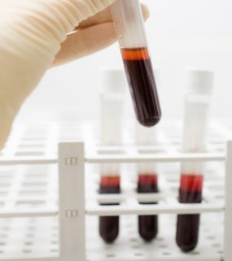
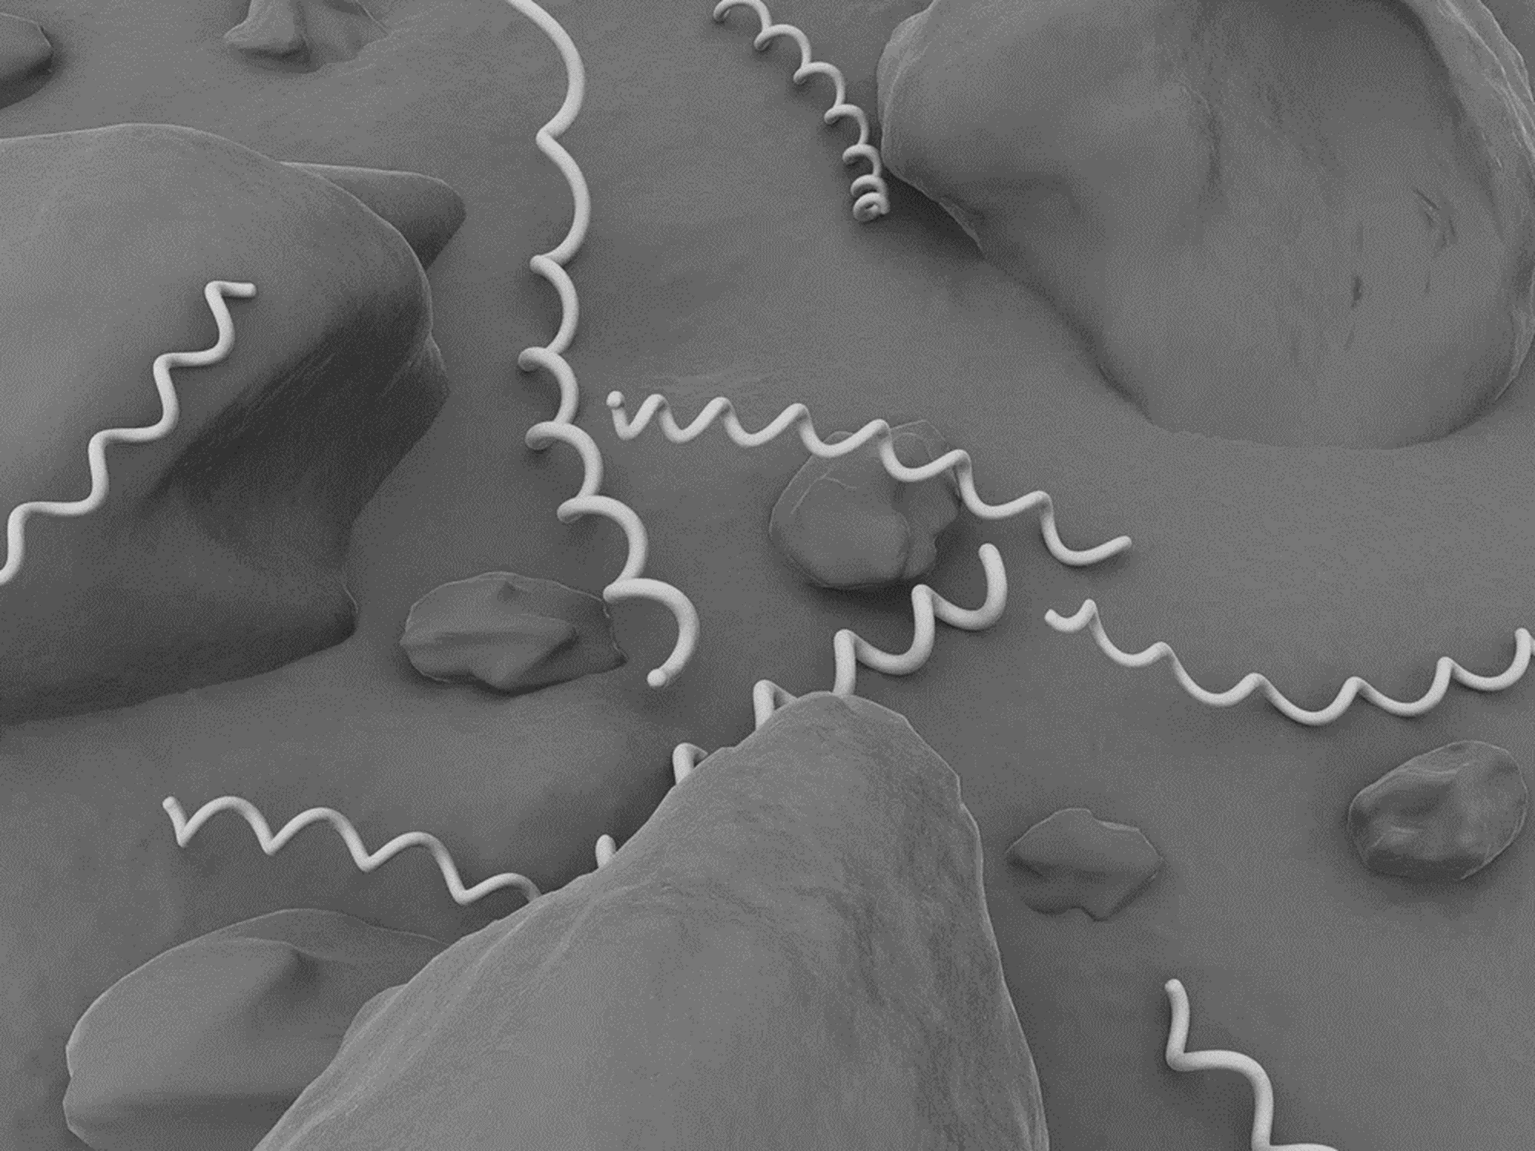
Who should you test/screen?
Patients with classic symptoms
Patients with symptoms without an alternative diagnosis
Patients in a high prevalence setting
Notes:
Now that we’ve described recent epidemiology of syphilis, let’s move into screening practices.
Syphilis still requires complex testing requirements.
There are two testing algorithms possible, and treatment varies based on the clinical stage, with primary and secondary stages requiring one dose of penicillin, and later stages requiring multiple doses.
This need for multiple doses for later stages can lead to patient loss to follow-up and can make disease control difficult.
So who should be tested/screened?
Patients with classic symptoms
Patients with symptoms without an alternative diagnosis
Patients at risk in high prevalence setting
t

Slide 21
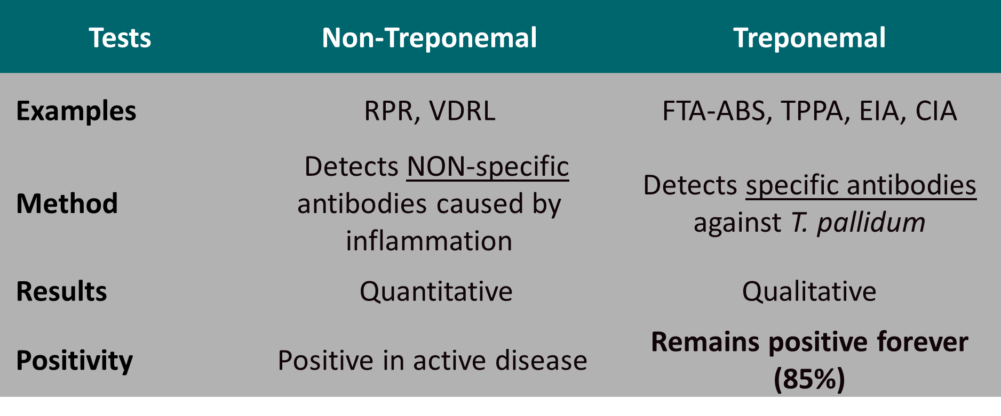
Two Types of serologic tests for syphilis
2021 STI Treatment Guidelines
Notes:
There are two types of serologic tests for syphilis: non-treponemal tests and treponemal tests. This table compares the two.
Non-treponemal tests, such as RPRs and VDRLs, detect nonspecific antibodies caused by inflammation. They are quantitative, measured in titers, and positive in active disease.
Treponemal tests include tests such as FTA-ABS, TP-PA, enzyme immunoassays, and rapid treponemal assays. These tests detect antibodies specific to syphilis. They are qualitative and remain positive forever in 85% of people.
BOTH a treponemal test and a nontreponemal test are needed to confirm the diagnosis of syphilis.

Slide 22
Serologic Diagnosis of Syphilis
Notes:
There are two types of serologic tests for syphilis: non-treponemal tests and treponemal tests. This table compares the two.
Non-treponemal tests, such as RPRs and VDRLs, detect nonspecific antibodies caused by inflammation. They are quantitative, measured in titers, and positive in active disease.
Treponemal tests include tests such as FTA-ABS, TP-PA, enzyme immunoassays, and rapid treponemal assays. These tests detect antibodies specific to syphilis. They are qualitative and remain positive forever in 85% of people.
BOTH a treponemal test and a nontreponemal test are needed to confirm the diagnosis of syphilis.

Slide 23
Non-Treponemal Test
Treponemal Test
Traditional
Missed treatment opportunities
Treponemal Test
Non-Treponemal Test
Reverse
Overtreatment
Notes:
So in using these types of tests there are 2 commonly used algorithms, the traditional and the reverse.
There are advantages and disadvantages to either algorithm. The decision for which algorithm to use, will be based on a variety of factors, including availability, cost, and (ideally) local prevalence and population risk factors.
the traditional algorithm results in a missed treatment opportunities in asymptomatic individuals.
This is because non-trep tests can result false negatives during the incubation phase and the test is manual and labor intensive, which means results aren’t immediate.
the reverse algorithm results in a potential overtreatment of patients because a trep test alone cannot tell us if there is active disease or if this is a previous infection that was treated. As you saw on the previous slide, there is lifelong reactivity in about 85% of people that have ever had syphilis so it’s difficult to discern a new or old infection without a titer or more information.
Nevertheless, using a reverse algorithm should be considered in a high prevalence or outbreak setting, if treating based on a single result (so treating presumptively before the second test has returned)

Slide 24
Case Question
This patient has syphilis and should receive treatment
This patient has a biologic false positive and nothing more is needed
More information is needed to interpret these results
This is a problem for the ID docs and OBs
28-year-old pregnant female presents to clinic with complaints of abnormal vaginal discharge. She has not been linked to prenatal care, so you decide to add a syphilis screening to your work-up. Three days later, results come back with an RPR value of 1:16. How do you interpret these results?
Notes:
To wake us up, let’s start with a quiz question…
Duplicate slide again later with answer

Slide 25
Case Question
This patient has syphilis and should receive treatment
This patient has a biologic false positive and nothing more is needed
More information is needed to interpret these results
This is a problem for the ID docs and OBs
28-year-old pregnant female presents to clinic with complaints of abnormal vaginal discharge. She has not been linked to prenatal care, so you decide to add a syphilis screening to your work-up. Three days later, results come back with an RPR value of 1:16. How do you interpret these results?
Notes:
Duplicate slide again later with answer

Slide 26
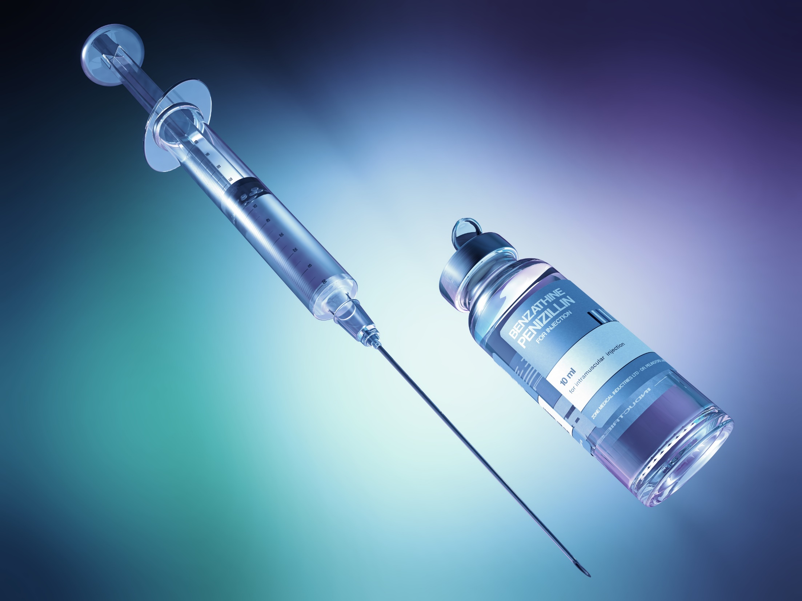
Treatment
Notes:
Now let’s move on to treatment:
-----------------------------------------
https://www.cdc.gov/std/treatment-guidelines/default.htm

Slide 27
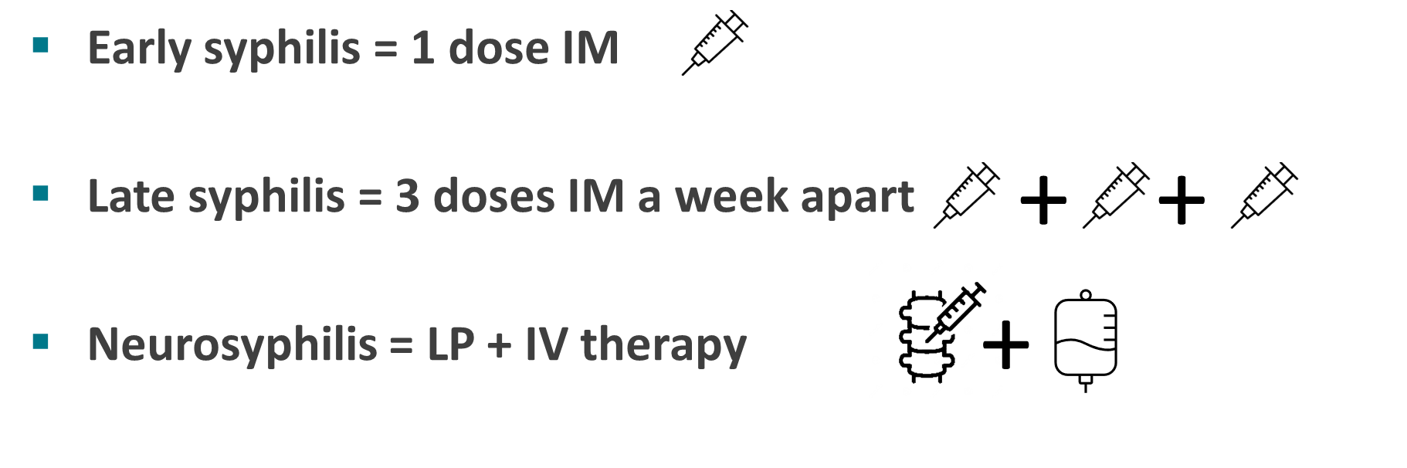
In Summary
Single dose 2.4 MU Benzathine Penicillin G
3 doses 2.4 MU Benzathine Penicillin G
IV Aqueous crystalline penicillin G 18 – 24 million units/day x 10-14 days
Notes:
Early syphilis, which includes the entire period from the time infection through the first year of infection (as long is there’s no evidence of neurosyphilis) is treated with
Benzathine penicillin 2.4 million units IM in a single dose
Late syphilis, which includes late latent, late unknown duration, and tertiary (non-neurosyphilis). These patients generally aren’t symptomatic or typically as contagious, and are treated with Benzathine penicillin 2.4 million units total administered as 3 doses of 2.4 million units IM each at 1-week intervals
Neurosyphilis, ocular syphilis and otosyphilis
Aqueous crystalline penicillin G 18-24 million units per day, administered as 3-4 million units by IV every 4 hours or continuous infusion for 10-14 days
Alternative: procaine penicillin G 2.4 million units IM 1x/day PLUS probenecid 500 mg orally 4x/day, both for 10-14 days

Slide 28


Pregnant People
Treatment
According to Stage
Notes:
We won’t get into treatment of congenital syphilis in this talk, but again, can provide resources for those interested in learning more about diagnosing and treating an infant with congenital syphilis.
(Benzathine penicillin is the only appropriate treatment for syphilis during pregnancy)

Slide 29
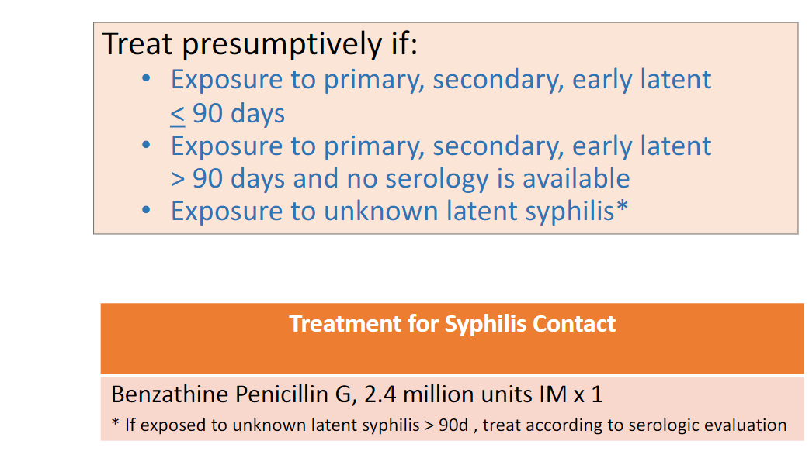
Management of Sex Partners
Notes:
Here, the bottom line is treat any persons who reports sexual exposure to someone with syphilis, even in the absence of signs or symptoms of infection or a positive test result. Serological testing can be falsely negative early in infection (i.e., “incubating syphilis”). Test these individuals for syphilis but treatment should not be withheld awaiting test results.

Slide 30
IHS CMO Tribal Leader
Letter on Syphilis
IHS Recommended Guidelines for Syphilis Testing, Treatment and Prevention 2/15/2024
1. Offer annual syphilis testing for persons ages 13 and older to eliminate syphilis
transmission by early case recognition.
2. Prescribe and administer Penicillin G Benzathine for every age and every stage of syphilis infection in the absence of contraindications to therapy.
  The IHS National Supply Service Center (NSSC) and IHS Pharmaceutical Prime Vendor report that all reasonable orders for Bicillin are currently being fulfilled. For questions about how to order this medication, please get in touch with Weston.Thompson@ihs.gov at NSSC.

Slide 31
IHS CMO Tribal Leader
Letter on Syphilis
3. Turn on the annual Electronic Health Record reminder at all sites to facilitate testing for two years or until incidence rates decrease locally to baseline.
4. Provide three-point syphilis testing for all pregnant people at the first prenatal visit, the beginning of the third trimester, and delivery.
5. Adoption of an HIV/Viral Hepatitis/STI testing bundle (plus pregnancy test when appropriate) at all sites to screen broadly:
  -Syphilis screening test with reflex RPR + titer.
  -HIV serology (with documentation of consent if required in the local state jurisdiction.)
  -Screening for gonorrhea and chlamydia at three sites: Urine, Pharynx, Rectum.
  -Screening for hepatitis B and C.
  -Pregnancy test.

Slide 32
IHS CMO Tribal Leader
Letter on Syphilis
6.Adopt and provide Express STI testing services at all sites.
-Provide universal screening and treatment for syphilis in Urgent Care and Emergency
Department settings, as many individuals utilize Urgent Care and Emergency
Departments as their primary access to care.
7. Provide field testing outside hospitals and clinics to increase screening rates.
-Utilize point-of-care, rapid syphilis, or dual HIV/syphilis antibody tests.
8. Provide field treatment for syphilis whenever necessary for adults diagnosed with syphilis
and their partners.
    -Note: When field testing, provide immediate treatment following a reactive syphilis
    antibody result if there is uncertainty that the individual may not follow up
    appropriately.

Slide 33

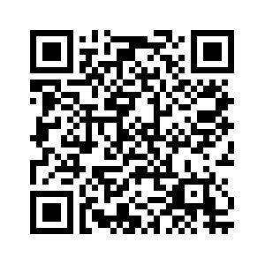
IHS CMO Tribal Leader
Letter on Syphilis
9. Provide presumptive treatment of syphilis for anyone having signs or symptoms of syphilis or with known exposure to syphilis.
-Provide testing and treatment with Penicillin G Benzathine for all contacts and partners, including non-beneficiaries.
10. Offer and provide DoxyPEP to appropriate populations indicated in the updated IHS guidelines to prevent bacterial STIs, including syphilis.
IHS STI Toolkit
Indian Country ECHO Resource Hub

Slide 34
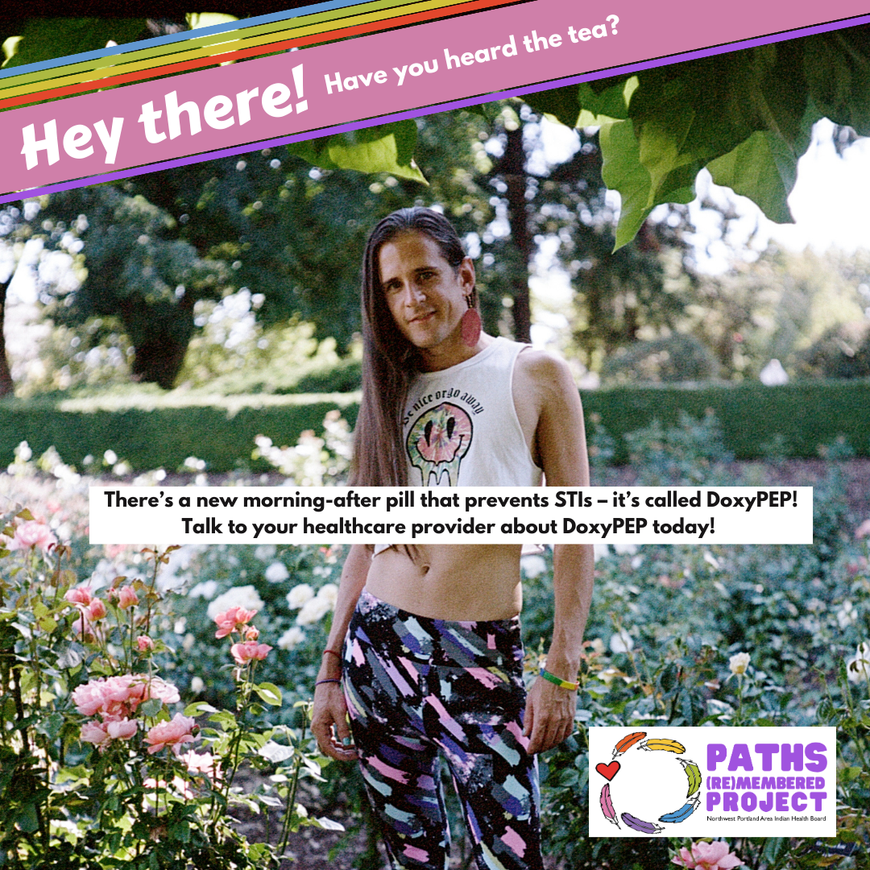
DoxyPEP
DoxyPEP (post-exposure prophylaxis)
  Take 1 dose of Doxycycline 200mg 24-72hrs after condomless sex
  Who should receive DoxyPEP?
    MSM/Trans Women (TGW) on HIV PrEP or living with HIV.
    If not on HIV PrEP, MSM/TGW with history of STIs within the past 12 months, sex work
  In study, found a 65% reduction in chlamydia, gonorrhea, and syphilis among men who have sex with men (MSM) and transgender women
Notes:
For DoxyPrEP:
In a pilot study, 30 MSM living with HIV with previous syphilis (two or more episodes since HIV diagnosis) were randomly assigned to doxycycline 100 mg for 48 weeks versus a financial incentive–based behavioral intervention
A reminder that current studies have shown promise among MSM and
transgender women, but not among cis-gender women
Only Doxycycline has been studied, no other antibiotics
Doxycycline may cause fatty liver disease in pregnant people and fetal tooth staining
U.S. Centers for Disease Control and Prevention, DRAFT Guidelines for the Use of Doxy-PEP for Prevention of Bacterial STI. Accessed March 12, 2024.

Slide 35
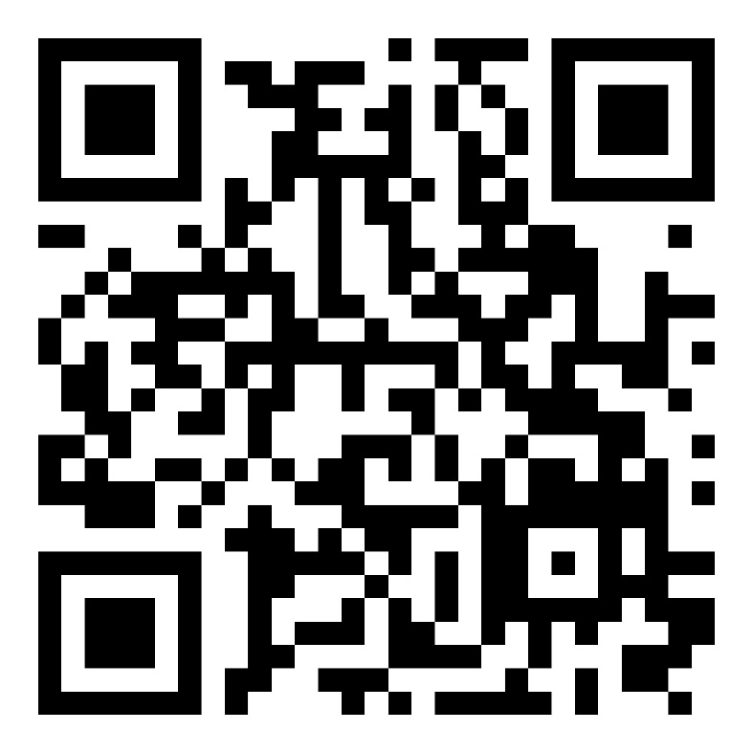
HHS Tribal Leader Consultation on Syphilis & Congenital Syphilis
The U.S. Department of Health and Human Services (HHS) Office of the Assistant Secretary for Health (OASH) will hold a Tribal consultation on August 5, 2024, to discuss the syphilis and congenital syphilis outbreak in Tribal Communities.
Innovative and new ways are needed to ensure timely screening and treatment for all AI/AN people
Invest in maternal child health and reproductive healthcare for AI/AN people
Increase care for the syndemic issue of syphilis and substance use disorder in AI/AN communities
Invest in comprehensive culturally-specific sexual health education is urgently needed

Slide 36
Facility Assessments

Slide 37




Goals
Provider training to support care and treatment
Assess clinic capacity to provide STI/HIV/HCV clinical care, surveillance, and partner services
Provide site specific recommendations for syndemic response
Share aggregate findings to support guidance for other clinics locally/nationally
Notes:
We’ve had four main goals for this project:
-Provider training to support care and treatment
-Assess clinic capacity to provide STI/HIV/HCV clinical care, surveillance, and partner services
-Provide site specific recommendations for syphilis control and prevention
-Share aggregate findings to support guidance for other clinics locally/nationally.
We’ve also used some of this information collected to support our collaboration with state partners to strengthen response in Tribal communities.
During these site visits, we typically start with an in-service provider training followed by both formal and informal interviews with various clinic staff to gather information for the assessments.

Slide 38
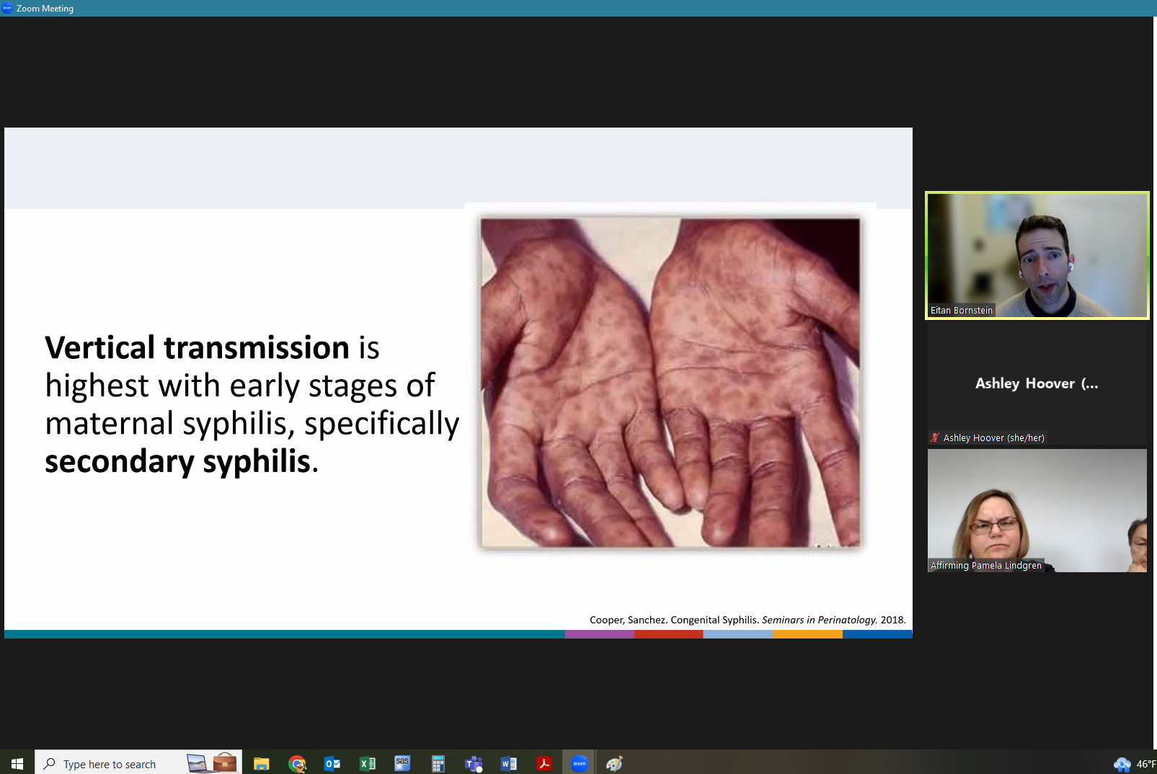
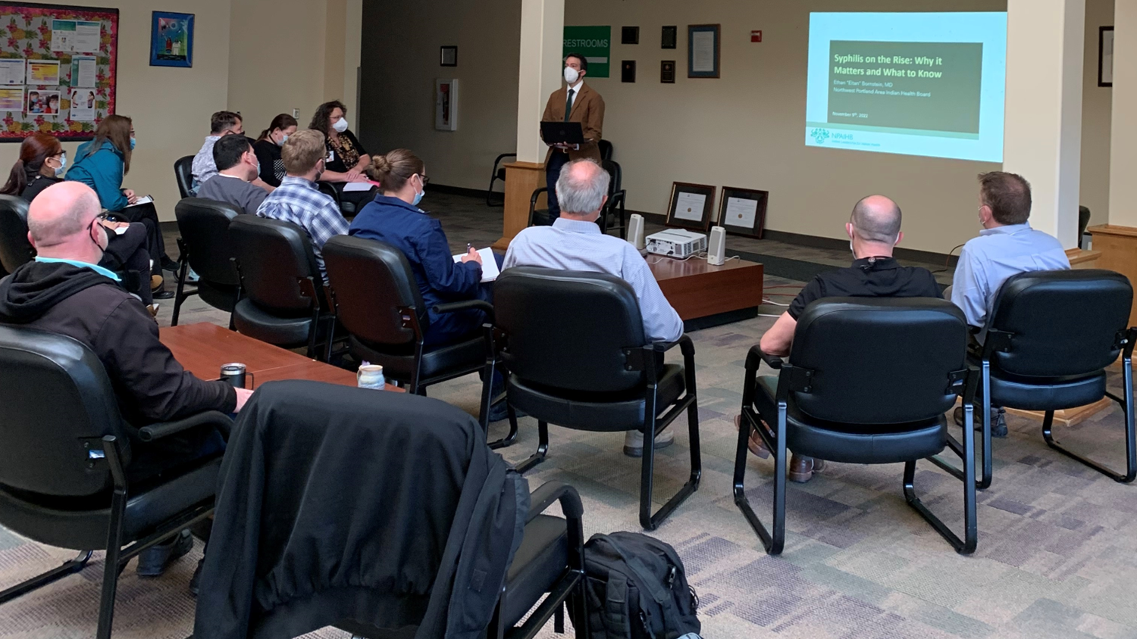
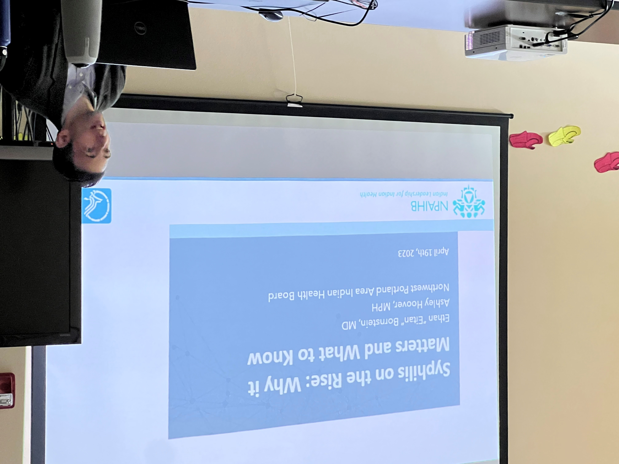
Provider Training
Notes:
Here are some snapshots of the in-service training we provided as part of each visit. These were most often done during admin time at the clinics and took anywhere between 45 minutes to an hour. We visited most sites in person, but we did conduct a couple remotely, as you can see by the screenshot on the right. Each site was different in terms of who attended these trainings, but we typically had most clinicians from each clinic, public health nurses, clinic administration, lab and pharm staff, as well as some folks from behavioral health.

Slide 39

Facility Assessments:
Who we Interviewed
Acting Medical Director
Primary Care Physicians/Providers
Notes:
As I mentioned earlier, we followed the in-service trainings by conducting both formal and informal interviews with various clinic staff to gather information for the assessments. We started out with a very formal process but as Ashley and I became more comfortable with the information we were trying to collect, we were able to gather this information in more informal conversations.
Here are some examples of types of roles we interviewed.
Provider Staff

Slide 40
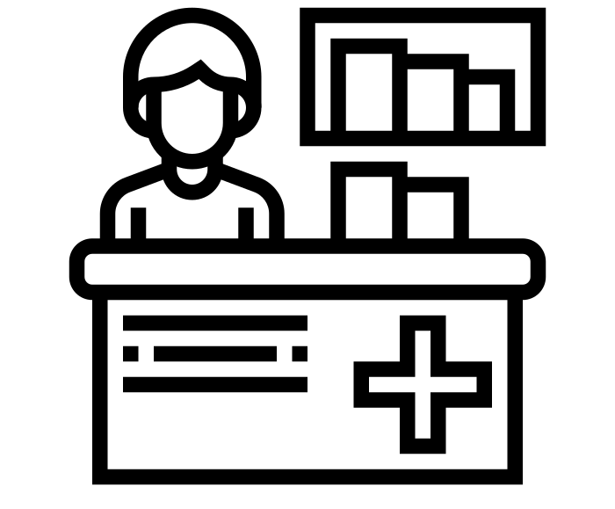
Facility Assessments:
Who we Interviewed
Acting Medical Director
Primary Care Physicians/Providers
Clinical Pharmacist
Pharmacy Director
Notes:
Pharmacy staff

Slide 41
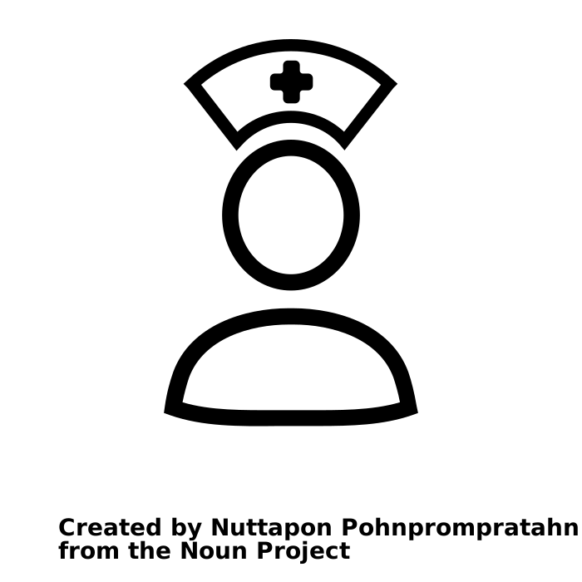
Facility Assessments:
Who we Interviewed
Acting Medical Director
Primary Care Physicians/Providers
Public Health Nurse
Infection Control Nurse
Public Health Director
Clinical Pharmacist
Pharmacy Director
Notes:
Public Health Staff

Slide 42

Facility Assessments:
Who we Interviewed
Acting Medical Director
Primary Care Physicians/Providers
Public Health Nurse
Infection Control Nurse
Public Health Director
Clinical Pharmacist
Pharmacy Director
Lab Director/Manager
Lab Tech
Notes:
Lab staff

Slide 43




Facility Assessments:
Data Collected—Lab
Testing algorithm?
Reporting Process?
Result turnaround time?
Notes:
The facility assessment itself is quite long and we were able to collect a lot of information from each site. These are just a couple of different indicators we discussed with each department.
For the Lab,
Reverse algorithm specifically for syphilis
Turnaround time for all test results
Lab reporting processes both to the county/state level and back to the clinic.

Slide 44


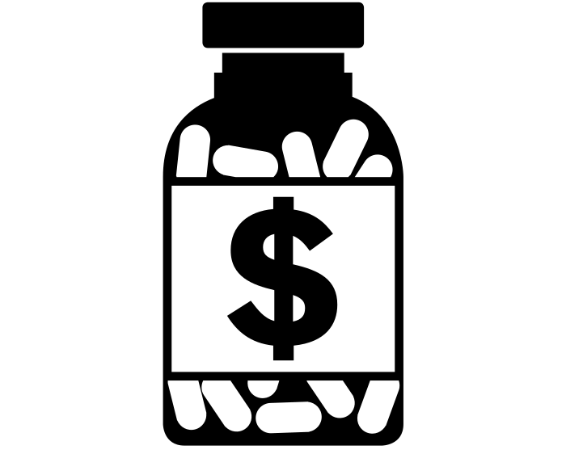
Facility Assessments:
Data Collected—Pharmacy
Treatment availability?
Treatment order sets and reminders?
Costs?
Notes:
Pharmacy
Treatment availability? For syphilis, gc/ct, HIV, PrEP, and SUD treatment availability
Costs of these treatments, specifically for bicillin
Order sets?

Slide 45

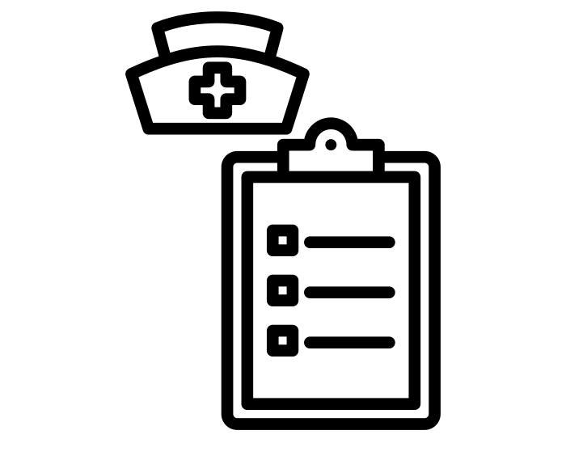

Facility Assessments:
Data Collected—Public Health
Case Management and Linkage to Care?
Case Reporting?
Field-based testing and treatment?
Notes:
Public Health
Case Investigation ?
Case Reporting?
Any linkage to care processes within the clinic

Slide 46




Facility Assessments:
Data Collected—Physicians
Obtaining sexual histories?
Assessing community risk?
Screening practices?
Availability of order sets, reminders and templates?
Staging?
Notes:
For clinicians:
Comfort and barriers to taking sexual histories
Screening Practices—who is screened, barriers to screening
Staging—comfort with staging syphilis
Follow-up? What type of follow-up providers can give and
Knowledge of community risk?
Order sets for testing and treatment for providers

Slide 47

Initial Findings
Notes:
Over the last year, we were able to visit nine different facilities across Oregon, Idaho, and Washington. These are some of the initial findings from these visits.

Slide 48









Feedback from Clinics
Barriers to screening, treatment, and taking a sexual history
Geographic factors
Social factors
Admin factors
Training Needs/Requests
STI Screening +
Treatment Recs
Taking a sexual history
Interpreting Lab Results
Notes:
Barriers to screening, treatment, and taking a sexual history:
Geographic Factors
Many patients live far from the clinic
Small towns with limited resources and fear of others finding out (hand in hand with stigma and social factors)
Social Factors--
Stigma, taboos, and lack of trust with providers within the healthcare system. “Taboos, discomfort in discussing sexual history”
Building trust within the healthcare system
Hard to reach populations—vulnerable populations not coming to clinic
Admin Factors—
Time limitations in clinic; “Patients are seen in the field, so history is really being done by the Community Health Reps and/or Public Health Nurses, often no time in clinic to address this”
Need additional staffing that are qualified and trained, suggested a tribal nurse dedicated to providing field treatment and partner services.
“Only really done if indicated for MAT program screening and if someone does test positive”
From our visits, we also identified what types of training were important to providers and other clinical staff. Commonly there were requests for further information on STI screening and treatment recommendation, development of improved history taking and patient engagement, and interpreting syphilis lab results at varying intervals.

Slide 49




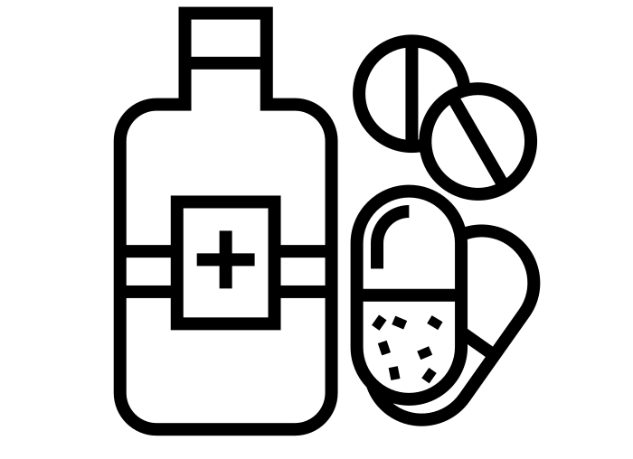
Best Practices: Strengths
Intergovernmental collaboration
Bicillin availability
Reverse Algorithm
Syndemic-related
medication availability
Notes:
We also identified several best practices concerning syphilis detection and treatment. Many sites had established collaboration with county, local health jurisdictions, and even the state on disease intervention. Some had access to the state STI surveillance system and many worked with their local DIS and/or county Epidemiologists to conduct case investigation and linkage to care (when treatment was not an option at the clinic).
As noted on a previous slide, many sites were using reverse algorithm for syphilis, which is recommended for high-risk populations
Most clinics had easy access to bicillin. They either stocked bicillin or had a working relationship with their local health jurisdiction to obtain doses. Many also worked with their LHJs or the state to procure doses through 340b pricing.
Most sites also had PrEP and MAT availability, with capacity for further syndemic treatment approaches

Slide 50
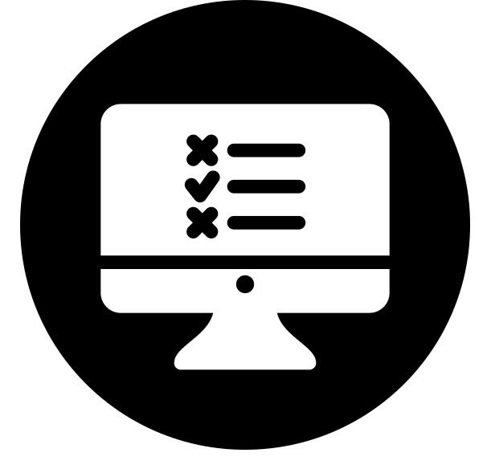


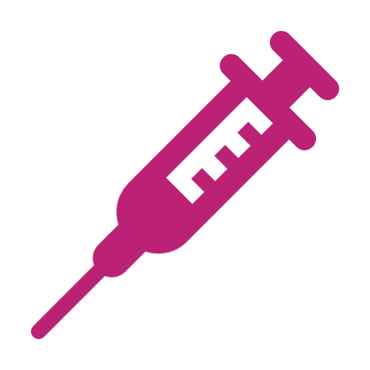

Areas of Growth
Standardized STI screening order sets/EHR notifications
Trainings for sexual health history taking, interpreting syphilis lab results, and treatment recommendations
Screening in all clinical services
Presumptive treatment of symptomatic persons and partners
In Field Testing/Treatment
Notes:
While we identified many best practices, we also identified some areas of growth for sites, including
Implementing Standardized STI screening order sets with EMRs
Electronic health record notifications for testing and treatment reminders
Screening in all clinical services: Coordination with substance use disorder treatment programs and other behavioral health programs offered within Tribal health for increased access to STI screening
Adopting the practice of presumptive treatment for symptomatic persons and their partners (specifically for syphilis), and
Increasing practices around in-field treatment

Slide 51
Follow-Up &
Key Takeaways
Increased collaboration/partnership between Health Boards and Partner Tribes
Assessment can be a helpful Quality Improvement (QI) tool to support improved processes for syndemic-related activities
Opportunity to share best practices
Supports Indigi-HAS initiatives
Notes:
After each site visit, we follow up with each site to share our findings and offer resources to address the areas of growth identified.
We acknowledge that awareness around syphilis increases in Indian country is growing at the local level and a lot of work to address this is happening without our support/intervention; however, we do believe the visits themselves have hopefully started conversations and changes around facility improvements concerning syndemic response as we ramp up this work to address the increasing rates of syphilis and other STIs.
And while we don’t yet have a full list of actions that sites have taken to address some of these identified areas of growth, we do know a couple of the sites have implemented some best practices, especially those that have seen significant increases in syphilis in their communities.
We’re still in the process of figuring out a post visit follow-up process with each site to provide additional support and guidance as we all work toward reducing cases of syphilis, HIV, and other STIs in Indian Country.
We do know there are specific areas of concern that will need to be addressed in this process, including
Figuring out impact of the shortage of bicillin at the local level and potential changes in available resources; staffing changes, field treatment implementation, and coordination of care with state/local health jurisdictions.
Identification of sites with higher incidence; use that as indicator for more frequent follow up
Areas for followup include tx availability; identification of CS cases; coordination of care with LHJs; field treatment implementation

Slide 52
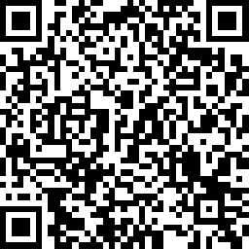
How to Get Involved
If you and/or your clinic would like to work with NPAIHB on these efforts, please scan the QR code and fill out the Request for Information online form. NPAIHB will contact you to discuss additional details and potential scheduling!
(Alternatively, you can click the link below from the slide deck)
Facility Assessment Project Request for Information

Slide 53
Outbreak Response and Best Practices

Slide 54

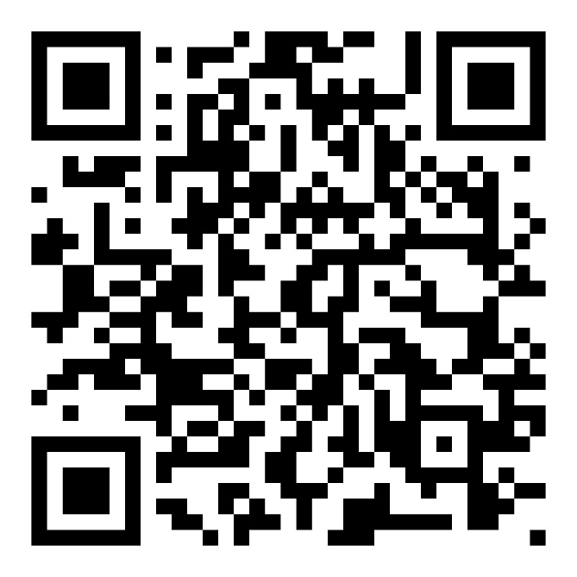
Family Care Plans
A Toolkit for Pregnant People and Families
Experiencing Substance Use Disorder
This toolkit is culturally specific and designed to:
Help clinicians care for AI/AN pregnant and parenting people and their infants impacted by SUDs
Support pregnant and parenting people transitioning into and remain in active recovery
Assist affected partners and families in
growing stronger
Notes:
This toolkit is is culturally specific and designed to:
Help clinicians care for AI/AN pregnant and parenting people and their infants impacted by SUDs
Support pregnant and parenting people transitioning into and remaining in active recovery, and
Assist affected partners and families in growing stronger
The toolkit offers:
A guide for clinicians on improving outcomes for AI/AN pregnant and parenting people and their infants, partners, and families
A variety of handouts for AI/AN pregnant and parenting people and their supports
Eye catching posts to share on organizational social media accounts

Slide 55


Rapid Testing &
Self-collection Kits
Rapid, Point-of-Care tests can be performed outside of traditional clinic settings
  Health Check (10 min result)
  Chembio – Dual rapid HIV-syphilis test (15 min result)
  Can treat immediately after rapid test results (for syphilis)
In-home specimen collection/lab-based testing:
Swab/Urine: trichomonas, gonorrhea/chlamydia (x3)
Blood: HIV (confirmatory), syphilis (RPR+TPPA), HCV, HBV
Even if test results are not available, but syphilis is indicated: TREAT!

Slide 56
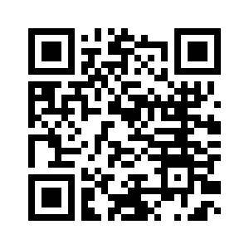

Native Health Resources

Slide 57
Acknowledgements
Tribes of the Pacific Northwest and Southwest
I/T/U Facility staff
Jorge Mera, MD
Eitan Bornstein, MD
Melanie Taylor, MD
Jessica Leston, MPH
Brigg Reilley, MPH
Alicia Edwards, MPH
ANTCH
Hope Committee

Slide 58
Thank you!
Ashley Hoover, MPH ahoover@npaihb.org
Marketing: Alicia Edwards (Colville), MBA, MPH aedwards@npaihb.org

Slide 59


Slide 60
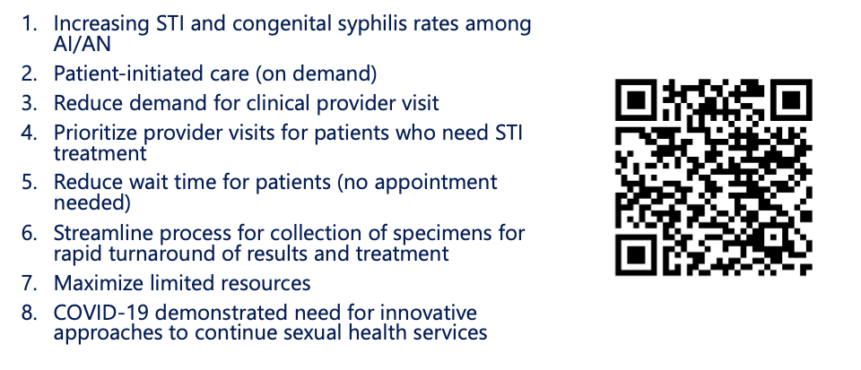
Express STI Testing
Notes:
Now I want to talk about some additional resources and models for outbreak response.
Adoption of "Express STI Testing" Express STI services refer to triage-based STI testing without a full clinical exam, using standing orders
The idea here is the more efficient the process (decreased wait times, decreased time to get results, decrease in the # of people you need to speak with), the greater likelihood of patients returning. (Drive-thru vs dining-in)
Research shows that express STI services increase clinic capacity and reduce the time to treatment
Side note: This plan also includes policy examples for PHNs providing field treatment of benzathine penicillin. For questions, contact Tina Tah or Melissa Wyaco

