Slide 1
ECHO Diabetes Diagnosis of Diabetes Review of ADA Standards of Care
October 10, 2024
Carol Greenlee MD

Slide 2
Pre-Question (pick one answer that is most correct)
The Diagnosis of Diabetes
Must be confirmed by a 2-hour oral glucose tolerance test (OGTT)
Can be made based on a fingerstick blood glucose
Can be made in a person with classic hyperglycemic symptoms and a venous blood glucose level =/>200 mg/dl
Can be established based on CGM (Continuous Glucose Monitoring) results

Slide 3
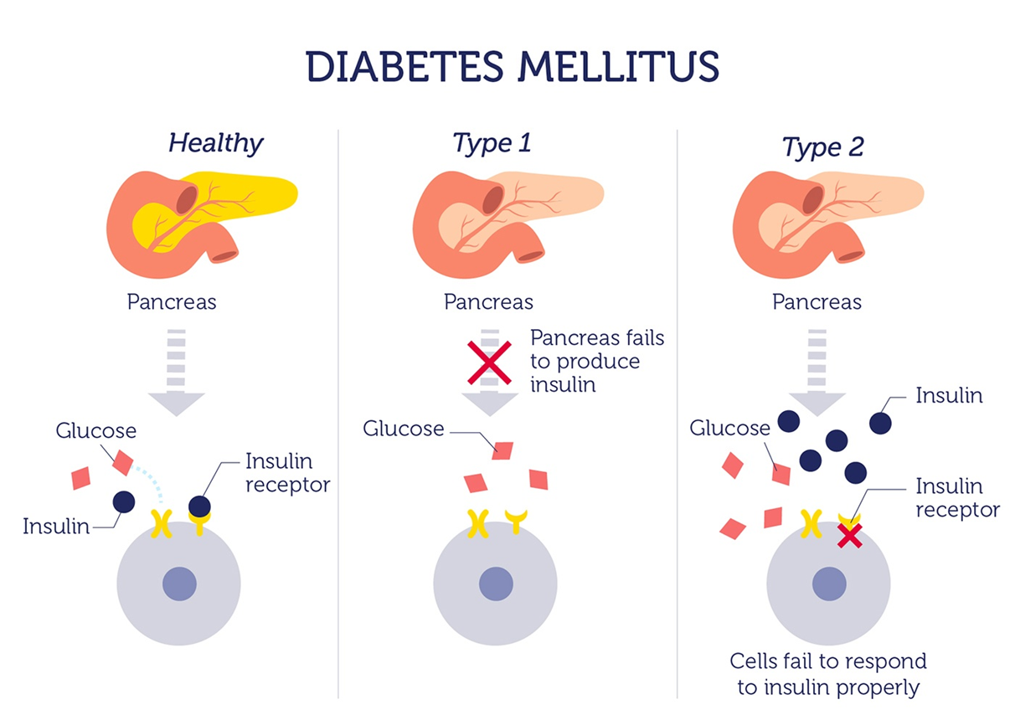
What is diabetes
Diabetes mellitus refers to a group of diseases that affect how the body uses blood sugar (glucose).
It is a metabolic disorder in which the body has high sugar levels for prolonged periods of time
From the ADA
Diabetes mellitus is a group of metabolic disorders of carbohydrate metabolism in which glucose is both underutilized as an energy source and overproduced due to inappropriate gluconeogenesis and glycogenolysis[hepatic glucose production/output], resulting in hyperglycemia.

Slide 4
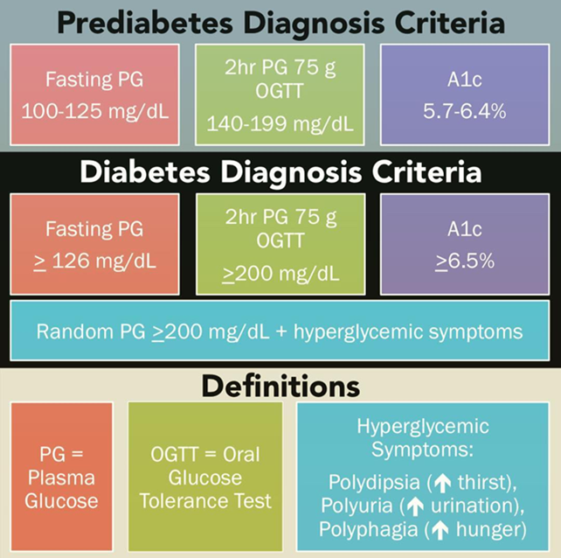
ADA 2024 Standards of Care Recommendations Diagnose Diabetes
2.1a Diagnose diabetes based on
A1C or
Plasma glucose criteria, either
the fasting plasma glucose (FPG) value,
2-h plasma glucose (2-h PG) value during a 75-g oral glucose tolerance test (OGTT), or
random glucose value accompanied by classic hyperglycemic symptoms/crises criteria. A
2.1b In the absence of unequivocal hyperglycemia (e.g., hyperglycemic crises), diagnosis requires confirmatory testing. A
The same tests may be used to screen for and diagnose diabetes and to detect individuals with prediabetes

Slide 5
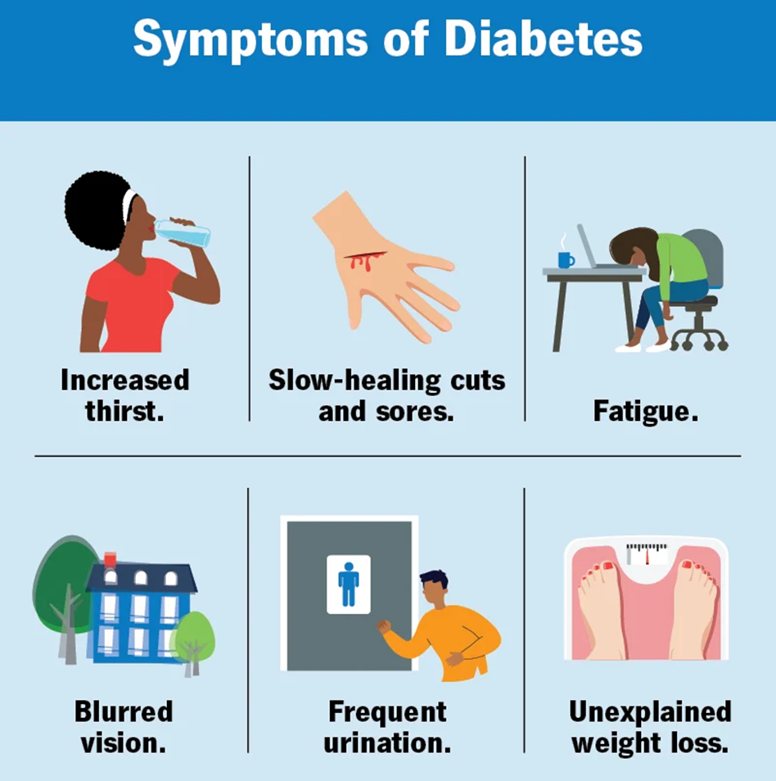
Presenting with Classic Hyperglycemic Symptoms* or Hyperglycemic Crisis
In this scenario, measurement of random plasma glucose is sufficient to diagnose diabetes (symptoms of hyperglycemia or hyperglycemic crisis plus random plasma glucose ≥200 mg/dL).
In these cases, knowing the plasma glucose level is critical because, in addition to confirming that symptoms are due to diabetes, it will inform management decisions.
Does not require a second test to confirm the diagnosis of diabetes , but health care professionals may also want to know the A1C to determine the chronicity of hyperglycemia.
*classic hyperglycemic symptoms (e.g., polyuria, polydipsia, and unexplained weight loss)

Slide 6
In Asymptomatic Individuals – Who & How to Screen
2.9 Screening for prediabetes and type 2 diabetes with an assessment of risk factors or validated risk calculator should be done in asymptomatic adults. B
2.10a Testing for prediabetes or type 2 diabetes in asymptomatic people should be considered in adults of any age with overweight or obesity who have one or more risk factors (Table 2.4 ). B
2.10b For all other people, screening should begin at age 35 years. B
2.11 If tests are normal, repeat screening recommended at a minimum of 3-year intervals is reasonable, sooner with symptoms or change in risk (e.g., weight gain). C
2.12 To screen for prediabetes and type 2 diabetes, FPG, 2-h PG during 75-g OGTT, and A1C are each appropriate. B [increasing research on using 1-h PG during 75-g OGTT ]
2.13 When using OGTT as a screen for prediabetes or diabetes, adequate carbohydrate intake (at least 150 g/day) should be assured for 3 days prior to testing. A

Slide 7
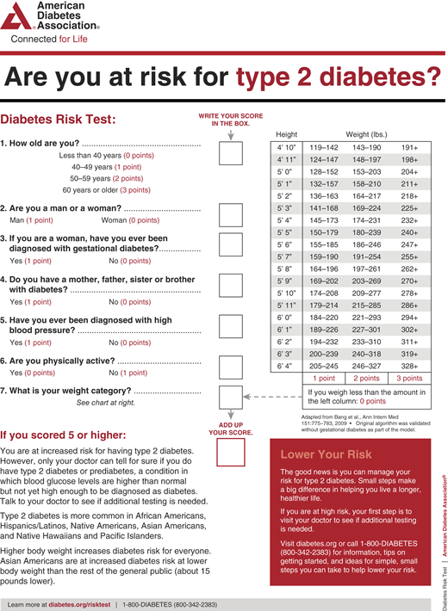
ADA Risk Calculator for T2D

Slide 8
Table 2.4 Criteria for screening for diabetes or prediabetes in asymptomatic adults
1.Testing should be considered in adults with overweight or obesity (BMI ≥25 kg/m2 or ≥23 kg/m2 in Asian American individuals) who have one or more of the following risk factors:
First-degree relative with diabetes
High-risk race and ethnicity (e.g., African American, Latino, Native American, Asian American, Pacific Islander)
History of cardiovascular disease
Hypertension (≥130/80 mmHg or on therapy for hypertension)
HDL cholesterol level <35 mg/dL (<0.9 mmol/L) and/or a triglyceride level >250 mg/dL (>2.8 mmol/L)
Individuals with polycystic ovary syndrome
Physical inactivity
Other clinical conditions associated with insulin resistance (e.g., severe obesity, acanthosis nigricans)
2. People with prediabetes (A1C ≥5.7%, IGT, or IFG) should be tested yearly.
3. People who were diagnosed with GDM should have lifelong testing at least every 3 years.
4. For all other people, testing should begin at age 35 years.
5. If results are normal, testing should be repeated at a minimum of 3-year intervals, with consideration of more frequent testing depending on initial results and risk status.
6. People with HIV, exposure to high-risk medicines, history of pancreatitis

Slide 9
When to Screen for T2D in Youth
Table 2.5
Risk-based screening for type 2 diabetes or prediabetes in asymptomatic children and adolescents in a clinical setting
2.14 Risk-based screening for prediabetes or type 2 diabetes should
be considered after the onset of puberty or after 10 years of age,
whichever occurs earlier, in children and adolescents with
overweight (BMI ≥85th percentile) or obesity (BMI ≥95th percentile)
and who have one or more risk factors for diabetes. B
Screening should be considered in youth who have overweight (≥85th percentile) or obesity (≥95th percentile) A and who have one or more additional risk factors based on the strength of their association with diabetes:
• Maternal history of diabetes or GDM during the child’s gestation A
• Family history of type 2 diabetes in first- or second-degree relative A
• Race and ethnicity (e.g., Native American, African American, Latino, Asian American, Pacific Islander) A
• Signs of insulin resistance or conditions associated with insulin resistance (acanthosis nigricans, hypertension, dyslipidemia, polycystic ovary syndrome, or small-for-gestational-age birth weight) B

Slide 10
Diagnostic Screening
In people without symptoms, FPG, 2-h PG during 75-g OGTT, and A1C are appropriate for diagnostic screening.
Detection rates of different screening tests vary in both populations and individuals.
FPG, 2-h PG, and A1C reflect different aspects of glucose metabolism, and diagnostic cut points for the different tests will identify different groups of people.
Compared with FPG and A1C cut points, the 2-h PG value diagnoses more people with prediabetes and diabetes. (Gold Standard)
the 2-h PG (OGTT) testing protocol may identify individuals with diabetes who may otherwise be missed (e.g., those with cystic fibrosis–related diabetes, post-transplantation diabetes mellitus, PCOS, hepatogenous diabetes [cirrhosis])
In the absence of classic hyperglycemic symptoms, repeat testing is required to confirm the diagnosis regardless of the test used
There is presently insufficient evidence to support the use of continuous glucose monitoring (CGM) for screening or diagnosis of prediabetes or diabetes.

Slide 11
Use of A1C for Screening and Diagnosis of Diabetes
Recommendations
2.2a The A1C test should be performed using a method that is certified by the National Glycohemoglobin Standardization Program (NGSP) as traceable to the Diabetes Control and Complications Trial (DCCT) reference assay. B
2.2b Point-of-care A1C testing for diabetes screening and diagnosis should be restricted to U.S. Food and Drug Administration (FDA)–approved devices at Clinical Laboratory Improvement Amendments (CLIA)–certified laboratories that perform testing of moderate complexity or higher by trained personnel. B
2.3 Marked discordance between A1C and repeat blood glucose values should raise the possibility of a problem or interference with either test. B
2.4 In conditions associated with an altered relationship between A1C and glycemia, such as some hemoglobin variants, pregnancy (second and third trimesters and the postpartum period), glucose-6-phosphate dehydrogenase deficiency, HIV, hemodialysis, recent blood loss or transfusion, or erythropoietin therapy, plasma glucose criteria should be used to diagnose diabetes. B

Slide 12
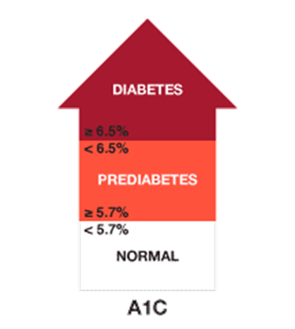
Use of A1C for Screening and Diagnosis of Diabetes
A1C has several advantages compared with FPG and OGTT, including:
greater convenience (fasting not required)
greater preanalytical stability
fewer day-to-day perturbations during stress, changes in nutrition, or illness.
Disadvantages:
lower sensitivity of A1C at the designated cut point compared with that of glucose tests
the A1C cut point of ≥6.5% identifies one-third fewer cases of undiagnosed diabetes than a fasting glucose cut point of ≥126 mg/dL (NHANES Data) (www.cdc.gov/diabetes/pubs/factsheet11/tables1_2.htm)
greater cost
limited access in some parts of the world.
Notes:
ADA 2024 Standards of Care
https://diabetes.org/about-diabetes/diagnosis
www.cdc.gov/diabetes/pubs/factsheet11/tables1_2.htm

Slide 13
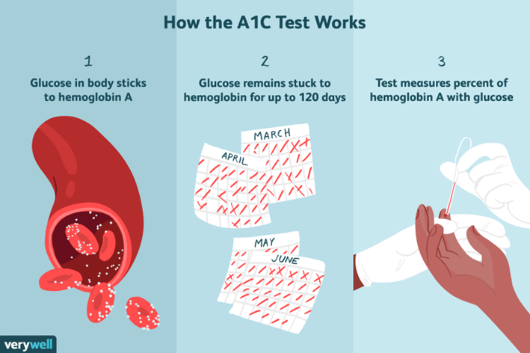
Use of A1C for Screening and Diagnosis of Diabetes
A1C reflects glucose bound to hemoglobin over the life span of the erythrocyte (∼120 days)
It provides a “weighted” average that is more heavily affected by recent blood glucose exposure.
This means that clinically meaningful changes in A1C can be seen in <120 days.
Factors that affect hemoglobin concentrations or erythrocyte turnover can affect A1C (e.g., thalassemia or folate deficiency).
A1C may not be a suitable diagnostic test in people with anemia, people treated with erythropoietin, or people undergoing hemodialysis or HIV treatment.
Notes:
ADA 2024 Standards of Care

Slide 14
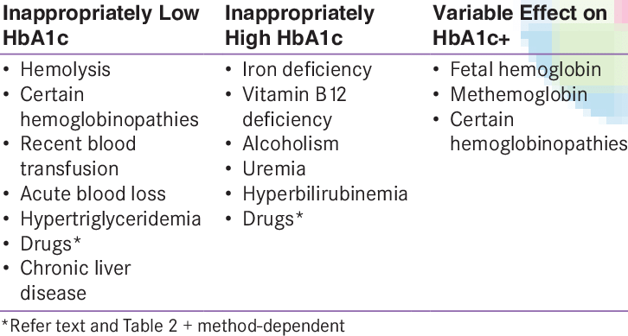
Conditions Affecting HbA1c Results
https://www.researchgate.net/publication/230574474_Drugs_affecting_HbA1c_levels
Notes:
https://www.researchgate.net/publication/230574474_Drugs_affecting_HbA1c_levels

Slide 15
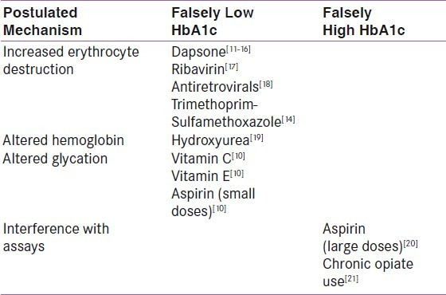
Drugs Affecting HbA1c Results
Notes:
https://europepmc.org/article/med/22837911
J Gen Intern Med. 2014 Feb; 29(2): 388–394.
Pitfalls in Hemoglobin A1c Measurement: When Results may be Misleading
Michael S. Radin, MD, FACE https://www.ncbi.nlm.nih.gov/pmc/articles/PMC3912281/#:~:text=Several%20medications%20and%20substances%20have,alcohol%2C%20salicylates%2C%20and%20opioids.&text=Ingestion%20of%20vitamin%20C%20may,levels%20when%20measured%20by%20chromatography.

Slide 16
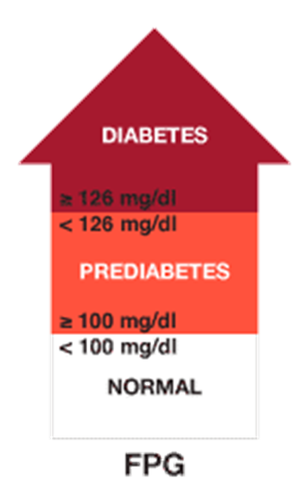
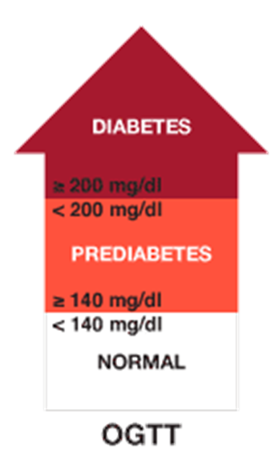
Use of Plasma Glucose for Screening & Diagnosis of Diabetes
FPG or 2-h PG can be used for screening and diagnosis of diabetes.
Advantages of glucose testing:
these assays are inexpensive and widely available.
Disadvantages include:
High diurnal variation in glucose
Fasting requirement (individuals may have difficulty fasting for the full 8-h period or may misreport their fasting status)
Recent physical activity, illness, or acute stress can also affect glucose concentrations.
Glycolysis is also an important and underrecognized concern with glucose testing.
Glucose concentrations will be falsely low if samples are not processed promptly or stored properly prior to analysis .
Protocol:
Fasting except for water for 8 hours; should not smoke or consume caffeine containing drinks, such as coffee – for either FPG or 2-h OGTT
People should consume a mixed diet with at least 150 g of carbohydrates on the 3 days prior to OGTT.
Carbohydrate restriction can falsely elevate glucose level with an oral glucose challenge.
75-gram glucose drink ingested in ~5 minutes (nonpregnant adult) (N&V)
With OGTT - obtain both FPG and 2-hPG

Slide 17
Confirming the Diagnosis of Diabetes
Diagnosis requires two abnormal screening test results*, measured either at the same time or at two different time points.
If using samples at two different time points:
The second test should be performed promptly (immediately)
May be either a repeat of the initial test or a different test
For example, if the A1C is 7.0% and a repeat result is 6.8%, the diagnosis of diabetes is confirmed.
If using two different tests (such as A1C and FPG) collected at the same time or at two different time points:
Diagnosis is confirmed if both tests have results above the diagnostic threshold.
If one test is above threshold and the other is not, repeat the test that is above threshold
E.g., FPG 119 and A1c 6.9% - repeat the A1c/ if A1c is 6.2% but FPG is 129, repeat the FPG
Careful consideration of factors that may affect measured A1C or glucose levels
Diagnosis is made based on the confirmed test
E.g., , if an individual meets the diabetes criterion of FPG (126 mg/dL or more) on two tests but A1c is <6.5% , that person should nevertheless be considered to have diabetes
*Unless there is a clear clinical diagnosis (e.g., individual with classic symptoms of hyperglycemia or hyperglycemic crisis and random plasma glucose ≥200 mg/dL),
Notes:
*Unless there is a clear clinical diagnosis (e.g., individual with classic symptoms of hyperglycemia or hyperglycemic crisis and random plasma glucose ≥200 mg/dL),

Slide 18
Confirmation Confusion
Due to pre-analytic and analytic variability of all the tests, it is also possible that when a test whose result was above the diagnostic threshold is repeated, the second value will be below the diagnostic cut point. This is
least likely for A1C
somewhat more likely for FPG
most likely for the 2-h PG
Unless there is a laboratory error, such patients are likely to have test results near the margins of the threshold for a diagnosis
If individuals have test results near the margins of the diagnostic threshold, the HCP should educate the individual about the onset of possible hyperglycemic symptoms and repeat the test in 3–6 months.
Consistent and substantial discordance between glucose and A1C test results should prompt additional follow-up to determine the underlying reason for the discrepancy and whether it has clinical implications for the individual.
Notes:
https://diabetesjournals.org/care/article/37/Supplement_1/S81/37753/Diagnosis-and-Classification-of-Diabetes-Mellitus

Slide 19
Post-Question (pick one answer that is most correct)
The Diagnosis of Diabetes
Must be confirmed by a 2-hour oral glucose tolerance test (OGTT)
Can be made based on a fingerstick blood glucose
Can be made in a person with classic hyperglycemic symptoms and a venous blood glucose level =/>200 mg/dl
Can be established based on CGM (Continuous Glucose Monitoring) results

Slide 20
References & Resources

Slide 21
References
https://diabetesjournals.org/care/article/37/Supplement_1/S81/37753/Diagnosis-and-Classification-of-Diabetes-Mellitus
https://diabetesjournals.org/care/article/47/Supplement_1/S20/153954/2-Diagnosis-and-Classification-of-Diabetes
Boakye, M. D. S., Miyamoto, S., & Greenwood, D. (2022). What Individuals Want to Hear at the Point of Type 2 Diabetes Diagnosis. Clinical diabetes : a publication of the American Diabetes Association, 41(1), 110–119. https://doi.org/10.2337/cd21-0151
Physician–patient communication at diagnosis of type 2 diabetes and its links to patient outcomes: New results from the global IntroDia® study. Diabetes Research & Clinical Practice VOLUME 127, P265-274, MAY 2017. William H. Polonsky, Matthew Capehorn, Anne Belton, Friedericke Nagel, Jisoo Lee, Steven Edelman, et al
https://diabetes.org/about-diabetes/diagnosis
https://behavioraldiabetes.org/xwp/wp-content/uploads/2015/12/DontFreakOutfinal.pdf
https://www.youtube.com/watch?v=jZn1mb7aaK0 diagnosis of T2D
https://www.thebloodproject.com/cases-archive/hemoglobin-a1c/postscript/

Slide 22
For Patients
https://www.youtube.com/watch?v=ufjyi6Ft-U4 Diabetes is not your fault
https://behavioraldiabetes.org/xwp/wp-content/uploads/2015/12/DontFreakOutfinal.pdf

