Slide 1
Opioid & Substance Data
among American Indian & Alaska Native People
Presentation created by: Crisandra Wilkie, MPH
Substance Use Epidemiologist
Northwest Portland Area Indian Health Board (NPAIHB)
Presenter: Alexis Harris, MS
ECHO, October 3rd, 2024

Slide 2
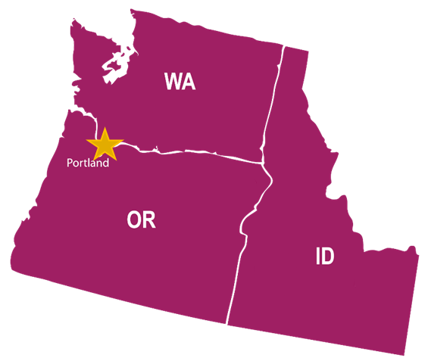
Where do I work?
Northwest Tribal Epidemiology Center (NWTEC)
Housed within the Northwest Portland Area Indian Health Board (NPAIHB)
One of 12 Tribal Epicenters across the US
Our organization provides epidemiological and public health support for the 43 federally recognized tribes in a three-state region: Washington, Oregon, and Idaho (~300,000 AI/AN)
If you are in the NW region, visit the DRTA website for data assistance! https://www.npaihb.org/drta/
If you are located outside the NW, contact your EpiCenter! https://tribalepicenters.org/

Slide 3
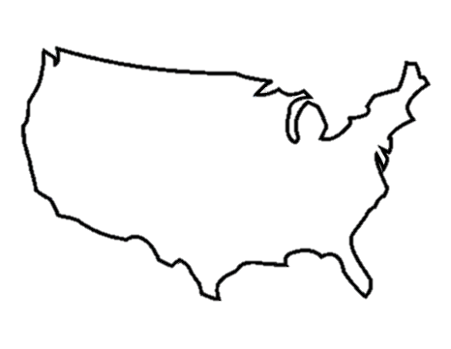
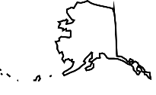
National Drug Overdose Deaths:
Trend Since 1999
5.4x higher
Deaths per 100,000 Population
6.1
*Data for 2022 is preliminary
National Age-Adjusted Rates per CDC NCHS Multiple Cause of Death Files 1999-2020 and from provisional data for years 2021-2022 on CDC WONDER Online Database

Slide 4
National Drug Overdose Deaths:
Trend Since 1999
National Public Health Emergency Declared
in 2017
Deaths per 100,000 Population
3.6x higher
6.1
*Data for 2022 is preliminary
National Age-Adjusted Rates per CDC NCHS Multiple Cause of Death Files 1999-2020 and from provisional data for years 2021-2022 on CDC WONDER Online Database

Slide 5
National Drug Overdose Deaths:
Trend Since 1999
Deaths per 100,000 Population
31%
Increase
Largest single year increase
*Data for 2022 is preliminary
National Age-Adjusted Rates per CDC NCHS Multiple Cause of Death Files 1999-2020 and from provisional data for years 2021-2022 on CDC WONDER Online Database

Slide 6
National Drug Overdose Deaths:
Trend Since 1999
40.1
AI/AN
33.2
White
32.8
National
Deaths per 100,000 Population
*Data for 2022 is preliminary
National Age-Adjusted Rates per CDC NCHS Multiple Cause of Death Files 1999-2020 and from provisional data for years 2021-2022 on CDC WONDER Online Database
Notes:
Consider disability adjusted life years instead of just age-adjusted death rates

Slide 7
National Drug Overdose Deaths:
AI/AN Rate
40.1
2019 to 2020 is still the highest single year increase for drug overdose deaths among AI/AN
1.1 x Increase
1.3 x Increase
Deaths per 100,000 Population
1.4 x Increase
*Data for 2022 is preliminary
National Age-Adjusted Rates per CDC NCHS Multiple Cause of Death Files 1999-2020 and from provisional data for years 2021-2022 on CDC WONDER Online Database

Slide 8
National Drug Overdose Deaths:
AI/AN Number of Deaths
Number of Deaths
*Data for 2022 is preliminary
National Age-Adjusted Rates per CDC NCHS Multiple Cause of Death Files 1999-2020 and from provisional data for years 2021-2022 on CDC WONDER Online Database

Slide 9
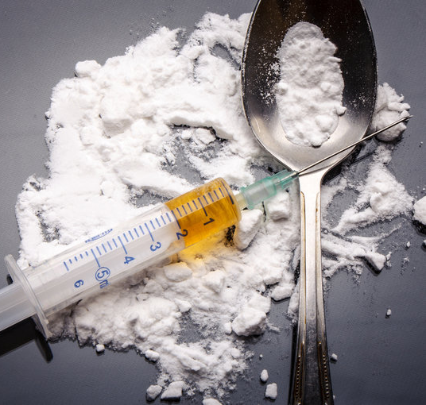
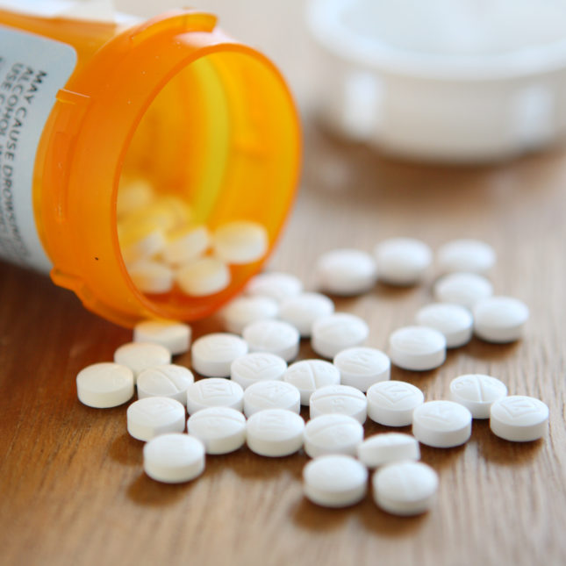
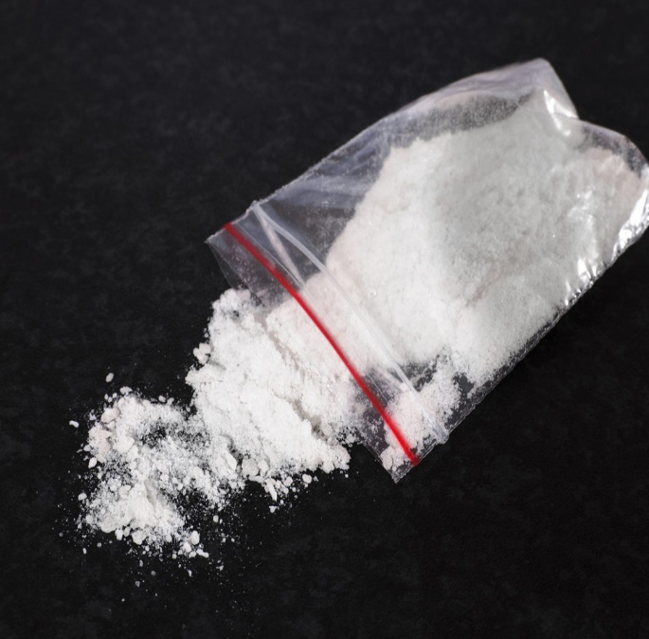
What Drugs are Involved?
Notes:
Ref: images.google.com

Slide 10
National AI/AN Drug Overdose Deaths:
Which Drugs?
All Drug
Opioid Involved
Deaths per 100,000 Population
Opioid Involvement
2018 - 54%
2019 - 58%
2020 - 66%
2021 - 68%
*Data for 2022 is preliminary
National Age-Adjusted Rates per CDC NCHS Multiple Cause of Death Files 1999-2020 and from provisional data for years 2021-2022 on CDC WONDER Online Database

Slide 11
National AI/AN Drug Overdose Deaths:
Which Opioids?
26.9 Synthetic Opioids
Deaths per 100,000 Population
2.8 Natural and Semi-synthetic Opioids
1.7 Heroin
0.8 Methadone
*Data for 2022 is preliminary
National Age-Adjusted Rates per CDC NCHS Multiple Cause of Death Files 1999-2020 and from provisional data for years 2021-2022 on CDC WONDER Online Database
Notes:
Question and point from crowd: Has methadone use increased and yet the OD rates remain the same?
Methadone use for pain management often is driver behind Ods, versus methadone use for SUD.

Slide 12
National AI/AN Drug Overdose Deaths:
Prescription Opioids
Synthetic Opioids Include:
Fentanyl
Tramadol
Natural and Semi-synthetic Opioids Include:
Hydrocodone
Oxycodone (OxyContin, Percocet)
Morphine
Hydromorphone (Dilaudid)
The NIH National Institute on Drug Abuse reports that fentanyl now makes up most of this category of drugs¹
Note: The individual may or may not have had a valid prescription for the drug. It could have been obtained illegally.
1. https://nida.nih.gov/research-topics/trends-statistics/overdose-death-rates

Slide 13
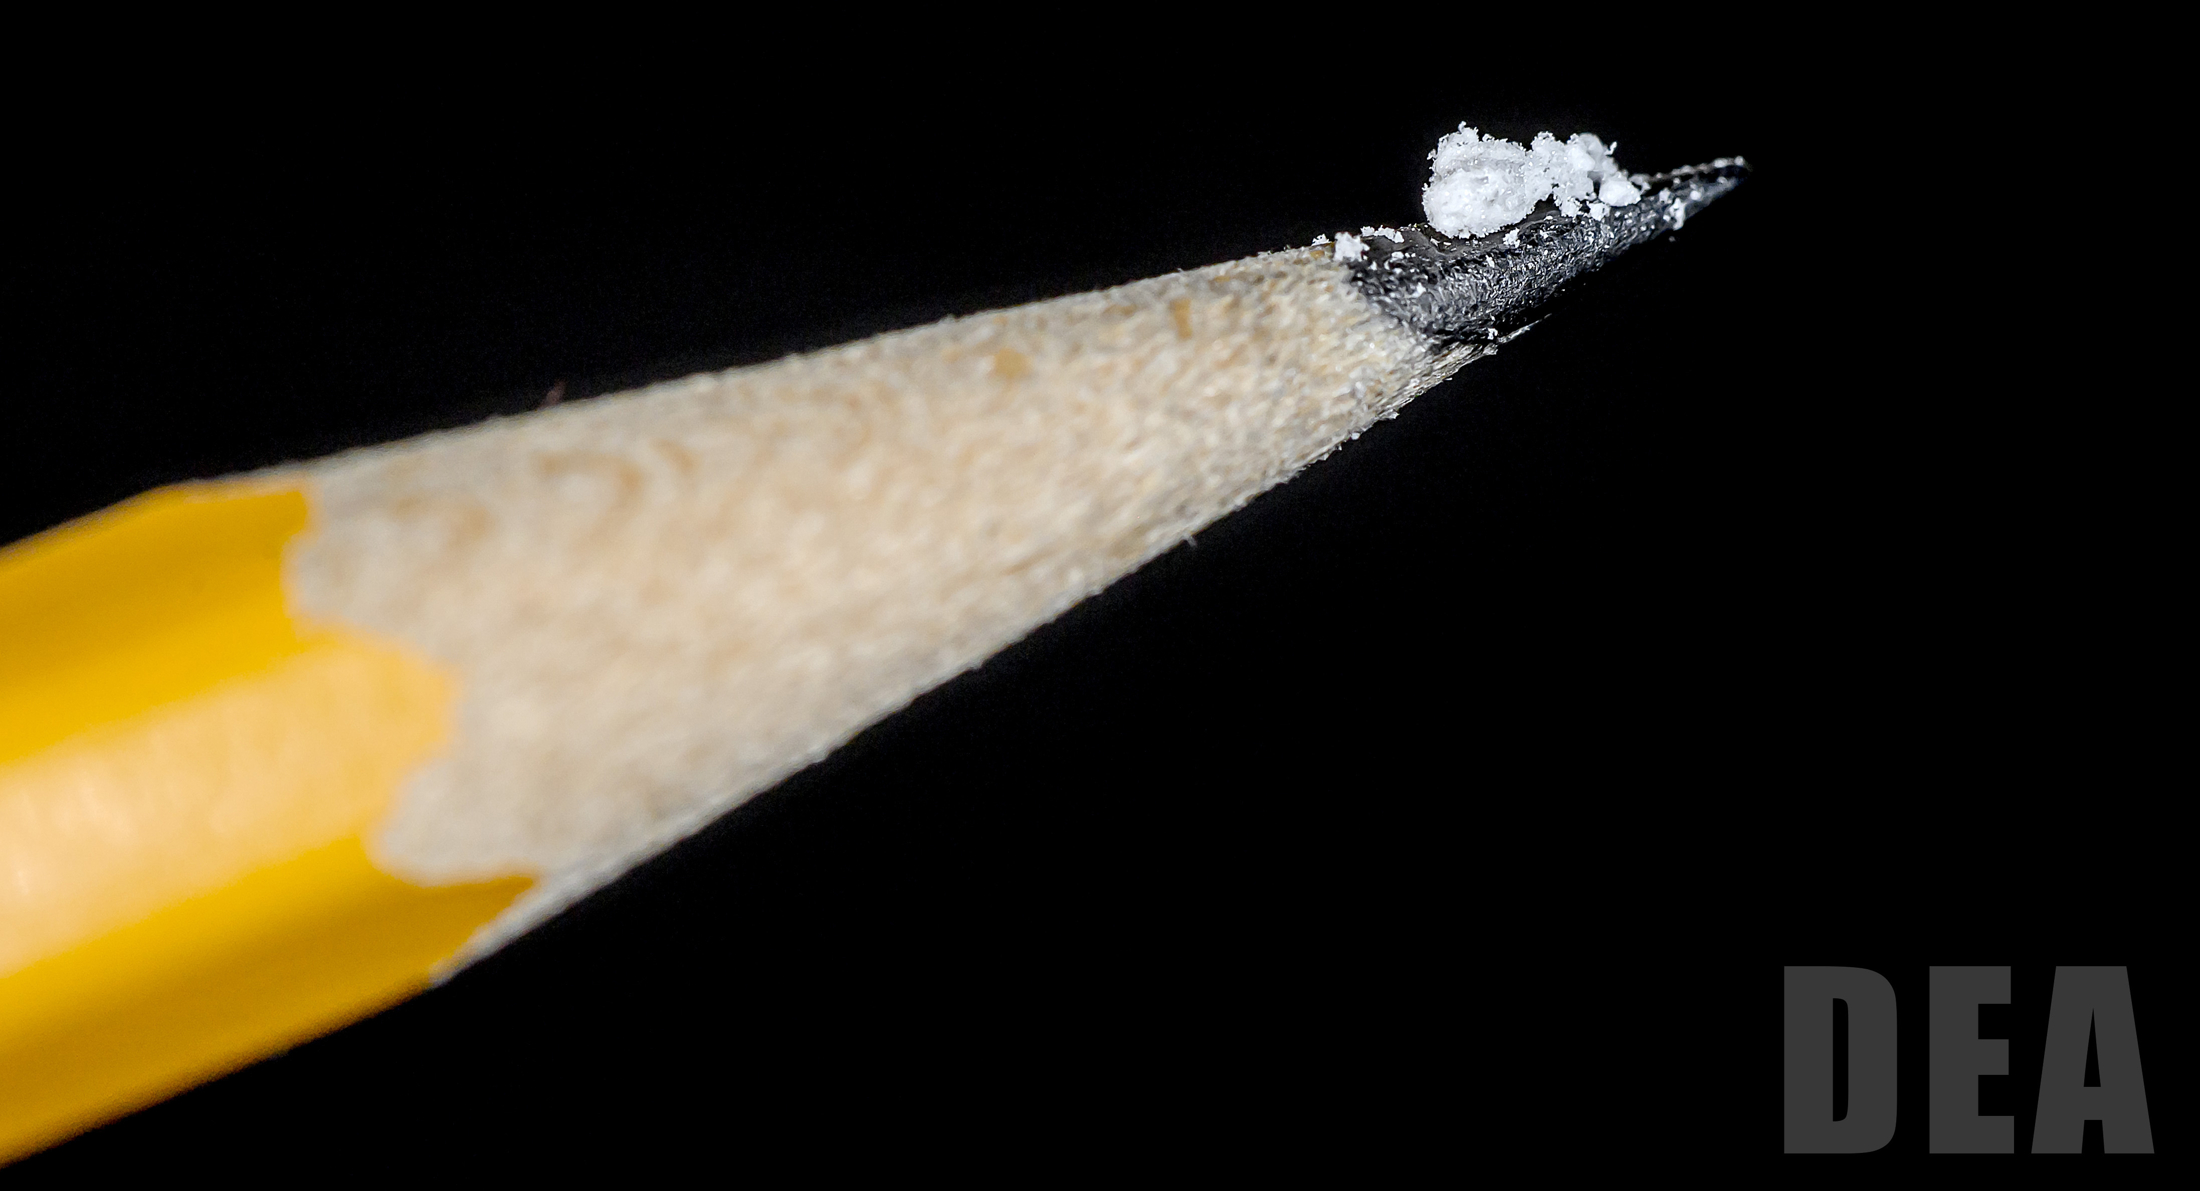
National AI/AN Drug Overdose Deaths:
Fentanyl
Fentanyl is 50-100 times stronger than morphine
2 mg of fentanyl equates to a potentially deadly dose
Originally developed for cancer patients (pain)
Manufactured as a pharmaceutical, but increasingly manufactured illegally
Illegally manufactured to look like other opioid pills or added to other drugs, often unknown to the person consuming it
DEA Fentanyl Seizures in 2022:
59.6 million fentanyl-laced fake pills
More than 13,300 pounds of fentanyl powder
These seizures are equivalent to more than 398 million lethal doses of fentanyl
https://www.dea.gov/factsheets/fentanyl
https://www.dea.gov
https://www.dea.gov/onepill

Slide 14
National AI/AN Drug Overdose Deaths:
Other Drugs?
19.7 Psychostimulants
(Includes meth)
Rate is 33 times higher than in 2003
Deaths per 100,000 Population
5.0 Cocaine
Rate is 6 times higher than in 1999
*Data for 2022 is preliminary
National Age-Adjusted Rates per CDC NCHS Multiple Cause of Death Files 1999-2020 and from provisional data for years 2021-2022 on CDC WONDER Online Database

Slide 15
National AI/AN Drug Overdose Deaths:
Overdose Intent, 2018-2022*
Most AI/AN overdose deaths were unintentional (accidental).
3.7% of overdose deaths were intentional (suicide)
In some cases, the intent could not be determined
*Data for 2022 is preliminary; Homicide suppressed due to small numbers
National Age-Adjusted Rates per CDC NCHS Multiple Cause of Death Files 1999-2020 and from provisional data for years 2021-2022 on CDC WONDER Online Database

Slide 16
National Drug Overdose Deaths:
By Sex, 2018-2022*
All Drugs:
Less difference in rates between AI/AN males and females compared to US average
AI/AN female rate 1.3x that of the US female rate
AI/AN male rate is lower than the US male rate
Male
1.6x higher
Deaths per 100,000 Population
Male
2.3x higher
*Data for 2022 is preliminary
National Age-Adjusted Rates per CDC NCHS Multiple Cause of Death Files 1999-2020 and from provisional data for years 2021-2022 on CDC WONDER Online Database
Notes:
Point made by participant that if AI/AN women have higher rates this indicates they are driving the national female rate and that they should be a focus group. Additionally, point made that AI/AN women are the generally the caretakers and that if they have higher rates of SUD then this will impact the next generation, perpetuating SUD in this population.

Slide 17
National Drug Overdose Deaths:
By Sex, Opioids, 2018-2022*
Opioids:
Less difference in rates between AI/AN males and females compared to US average
AI/AN female rate 1.2x that of the US female rate
AI/AN male rate is lower than the US male rate
Male
1.6x higher
Deaths per 100,000 Population
Male
2.4x higher
*Data for 2022 is preliminary
National Age-Adjusted Rates per CDC NCHS Multiple Cause of Death Files 1999-2020 and from provisional data for years 2021-2022 on CDC WONDER Online Database

Slide 18
National Drug Overdose Deaths:
By Sex, Stimulants, 2018-2022*
Stimulants:
Less difference in rates between AI/AN males and females compared to US average
AI/AN female rate 1.7x that of the US female rate
Male AI/AN rate is similar to the US male rate
Male
1.6x higher
Deaths per 100,000 Population
Male
2.5x higher
*Data for 2022 is preliminary
National Age-Adjusted Rates per CDC NCHS Multiple Cause of Death Files 1999-2020 and from provisional data for years 2021-2022 on CDC WONDER Online Database

Slide 19
National AI/AN Drug Overdose Deaths:
By Age, 2018-2022*
Deaths per 100,000 Population
**
**
*Data for 2022 is preliminary; **Rate suppressed or unreliable due to small count
National Age-Adjusted Rates per CDC NCHS Multiple Cause of Death Files 1999-2020 and from provisional data for years 2021-2022 on CDC WONDER Online Database

Slide 20
National AI/AN Drug Overdose Deaths:
By Age & Drug, 2018-2022*
Deaths per 100,000 Population
**
*Data for 2022 is preliminary; **Rate suppressed or unreliable due to small count
National Age-Adjusted Rates per CDC NCHS Multiple Cause of Death Files 1999-2020 and from provisional data for years 2021-2022 on CDC WONDER Online Database

Slide 21
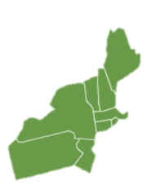
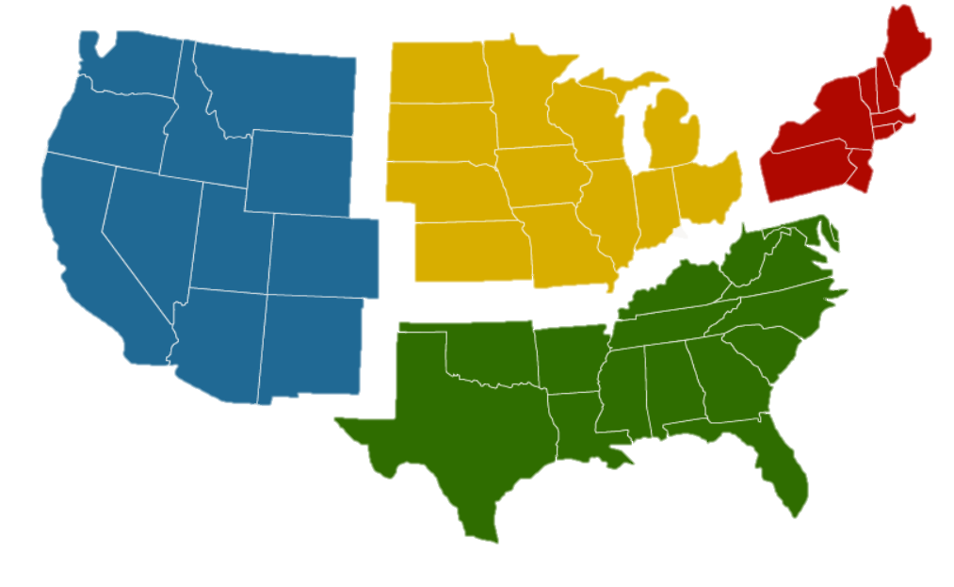
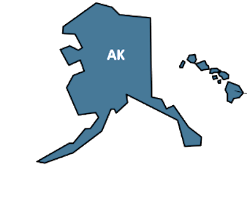
National All Population Drug Overdose Deaths:
By Census Region, 2022* Rates
Lowest
Rate:
West
Midwest
Death Rate:
35.6
Northeast
West
(Includes Alaska & Hawaii)
Death Rate:
32.5
Death Rate:
29.3
Highest
Rate:
Northeast
Death Rate:
33.9
South
*Data for 2022 is preliminary
National Age-Adjusted Rates per CDC NCHS Multiple Cause of Death Files 1999-2020 and from provisional data for years 2021-2022 on CDC WONDER Online Database

Slide 22
National AI/AN Drug Overdose Deaths:
By Census Region, 2022* Rates
Lowest
Rate:
Northeast
Midwest
Death Rate:
18.1
Northeast
West
(Includes Alaska & Hawaii)
Death Rate:
63.0
Death Rate:
46.2
Highest
Rate:
Midwest
Death Rate:
28.2
South
*Data for 2022 is preliminary
National Age-Adjusted Rates per CDC NCHS Multiple Cause of Death Files 1999-2020 and from provisional data for years 2021-2022 on CDC WONDER Online Database

Slide 23
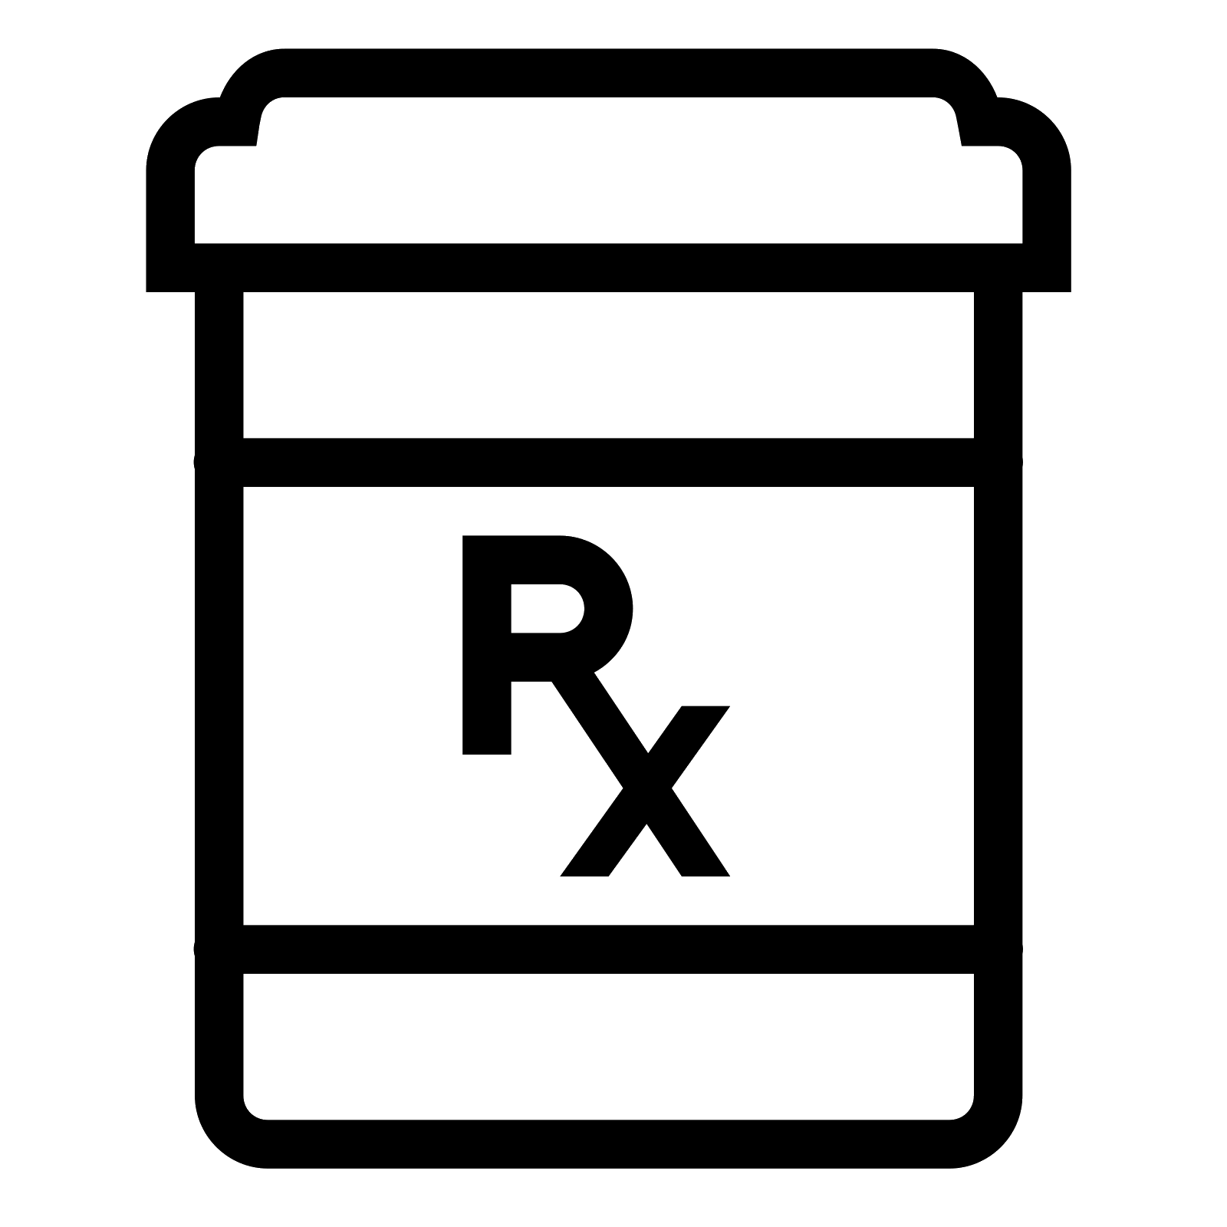
Opioid and Overdose Epidemiology Data Limitations
Racial misclassification
Many AI/AN are not classified as AI/AN in state data systems
= underrepresentation of burden on AI/AN
Limited access to behavioral health/treatment data
Hard to know how many people have SUD in the community or are being treated for SUD
Difficulty obtaining tribe-specific data
Can only provide state or county data
Inconsistency in overdose cause of death reporting
What drug(s) actually involved?
“Unspecified Narcotic”
?

Slide 24
Opioid and Overdose Epidemiology Data Challenges
Racial misclassification
Many AI/AN are not classified as AI/AN in state data systems
= underrepresentation of burden on AI/AN
Limited access to behavioral health/treatment data
Hard to know how many people have SUD in the community or are being treated for SUD
Difficulty obtaining tribe-specific data
Can only provide state or county data
Inconsistency in overdose cause of death reporting
What drug(s) actually involved?
“Unspecified Narcotic”
?

Slide 25
What is racial misclassification?
Racial misclassification is an incorrect recording of a person’s race in a data or surveillance system
Examples:
A person who is American Indian is coded as “white” on their death certificate
A person who is American Indian and Black is recorded as only “Black” on their hospital visit record
A person who is American Indian is recorded as “Hispanic White” at their doctor’s office
Race:
x
White
x
Black
AI/AN
Notes:
Occurs when a person’s race is incorrectly recorded in a data system, can happen in many different data systems

Slide 26
Why does misclassification matter?
Misclassified AI/AN are not counted in AI/AN
health reports, disease rates, or public health surveillance
Leads to an underrepresentation of AI/AN and:
Inaccurate AI/AN health data
Artificially lowered disease burden
Too few AI/AN to calculate stable disease rates and trends
Incomplete health data for public health decision-making
?
?
?

Slide 27
Take Away Messages
Deaths from drug overdoses are increasing over time
Steep increase since start of COVID-19 pandemic (2020)
Most overdose deaths involve opioids, synthetic opioids (specifically fentanyl) are most common
Deaths involving stimulants (mostly methamphetamine) are increasing
Male AI/AN have higher rates of overdose compared to female AI/AN, but lower rates of overdose compared to the US male average (except for stimulant-related deaths, about the same as US average)
Female AI/AN have higher stimulant-related overdose deaths compared to the US female average
The Midwest region has the highest rate of AI/AN overdose deaths, followed by the West
This differs from the US average where the West and Midwest have the lowest rates
National and state statistics may significantly underestimate AI/AN statistics
Notes:
This is not typical;

Slide 28
Thank You!
Questions?
Crisandra Wilkie, MPH
Substance Use Epidemiologist
Northwest Portland Area Indian Health Board
CWilkie@NPAIHB.org

