Slide 1
UTILIZING FUNCTIONAL STATUS ASSESSMENTS IN PAIN MANAGEMENT
LCDR Brandon Anderson, PharmD, BCACP
Notes:
Background information on me
Pharmacy Pain Management Clinic
Focus on relationship based care

Slide 2
OBJECTIVES
Understand the role of assessing function in pain management
Utilize the PEG-3 and PSEQ tools in clinical practice to assess patient function
Develop skills to monitor patient function effectively using assessment tools

Slide 3
FUNCTIONAL STATUS ASSESSMENT
What is function?
Why assess function?
Pain is subjective
What is a Functional Status Assessment?
Notes:
Pain is a subjective measurement we do not have a lab like an a1c to meaaure
Everyone rates pain at different levels
Everyone perception of pain is different
Pain is not something that is not curable
3-30.9 INITIAL ASSESSMENT
Comprehensive review of pain history (onset, location, quality, duration, and intensity), prior pain treatments, diagnostic tests, and functional status assessments
3-30.23 DOCUMENTATION
Results of ongoing monitoring patient progress (or lack of progress) in terms of pain management and functional improvement;

Slide 4
KEY ASPECTS OF ASSESSING FUNCTION IN PAIN MANAGEMENT
Physical Function
Emotional and Social Function
Cognitive Function
Work and Role Function
Quality of Life

Slide 5
TOOLS TO ASSESS FUNCTION
DVPRS
Grip strength
STEADI
PASS Score
PEG 3
PSEQ

Slide 6
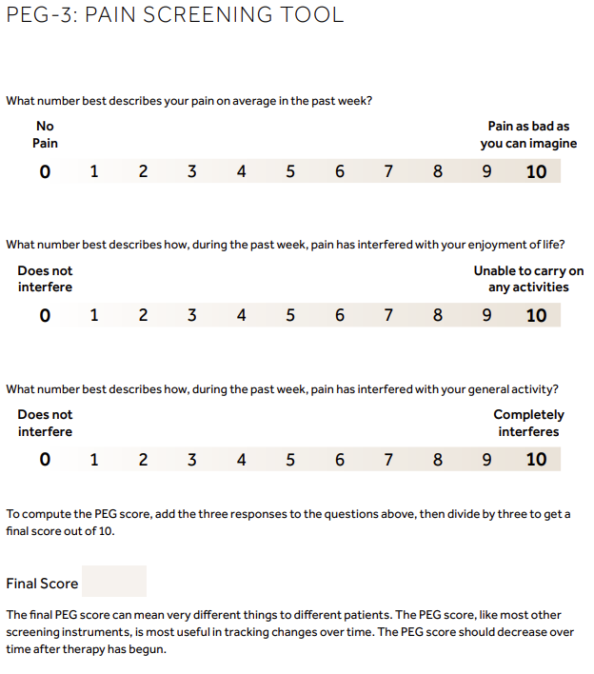
PEG-3
Notes:
setting functional goals

Slide 7
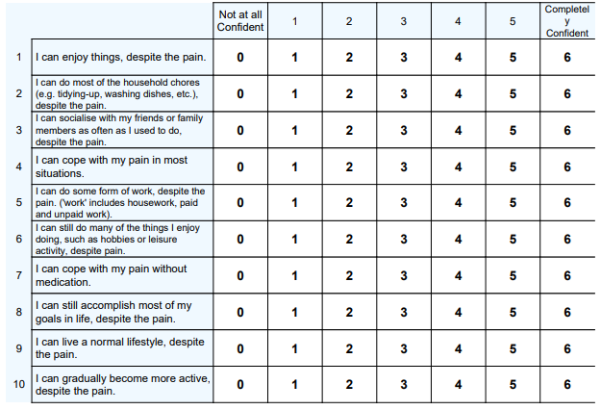
PSEQ
Notes:
Aimed to assess the confidence of people with persistent pain to achieve different activities despite their pain.
A score of 40 is usually considered as a cut off to return to work
Among injured workers, raw scores around 40 (percentile = 50) are associated with return to work and maintenance of functional gains, whilst lower scores (for example a raw score of 30, percentile = 18) tend to predict less sustainable gains (Adams and Williams, 2003).

Slide 8
MONITORING
When to use these tools?
Initial visits
Upon every follow up?
Chapter 30?
Revisit functional goal
Notes:
Scores help monitor progress but is not all inclusive, come back to the functional goal

Slide 9
PATIENT CASES
LJ 36 y/o rates pain 10/10
Functional goal: be able to sit long enough in car to go visit family
Initial visit
PEG-3: 8,9,8 total: 25
Working out at gym daily
Stated is able to live a normal live
PSEQ: 23
Follow up
PEG-3: 8,9,8 total: 25
Able to goto gym twice daily some days
PSEQ: 25
MJ 65 y/o rates pain 6/10
Functional goal: be able to clean house
Initial visit
PEG-3: 6,8,8 total: 22
Has disability for pain
Has a PCA
PSEQ: 18
Follow up
PEG-3: 7,7,7 total: 21
was able to clean kitchen in setting
PSEQ: not assessed
Notes:
No follow up yet as these were patients I
IN summary: pain is subjective by assessing function this gives the provider insight the impact the pain is affecting ability to perform

Slide 10
QUESTIONS?

