Slide 1
HCV Elimination: Is it Possible?
JORGE MERA, MD

Slide 2
Outline
Basic concepts in HCV elimination
Status of HCV elimination in the US
HCV elimination in a Tribal Health System
What will it take to eliminate HCV in the US?

Slide 3
Definitions
Control:
The reduction of disease incidence, prevalence, and morbidity to a locally acceptable level
Elimination:
Reduction to zero of the incidence of an infection caused by a specific agent in a defined geographical area
Eradication
Permanent reduction to zero of the worldwide incidence of an infection caused by a specific agent
World Health Organization calls for global elimination of hepatitis C as a public health threat by 2030
Miller M. et al. In Disease Control Priorities in Developing Countries: 2nd Edition 2006

Slide 4
Syndemic
Structural
Behavioral
Social norms, traditions, shared beliefs, etc.
Social
Stigma, lack of education, employment, healthy food, health coverage, etc.
Lack of access to housing, transportation, SSP, etc.
Core principles:
Clustering of two or more conditions in a specific population
Their synergism in producing excess burden of disease in a population
Precipitation and propagation by large scale behavioral, structural and social forces
HIV
HCV
SUD
COVID-19
Singer, M. and Clair, S. (2003), Syndemics and Public Health: Reconceptualizing Disease in Bio‐Social Context. Medical Anthropology Quarterly, 17: 423-441. https://doi.org/10.1525/maq.2003.17.4.423

Slide 5
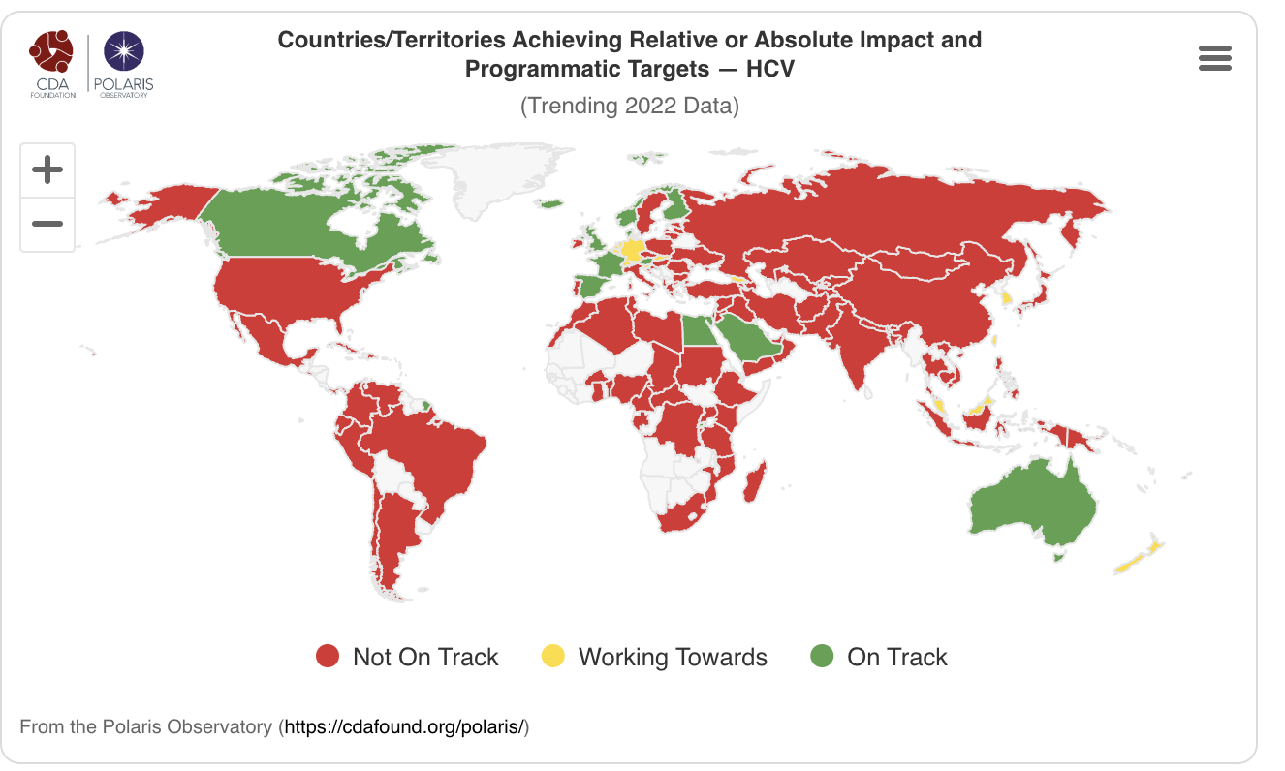
WHO HCV Elimination 2030 Targets
Targets
90% diagnosed
80% treated
65% reduced mortality
90% reduction in HCV incidence
https://cdafound.org/polaris/ Accessed August 22, 2024

Slide 6
Targets to Eliminate HCV
Prevent sequelae of advancing liver disease
65% reduction
in mortality
Treat Baby Boomers
Prevent new or “incident” infections
90% reduction
in incidence
Treat persons who inject drugs

Slide 7
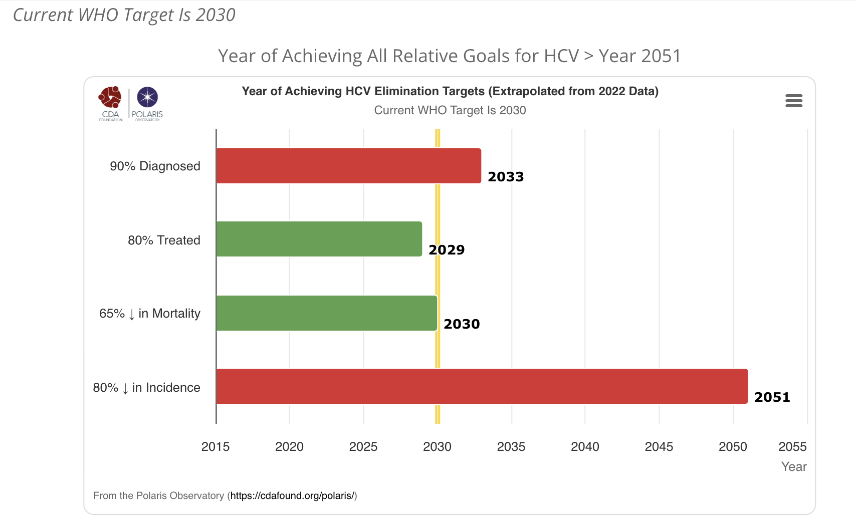
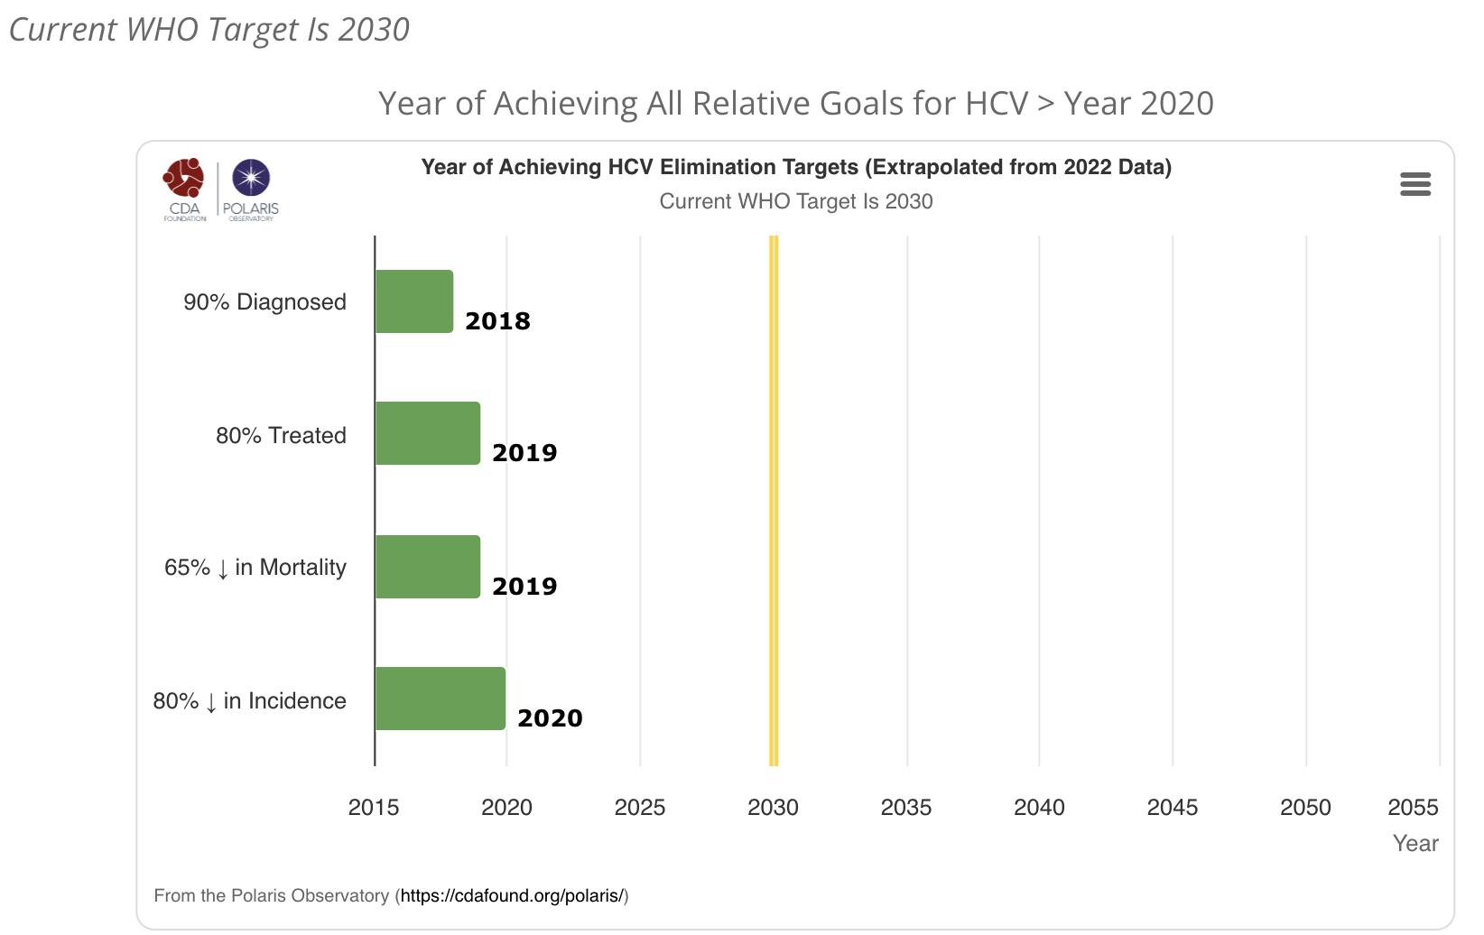
Year of Achieving HCV Elimination Targets
United States
EGYPT
 | USA | EGYPT
Universal Health Care | NO | YES
HCV RNA point of care testing | NO | YES
Affordable DAAs for all | NO | YES
Most of HCV care delivered by primary care | NO | YES
Robust harm reduction programs | NO | YES
https://cdafound.org/polaris/ Accessed August 22, 2024

Slide 8
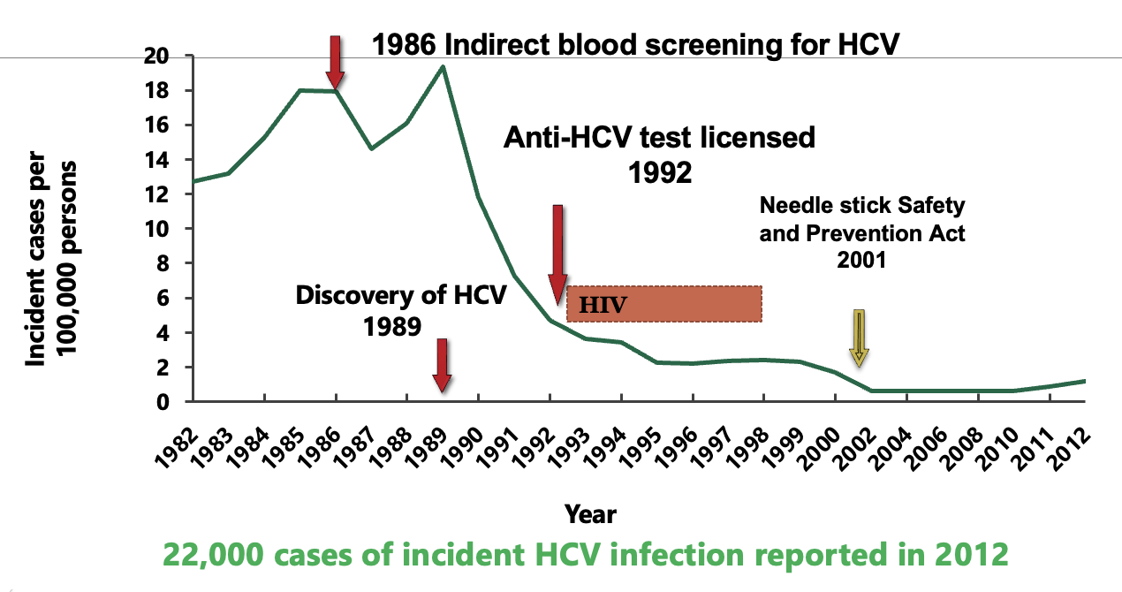
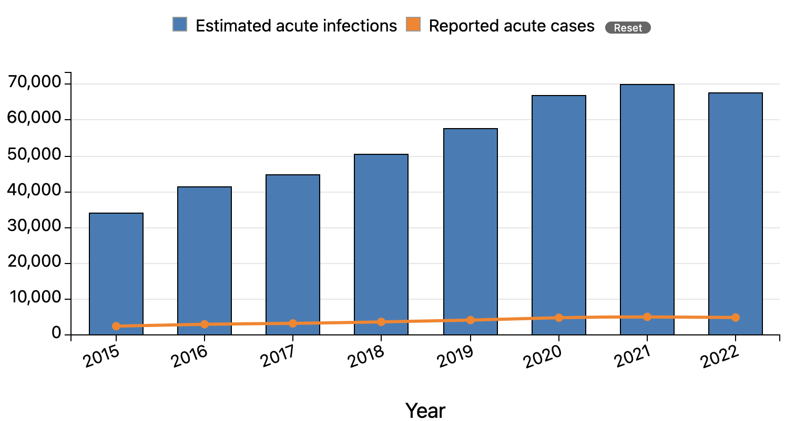
HCV Elimination Started with discovery of HCV
HCV Infections in the US are Rising
Number of Acute Cases
The incidence rate of acute hepatitis C has more than doubled since 2013 and increased 15% from 2019.
Persons aged 20-39 years had the highest incidence of acute hepatitis C.
66% of cases with risk information, reported injection drug use.
Centers for Disease Control and Prevention. Viral Hepatitis Surveillance Report – United States, 2020., https://www.cdc.gov/hepatitis/statistics/2020surveillance/index.htm. Published September 2022. Accessed July, 2024 2023.
Alter MJ JAMA 1990; Jagger J, J infect Dis Pub Health 2008; CDC.gov/hepatitis;

Slide 9
US HCV Cases Increase as Treatment Rates Decrease
It is estimated that to eliminate HCV > 260,000 people should be treated every year.
Eyasu H Teshale, MD, Henry Roberts, PhD, Neil Gupta, MD, MPH, Ruth Jiles, MS, MPH, PhD, Characteristics of persons treated for hepatitis C using national pharmacy claims data, United States, 2014–2020, Clinical Infectious Diseases, 2022;, ciac139, https://doi.org/10.1093/cid/ciac139, slide credit NVHR/ CHLPI

Slide 10
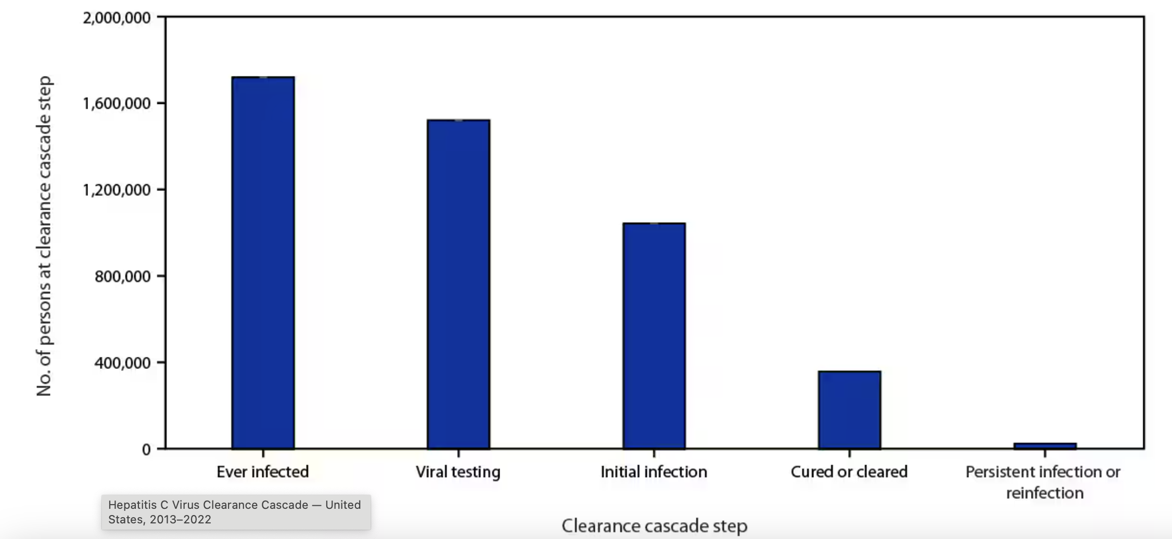
Hepatitis C virus clearance cascade using national commercial laboratory data, — United States, 2013–2022
Only 34% of those with an HCV diagnosis were cured
Wester C, Osinubi A, Kaufman HW, et al. Hepatitis C Virus Clearance Cascade — United States, 2013–2022. MMWR Morb Mortal Wkly Rep 2023;72:716–720. DOI: http://dx.doi.org/10.15585/mmwr.mm7226a3.

Slide 11
HCV Care: A Health Equity Issue
Communities with high HCV impact and with restricted access to treatment
Communities of color
Rural communities
People who have housing insecurity
People who use drugs
People who have a history of incarceration
Only 1 in 3 of Insured Receive Timely HCV Treatment
Thompson WW, Symum H, Sandul A, et al. Vital Signs: Hepatitis C Treatment Among Insured Adults — United States, 2019–2020. MMWR Morb Mortal Wkly Rep 2022;71:1011-1017. DOI: http://dx.doi.org/10.15585/mmwr.mm7132e1. Slide credit: NVHR and CHLPI

Slide 12
Barriers to HCV Elimination in the US
Lack of awareness of infection in 50 %
Lack of point-of-care diagnostics
Delay in Treatment
High Cost of DAAs Insurance restrictions
Treatment not incorporated routinely in primary care
Marginalized populations not properly served (People who are incarcerated, homeless or inject drugs) Increased Transmission

Slide 13
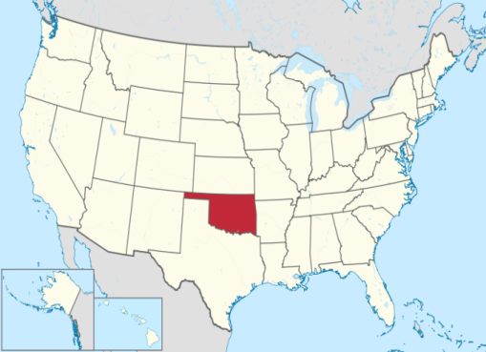
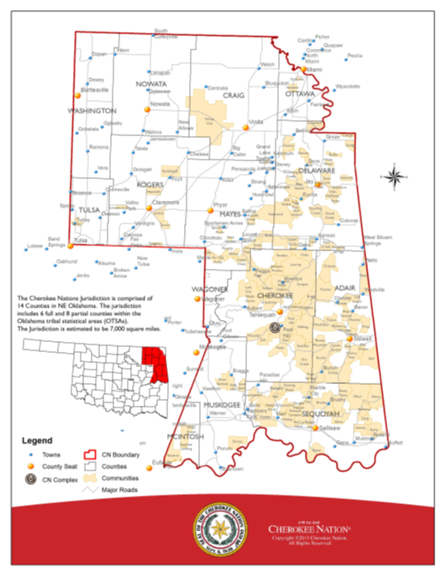
Cherokee Nation
Cherokee Nation Health Services
Sovereign Nation within a Nation
Largest Tribe in the US
> 450,000 citizens worldwide
14 county area (over 9,200 sq mi.)
141,000 reside within the reservation
Largest Tribal Health System in the USA
One central hospital and 9 outlying clinics
Serves > 140,000 American Indian/Alaska Native
Source: Cherokee Nation Health Services, 2024
Notes:
The Cherokee Nation is a sovereign nation within a nation, located in the NE part of Oklahoma. The capitol is located in Tahlequah OK and it governing system is composed of 3 branches. It operates the largest Tribal Health System in the USA and it is the second largest tribe. There are over 350,000 Cherokee citizens across the globe but the Cherokee Nation Health Services mainly provide medical care to the 130,000 AI/AN that live in the 14 Cherokee counties through its central hospital located in Tahlequah or one of the 8 outlying clinics. The CNHS has a unified electronic health record. In the last 5 years there have been over 900,000 patient visits per year.

Slide 14
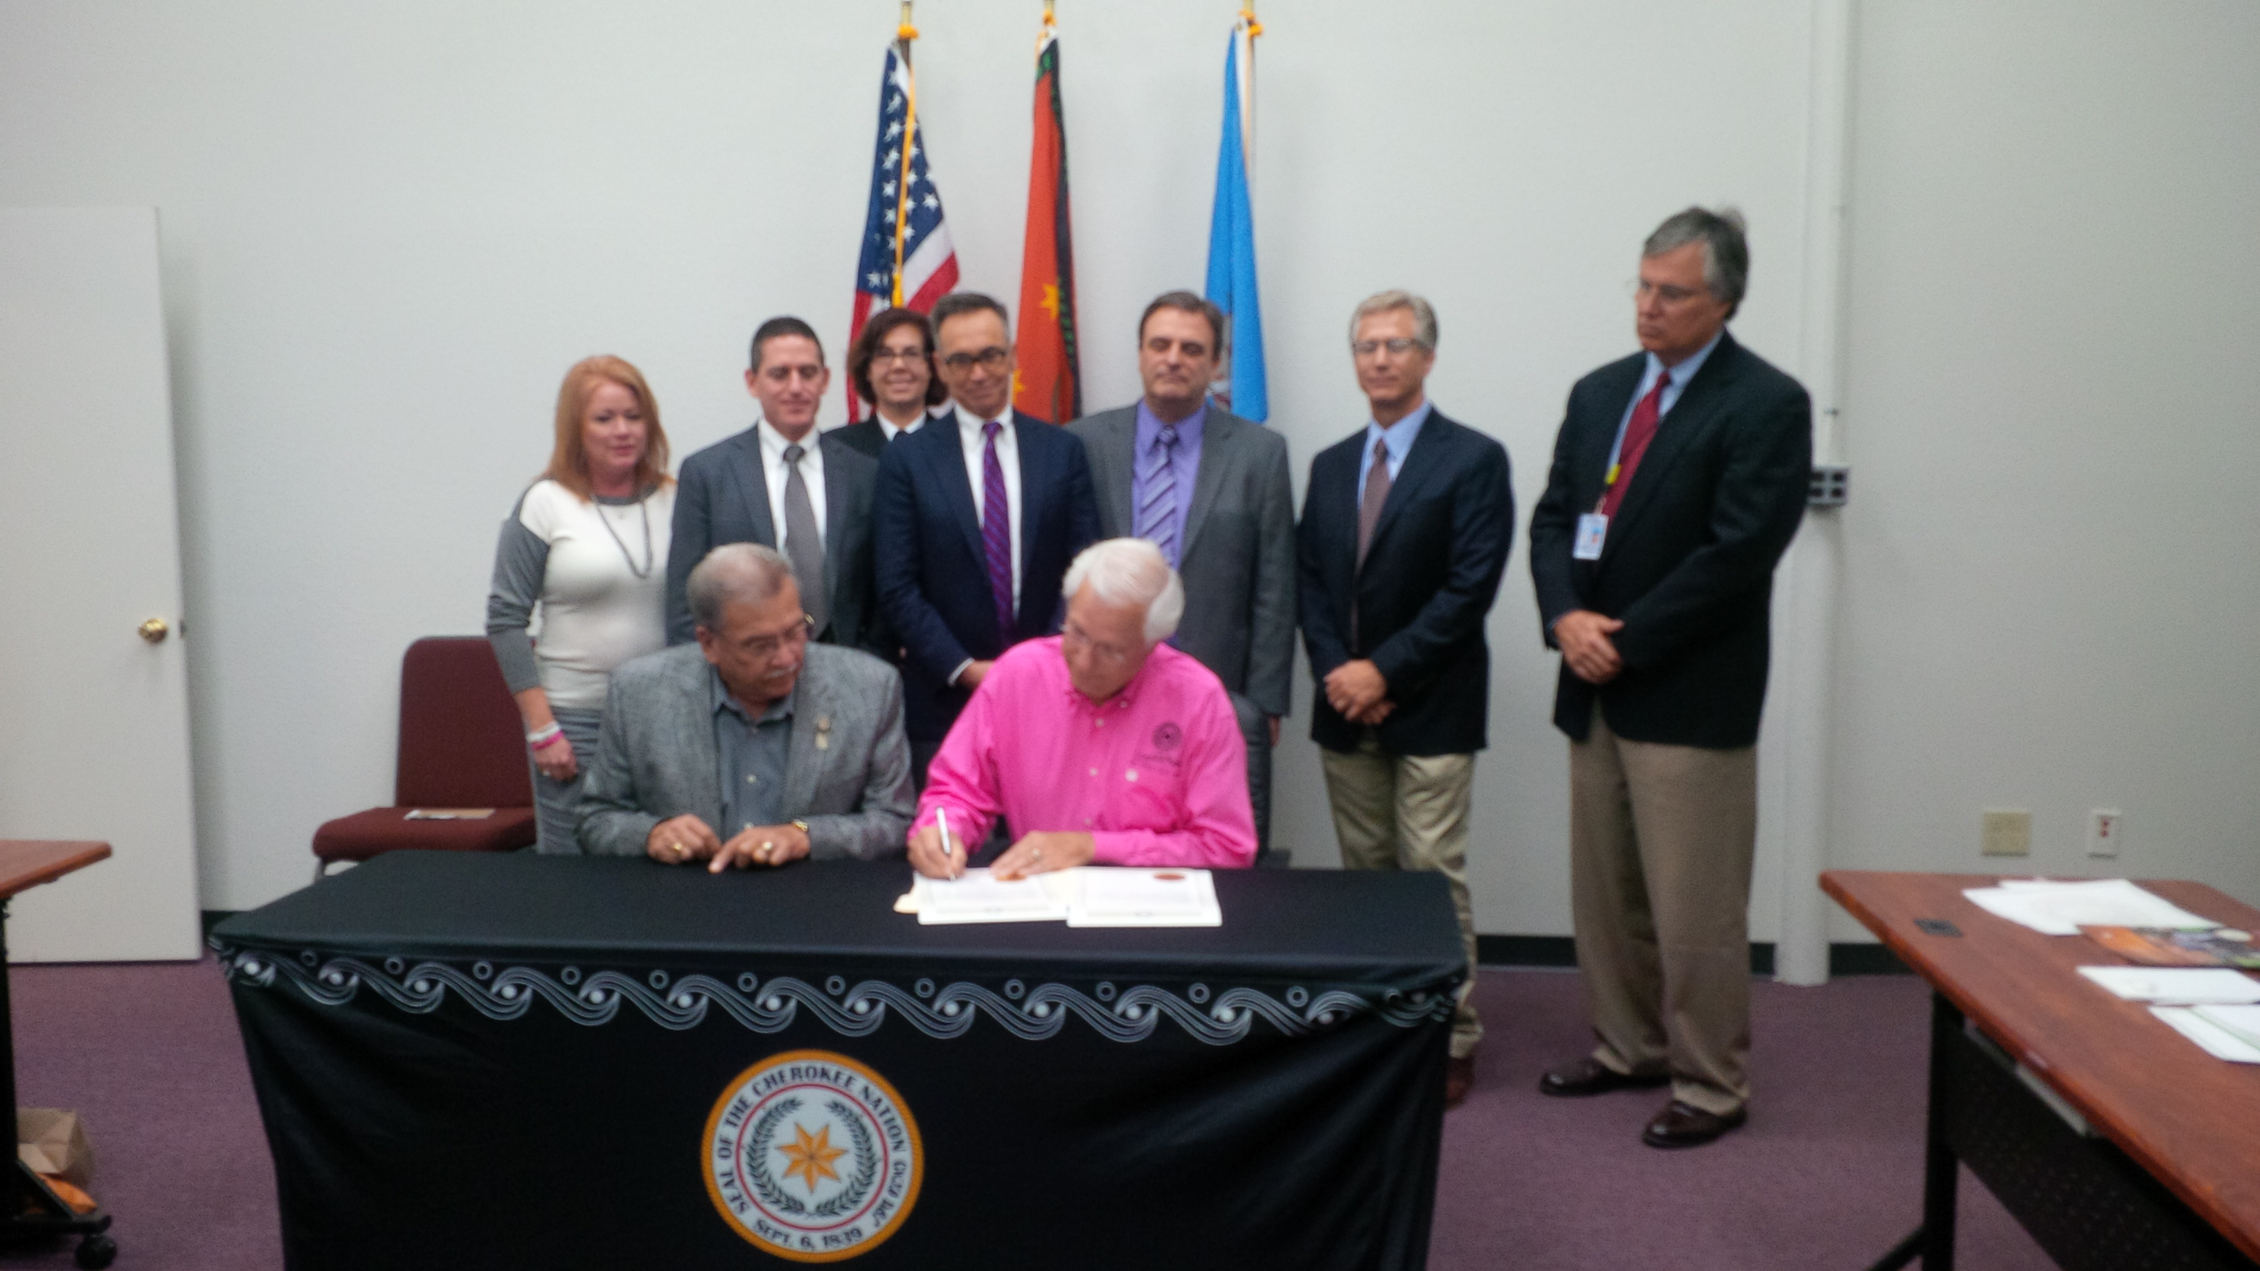
Eliminating hepatitis C virus (HCV) as a public health threat: A comprehensive approach involving various interventions
HCV Awareness Day
October 31, 2015
Leadership and Partners
Screening and Diagnosis:
Universal Screening
Expanding HCV Workforce
Training primary care providers through Project ECHO
Treatment Access
Dedicated case managers
Prevention Programs
SSP, MAT, treatment as prevention
Government, universities, pharma
“As Native people and as Cherokee Nation citizens, we must keep striving to eliminate hepatitis C from our population.” Chief Bill John Baker
Source: Cherokee Nation Health Services, 2024

Slide 15
CNHS HCV Screening and Diagnosis: Interventions
Age targeted screening
2012-2015: Baby boomer screening
2015-2024: Universal screening
Electronic Health Reminders
HCV Ab reflex to RNA
Lab triggered Screening
Point of care antibody testing
Addressed by nurses
ED and UC
ED, Dental Clinics, SSP, homeless shelter,
substance use recovery programs
Health system wide
SSP: Syringe Service Program, ED: Emergency Department
UC: Urgent Care
Source: Cherokee Nation Health Services, 2024

Slide 16
The CNHS Syndemic Care Model
Universal Screening
Community Health Worker
HCV Evaluation
Nurse
Behavioral health counselor
HCV provider (Offer MAT or HIV PrEP)
Case manager (DAA Procurement)
Pharmacist
Community health worker
Non-Adherence Risk Assessment
Treatment
Community Health Worker
CNHS: Cherokee Nation Health Services
DAA: Direct Acting Antiviral, MAT: Medication Assisted Therapy
Source: Cherokee Nation Health Services, 2024

Slide 17
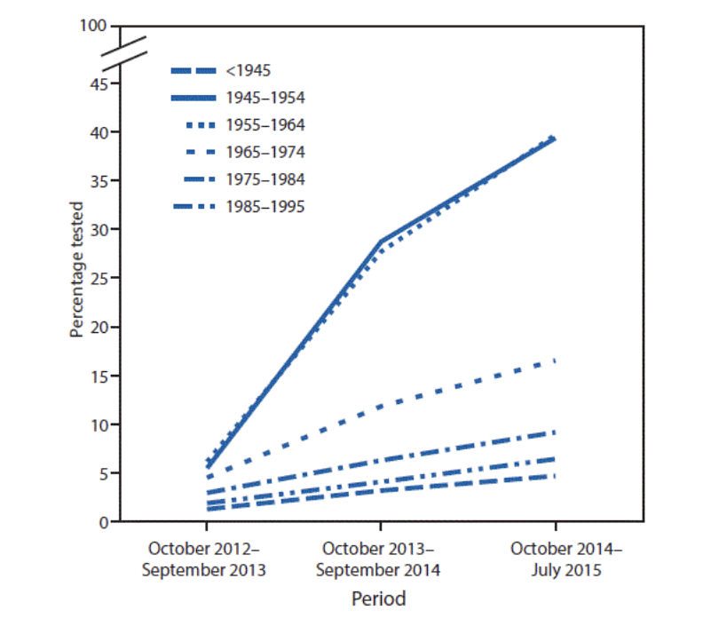
CNHS HCV Screening Outcomes
Cumulative percentage of persons who received one or more hepatitis C virus antibody tests, by birth cohort — Cherokee Nation Health Services, October 2012–July 2015
Universal Screening of Individuals Who Accessed the CNHS Screening sites from October 2015-December 2023 and Were Screened for HCV
*Numerator: # of unique (≥18 years) screened for HCV
**Denominator: # of unique patient (≥18 years) who had an encounter in the UC/ED, Hospital, primary care and women’s clinic
As of December 2023, 82.5% of patients > 18 yo who accessed the health system have been screened
Mera J, Vellozzi C, Hariri S, et al. Identification and Clinical Management of Persons with Chronic Hepatitis C Virus Infection — Cherokee Nation, 2012–2015. MMWR Morb Mortal Wkly Rep 2016;65:461–466.
Source: Cherokee Nation Health Services, 2024

Slide 18
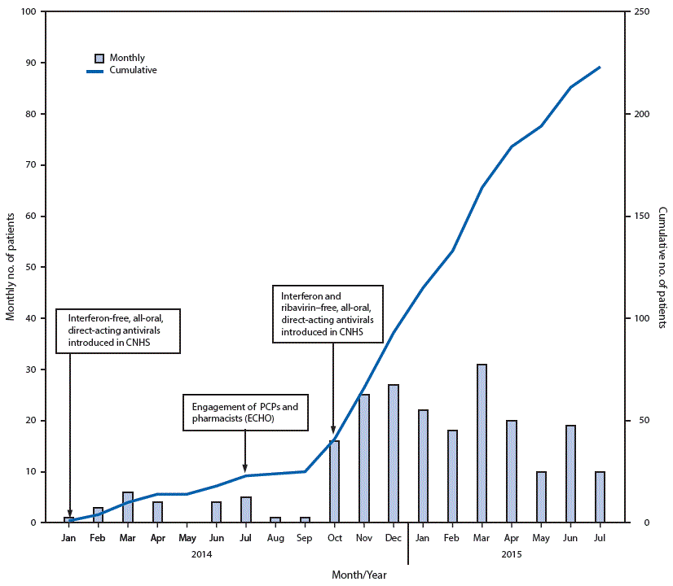
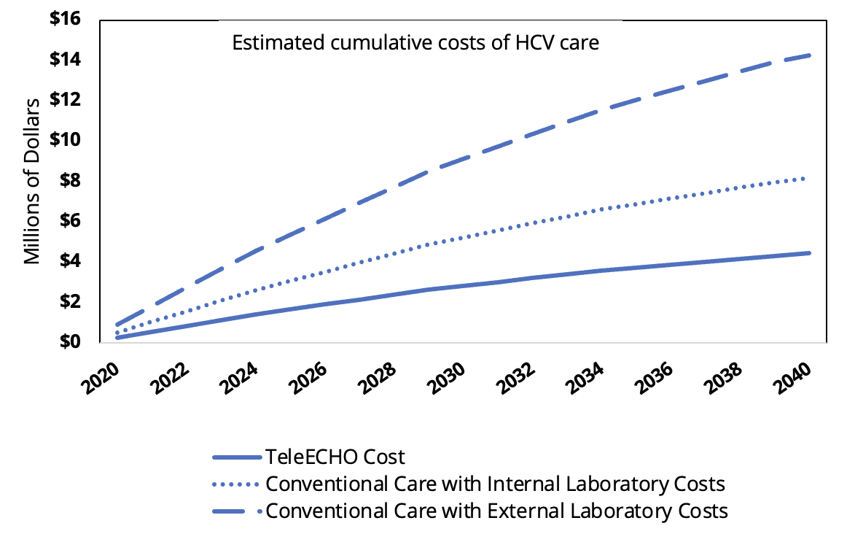
HCV Health Care Infrastructure Strengthening: Incorporating the ECHO Model
Number of patients with hepatitis C virus (HCV) infection who tested RNA positive and initiated all-oral, anti-HCV therapy, by month and cumulative total — Cherokee Nation Health Services (CNHS), January 2014–July 2015¹
Estimated cumulative costs of care for hepatitis C virus infection via ECHO and conventional care — Cherokee Nation Health Services, Oklahoma, 2020-2040²
Mera J, Vellozzi C, Hariri S, et al. Identification and Clinical Management of Persons with Chronic Hepatitis C Virus Infection — Cherokee Nation, 2012–2015. MMWR Morb Mortal Wkly Rep 2016;65:461–466
2. Jorge Mera, Molly Feder , Jeri Sawyer , Gretchen Greene , Brigg Reilley , Ashley Wirth , David Stephens , Jessica Leston: Poster 01946 presented at ID Week 2023, Washington, DC

Slide 19
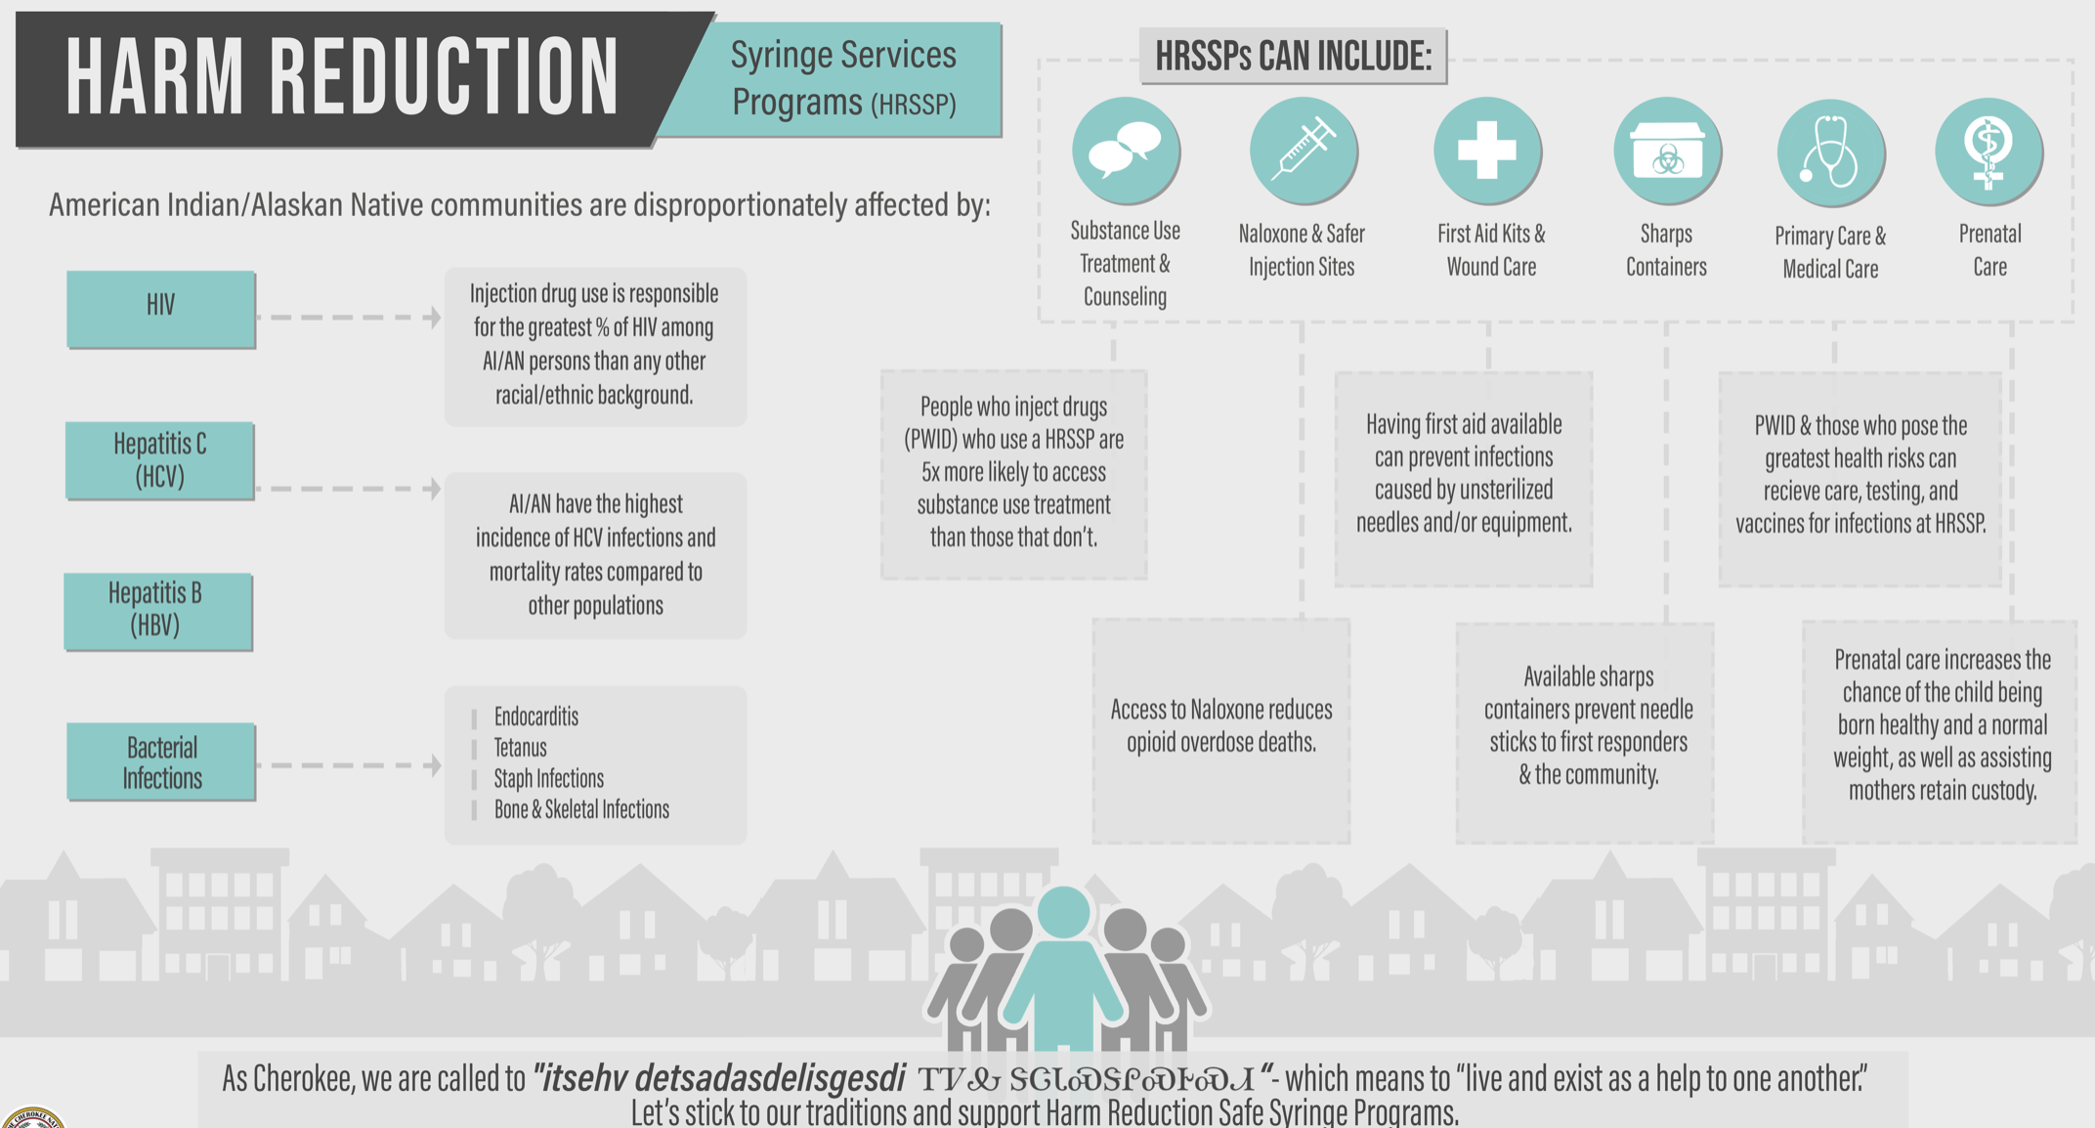
CNHS Harm Reduction Program
MAT services: 798 patients enrolled
SSP services: 806 clients enrolled
Source: Cherokee Nation Health Services, 2024

Slide 20
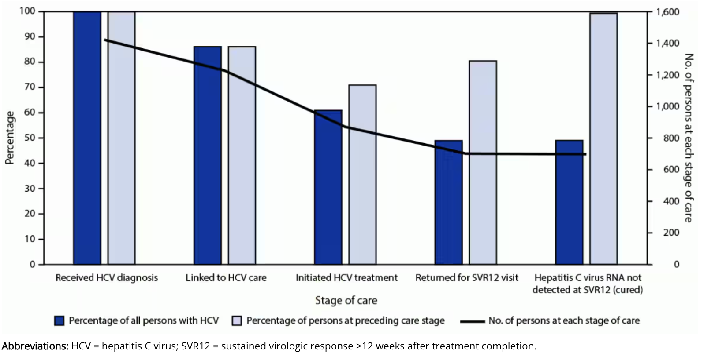
Impact of Interventions on CNHS HCV Cascade of Care
Cascade of care among persons with hepatitis C virus infection (N = 1,423) — Cherokee Nation Health Services, Oklahoma, November 2015–October 2020
Five years after implementing a hepatitis C elimination program, Cherokee Nation Health Services (CNHS) had diagnosed hepatitis C in 1,423 persons, 86% of whom were linked to care.
Although only 61% initiated treatment, 99% of those who completed treatment were cured.
Barriers to HCV treatment initiation include lack of access to direct-acting antivirals at the time of HCV evaluation.
Essex W, Feder M, Mera J. Evaluation of the Cherokee Nation Hepatitis C Virus Elimination Program — Cherokee Nation, Oklahoma, 2015–2020. MMWR Morb Mortal Wkly Rep 2023;72:597–600.

Slide 21
CNHS HCV Cascade of Care By Year
Community Viral Load is Decreasing
N=100
N=484
N=300
N=217
N=179
N=142
N=133
N=121
N=75
Treatment Initiation is Decreasing
Percentage of Persons at Preceding Care Stage
Cherokee Nation Health Services, 2024

Slide 22
HCV Screening: Community Outreach
Site | # of Individuals Screened | # of individuals with positive HCV antibody | Percentage Positive
Food distribution site* | 340 | 11 | 3.5%
Homeless Shelter | 15 | 2 | 13%
Syringe service program | 162 | 39 | 24%
Peer Recovery | 51 | 14 | 27%
Jail | 0 | NA | NA
Essex, W., Mera, J., Comiford, A. et al. Assessing the Feasibility, Acceptability, and Effectiveness of a Pilot Hepatitis C Screening Program at Food Distribution Sites in Cherokee Nation, Oklahoma. J Community Health 48, 982–993 (2023).
Cherokee Nation Health Services, 2024

Slide 23
What Will it Take To Eliminate HCV in the CNHS?
Syringe Service Program
Homeless Shelter/Peer Recovery
Jail
Peer Recovery Specialist

Slide 24
What Will it Take to Eliminate HCV in the US?
Test and treat patients where they are
SSPs, jails, prisons, MAT clinics, homeless shelters, etc.
HCV RNA POC
Access to SSP and MAT
Social determinants of health
Address stigma, poverty, housing, food insecurity, mobility, incarceration, etc.
DAAs at affordable prices and available on site
For al people who need it
HCV Care
Mostly delivered by Primary Care and pharmacists
DAAs: Direct Acting Antiviral Agents, SSP: Syringe Service Programs, MAT: Medication Assisted Treatment

Slide 25
“The targets for HCV screening, treatment, and cure should aim for a 100% success rate, otherwise, the most vulnerable persons are at risk of being overlooked and left behind”

Slide 26
Thank you
Questions?

