Slide 1




Managing Behaviors in Dementia and Delirium
October 10, 2024
Jessica Wright PA-C
OHSU Inpatient Geriatrics Consult Service
Indian Country Clinical Dementia ECHO Virtual Clinic
Presentation Co-Created By Dr. Katie Drago

Slide 2
Objectives
Define
Define delirium and its spectrum of symptoms
Discuss
Discuss a framework for delirium mitigation and management
Reframe
Reframe behavioral symptoms as a means of communication
Managing Behavioral Symptoms
Discuss nonpharmacologic management strategies

Slide 3

Delirium
Acute confusion (aka. “acute brain failure”, acute encephalopathy) that develops as a result of intersection of patient risk factors and situation specific stressors
Inouye S. NEJM, 2006

Slide 4
About 30% of delirium cases are recognized
About 2/3rds of cases are never recognized or misattributed
These patients spend longer in
the hospital, in ICU, on
mechanical ventilation
2.5x greater cost
~40% are dead at 1 year
Kales, et al. Geriatric Psychiatry, 2003

Slide 5
Delirium
Inattention
Disorganized Thinking
  Reduced ability to maintain focus on external activities and/or to shift focus between external activities​
    Ex. Lack of ability to multi-task, inability to sustain a multilateral conversation
    Thought content that is disordered, demonstrates deficits in logic​
      Ex. Answering a different question than was asked, inability to answer simple questions

Slide 6
Delirium-Associated Symptoms
  Disorientation​
  Memory & language impairments​
  Misperceptions of stimuli​
  Hyper- or hypo-motor activity​
  Altered sleep cycle, sleep-wake reversal​
  Emotional lability, anxiety, depressed mood, suicidality​
      Up to 40% may voice some life ending desire
Inouye S. NEJM, 2006​
​

Slide 7

Not all confusion is delirium
Dementia, traumatic brain injury, developmental delay, anxiety, depression, bipolar disorder, primary psychotic disorders
Sleep deprivation, undertreated pain, medication side effect
Treatments and prognosis differ!

Slide 8
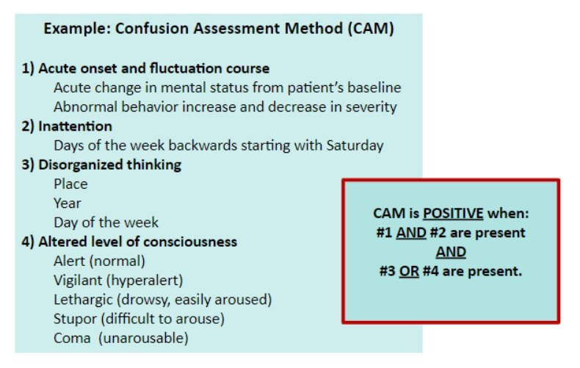
Screening for Delirium
Image: Lynne O'Mara, geriatrics PA extraordinaire. Brigham and Women's Hospital, Center for Geriatric Surgery ​
Notes:
Highly educated and/or well socialized patients may need additional assessment--May present with less obvious signs of inattention, disorganization
Start with less complex and move to more complex tests of attention

Slide 9

What if you're unsure?
Wait and observe … Signs and symptoms will become more apparent with time
Continue screening
More collateral history

Slide 10
Treat the Underlying Cause(s)
Pain
  Recognize that this patient will not call for PRNs, pain from rib fractures comes on fast without warning
  Schedule Tylenol 1000mg TID +/- scheduled short acting opioid with PRN dosed for signs of pain
Sleep
  Retime routine care for normal waking hours, no routine assessments / VS from 0200-1200
  Melatonin at 0100 to reinforce normal sleep cycle, backstop with PRN trazodone or quetiapine
Immobility
  At minimum, up to chair TID after treatment for pain
  Use commode or bathroom for voiding

Slide 11
Stabilize Underlying Physiologic Issues
Dehydration AND volume overload
Electrolyte derangements: hyper & hyponatremia, hypercalcemia
Medications: both initiation AND withdrawal
Traumatic brain injury
Acute concussion
Stroke
Cerebral hemorrhage
Sleep deprivation
Systemic acute infections
Sepsis and other forms of shock
Musculoskeletal Injuries
  Acute fractures
Any acute organ failure
Acute constipation
Acute urinary retention
Hepatic encephalopathy (in cirrhosis)
Internal hemorrhage
Localized infection (ie. Pneumonia, pyelonephritis, peritonitis)
Acute Myocardial Infarction
Acute heart failure
Notes:
Don’t forget that almost any insult to the body or brain can precipitate delirium

Slide 12
Natural history of delirium
Photo credit: New York Times, 2021

Slide 13
Weeks to months later ….
Photo credit: NOEMA Magazine

Slide 14
Prolonged Effects
Weeks to months later.....
  Patients may still experience issues with executive functioning, concentration, abstract thinking, complex calculations and other high order functions
  PTSD, anxiety are common → 1/3rd of survivors in one small study¹
    Risk may be greater in those with more severe delirium
Years later....
Survivors are at 6-40x greater risk of developing dementia from 1-5 years after delirium²
Delirium is an independent risk factor for developing dementia²
1. Grover, et al. J Psychosomatic Res, 2019 2. Fong TG, et al. Lancet Neurol, 2015

Slide 15
Managing Behavioral Symptoms
In Delirium and Dementia

Slide 16

Behaviors exist on a spectrum
Hypoactivity
Lethargy
Withdrawal
Hyperactivity
Restlessness
Aggression
May fluctuate through the day, alongside fatigue or as situations change

Slide 17
Behaviors As Communication
For those less able to communicate their needs verbally or rely on others for their care, behaviors are a means of communicating an unmet need
  What are some common “unmet needs”?
    Physiologic --> hunger, thirst, urge to void, pain / discomfort / stiffness, too hot, too cold, can’t see, can’t hear
    Psychologic --> desire for social contact, investigating unfamiliar noises / sights, fear, anxiety, loneliness, desire to orient oneself, desire to restore familiar routine
Stems from personhood definition that includes all human beings, regardless of capacity or other abilities

Slide 18
“Help me, help me” should be considered pain until proven otherwise
TAKE HOME POINT
Use a more descriptive term than “agitation”

Slide 19
Supportive Care: Good Care for Everyone!
Appropriate for ALL Patients!
SLEEP: Start melatonin 1mg QPM. Minimize interruptions overnight - DC routine VS from 2200-0600
ACTIVITY: Expectation should be OOB at least TID +/- walks around the room or in hallways.
PAIN: Low threshold for heating pad TID x 20 minutes for sore joints, muscles. Consider scheduled Tylenol 1000mg TID for persistent discomfort.
PO INTAKE: Avoid fluid restriction to ensure adequate hydration, goal 1L noncaffeinated fluid per day along with 3 regular meals.
BOWELS: Goal 1 BM per day.
URINARY RETENTION: Scheduled toileting Q2hrs while awake to maximize natural emptying. Limit PVRs & straight caths at night unless symptomatic. Avoid Foley placement as it will prolong delirious state.

Slide 20
Supportive Care: Good Care for Everyone!
POLYPHARMACY: Avoid the centrally acting, sedating, anticholinergic agents (ie. Promethazine, prochlorperazine, diphenhydramine, hydroxyzine, oxybutynin, benzodiazapines, sedative-hypnotics, etc) that are associated with high delirium risk
BEHAVIORS: Assess for pain, urge to void/move bowels, hunger, thirst, hot/cold, urge to move. If all have been ruled out, go for a walk with staff for distraction. If all the above have been addressed and behavior continues, okay to give PRN medication as written.
Encourage visitors, family, friends to be with present for reassurance and stimulation throughout the day

Slide 21
Addressing unmet needs
Drivers | Treatment Options
Pain | Scheduled Tylenol 1000mg TID, topical agents, low dose opiates, heating pad/ice pack
Other discomfort | Change positions regularly, ambulate, distract with activity, remove tethers
Urinary urgency/retention | DC contributing meds, scheduled toileting Q2 while awake, OOB to void, straight cath during the day for clinically significant retention (okay to allow lenient PVR threshold)
Constipation | Regular senna + Miralax (especially if on opiates!), Bisacodyl or mag citrate if fast action needed, ensure sufficient PO fluids and routine activity
Sleep Disruption | Limit daytime napping, ambulate, DC routine vitals 2200-0600, remove alarms/monitors, scheduled melatonin
Disorienting Surroundings | Regular daytime & mealtime schedule, reduce disorienting alarms, glasses + hearing aids on, borrow pocket talker, open window shades during day, lights off at night

Slide 22

Cases

Slide 23

Miriam
83 year old woman who was living independently in the community prior to a fall. She has been somewhat avoidant of medical care, preferring to use over the counter medicines for management of her medical issues, mainly, polyarticular osteoarthritis. She has a son who lives in a different state. Miriam was found in her home by paramedics when she did not call her fellow church member. In the emergency department she was found to have a femur and humerus fracture and was admitted for surgical repair of femur. During her hospital admission she was intermittently paranoid and striking at staff and was restrained and given antipsychotics. She experienced constipation and urinary retention and had foley placed. She remained in restraints to prevent her from removing her foley.

Slide 24

Sarge
84 yo memory care unit dwelling, retired army sergeant with advanced dementia, dyslipidemia, atrial fibrillation, hypertension and frequent falls. You receive a call from the memory care stating that they are having a hard time managing Sarge's behaviors. He has been swinging at staff when they try to keep him from going into other residents' rooms.
He is on the following medications: Donepezil 23 mg once daily
  Vitamin D 2000 IU once daily
  Atorvastatin 10 mg once nightly
  Furosemide 20 mg once daily
  Warfarin 2 mg Tuesday and Thursday, 1 mg once nightly the remainder of the week
  Tylenol PM once nightly
  Oxybutynin ER 10 mg daily

Slide 25

Virginia
81 yo assisted living facility dwelling woman with PMH of hypertension, depression, chronic lower back pain due to lumbar compression fracture, SLE with pericarditis, anxiety with depression, Type II DM (A1c 6.7%) who was sent to the ED for altered mental status and fall. They did not identify any injury, CT head was negative and she was sent back to her facility. Since returning she has been leaving the building and getting lost and has been disrobing.

Slide 26

James
76 years old, community-dwelling. Formerly robustly healthy retired physicist with metastatic prostate cancer diagnosed several months ago. Admitted from SNF with pneumonia and volume overload. This is his 3rd admission in the last 4 months following a fall with vertebral burst fracture and experienced multiple episodes of hyperactive delirium during admission. He just moved into ALF and you are seeing him for follow-up in his facility. Staff reports that he sleeps most of the day and has not been coming down for meals. Labs and vitals are WNL.

Slide 27

Thank you!

Slide 28

Visit: IndianCountryECHO.org
Jessica Wright, PA-C
Assistant Professor of Medicine
Oregon Health & Science Unviersity
wrighjes@ohsu.edu
Notes:
Please visit our website to sign-up to join one of our many ECHO sessions. Thank you!

